Slide 1
Introduction to Digital Marketing Game-Changing Techniques

Slide 2
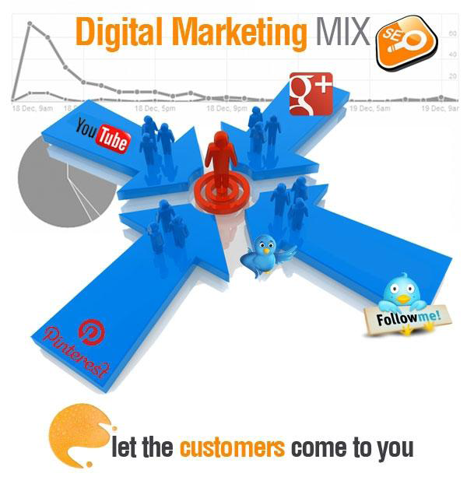
What is Digital Marketing?

Slide 3
Digital marketing is marketing that makes use of electronic devices such as computers, tablets, smart phones, cell phones, digital billboards, and game consoles to engage with consumers and other business partners. Internet Marketing is a major component of digital marketing.

Slide 4
Steps to developing your own digital marketing strategy
It all begins with the customer, listen!
But don’t forget about your objectives
Make sure you know what you’re already doing
Play to your strengths and manage your weaknesses
Find out what your competition is doing
Craft a strategy based on your strengths and capabilities
Measure everything in real time
Continuously review, adjust and improve the customer experience

Slide 5
Search Engine Optimization
Search engine optimization (SEO) is the process of affecting the visibility of a website or a web page in a search engine's "natural" or un-paid ("organic") search results.
The higher ranked on the search results page and more frequently a site appears in the search results list, the more visitors it will receive from the search engine's users.
SEO may target different kinds of search, including image search, local search, video search, academic search, news search and industry-specific vertical search engines.

Slide 6
Web Analytics
Web analytics is the measurement, collection, analysis and reporting of internet data for purposes of understanding and optimizing web usage.

Slide 7
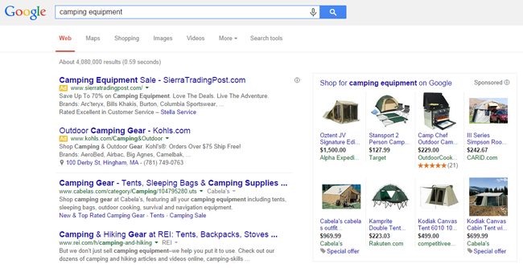
Pay per click (PPC) Marketing

Slide 8
Pay Per Click - an Internet advertising model used to direct traffic to websites, where advertisers pay the publisher (typically a website owner) when the ad is clicked.
With search engines, advertisers typically bid on keyword phrases relevant to their target market.
PPC "display" advertisements, also known as "banner" ads, are shown on web sites or search engine results with related content that have agreed to show ads.

Slide 9
Email Marketing
Email marketing is directly marketing a commercial message to a group of people using email.
It usually involves using email to send ads, request business, or solicit sales or donations, and is meant to build loyalty, trust, or brand awareness. Email marketing can be done to either cold lists or current customer database.
Steps involved in Email Marketing are:
•Emailer design
•Emailer HTMLization
•Database collection
•Database filtering based on demographics
•Domain verification
•Emailer upload
•Text Emailer
•Database upload
•Bulk Emailers blast

Slide 10
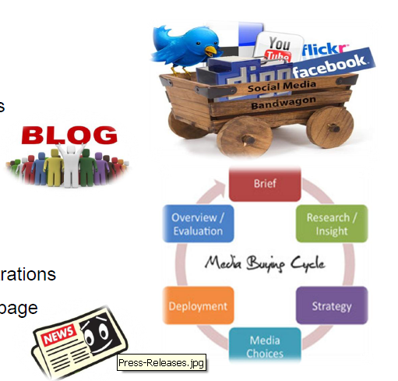
Social Media Marketing
Advertising on social networking sites as Face book, Twitter, LinkedIn, YouTube.
Media buying
Creating pages and accounts
Program updates & news feeds
Articles
Blogs
Press releases
Feedback responses
Weblink to enquiries and registrations

Slide 11
Affiliate Marketing
Affiliate marketing is a type of performance-based marketing in which a business rewards one or more affiliates for each visitor or customer brought about by the affiliate's own marketing efforts.
The industry has four core players: the merchant ('retailer' or 'brand'), the network, the publisher (also known as 'the affiliate'), and the customer.

Slide 13
Digital Display Advertising (Banner Ads)
Online Display advertising appears on web pages in many forms, including web banners, leader boards, skyscrapers, large boxes, and other sized graphical ads.
Display ads use eye-catching visuals to quickly grab catch the attention of website visitors browsing the pages on which they are featured.
Display ads are sold on non-search websites and can be served either by individual websites, or a publisher’s own ad servers. Basis banner ads:
I.Cost per mili (CPM)
II.Cost per click (CPC)

Slide 15
Mobile Marketing
Mobile marketing - marketing on or with a mobile device such as a cell phone, enabling the distribution of any promotional/ advertising messages to customers.

Slide 16
Online PR
Online PR- involves activities geared towards influencing media and audiences that exist solely on the Internet.
Includes search engines, blogs, news search, forums, discussion threads, social networks and other online communication tools.
Focus area- Brand reputation monitoring and management.

Slide 18
Online Video Marketing
Online Video Marketing- Making videos and posting them online is fairly inexpensive.
Videos were 50 times more likely to receive an organic first page ranking than traditional text pages.
Online videos stay online forever.
Money is spend to record a video once but it could still be getting views a year later.
Social media sites and videos go hand in hand and most sites encourage video posting and sharing.

Slide 20
Search Marketing

Slide 21
What are Paid Listings?
These are listings that search engines sell to advertisers, usually through paid placement or paid inclusion programs. In contrast, organic listings are not sold.
Paid inclusions - Advertising programs where pages are guaranteed to be included in a search engine's index in exchange for payment. - No guaranteed ranking - Payment made on a Cost Per Click (CPC) basis .
Paid placements - Advertising programs where listings are guaranteed to appear in organic listings. - The higher the fee, the higher the ranking. E.g. sponsored links and Google’s Adwords

Slide 23
Benefits Of SEM

Slide 24
Why SEM?

Slide 26
Social Media Marketing- Facebook Rules
Total users on Facebook 845 million.
More than 50% of active users log in to Facebook in any given day.
Facebook has 45 million users in India.
Average user has 130 friends.
More than 900 million objects that people interact with (pages, groups, events and community pages).
The average time spent 3 hrs per month
More than 350 million active users currently access FB through their mobile devices.
Is on road to become the next Google, is transforming to a Social Media based Search Engine.
Social Media Marketing- Facebook Rules

