Slide 1
Unit I: Chapter 1
Event handling

Slide 2
WHAT IS GUI?
A GUI is a graphical user interface to a computer. It is the medium provided by software for a human to interact with the computer. In initial days of computer we can interact only through the console & using keyboard. We have to remember several of command for interaction. The DOS OS is the example of console, keyboard interaction example. The GUI provides us images, Buttons, colors for easy understanding & for firing a command using keyboard & mouse both.

Slide 3
AWT
AWT (the Abstract Window Toolkit) is the part of Java classes, designed for creating user interfaces and painting graphics and images. It is a set of classes planned to provide support for a developer to create a graphical interface for any Java applet or Application. Most AWT components are derived from the java.awt.Component class.

Slide 4
Java AWT (Abstract Window Toolkit) is an API to develop GUI or window-based applications in java.
Java AWT components are platform-dependent i.e. components are displayed according to the view of operating system. AWT is heavyweight i.e. its components are using the resources of OS.
The java.awt package provides classes for AWT api such as TextField, Label, TextArea, RadioButton, CheckBox, Choice, List etc.

Slide 5
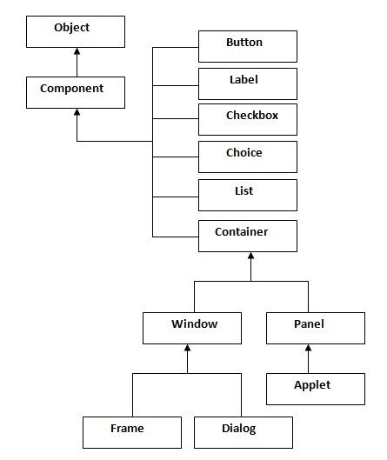
Java AWT Hierarchy
The hierarchy of Java AWT classes are given below.

Slide 6
Container
The Container is a component in AWT that can contain another components like buttons, textfields, labels etc. The classes that extends Container class are known as container such as Frame, Dialog and Panel.
Window
The window is the container that have no borders and menu bars. You must use frame, dialog or another window for creating a window.
Panel
The Panel is the container that doesn't contain title bar and menu bars. It can have other components like button, textfield etc.
Frame
The Frame is the container that contain title bar and can have menu bars. It can have other components like button, textfield etc.

Slide 7
Java AWT Example
To create simple awt example, you need a frame. There are two ways to create a frame in AWT.
By extending Frame class (inheritance)
By creating the object of Frame class (association)

Slide 8
AWT Example by Inheritance
import java.awt.*;
class First extends Frame
{
First()
{
Button b=new Button("click me");
b.setBounds(30,100,80,30);// setting button position
add(b);//adding button into frame
setSize(300,300);//frame size 300 width and 300 height
setLayout(null);//no layout manager
setVisible(true);//now frame will be visible, by default not visible
}
public static void main(String args[]){
First f=new First();
}}

Slide 9
AWT Example by Association
import java.awt.*;
class First2
{
First2()
{
Frame f=new Frame();
Button b=new Button("click me");
b.setBounds(30,50,80,30);
f.add(b);
f.setSize(300,300);
f.setLayout(null);
f.setVisible(true);
}
public static void main(String args[])
{
First2 f=new First2();
}}

Slide 10
Java Applet
Applet is a special type of program that is embedded in the webpage to generate the dynamic content. It runs inside the browser and works at client side.
Advantage of Applet
There are many advantages of applet. They are as follows:
It works at client side so less response time.
Secured
It can be executed by browsers running under many platforms, including Linux, Windows, Mac Os etc.
Drawback of Applet
Plugin is required at client browser to execute applet.

Slide 11
As displayed in the above diagram, Applet class extends Panel. Panel class extends Container which is the subclass of Component.
Hierarchy of Applet

Slide 12
Lifecycle of Java Applet
Applet is initialized.
Applet is started.
Applet is painted.
Applet is stopped.
Applet is destroyed.

Slide 13
How to run an Applet?
There are two ways to run an applet
By html file.
By appletViewer tool (for testing purpose).

Slide 14
http://www.javafile.com/games.php

Slide 15
What is Event?
An event is any happening or occurring.
Java events are a part of the Java Abstract Windowing Toolkit (AWT) package.
An applet is basically an event-driven program in which events are generated by mouse, keyboard and window or other graphical user interface components.
Events are supported by the java.awt.event package.
There are two main models for handling events in Java: the old model, called the Inheritance Event Model, is obsolete; the new model, called the Delegation Event Model, will be discussed in detail.

Slide 16
The Delegation event model
Event Model is based on the concept of an "Event Source" and "Event Listeners". Any object that is interested in receiving messages (or events) is called an Event Listener, and any object that generates these messages (or events) is called an Event Source.
The delegation event model derives its name from the fact that event handling is delegated from an event source to one or more event listeners.

Slide 17
An Event Source is an object that originates or "fires" events. A source is an object that generates an event.
An EventListener interface defines one or more methods that are to be invoked by the event source in response to each specific event type handled by the interface. A Listener is an object that implements a specific EventListener interface that extends from the generic java.util. EventListener.
An event is propagated from a "Source" object to a "Listener" object by invoking a method on the listener and passing in the instance of the event subclass which defines the event type generated.

Slide 18
Event classes
Event Model defines a large number of event classes.
java.awt.AWTEvent: AWT events, which are the main concern here, are subclasses of java.

Slide 19
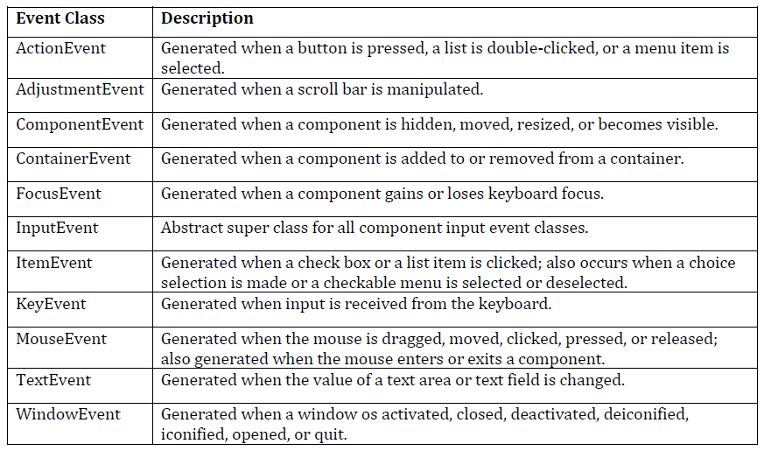

Slide 20
The ActionEvent Class
An object of this class represents a high-level action event generated by an AWT component. The ActionEvent is generated when button is clicked or the item of a list is double clicked.
getID() method returns the type of action that has occurred.
getActionCommand() method returns a String that serves as a kind of name for the action that the event represents.
setActionCommand() method that allows the programmer to specify an action command string to be included with any action events generated by those components.
getModifiers() returns a value that indicates the keyboard modifiers that were in effect when the action event was triggered.

Slide 21
ActionEvent has these constructors:
ActionEvent(Object src, int type, String cmd)
ActionEvent(Object src, int type, String cmd, int modifiers)
Here, src is a reference to the object that generated this event. The type of the event is specified by type, and its command string is cmd.

Slide 22
The AdjustmentEvent class
An event of this type indicates that an adjustment has been made to an Adjustable object-- usually, this means that the user has interacted with a Scrollbar component.
The getValue() method returns the new value of the Adjustable object.
getID() method returns the type of an AdjustmentEvent.
getAdjustable()returns the Adjustable object that was the source of the event.
UNIT_INCREMENT indicates that the Adjustable value has been incremented by one unit, as in a scroll-line-down operation.
UNIT_DECREMENT indicates the opposite: scroll-line-up.
BLOCK_INCREMENT and BLOCK_DECREMENT indicate that the Adjustable object has been incremented or decremented by multiple units, as in a scroll-page-down or scroll-page-up operation.

Slide 23
Here is one AdjustmentEvent constructor:
AdjustmentEvent(Adjustable src, int id, int type, int data)

Slide 24
The ComponentEvent class
An event of this type serves as notification that the source Component has been moved, resized, shown, or hidden. (Component can be button, textfield, etc)
getComponent() returns the component that was moved, resized, shown, or hidden.
getID() returns one of four COMPONENT_ constants to indicate what operation was performed on the Component.
The constants and their meanings are shown here:
COMPONENT_HIDDEN indicates that the component was hidden.
COMPONENT_MOVED indicates that the component was moved.
COMPONENT_RESIZED indicates that the component was resized.
COMPONENT_SHOWN indicates that the component became visible.

Slide 25
ComponentEvent has this constructor:
ComponentEvent(Component src, int type)

Slide 26
The ContainerEvent class
An event of this type serves as notification that the source Container has had a child added to it or removed from it.
getChild() returns the child Component that was added or removed
getContainer() returns the Container to which it was added or from which it was removed.

Slide 27
ContainerEvent is a subclass of ComponentEvent and has this constructor:
ContainerEvent(Component src, int type, Component comp)

Slide 28
The FocusEvent class
An event of this type indicates that a Component has gained or lost focus on a temporary or permanent basis.
Use getID() to determine the type of focus event; it returns FOCUS_GAINED or FOCUS_LOST.
When focus is lost, you can call isTemporary() to determine whether it is a temporary loss of focus.

Slide 29
FocusEvent is a subclass of ComponentEvent and has these constructors:
FocusEvent(Component src, int type)
FocusEvent(Component src, int type, boolean temporaryFlag)
Here, src is a reference to the component that generated this event. The type of the event is specified by type. The argument temporaryFlag is set to true if the focus event is temporary. Otherwise, it is set to false.

Slide 30
The InputEvent class
This abstract class serves as the superclass for the raw user input event types MouseEvent and KeyEvent.
getComponent() method to determine in which component the event occurred.
Use getWhen() to obtain a timestamp for the event.
getModifiers() to determine which keyboard modifier keys or mouse buttons were down when the event occurred.

Slide 31
The ItemEvent class
An event of this type indicates that an item within an ItemSelectable component has had its selection state changed.
getItem() returns an object that represents the item that was selected or deselected.
getID() returns the type of the ItemEvent.
getStateChange() method returns the new selection state of the item: it returns one of the constants SELECTED or DESELECTED. (This value can be misleading for Checkbox components that are part of a CheckboxGroup.

Slide 32
ItemEvent has this constructor:
public ItemEvent (ItemSelectable src, int id, Object item, int stateChange);

Slide 33
The KeyEvent class
An event of this type indicates that the user has pressed or released a key on the keyboard.
getID() to determine the particular type of key event that has occurred.
The constant KEY_PRESSED indicates that a key has been pressed, while the constant KEY_RELEASED indicates that a key has been released.
use getKeyChar() to return the Unicode character that was typed.
getKeyCode() to obtain the virtual keycode of the key that was pressed or released.
VK_0 through VK_9 and VK_A through VK_Z define the ASCII equivalents of the numbers and letters.

Slide 34
KeyEvent is a subclass of InputEvent. Here are two of its constructors:
KeyEvent(Component src, int type, long when, int modifiers, int code)
KeyEvent(Component src, int type, long when, int modifiers, int code, char ch)

Slide 35
The MouseEvent class
An event of this type indicates that the user has moved the mouse or pressed one of the mouse buttons.
getID() to determine the specific type of mouse event that has occurred

Slide 36
MOUSE_PRESSED
The user has pressed a mouse button.
MOUSE_RELEASED
The user has released a mouse button.
MOUSE_CLICKED
The user has pressed and released a mouse button without any intervening mouse drag.
MOUSE_DRAGGED
The user has moved the mouse while holding a button down.
MOUSE_MOVED
The user has moved the mouse without holding any buttons down.
MOUSE_ENTERED
The mouse pointer has entered the component.
MOUSE_EXITED
The mouse pointer has left the component.

Slide 37
MouseEvent is a subclass of InputEvent. Here is one of its constructors.
public MouseEvent(Component src, int type, long when, int modifiers, int x, int y, int clicks, boolean triggersPopup)

Slide 38
The TextEvent class
An event of this type indicates that the user has edited the text value that appears in a TextField, TextArea, or other TextComponent.
The one constructor for this class is shown here:
public TextEvent(Object src, int type)

Slide 39
The WindowEvent class
An event of this type indicates that an important action has occurred for a Window object.
getWindow() to determine the Window object that is the source of this event. Call getID() to determine the specific type of event that has occurred.
WINDOW_OPENED
WINDOW_CLOSING
WINDOW_CLOSED

Slide 40
WindowEvent is a subclass of ComponentEvent. It defines constructor:
public WindowEvent(Window src, int type)

Slide 41
Event Listener Interfaces
Listeners are created by implementing one or more of the interfaces defined by the java.awt.event package.
When an event occurs, the event source invokes the appropriate method defined by the listener and provides an event object as its argument.

Slide 42
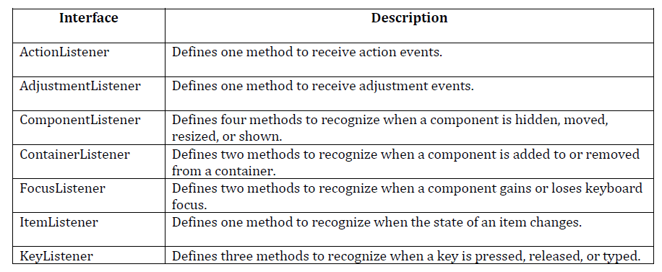

Slide 43
The ActionListener Interface
This interface defines the method that an object must implement to listen for action events on AWT components. When an ActionEvent occurs, an AWT component notifies its registered ActionListener objects by invoking their actionPerformed() methods.
Its general form is shown here:
void actionPerformed(ActionEvent ae)

Slide 44
The AdjustmentListener Interface
This interface defines the method that an object must implement to listen for adjustment events on AWT components. When an AdjustmentEvent occurs, an AWT component notifies its registered AdjustmentListener objects by invoking their adjustmentValueChanged() methods.
Its general form is shown here:
void adjustmentValueChanged(AdjustmentEvent ae)

Slide 45
The ComponentListener Interface
This interface defines the methods that an object must implement to listen for component events on AWT components. When a ComponentEvent occurs, an AWT component notifies its registered ComponentListener objects by invoking one of their methods.
Their general forms are shown here:
void componentResized(ComponentEvent ce)
void componentMoved(ComponentEvent ce)
void componentShown(ComponentEvent ce)
void componentHidden(ComponentEvent ce)

Slide 46
The ContainerListener Interface
This interface contains two methods. When a component is added to a container, componentAdded( ) is invoked. When a component is removed from a container, componentRemoved( ) is invoked. Their general forms are shown here:
void componentAdded(ContainerEvent ce)
void componentRemoved(ContainerEvent ce)

Slide 47
The FocusListener Interface
This interface defines the methods that an object must implement to listen for focus events on AWT components. When a FocusEvent occurs, an AWT component notifies its registered FocusListener objects by invoking one of their methods. Their general forms are shown here:
void focusGained(FocusEvent fe)
void focusLost(FocusEvent fe)

Slide 48
The ItemListener Interface
This interface defines the itemStateChanged( ) method that is invoked when the state of an item changes. Its general form is shown here:
void itemStateChanged(ItemEvent ie)

Slide 49
The KeyListener Interface
This interface defines the methods that an object must implement to listen for key events on AWT components. When a KeyEvent occurs, an AWT component notifies its registered KeyListener objects by invoking one of their methods. The general forms of these methods are shown here:
void keyPressed(KeyEvent ke)
void keyReleased(KeyEvent ke)
void keyTyped(KeyEvent ke)

Slide 50
The MouseListener Interface
This interface defines the methods that an object must implement to listen for mouse events on AWT components. When a MouseEvent occurs, an AWT component notifies its registered MouseListener objects by invoking one of their methods. The general forms of these methods are shown here:
void mouseClicked(MouseEvent me)
void mouseEntered(MouseEvent me)
void mouseExited(MouseEvent me)
void mousePressed(MouseEvent me)
void mouseReleased(MouseEvent me)

Slide 51
The MouseMotionListener Interface
This interface defines two methods. The mouseDragged( ) method is called multiple times as the mouse is dragged. The mouseMoved( ) method is called multiple times as the mouse is moved. Their general forms are shown here:
void mouseDragged(MouseEvent mme)
void mouseMoved(MouseEvent mme)

Slide 52
The MouseWheelListener Interface
This interface defines the mouseWheelMoved( ) method that is invoked when the mouse wheel is moved. Its general form is shown here:
void mouseWheelMoved(MouseWheelEvent mwe)

Slide 53
The TextListener Interface
This interface defines the textChanged( ) method that is invoked when a change occurs in a text area or text field. Its general form is shown here:
void textChanged(TextEvent te)

Slide 54
The WindowFocusListener Interface
This interface defines two methods windowGainedFocus( ) and windowLostFocus( ). These are called when a window gains or losses input focus. Their general forms are shown here:
void windowGainedFocus(WindowEvent wfe)
void windowLostFocus(WindowEvent wfe)

Slide 55
The WindowListener Interface
This interface defines the methods that an object must implement to listen for window events on AWT components. When a WindowEvent occurs, an AWT component notifies its registered WindowListener objects by invoking one of their methods. The general forms are shown here:
void windowActivated(WindowEvent we)
void windowClosed(WindowEvent we)
void windowClosing(WindowEvent we)
void windowDeactivated(WindowEvent we)
void windowDeiconified(WindowEvent we)
void windowIconified(WindowEvent we)
void windowOpened(WindowEvent we)

Slide 56
Using the delegation event model
Handling Mouse Events
there are five different mouse event methods we must implement:
mousePressed(), which is triggered when the mouse is on the component.
mouseClicked(), which is triggered when the mouse is pressed and released on the component. (mousePressed() is called first.)
mouseReleased(), which is triggered when the mouse is released on the component. (mousePressed() must have been called first.)
mouseEntered(), which is triggered upon entry to the component.
mouseExited(), which is triggered upon leaving the component.

Slide 57
Note that when we implement the MouseListener interface, we must provide all five methods. The full headers look like this:
public void mousePressed(MouseEvent e)
public void mouseClicked(MouseEvent e)
public void mouseReleased(MouseEvent e)
public void mouseEntered(MouseEvent e)
public void mouseExited(MouseEvent e)

Slide 58
Java Adapter Classes
Java adapter classes provide the default implementation of listener interfaces. If you inherit the adapter class, you will not be forced to provide the implementation of all the methods of listener interfaces. So it saves code.
The class WindowAdapter is an abstract (adapter) class for receiving window events. All methods of this class are empty. This class is convenience class for creating listener objects.
Class declaration
Following is the declaration for
java.awt.event.WindowAdapter class:
public abstract class WindowAdapter extends Object implements WindowListener, WindowStateListener, WindowFocusListener

Slide 59
Adapter Class constructor
WindowAdapter()
Class methods
void windowClosed(WindowEvent e) | Invoked when a window has been closed.
void windowOpened(WindowEvent e) | Invoked when a window has been opened.

Slide 60
The Adapter classes with their corresponding listener interfaces are given below. java.awt.event Adapter classes
Adapter class | Listener interface
WindowAdapter | WindowListener
KeyAdapter | KeyListener
MouseAdapter | MouseListener
MouseMotionAdapter | MouseMotionListener
FocusAdapter | FocusListener
ComponentAdapter | ComponentListener
ContainerAdapter | ContainerListener

Slide 61
Program.docx

