Slide 1
Chapter 2
AWT

Slide 2
Introduction
The AWT is both powerful and flexible.
The AWT provides a well-designed object-oriented interface to these low-level services and resources.

Slide 3
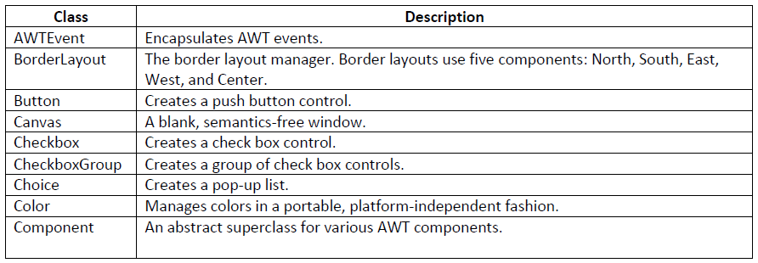
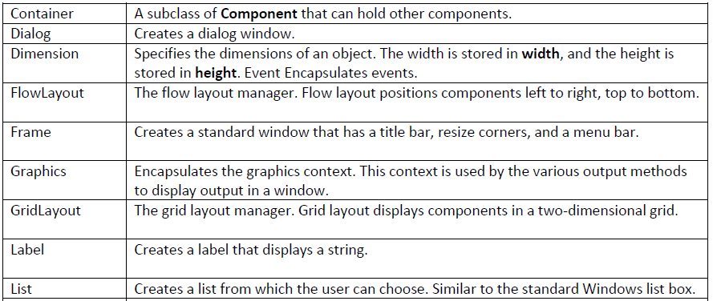
AWT classes

Slide 5
Windows Fundamentals
The AWT contains numerous classes and methods that allow us to create and manage windows. Although the main purpose of the AWT is to support applet windows, it can also be used to create stand -alone windows that run in a GUI environment, such as Windows.

Slide 6
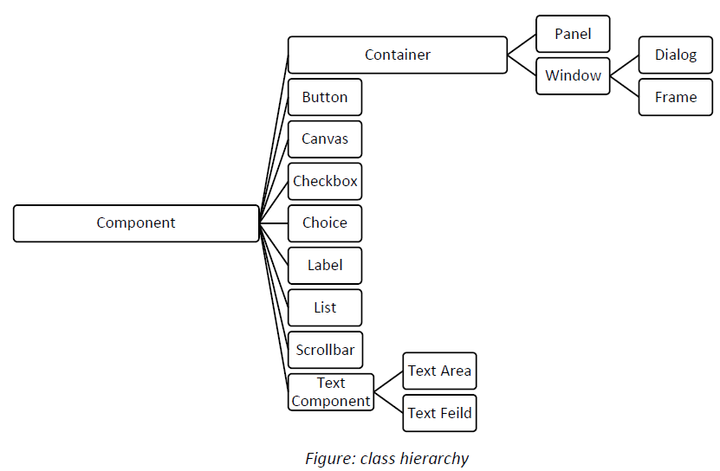

Slide 7
Component
Container
Panel: Panel is the super-class for Applet. When screen output is directed to an applet, it is drawn on the surface of a Panel object. In essence, a Panel is a window that does not contain a title bar, menu bar, or border.
Window
Frame: It is a subclass of Window and has a title bar, menu bar, borders, and resizing corners.
Canvas: Canvas encapsulates a blank window upon which we can draw.

Slide 8
Working with frame windows
Following are two of Frame’s constructors:
Frame()
Frame(String title)

Slide 9
Program for creating a frame which does not contain title:
import java.awt.*;
public class Frame1
{
public static void main(String [] args)
{
Frame f = new Frame();
f.show();
}
}

Slide 10
Program for creating frame which contains title:
import java.awt.*;
public class Frame2
{
public static void main(String [] args)
{
Frame f = new Frame("welcome");
f.show();
}
}

Slide 11
Setting the Window’s Dimensions
setSize( ) method
getSize( ) method

Slide 12
Program:
import java.awt.*;
public class ResizeFrame
{
public static void main(String [] args)
{
Frame f = new Frame("Resize");
f.setSize(500,500);
f.show();
}
}

Slide 13
Hiding and Showing a Window
setVisible( ).
Setting a Window’s Title
setTitle( )

Slide 14
Closing a Frame Window
windowClosing( ) method

Slide 15
Control fundamental
Label : Label defines the following constructors:
Label ()
Creates a blank Label instance.
Label (String Text)
Creates a Label instance with the specified text.
Label (String Text, int Alignment)
Creates a Label instance with the specified text and horizontal alignment.

Slide 16
Common Methods:
void setBackground (Color BgdColor)
Sets the color of the background for the label.
void setAlignment (int Alignment)
Sets the alignment of the label's contents along the X axis.
void setFont (Font TextFont)
Sets the font for this component.Arguments
void setForeground (Color TextColor)
Sets the color of the text for the label.
void setText (String Text)
Sets the text for the label.

Slide 17
Alignment
The horiziontal position of the text within the label. One of:
Label.CENTER
The central position in an area.
Label.LEFT
Box-orientation constant used to specify the left side of a box.
Label.RIGHT

Slide 18
Program.docx

Slide 19
Buttons
Button defines these two constructors:
Button ()
Creates a blank Button instance.
Button (String Text)
Creates a Button instance with the specified text.

