Slide 1
Big Data and Business Intelligence

Slide 2
What is Big Data?
Massive sets of unstructured/semi-structured data from Web traffic, social media, sensors, etc
Petabytes, Exabyte's of data
Volumes too great for typical DBMS
Information from multiple internal and external sources:
Transactions
Social media
Enterprise content
Sensors
Mobile devices
In the last minute there were …….
204 million emails sent
61,000 hours of music listened to on Pandora
20 million photo views
100,000 tweets
6 million views and 277,000 Facebook Logins
2+ million Google searches
3 million uploads on Flickr

Slide 3
Changing data alone won’t solve problems
A concrete example…

Slide 4
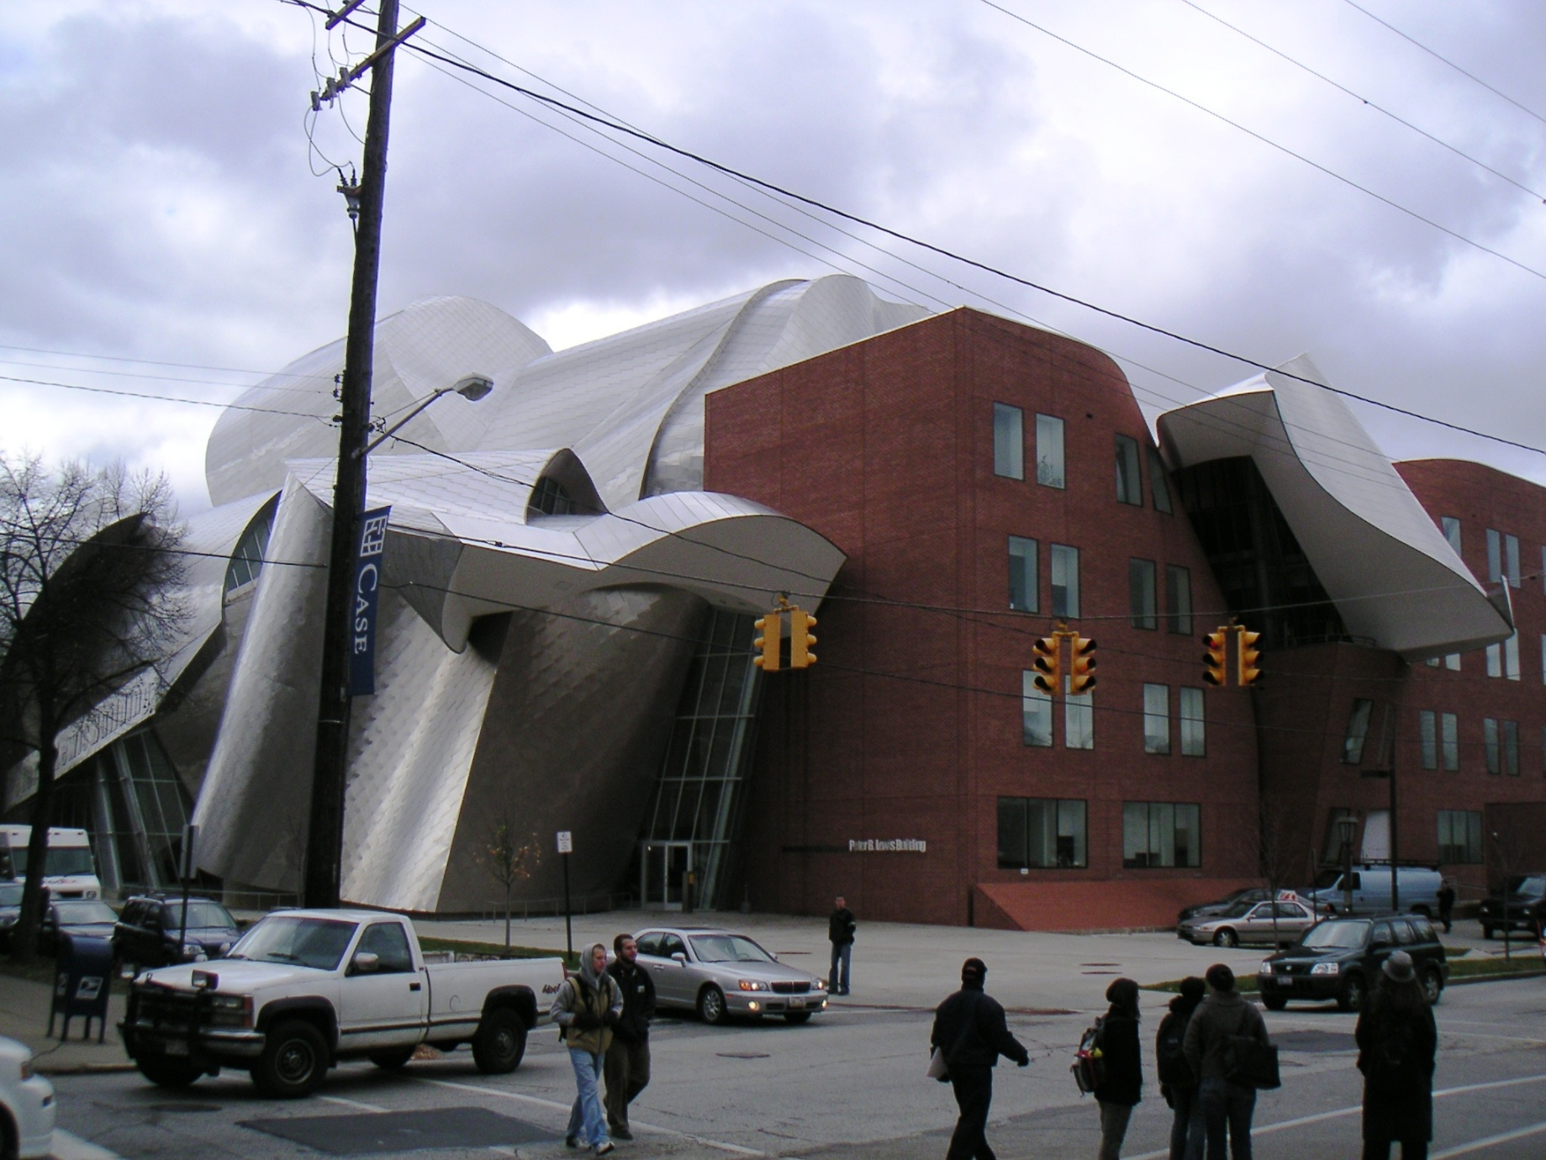
This is the Peter B. Lewis building. The building was designed by world-renowned architect, Frank Gehry. You can look him up to see the other types of radically shaped buildings.

Slide 5
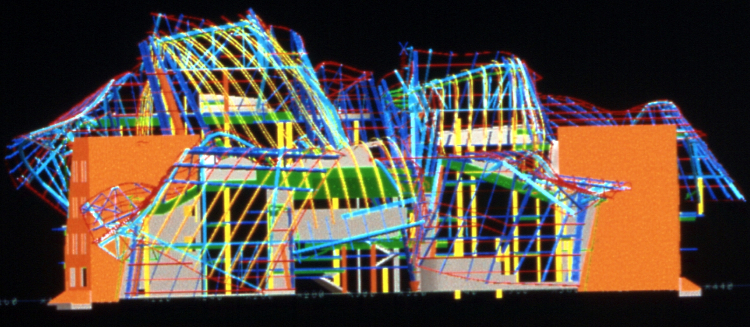
Notes:
Instead, they used 3D modeling tools that are more commonly employed in product development, automotive, and aeronautical design.

Slide 6
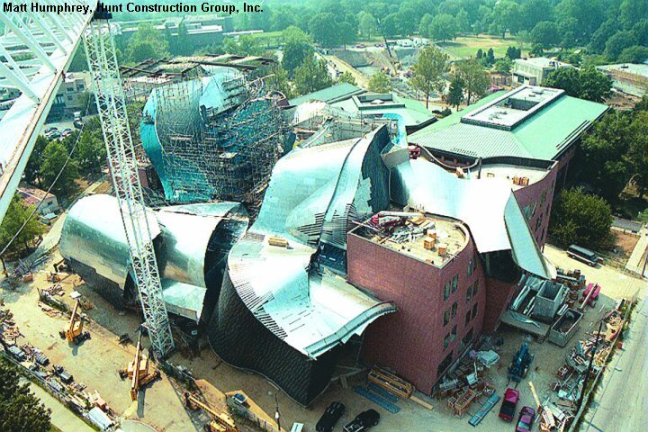
Notes:
However, just changing to a 3D model didn’t automatically make constructing the building easier. The construction workers and trades had to come up with new ways to use 3D information to organize how they worked together. The 3D models had a lot more data, but it required a lot more reworking of old processes of connecting data to decisions to make this happen. The parallel with Big Data is similar – it’s not just the data alone…

Slide 7
What is Big Data?

Slide 8
https://youtu.be/-RiiXVUrAdc
https://www.youtube.com/watch?v=j-0cUmUyb-Y

Slide 9
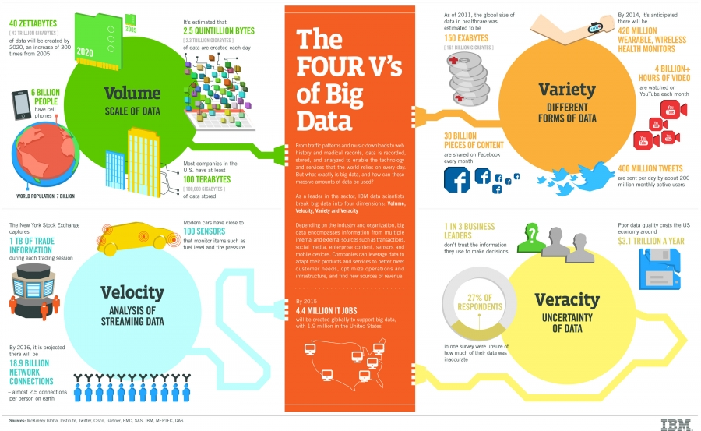
http://www.ibmbigdatahub.com/infographic/four-vs-big-data

Slide 10
How many Vs does it take to define Big Data?
Volume
Variety
Velocity
Veracity
Variability
Visualization
Value
3 Vs of Big Data
4 Vs of Big Data by IBM
Notes:
Veracity (Is Big Data Reliable? Contrast: Sentiments in Social Media?, Perception vs. Action, Immediate vs. Reflection, Self-reported vs. Observed)

Slide 11
Where is the data coming from?

Slide 12
Decreasing cost of data storage
Recreated from source: http://www.statisticbrain.com/average-cost-of-hard-drive-storage/

Slide 13
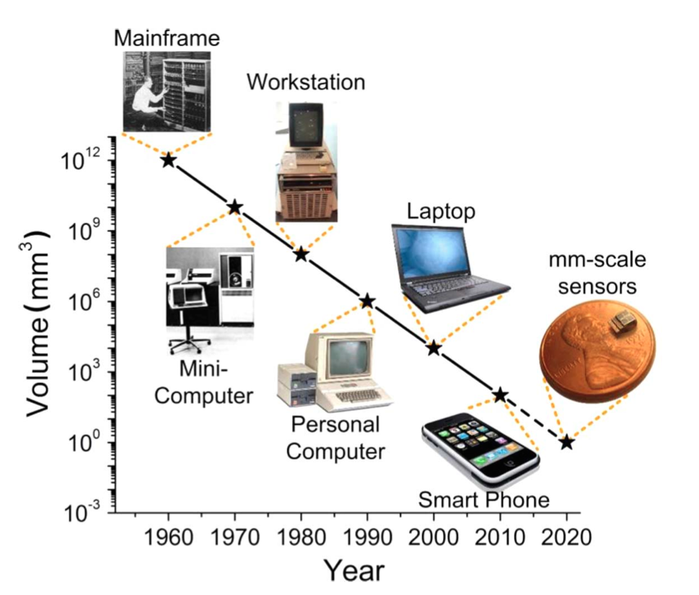
Miniaturization and Mobility of Computing Technology and Sensors
http://www.computerhistory.org/atchm/the-worlds-smallest-computer/

Slide 14
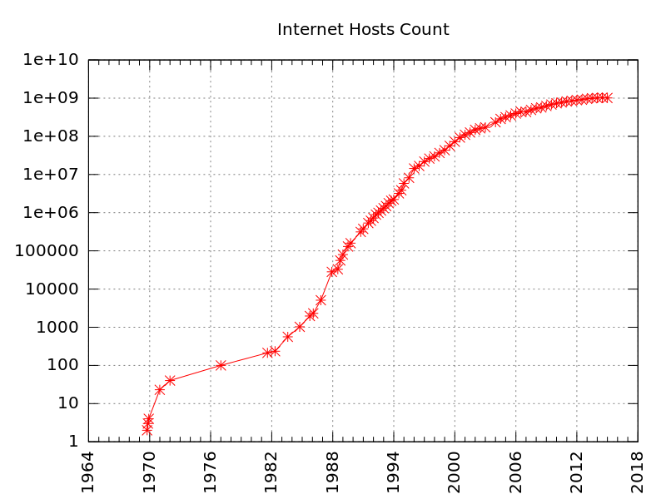
By Kopiersperre (talk) - Own work, CC BY-SA 3.0, https://commons.wikimedia.org/w/index.php?curid=36391402

Slide 15
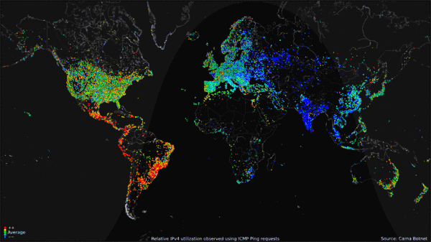
By Author of Carna Botnet "Internet Census 2012", https://commons.wikimedia.org/w/index.php?curid=26114329

Slide 16
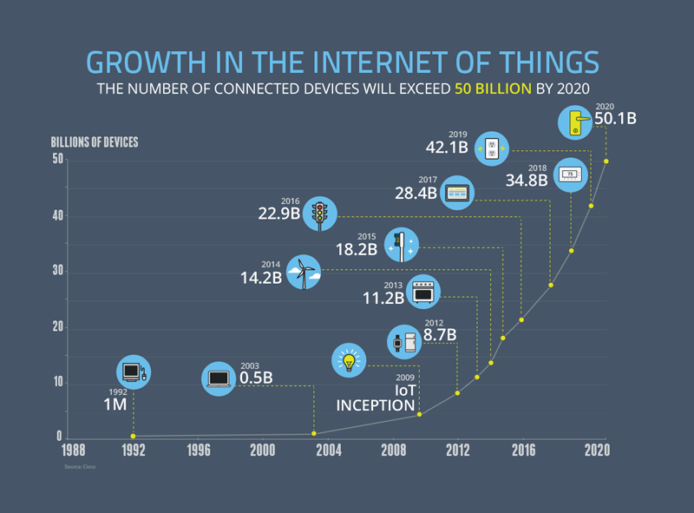
Automotive
Appliances
Computers
Consumer Electronics
Healthcare
Industrial
Military
https://www.ncta.com/platform/broadband-internet/behind-the-numbers-growth-in-the-internet-of-things-2/

Slide 17
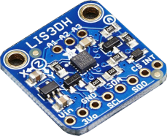
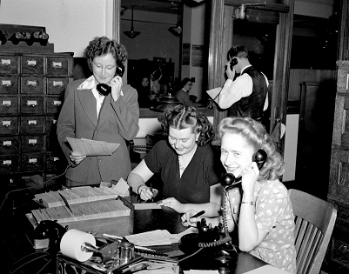
Customer Interaction Evolution
Small Merchants:
Early Large Merchant
Maturing National Merchant
Rich, organic, credible narrative data
Tight Relationship with customer –
Loose Relationship with customer
Little personal data, but lots of general data
Current National Merchant
Tightening relationship with customer
Increasing personal data + lots of aggregate data
Intimate relationship with customer
Lots of personal and aggregate data
Future Global and SME Merchants
Multi-faceted relationship with customer
Huge amount of personal and aggregate data
https://www.flickr.com/photos/gleonhard/8979555482/
https://www.flickr.com/photos/davedugdale/5102910864/in/photostream/
Notes:
One reason data has increased is the ability to capture relevant information about how a customer interacts with a company. This slide illustrates some of the evolution from when a company would no little if anything about what products or services a customer might be interested in to tracking everything in the customer – company interaction.
Starting from the left-bottom is the Sears Christmas Catalog. When Sears sent this out it had no idea what pages kids were spending the most time on and which products they circled so that their mom and dad would know what they wanted for Christmas. Now we have Amazon wishlists and they know patterns of pages visited and what you’ve done on their site.
Call centers (left-top) were the way to interact with the customer making an order (if they didn’t mail it in).
Bar codes and rewards cards enabled electronic tracking of products with customers to build a profile and identify patterns.
Social media can be analyzed to understand the sentiments about a product or service or what a customer might be interested in.

Slide 18
What other trends or advances are contributing to data growth?

Slide 19
Analytics, Big Data, Business Intelligence, Decision Support Systems, Data Mining… How do these fit together?

Slide 21
How do we deal with this data? Volume, Variety, Velocity

Slide 22
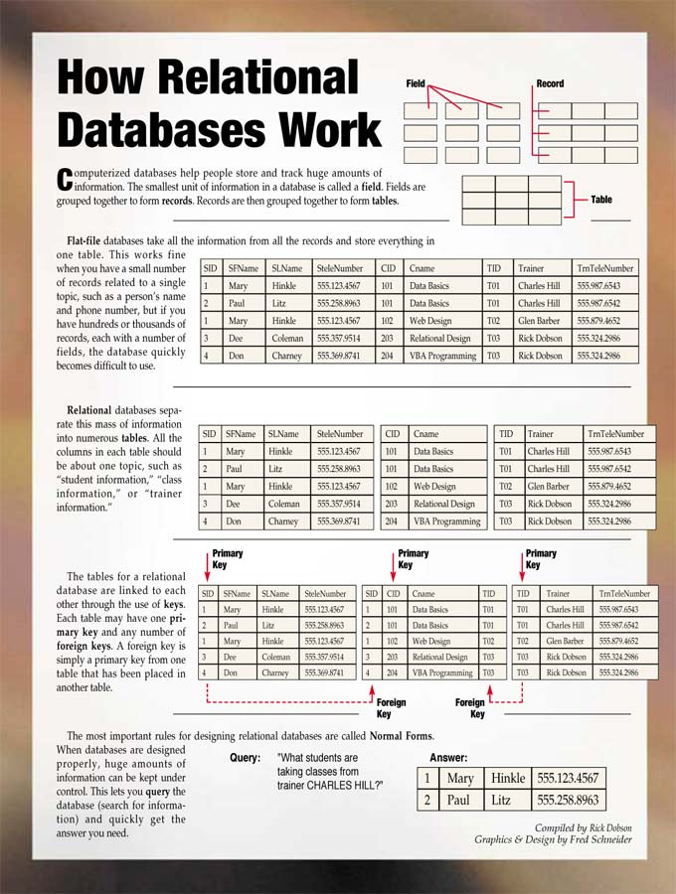
The relational database
Good
Avoid redundant data (save space!)
Transaction friendly
Consistency during update
Bad
Scaling
High volume availability
Sensitive to small changes
Notes:
“How Relational Databases Work,” http://www-03.ibm.com/ibm/history/ibm100/us/en/icons/reldb/

Slide 23
Relational Databases are Sensitive to Change
“This notion of thinking about data in a structured, relational database is dead.” ¹
Each year, billions of dollars are spent on data modeling and ETL* processes to create and recreate more “perfect” data models that will never change. BUT THEY ALWAYS DO.²

Slide 24
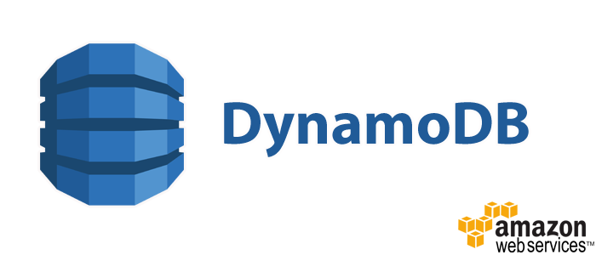
Necessity is the mother of …
Notes:
For a more detailed review of these three see: http://www.ijecse.org/wp-content/uploads/2012/12/Volume-2Number-1PP-133-140.pdf
Cassandra logo: By Apache Software Foundation - https://svn.apache.org/repos/asf/cassandra/logo/cassandra.svg, Apache License 2.0, https://commons.wikimedia.org/w/index.php?curid=25112706
Dynamo Logo: By Amazon Web Services LLC - http://aws.typepad.com/aws/2011/12/introducing-aws-simple-icons-for-your-architecture-diagrams.html, CC BY-SA 3.0, https://commons.wikimedia.org/w/index.php?curid=30585241
Big Table Logo: http://insidebigdata.com/wp-content/uploads/2015/05/google-bigtable.jpg

Slide 25
Big Data Technologies Leverage
Controlling clusters of commodity hardware
Non-relational databases
Open source
Rapidly evolving

Slide 26
NoSQL: “Not only SQL” – Non Relational
Characteristics:
Non-relational
Schema-less (on input)
Open source
Cluster-friendly
Real-time (fast read/write)
Why?
Large dataset – scale horizontally
Ease of programming
Schema-less
Data variety
Faster capture
Redundant
Additional resource: https://www.youtube.com/watch?v=qI_g07C_Q5I (Introduction to NoSQL by Martin Fowler)

Slide 27
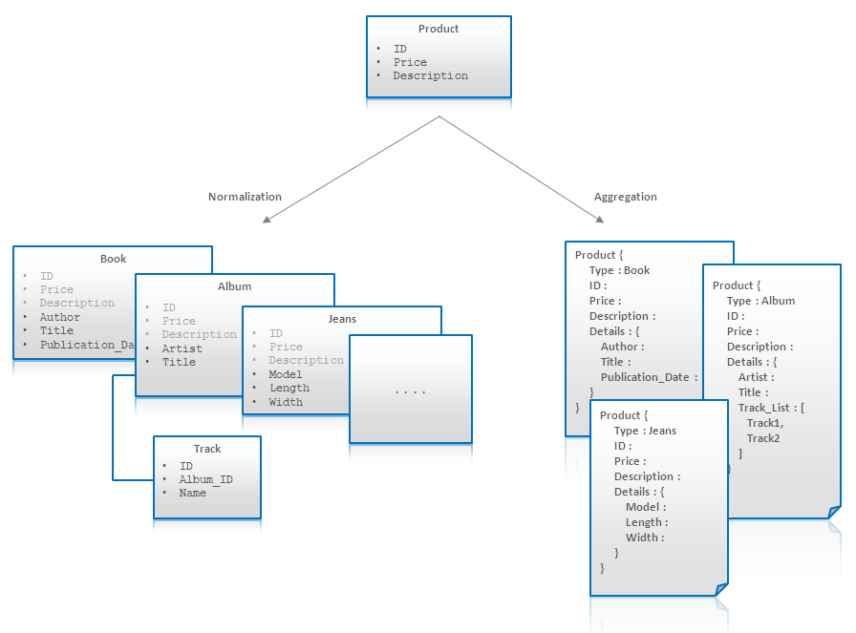
Normalization vs. Aggregation
Source: https://highlyscalable.wordpress.com/2012/03/01/nosql-data-modeling-techniques/

Slide 28
Apache Hadoop
Open source
Large scale, distributed storage and processing
Clusters of commodity hardware (high failure tolerance)
Immutability of Data
Batch oriented
Resource: https://developer.yahoo.com/hadoop/tutorial/module1.html
Notes:
Simplified: Hadoop is a software that enables the control of multiple computers to process information. It organizes how complex processes are broken apart to be processed on multiple computers and then reassembled.
History: Development of Alternative to and inspired by Google – further developed and refined by Yahoo – Hortonworks

Slide 29
Immutability(Changing) of Data
All data appended
No rewriting/updating
Learn from “streams of change”
Notes:
Immutability Resource: https://www.confluent.io/blog/turning-the-database-inside-out-with-apache-samza/

Slide 30
Criticisms of Big Data

Slide 31
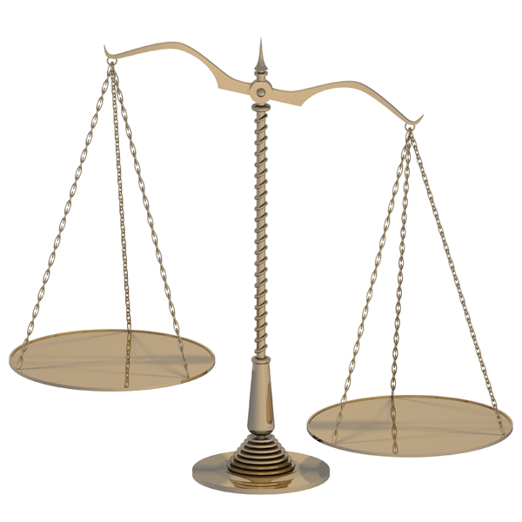
Privacy – Asymmetry of Power
“… these capabilities, most of which are not visible or available to the average consumer, also create an asymmetry of power between those who hold the data and those who intentionally or inadvertently supply it.”¹
Notes:
Privacy is clearly an issue when it comes to Big Data. While in principle Privacy is critical, it seems practically that there are many people that don’t worry about what companies collect and use about their personal information, histories, and habits.
“Unprecedented computational power and sophistication make possible unexpected discoveries, innovations, and advancements in our quality of life.” … But

Slide 32
Data will Help us Manifesto… (http://datawillhelp.us/)
“…we’re abandoning timeless decision-making tools like wisdom, morality, and personal experience for a new kind of logic which simply says: “show me the data”.

Slide 33
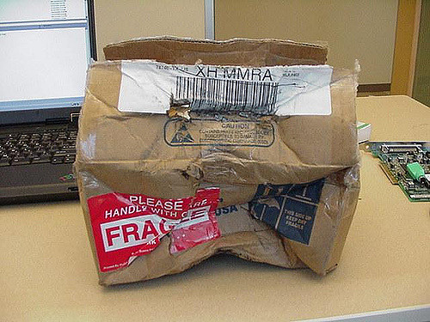
“Big data has arrived, but big insights have not.”
Big Data Articles of Faith:
It’s accurate
All data captured - (no need for sampling)
Causation is unimportant
“…the numbers speak for themselves”
Theory free analysis is fragile. “If you have no idea what is behind a correlation, you have no idea what might cause that correlation to break down. ”
Source: http://www.ft.com/cms/s/2/21a6e7d8-b479-11e3-a09a-00144feabdc0.html#axzz3MByvnOn8

Slide 34
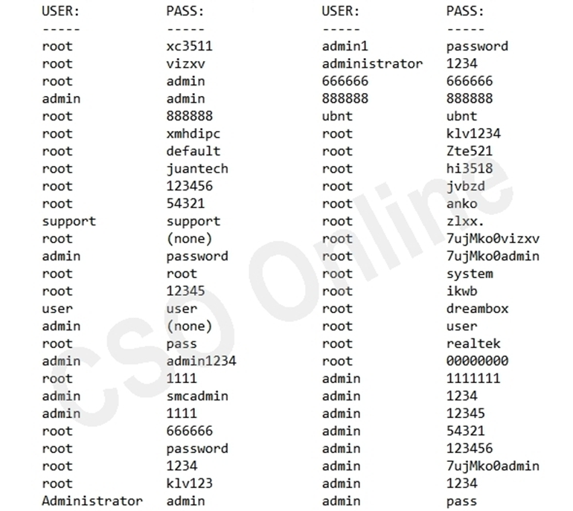
Mirai Bot – IOT – What’s Going on?
DDos attack on default IOT devices
61 default username/passwords
No Industry Minimum or Standard
Future regulation?
Partial List: http://www.csoonline.com/article/3126924/security/here-are-the-61-passwords-that-powered-the-mirai-iot-botnet.html

Slide 35
Medical Devices are vulnerable
“In our recent assessment of medical devices used in clinics and hospital around the country, weak encryption, lack of key management, poor authentication and authorization protocols, and insecure communications were all common findings.” -- Chandu Ketkar, Technical Manager at Cigital
https://www.bitsighttech.com/press-releases/news/industry-analysis-reveals-healthcare-and-pharmaceutical-industry-lags-in-security-effectiveness

Slide 36
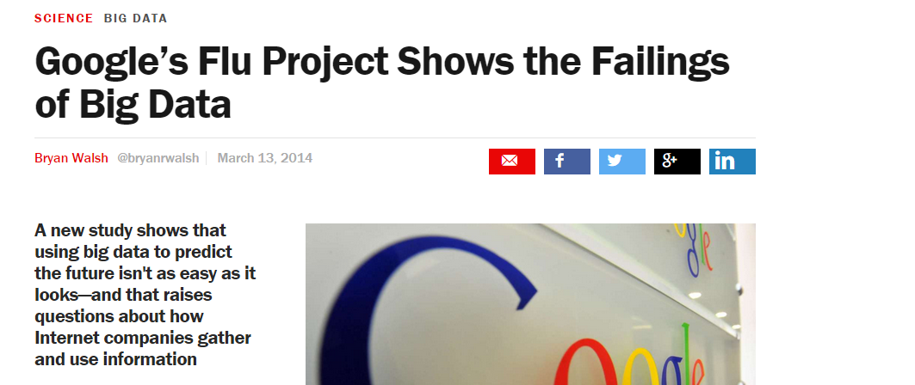
“A number of associations in the model were really problematic,”
“It’s scary enough to think that private companies are gathering endless amounts of data on us. It’d be even worse if the conclusions they reach from that data aren’t even right.” (Lazar)

Slide 37
Crime Prediction and Prevention
Police leverage real-time analytics to provide actionable intelligence that can be used to understand criminal behavior, identify crime/incident patterns, and uncover location-based threats.
That reminds me of a movie I once watched…
https://www.mapr.com/solutions/industry/big-data-and-apache-hadoop-government
Notes:
Additional: Criminals laundered close to $1.6 trillion in 2009, or 2.7% of the global GDP. U.S. Treasury Department analyzes large numbers of bank transactions in order to combat domestic and international money laundering, terrorist financing, and other financial crimes.

Slide 38
Prediction?
Source: http://paperathensupm59.files.wordpress.com/2010/11/schermafbeelding-2010-11-29-om-19-34-10.png
Notes:
You might recall the movie “Minority Report” which was about predicting crime before it could happen. Will Big Data enable better crime prediction?

Slide 39
Gaining or Losing from lost Privacy?
“When we lose privacy, we gain so much more. For example, if we open all our medical data for everybody to have, we can have insights.” (Kira Radinsky – CTO and co-founder of SalesPredict)
http://medcitynews.com/2015/08/to-probe-answers-to-sleep-questions-curious-and-oura-ring-activity-tracker-partner-up/
Notes:
While most people do want more privacy, if there was a way to privately share more medical data details it could be leveraged to improve healthcare.
Marketplaces for individuals to sell data. Secure solutions to anonymize data, yet, guarantee to data users that it is legitimate data.
Sources for Images: 23andme and WeareCurious from company websites. Image of smartphone and Ouraring from: http://medcitynews.com/2015/08/to-probe-answers-to-sleep-questions-curious-and-oura-ring-activity-tracker-partner-up/

Slide 40
Hold on! Are you leveraging existing data opportunities?

Slide 41
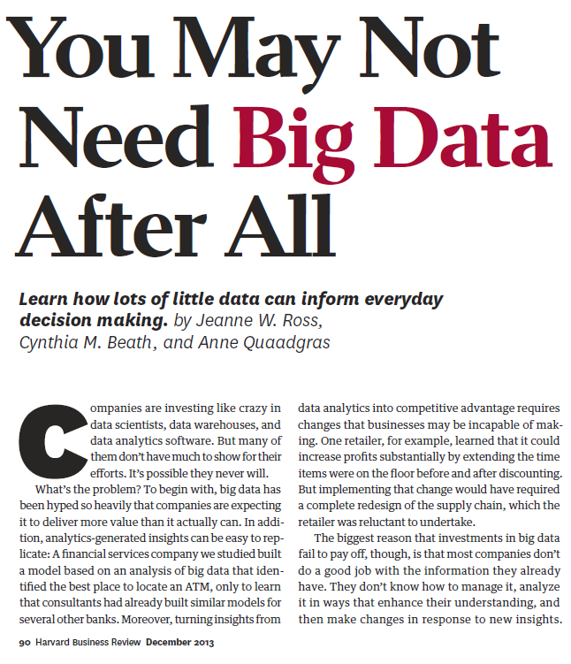
Little Data?
Management and work practices alignment
Data quality
Data synchrony
Scorecard – Evidence based management
Coaching
Business rules management (aligning operational decisions with strategy)

Slide 42
Best Practices for New Initiatives
8. Increase/Refine Infrastructure
Well-defined use cases
Hypotheses
Build Infrastructure
Measure
Adapt
Iterate…
Leverage increasing infrastructure to
explore
9. Measure
4. Measure
5. Adapt
1. Use Case
2. Hypotheses
7. Hypotheses
10. Adapt
3. Build Infrastructure
6. New Use Case
11. Iterate

Slide 43
Data Mining
Techniques for learning patterns in data by applying statistical techniques.
Training
Classifying, Clustering, Associations
Predictive
Resource: https://rayli.net/blog/data/top-10-data-mining-algorithms-in-plain-english/

Slide 44
Public Data Sets
Listings – e.g.
https://github.com/caesar0301/awesome-public-datasets
https://aws.amazon.com/datasets/
https://www.google.com/publicdata/directory
https://www.reddit.com/r/datasets/
Facebook Data Set Example: https://docs.google.com/spreadsheets/d/1mLO7SFqHmUaZEpp87cwkM0luJutSwmwKMx7kaM9348U/edit#gid=1042851424

Slide 45
Designing Data Repositories
Data Warehouse – Structured – Schemas on Data Write
Data Lake – Raw – structuring happens on Read

