Slide 1
Multiple Processor Systems

Slide 2
Introduction
Multiprocessing is the use of two or more central processing units (CPUs) within a single computer system. The term also refers to the ability of a system to support more than one processor and/or the ability to allocate tasks between them.
Applications in a multi-processing system are broken to smaller routines that run independently. The operating system allocates these threads to the processors improving performance of the system.
A multiprocessor is a computer system having two or more processing units (multiple processors) each sharing main memory and peripherals, in order to simultaneously process programs.

Slide 3
At the operating system level, multiprocessing is sometimes used to refer to the execution of multiple concurrent processes in a system, with each process running on a separate CPU or core, as opposed to a single process at any one instant.
When used with this definition, multiprocessing is sometimes contrasted with multitasking, which may use just a single processor but switch it in time slices between tasks (i.e. a time-sharing system).

Slide 4
Multiprocessor Hardware
Although all multiprocessors have the property that every CPU can address all of memory, some multiprocessors have the additional property that every memory word can be read as fast as every other memory word. These machines are called UMA (Uniform Memory Access) multiprocessors.
NUMA (Nonuniform Memory Access) multiprocessors do not have this property.

Slide 5
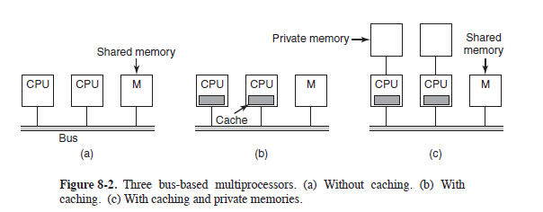
UMA Multiprocessors with Bus-Based Architectures

Slide 6
UMA Multiprocessors Using Crossbar Switches
Even with the best caching, the use of a single bus limits the size of a UMA multiprocessor to about 16 or 32 CPUs. To go beyond that, a different kind of interconnection network is needed. The simplest circuit for connecting n CPUs to k memories is the crossbar switch, shown in Fig.
Crossbar switches have been used for decades in telephone switching exchanges to connect a group of incoming lines to a set of outgoing lines in an arbitrary way.
At each intersection of a horizontal (incoming) and vertical (outgoing) line is a crosspoint. A crosspoint is a small electronic switch that can be electrically opened or closed, depending on whether the horizontal and vertical lines are to be connected or not.

Slide 7
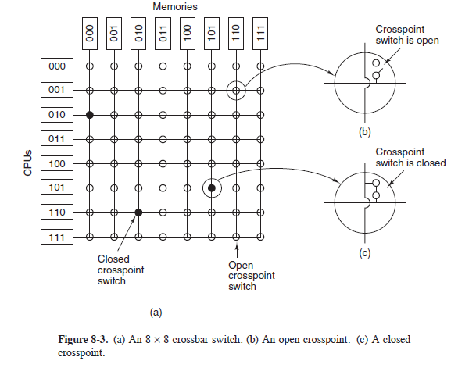
23retjkl

Slide 8
UMA Multiprocessors Using Multistage Switching Networks
The Module field tells which memory to use.
The Address specifies an address within a module.
The Opcode gives the operation, such as READ or WRITE.

Slide 9
NUMA Multiprocessors
Single-bus UMA multiprocessors are generally limited to no more than a few dozen CPUs, and crossbar or switched multiprocessors need a lot of (expensive) hardware and are not that much bigger.
NUMA machines have three key characteristics that all of them possess and which together distinguish them from other multiprocessors:
1. There is a single address space visible to all CPUs.
2. Access to remote memory is via LOAD and STORE instructions.
3. Access to remote memory is slower than access to local memory.

Slide 10
When the access time to remote memory is not hidden (because there is no caching), the system is called NC-NUMA (Non Cache-coherent NUMA). When the caches are coherent, the system is called CC-NUMA (Cache-Coherent NUMA).
A popular approach for building large CC-NUMA multiprocessors is the directory-based multiprocessor. The idea is to maintain a database telling where each cache line is and what its status is.

Slide 11
Multicore Chips
As chip manufacturing technology improves, transistors are getting smaller and smaller and it is possible to put more and more of them on a chip. This empirical observation is often called Moore’s Law, after Intel co-founder Gordon Moore, who first noticed it.
To put two or more complete CPUs, usually called cores, on the same chip. Dual-core, quad-core, and octacore chips are already common; and you can even buy chips with hundreds of cores.
While the CPUs may or may not share caches, they always share main memory.

Slide 12
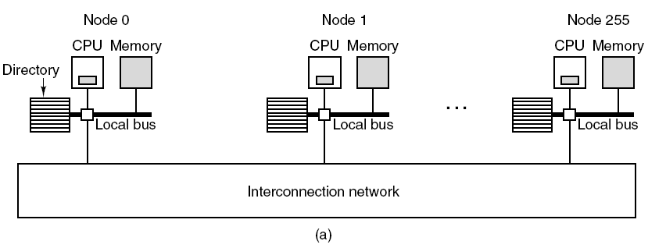
Special hardware circuitry makes sure that if a word is present in two or more caches and one of the CPUs modifies the word, it is atomically removed from all the caches in order to maintain consistency. This process is known as snooping.
The result of this design is that multicore chips are just very small multiprocessors.
In fact, multicore chips are sometimes called CMPs (Chip MultiProcessors).

Slide 13
Manycore Chips
Multicore simply means ‘‘more than one core,’’ but when the number of cores grows well beyond the reach of finger counting, we use another name. Manycore chips are multicores that contain tens, hundreds, or even thousands of cores.
Thousands of cores are not even that special any more. The most common manycores today, graphics processing units, are found in just about any computer system that is not embedded and has a monitor. A GPU is a processor with dedicated memory and, literally, thousands of itty-bitty cores. Compared to general-purpose processors, GPUs spend more of their transistor budget on the circuits that perform calculations and less on caches and control logic. They are very good for many small computations done in parallel, like rendering polygons in graphics applications. They are not so good at serial tasks. They are also hard to program.
While GPUs can be useful for operating systems (e.g., encryption or processing of network traffic), it is not likely that much of the operating system itself will run on the GPUs.

Slide 14
What does Graphics Processing Unit (GPU) mean?
A Graphics Processing Unit (GPU) is a single-chip processor primarily used to manage and boost the performance of video and graphics. GPU features include
2-D or 3-D graphics
Digital output to flat panel display monitors
Texture mapping
Application support for high-intensity graphics software such as AutoCAD
Rendering polygons
Support for YUV color space
Hardware overlays
MPEG decoding
These features are designed to lessen the work of the CPU and produce faster video and graphics. A GPU is not only used in a PC on a video card or motherboard; it is also used in mobile phones, display adapters, workstations and game consoles. This term is also known as a visual processing unit (VPU).

Slide 15
Heterogeneous Multicores
Some chips integrate a GPU and a number of general-purpose cores on the same die.
Systems that integrate multiple different breeds of processors in a single chip are collectively known as heterogeneous multicore processors.
An example of a heterogeneous multicore processor is the line of IXP network processors originally introduced by Intel in 2000 and updated regularly with the latest technology. The network processors typically contain a single general purpose control core (for instance, an ARM processor running Linux) and many tens of highly specialized stream processors that are really good at processing network packets and not much else.

Slide 16
Programming with Multiple Cores
Current programming languages are poorly suited for writing highly parallel programs and good compilers and debugging tools are scarce on the ground. Few programmers have had any experience with parallel programming and most know little about dividing work into multiple packages that can run in parallel.
Synchronization, eliminating race conditions, and deadlock avoidance are such stuff as really bad dreams are made of, but unfortunately performance suffers horribly if they are not handled well.

Slide 17
Multiprocessor Operating System Types
Each CPU Has Its Own Operating System:
The simplest possible way to organize a multiprocessor operating system is to statically divide memory into as many partitions as there are CPUs and give each
CPU its own private memory and its own private copy of the operating system. In effect, the n CPUs then operate as n independent computers.

Slide 19
Master-Slave Multiprocessors
Here, one copy of the operating system and its tables is present on CPU 1 and not on any of the others. All system calls are redirected to CPU 1 for processing there. CPU 1 may also run user processes if there is CPU time left over. This model is called master-slave since CPU 1 is the master and all the others are slaves.

Slide 21
Symmetric Multiprocessors
Our third model, the SMP (Symmetric MultiProcessor), eliminates this asymmetry. There is one copy of the operating system in memory, but any CPU can run it. When a system call is made, the CPU on which the system call was made traps to the kernel and processes the system call.

Slide 22
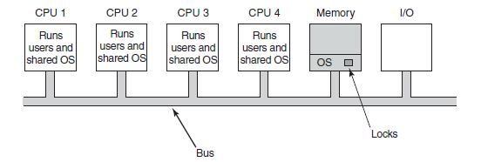
The simplest way around these problems is to associate a mutex (i.e., lock) with the operating system, making the whole system one big critical region. When a CPU wants to run operating system code, it must first acquire the mutex.

Slide 23
Multiprocessor Synchronization
The CPUs in a multiprocessor frequently need to synchronize. We just saw the case in which kernel critical regions and tables have to be protected by mutexes.
To start with, proper synchronization primitives are really needed. If a process on a uniprocessor machine (just one CPU) makes a system call that requires accessing some critical kernel table, the kernel code can just disable interrupts before touching the table.
On a multiprocessor, disabling interrupts affects only the CPU doing the disable. Other CPUs continue to run and can still touch the critical table. As a consequence, a proper mutex protocol must be used and respected by all CPUs to guarantee that mutual exclusion works.

Slide 24
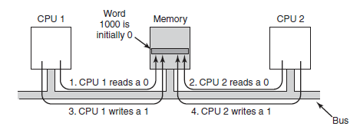

Slide 25
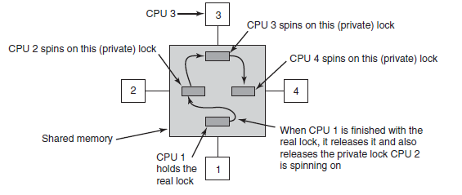
To prevent this problem, the TSL instruction must first lock the bus, preventing other CPUs from accessing it, then do both memory accesses, then unlock the bus. An even better idea is to give each CPU wishing to acquire the mutex its own private lock variable to test, as illustrated in Fig

Slide 26
Spinning vs. Switching
So far we have assumed that a CPU needing a locked mutex just waits for it, by polling continuously, polling intermittently, or attaching itself to a list of waiting CPUs. Sometimes, there is no alternative for the requesting CPU to just waiting.
For example, suppose that some CPU is idle and needs to access the shared ready list to pick a process to run. If the ready list is locked, the CPU cannot just decide to suspend what it is doing and run another process, as doing that would require reading the ready list. It must wait until it can acquire the ready list.

Slide 27
Multiprocessor Scheduling
On a uniprocessor, scheduling is one dimensional. The only question that must be answered (repeatedly) is: ''Which process should be run next?'' On a multiprocessor, scheduling is two dimensional. The scheduler has to decide which process to run and which CPU to run it on. This extra dimension greatly complicates scheduling on multiprocessors.
Another complicating factor is that in some systems, all the processes are unrelated whereas in others they come in groups. An example of the former situation is a timesharing system in which independent users start up independent processes. The processes are unrelated and each one can be scheduled without regard to the other ones

Slide 28
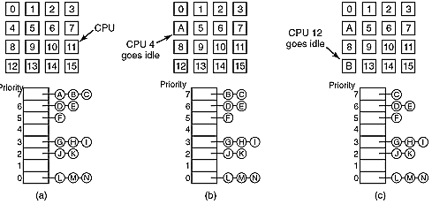
Timesharing
The simplest scheduling algorithm for dealing with unrelated processes (or threads) is to have a single systemwide data structure for ready processes, possibly just a list, but more likely a set of lists for processes at different priorities as depicted

Slide 29
Here the 16 CPUs are all currently busy, and a prioritized set of 14 processes are waiting to run. The first CPU to finish its current work (or have its process block) is CPU 4, which then locks the scheduling queues and selects the highest priority process, A

Slide 30
Next, CPU 12 goes idle and chooses process B, as illustrated in Fig. As long as the processes are completely unrelated, doing scheduling this way is a reasonable choice.

Slide 31
Having a single scheduling data structure used by all CPUs timeshares the CPUs, much as they would be in a uniprocessor system. It also provides automatic load balancing because it can never happen that one CPU is idle while others are overloaded. Two disadvantages of this approach are the potential contention for the scheduling data structure as the numbers of CPUs grows and the usual overhead in doing a context switch when a process blocks for I/O.
It is also possible that a context switch happens when a process' quantum expires.

