Slide 1
Unit 1- Chapter 2
HTML5

Slide 2
What Is HTML?
In simple terms, a Web page (or HTML document) is a plain text file that has been encoded using Hypertext Markup Language (HTML) so that it appears nicely formatted in a Web browser. Here’s what HTML means, word-by-word:
Hypertext Text that you click to jump from document to document.
Markup Tags that apply layout and formatting conventions to plain text.
Language A reference to the fact that HTML is considered a programming language.

Slide 3
When people think of computer programming, they usually think of writing a compiled program.
A compiled programming language runs the human-readable programming code through a utility that converts it to an executable file (usually with an .exe or .com extension), which is then distributed to users. In contrast, HTML is an interpreted programming language.
That means the program is distributed in human-readable format to users, and the program in which it is opened takes care of running it. The HTML code for Web pages resides in files.
Each time your Web browser opens a Web page, it processes the HTML code within the file.

Slide 4
HTML Documents
All HTML documents must start with a document type declaration: <!DOCTYPE html>.
The HTML document itself begins with <html> and ends with </html>.
The visible part of the HTML document is between <body> and </body>.

Slide 5
HTML Headings
HTML headings are defined with the <h1> to <h6> tags.
<h1> defines the most important heading. <h6> defines the least important heading:

Slide 6
HTML Paragraphs
The HTML <p> element defines a paragraph:
Example
<p>
This paragraph
contains a lot of lines
in the source code,
but the browser
ignores it.
</p>

Slide 7
<html>
<body>
<h1>My First Heading</h1>
<p>My first paragraph.</p>
</body>
</html>

Slide 8
The HTML Style Attribute
The HTML Style Attribute
Setting the style of an HTML element, can be done with the style attribute.
The HTML style attribute has the following syntax:
<tagname style="property:value;">

Slide 9
Background Color
The CSS background-color property defines the background color for an HTML element.
This example sets the background color for a page to powderblue:
Example
<body style="background-color:powderblue;">
<h1>This is a heading</h1>
<p>This is a paragraph.</p>
</body>

Slide 10
Text Color
The CSS color property defines the text color for an HTML element:
Example
<h1 style="color:blue;">This is a heading</h1>
<p style="color:red;">This is a paragraph.</p>

Slide 11
Fonts
The CSS font-family property defines the font to be used for an HTML element:
Example
<h1 style="font-family:verdana;">This is a heading</h1>
<p style="font-family:courier;">This is a paragraph.</p>

Slide 12
Text Size
The CSS font-size property defines the text size for an HTML element:
Example
<h1 style="font-size:300%;">This is a heading</h1>
<p style="font-size:160%;">This is a paragraph.</p>

Slide 13
Text Alignment
The CSS text-align property defines the horizontal text alignment for an HTML element:
Example
<h1 style="text-align:center;">Centered Heading</h1>
<p style="text-align:center;">Centered paragraph.</p>

Slide 14
HTML Formatting Elements
HTML also defines special elements for defining text with a special meaning.
HTML uses elements like <b> and <i> for formatting output, like bold or italic text.
Formatting elements were designed to display special types of text:
<b> - Bold text
<strong> - Important text
<i> - Italic text
<em> - Emphasized text
<mark> - Marked text
<small> - Small text
<del> - Deleted text
<ins> - Inserted text
<sub> - Subscript text
<sup> - Superscript text

Slide 15
HTML <b> and <strong> Elements
The HTML <b> element defines bold text, without any extra importance.
Example
<b>This text is bold</b>
Output:
This text is bold.

Slide 16
The HTML <strong> element defines strong text, with added semantic "strong" importance.
Example
<strong>This text is strong</strong>
Output:
This text is strong.

Slide 17
HTML <i> and <em> Elements
The HTML <i> element defines italic text, without any extra importance.
Example
<i>This text is italic</i>
This text is italic.

Slide 18
The HTML <em> element defines emphasized text, with added semantic importance.
Example
<em>This text is emphasized</em>
Output:
This text is emphasized.

Slide 19
HTML <small> Element
The HTML <small> element defines smaller text:
Example
<h2>HTML <small>Small</small> Formatting</h2>
output:
HTML Small Formatting

Slide 20
HTML <mark> Element
The HTML <mark> element defines marked/highlighted text:
Example
<h2>HTML <mark>Marked</mark> Formatting</h2>
Output:
HTML Marked Formatting

Slide 21

HTML <del> Element
The HTML <del> element defines deleted/removed text.
Example
<p>My favorite color is <del>blue</del> red.</p>
Output

Slide 22
HTML <ins> Element
The HTML <ins> element defines inserted/added text.
Example
<p>My favorite <ins>color</ins> is red.</p>
Output:
The ins element represent inserted (added) text.
My favorite color is red.

Slide 23
HTML <sub> Element
The HTML <sub> element defines subscripted text.
Example
<p>This is <sub>subscripted</sub> text.</p>
Output:
This is _{subscripted} text.

Slide 24

HTML <sup> Element
The HTML <sup> element defines superscripted text.
Example
<p>This is <sup>superscripted</sup> text.</p>

Slide 25
Specifying the Document Type
When creating an HTML5 document, the first line of the document should be this tag: <!DOCTYPE html>
The DOCTYPE tag always begins with an exclamation point and is always placed at the beginning of the document, before any other tag. Most HTML tags are not case-sensitive, but the word DOCTYPE should always be uppercase.
Using the DOCTYPE tag is like signing a contract. It is an optional tag, but when you use it, you are promising that your coding will conform to certain standards.
When the browser sees the tag <!DOCTYPE html>, it assumes you are using HTML5.

Slide 26
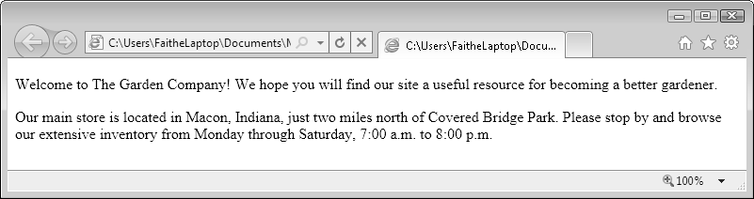
Line Breaks

Slide 27
To create a line break without officially starting a new paragraph (and thereby adding that extra white space), use the <br> tag. This is a one-sided tag placed within a paragraph, at the end of each line, like this:
<p>David Jaffe<br>
317-555-8882</p>

Slide 28
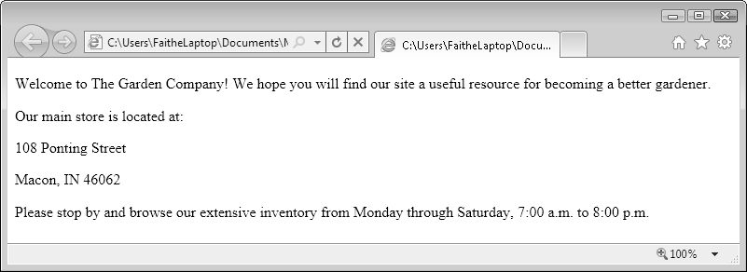

Slide 29
Specifying a Page Title and Metatags
That text is specified by a <title> tag that is placed in the <head> section (also called the header). Here’s an example:
<head>
<title>The Garden Company</title>
</head>
Troubleshooting: Make sure you place the <title> tag in the <head> section, and not in the <body> section.

Slide 30
Meta tags
When some search engines index your page, they rely not only on the full text of the page, but also on any keywords they find in the <meta> tag area.
Not all search engines refer to <meta> tags. Google does not, for example; it indexes only the text contained in the <body> area. Because of the potential for abuse of the system, such as Web developers packing their pages with unrelated keywords, fewer and fewer search engines these days are using them.

Slide 31
For example, suppose The Garden Company’s Web site would be useful to people who are searching for information about all types of gardening problems, such as pests, weeds, and fungus, and about growing flowers and vegetables. Perhaps all these topics are not mentioned on the main page, but you want people who search for those words to be directed to the main page anyway. You could place the following in the <head> section:
<meta name="keywords" content="pests, weeds, fungus, plants, flowers, vegetables">

Slide 32
The <meta> tag can also be used to redirect visitors to another page. For example, suppose you told everyone the address of your Web site, and then you needed to move it to another URL. You could place a “We’ve Moved” page at the original address and use the <meta> tag to redirect users to the new address after five seconds, like this:
<meta http-equiv="refresh" content="5; url=http://www.contoso.com/newpage.htm">

Slide 33
Here’s yet another common use: the <meta> tag can specify a character encoding scheme.
If you want, you can add <meta charset=”utf-8”> to the <head> section of your document

Slide 34
Publishing a File to a Server
Uploading through an FTP connection by using Internet Explorer. You do this by entering the address of an FTP server (which will start with ftp://) in the Address bar of Internet Explorer. A dialog box prompts you for your user name and password for that server. If you enter those correctly, a Windows Explorer-like file-management window appears, just as though you were browsing any folder on your hard disk. You can then transfer the files by dragging them into that window, or copying them and pasting them into the FTP window.

Slide 35
Uploading through an FTP connection by using FTP software. There are many third-party FTP applications available that make it simple to transfer files. These utilities have some advantages over the Internet Explorer transfer method, such as the ability to restart uploads that are interrupted due to communication errors.
Some examples include FileZilla (www.filezilla-project.org) and BulletProof FTP (www.bpftp.com).

Slide 36
Saving directly to a Web folder. Most Web development tools, such as Microsoft Expression Web, let you to save directly to a Web server by typing the URL of the site into the Save As dialog box.

Slide 37
Using Monospace and Preformatted Text
Most of the text in this book is set in a proportional font. This means that individual characters take up varying amounts of space horizontally, depending on the size of the individual character. For example, the letter M takes up more space than the letter I, so a string of Ms occupies more space than a string of Is. As a demonstration, let’s take a look at 10 of each character to see the difference:
MMMMMMMMMM
IIIIIIIIII

Slide 38

In contrast, a monospace font is one whose characters occupy exactly the same amount of horizontal space, regardless of the actual size and shape of the individual character.
Back in the days of the typewriter, all type was monospaced because of the way the typewriter worked: the carriage moved exactly the same amount of space to the right as you typed, no matter which letter was keyed. Here are those same 10 Ms and Is in a monospace font:

Slide 39
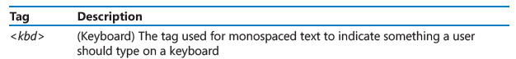
Most browsers do not make a formatting distinction between these tags by default, but you can define them differently in your styles if you like.

Slide 40
In Notepad, enclose the words premium in step 2 and customer in step 4 in <kbd> tags.
<p>1. Click in the Login box<br>
2. Type <kbd>premium</kbd><br>
3. Click in the Password box<br>
4. Type <kbd>customer</kbd></p>

Slide 41
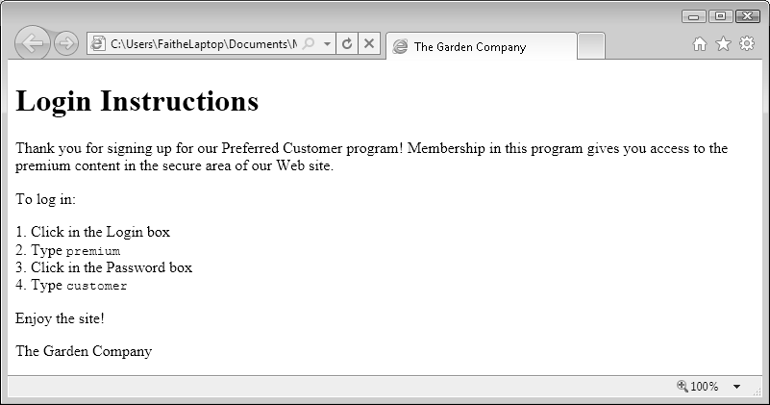
Save the file, and then refresh the Internet Explorer display.

Slide 42
using lists and backgrounds
Creating Bulleted and Numbered Lists
The tag for a numbered list is <ol>, which stands for ordered list. For a bulleted list, the tag is <ul>, which stands for unordered list. Each numbered or bulleted item within the list is tagged <li>, for list item.
<ol>
<li>Click in the Login box</li>
<li>Type <b>premium</b></li>
<li>Click in the Password box</li>
<li>Type <b>customer</b></li>
</ol>

Slide 43

The result is a standard, recognizable numbered list.
A bulleted list works the same way, except you use <ul> tags. Here’s an example:
<ul>
<li>Bring in the mail</li>
<li>Take out the trash</li>
<li>Feed the dogs</li>
<li>Stop the newspaper delivery</li>
</ul>

Slide 44


Slide 45
Nesting Lists
<ol>
<li>Thursday: Do Algebra homework</li>
<li>Friday: Housesit for neighbors:
<ul><li>Bring in the mail</li>
<li>Take out the trash</li>
<li>Feed the dogs</li>
<li>Stop the newspaper delivery</li></ul></li>
<li>Saturday: Wash car</li>
</ol>

Slide 46
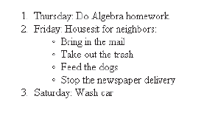

Slide 47
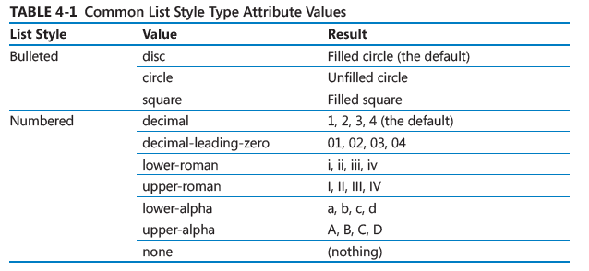
Changing the Bullet or Number Character

Slide 48
Creating Definition Lists
A definition list is just what it sounds like: a list that presents terms with their definitions, such as you would see in a glossary.
The complete list (headings and definition paragraphs) is contained within the <dl> and </dl> tags, which stands for definition list. Each word to be defined is contained in a <dt> (definition term) tag, and the definition paragraphs are in <dd> (definition description) tags. Here’s the code for the example just shown:

Slide 49
<dl>
<dt>Fungus</dt>
<dd>A primitive, non-vascular, non-photosynthetic form of plant life. Examples include mildews, molds, and mushrooms.</dd>
<dt>Nematode</dt>
<dd>A microscopic roundworm that lives in the soil. There are both harmful and beneficial nematodes. Harmful ones take their toll on the roots of the plant.
</dd>
</dl>

Slide 50
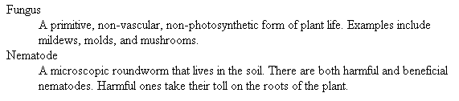

Slide 51
<dl>
<dt>Acid Soil</dt>
<dd>Soil that is lower than 7.0 pH. Acidity is measured by the amount of calcium in the soil. The opposite of acidic soil is alkaline soil.</dd>
<dt>Deciduous</dt>
<dd>A tree or plant that loses its leaves at the end of the growing season, such as a maple tree.</dd>
<dt>Fungus</dt>
<dd>A primitive, non-vascular, non-photosynthetic form of plant life. Examples include mildews, molds, and mushrooms.</dd>
<dt>Nematode</dt>
<dd>A microscopic roundworm that lives in the soil. There are both harmful and beneficial nematodes. Harmful ones take their toll on the roots of the plant.</dd>
</dl>

Slide 52
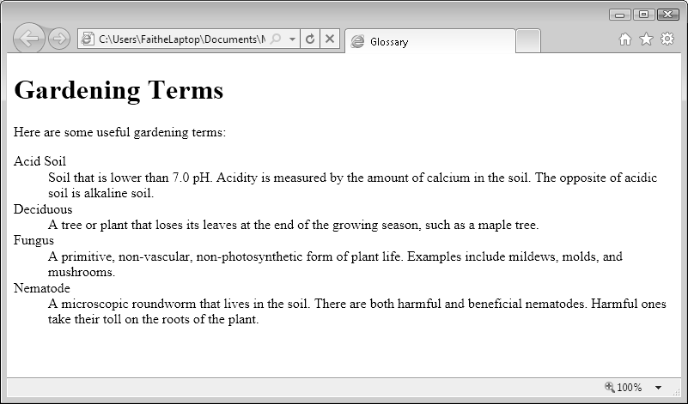

Slide 53
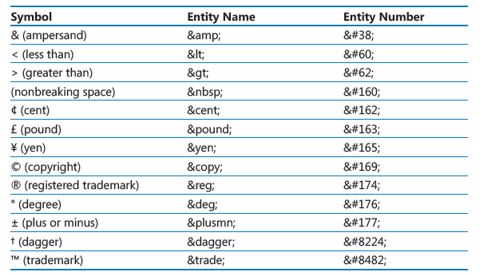
Inserting Special Characters

Slide 54
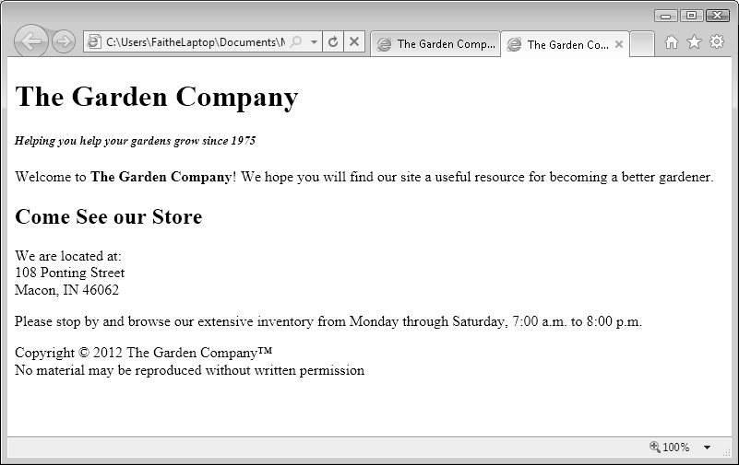
<p>Copyright &copy; 2012 The Garden Company &trade;<br>
No material may be reproduced without written permission</p>

Slide 55
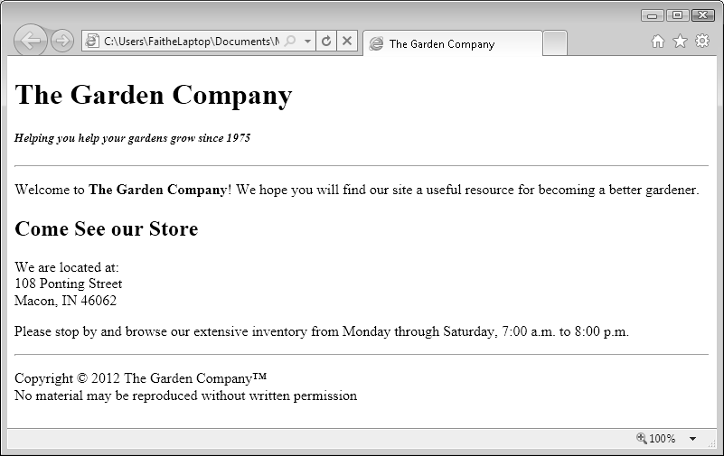
Inserting Horizontal Lines
<hr style="color: green; background-color: green; height: 3; width: 50%">

Slide 56
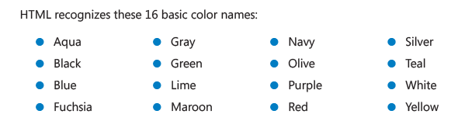

Slide 57
Choosing Background and Foreground Colors
Applying a Background Color
<body style="background-color: yellow">
You can use the color name, the RGB value, or the hexadecimal value. Therefore, the following are equivalent to the code just shown:
<body style="background-color: #FFFF00">

Slide 58
Applying a Foreground Color
<body style="background-color: navy; color: yellow">

Slide 59
Specifying a Background Image File
For example, to use the background image file called granite.gif that is located in the same folder as the HTML file, you would write:
<body style="background-image: url(granite.gif)">
For example, to combine the background image, background color, and foreground color in a single attribute, do the following:
<body style="background-image: url(granite.gif); color: green; background-color: beige">

Slide 60
Creating Hyperlinks and Anchors
The Web is based on hyperlinks. Each Web page contains active links to other pages, which in turn link to even more pages, until presumably the entire Web (or at least a great chunk of it) is bound together.
<a> tag, which is used to create various types of hyperlinks.

Slide 61
Hyperlinking to a Web Page
It starts with the <a> tag, and then uses an href= attribute which provides the URL or the path to the destination. For example, an opening tag might look like this:
<a href="http://www.microsoft.com">
Visit <a href="http://www.microsoft.com">Microsoft.com</a> for the latest information.
When viewed in a browser, this produces a text-based hyperlink similar to that shown in the following image:

Slide 62
if you wanted to provide a direct link to the page where users can download Windows Media Player, you would use this tag:
<a href=
"http://www.microsoft.com/windows/windowsmedia/player/download/download.aspx"> Download Windows Media Player</a>

Slide 63
Using Relative and Absolute Paths
Paths that contain a complete address that anyone can use to get to that page are called absolute paths. Absolute paths are very reliable, but they are also long and awkward to type. For example:
<a href="http://www.contoso.com/gardener/images/foliage.htm">Diagnosing Foliage Problems</a>

Slide 64
When you are linking to files in the same Web site as the link itself, you do not need to include the complete path to the file; you can simply provide its name. When the file is in the same folder, you need only supply the file name. For example, if the index.htm and foliage.htm pages of The Garden Company Web site were in the same folder, in the
index.htm file, you could refer to foliage.htm like this:
<a href="foliage.htm">Diagnosing Foliage Problems</a>
This is called a relative path, because the destination file is relative to the current file’s location.

Slide 65
To direct the hyperlink to open a page in a new window, add the attribute target=″_blank″ to the <a> tag. For example, to open the foliage.htm file in a new window, the tag would be structured like this:
<a href="foliage.htm" target="_blank">Diagnosing Foliage Problems</a>

Slide 66
Hyperlinking to an E-Mail Address
Hyperlinks can point to anything, not just to Web pages. You can create e-mail hyperlinks, for example, that start the user’s default e-mail program, create a new message, and enter the recipient’s address.
To create a hyperlink to an e-mail address, use the same href= attribute as you did previously, but instead of a Web address, type mailto: followed by the e-mail address, like this:
<a href="mailto:support@adatum.com">Contact Us</a>

Slide 67
Creating and Hyperlinking to Anchors
An anchor is a marker within an HTML document, roughly analogous to a bookmark in a Word document. You define a specific location in the document with an anchor name, and then you can hyperlink directly to that anchor.
Anchors are most valuable in long documents with multiple sections. They provide a means for users to jump directly to whatever section they want rather than having to read or scroll through the entire document.
<a name="conclusion">Conclusion</a>

Slide 68
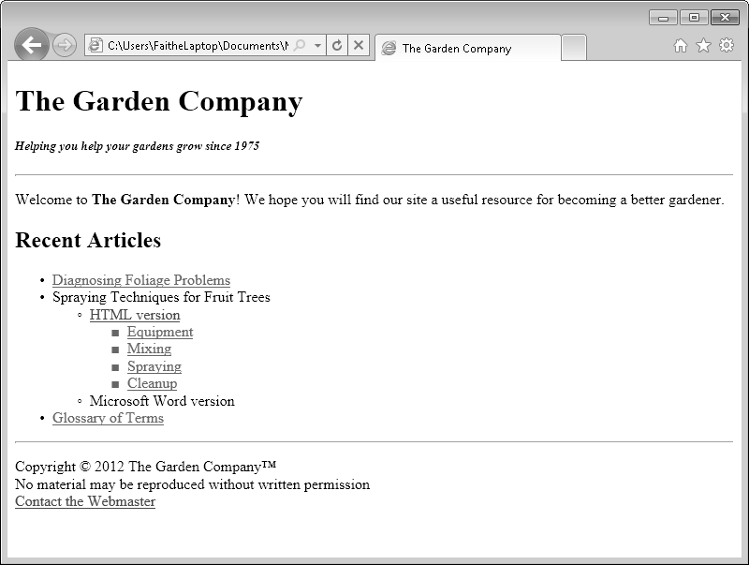

Slide 69
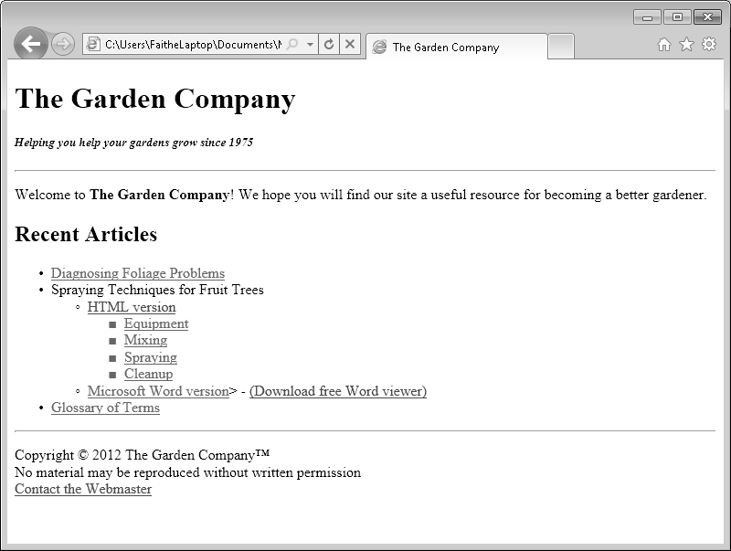
Hyperlinking to Other Content

Slide 70
Introduction to Style Sheets
A cascading style sheet (CSS) is code that specifies formatting based on styles. You can store the CSS code in the <head> section of the Web page to which you want it to apply, or you can store it in a separate file with a .css extension (which works well if you want the same CSS to apply to more than one Web page).

Slide 71
Understanding Styles
a style is a formatting rule. That rule can be applied to an individual tag, to all instances of a certain tag within a document, or to all instances of a certain tag across a group of documents.
For example, to use a square bullet character in an unordered list, you would use the style= attribute with the <ul> tag like this:
<ul style="list-style-type: square">

Slide 72
But suppose you have several unordered lists in your document, and you want them all to use the same square bullet character.
The <style> section might look like this:
<style type="text/css">
ul {
list-style-type: square
}
</style>

Slide 73
Constructing Style Rules
A style rule begins with the name of the tag or other element to which the style applies.
For example, if you are creating a rule that will apply to all instances of the <h1> tag, start the rule with h1 (no brackets):
<style>
h1
</style>
No brackets are necessary around h1 because it’s already enclosed in the <style> tag.

Slide 74
Next, type a set of curly braces (you can place them on separate lines for greater readability, if you want).
<style>
h1 {
color: red
}
</style>

Slide 75
If you have more than one rule to apply, such as a color plus a typeface, separate the rules with semicolons within the curly braces.
<style>
h1 {
color: red;
font-size: 14px;
}
</style>

Slide 76
If multiple tags should have the same rule applied to them, you can list them together and separate them by commas. For example, if all heading styles <h1> through <h6> should be red, you could write:
<style>
h1, h2, h3, h4, h5, h6 {
color: red
}
</style>

Slide 77
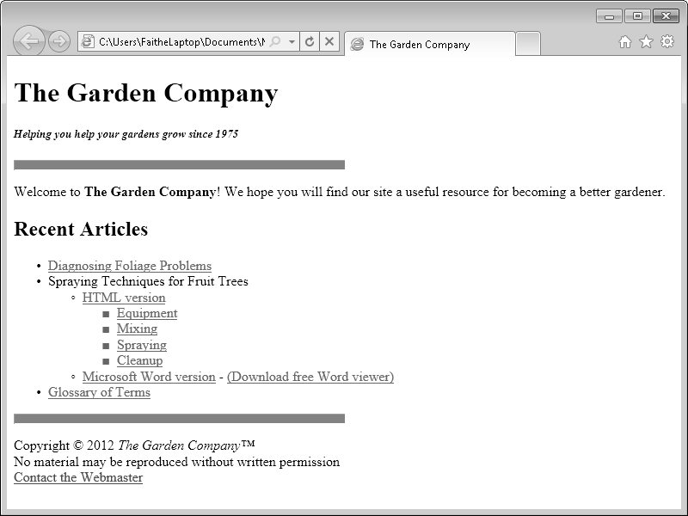

Slide 78
<style>
hr {
color: red;
background-color: red;
height: 10px;
width: 50%;
text-align: left;
}
</style>

Slide 79
Creating Styles for Nested Tags
Sometimes you might want to apply a specific formatting only when one tag is nested within another. For example, perhaps you want a bulleted list that’s nested within another bulleted list to use a different bullet character.
For example, to use round bullets for all bulleted lists that are nested within numbered lists, specify the following:
ol ul {list-style-type: circle}
ol ul ul {list-style-type: circle}

Slide 80
Creating Classes and IDs for Applying Styles
Classes and IDs mark certain elements so that you can refer to them in your style sheet.
A class can be applied to multiple selections, whereas an ID uniquely identifies a specific selection within a document. (Different documents can use the same ID.)
For example, suppose you have an unordered list of products, and you want new products to appear in red. One way to do it would be to manually add the style=”color: red” attribute to each of the list items, like this:
<li style="color: red">Spraying Techniques for Fruit Trees</li>

Slide 81
However, this method is not optimal because if you change your mind and decide to make the new items blue instead, you would need to make the change manually for each instance. A better way is to create a class called new and define formatting for it in the <style> area. Then you could apply the new class to each bullet point you want to spotlight.
To apply a class style, add a class= attribute to the opening tag for the element. For example, to make a list item part of the new class, use the following:
<li class="new">Spraying Techniques for Fruit Trees</li>

Slide 82
Then in the <style> area, add a style that defines the class as red.
<style>
.new {
color: red
}
</style>

Slide 83
IDs work the same way, except that you can apply them only once per document. For example, you might apply an ID to a unique heading. To create an ID, add an id= attribute to the tag, like this:
<li id="special">Spraying Techniques for Fruit Trees</li>
Then define the ID in the <style> area, preceding the ID name with a hash symbol (#), like this:
<style>
#special {
color: red
}
</style>

Slide 84
Applying Styles to Hyperlinks
By default in most browsers, textual hyperlinks appear as underlined blue text, and visited hyperlinks (that is, hyperlinks to pages you have already visited) appear as underlined purple text.
You can control hyperlink formatting by placing attributes in the <a> tag for each link, although it’s tedious to do so. For example, to make an individual hyperlink magenta, use the following:
<a href="foliage.htm" style="color: magenta">Diagnosing Foliage Problems</a>

Slide 85
For example, to make all visited links magenta and all unvisited links black:
<style>
a:link {color: black}
a:visited {color: magenta}
</style>

Slide 86
To apply different colors, you can use pseudo-classes.
There are three additional pseudo-classes that you can use with hyperlink styles:
focus: This is used for links that are selected by using the keyboard but not yet activated.
Hover: This is used to change the appearance of a link when the mouse is positioned over it.
Active: This is used for a link when it is clicked. Immediately after being clicked, the link changes to the visited state.

Slide 87
Creating and Linking to External Style Sheets
A single external style sheet can be linked to multiple documents, ensuring complete consistency even in a large site. An external style sheet also makes it easy to change the formatting of your site after the pages have been constructed. Rather than having to edit each page individually, you can simply change the style sheet.
An external style sheet is a plain text file, just like an HTML file. The only difference is that you assign it a .css rather than an .htm extension. It contains anything you would place within the <style> tag if you were creating the style sheet internally. You do not need the <style> and </style> tags themselves.

Slide 88
<link rel="stylesheet" type="text/css" href="default.css" />
The name “default.css” is common, but not required. You can name your style sheet anything you like, as long as the name ends with a .css extension.

Slide 89
Formatting Text by Using Style Sheets
Specifying a Font Family
<p style="font-family: Arial, Helvetica, sans-serif">
In the default.css style sheet, add a style rule that defines a font family of Verdana, Arial, Helvetica, and sans-serif for the <p> tag and the <li> tag, as shown in the following:
p, li {font-family: "Verdana", "Arial", "Helvetica", sans-serif}

Slide 90
Specifying a Font Size and Color
p {font-size: 12px}
<p style="font-size: x-small">This text is extra-small.</p>
p {color: blue}
<p style="color: blue">This is blue text.</p>
In the default style sheet, change the style rule for the <p> and <li> tags so they include a font size of 13px.
p, li {font-family: "Verdana", "Arial", "Helvetica", sans-serif; font-size: 13px}

Slide 91
Applying Bold and Italics
To include boldface in a style, use the font-weight attribute. For example, you might create a class called boldface in your style sheet like this:
.boldface {font-weight: bold}
You can apply the boldface class to all text elements of a specified type, for example, all paragraphs, in style sheets.
p {font-weight: bold}
You can also apply it by using a style= attribute in an individual paragraph.
<p style="font-weight: bold">This text is bold.</p>

Slide 92
p {font-style: italic}
<p style="font-style: normal">This paragraph is not italicized.</p>

Slide 95
Applying Strikethrough and Underlining
<p>List price: <del>$24.00</del> <ins>Now only $9.99</ins></p>
<p style="text-decoration: underline">This looks clickable, but isn’t.</p>
<p style="text-decoration: line-through">This is struck-through.</p>
<p style="text-decoration: blink">Congratulations, you win!</p>
.underlined {text-decoration: underline}

Slide 96
Creating Inline Spans
Part of the problem with replacing the old style tags like <b>, <i>, and <del> with styles for individual items is that the style= attribute must be placed within an existing tag. For example, in the following sentence, how would you avoid using <b> to make only one word bold?
<p>I had a <b>great</b> time.</p>
<p>I had a <span style="text-weight: bold">great</span> time.</p>

Slide 97
You can create a class called vocabulary, and apply that class to each vocabulary word.
<span class="vocabulary">Deciduous</span>
Then in your style sheet, you can define the class with the formatting you want. Suppose, for example, that you decide to make vocabulary words italicized. Simply create a style that defines vocabulary as italic:
.vocabulary {font-style: italic}

Slide 98
Adjusting Spacing Between Letters

Slide 99
To apply word and/or letter spacing, add spacing to the style= attribute for a specific tag.
<p style="letter-spacing: 4px">This text has increased letter spacing.</p>
You can also add spacing to a style rule in the style sheet.
p {letter-spacing: 4px}

Slide 101
In the <head> section, create the following <style> section:
<style>
h1, h2, p {word-spacing: 1px; letter-spacing: 1px}
</style>

Slide 102
Apply the default.css cascading style sheet to the document by inserting the following code in the <head> section (but not within the <style> tag):
<link rel="stylesheet" type="text/css" href="default.css">
5. Edit the embedded style sheet to decrease the line spacing and word spacing to 0.5px.
h1, h2, p {word-spacing: 0.5px; letter-spacing: 0.5px}

Slide 104
Formatting Paragraphs by Using
Style Sheets
Indenting Paragraphs
First-line indent This indents only the first line of a paragraph. Use the text-indent attribute. For in-line styling of a single paragraph, specify this style:
<p style="text-indent: 20px">
In a style sheet, specify a rule similar to this:
p {text-indent: 20px}

Slide 105
Padding This adds a specified amount of space between the border of an element and its contents (inside of the element). It applies equally to all lines of text in the paragraph. Use the padding attribute to create this space. For in-line styling of a single paragraph, specify this style:
<p style="padding: 20px">
In a style sheet, specify a rule like this:
p {padding: 20px}

Slide 106
Margin This adds a specified amount of white space around an element, on the outside of the element. It applies equally to all lines of text in the paragraph. Use the margin attribute to create this space. For a single paragraph, specify this style:
<p style="margin: 20px">
In a style sheet, specify the following rule:
p {margin: 20px}

Slide 107
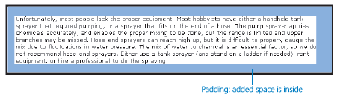
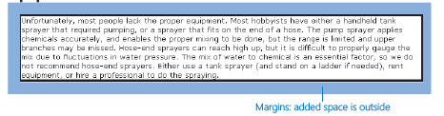

Slide 108
By default, margin and padding attributes apply to all four sides of an element, but you can add -top, -right, -bottom, or -left arguments to restrict the formatting to one or more specific sides.
p style="padding-left: 10px; padding-top: 5px; padding-bottom: 5px}
You can use either pixels (px) or percentage (%) as the unit of measure. For example, the following line indents the first line of a paragraph by 10 percent of its total width:
<p style="text-indent: 10%">
To apply the same formatting using a style sheet, specify the following rule:
p {text-indent: 10%}

Slide 109
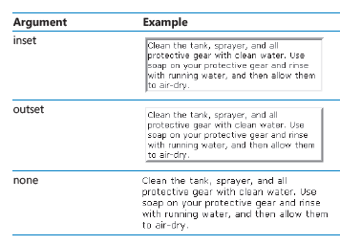
Applying a Border to a Paragraph
Specifying a Border Style

Slide 110
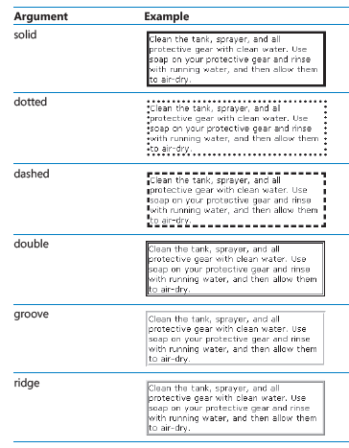

Slide 111
To apply a border style to an individual instance of a tag, use the following:
<p style="border-style: solid">
To apply the same formatting using a style sheet, specify the following rule:
p {border-style: solid}

Slide 112
Setting Border Padding
A border encloses the element very tightly by default. You will usually want to add a little more spacing. Create the spacing using the padding attribute. To apply padding using a style sheet, specify the following rule:
p {border-style: solid; padding: 15px}
To apply the same formatting to an individual instance of a tag, use the following:
<p style="border-style: solid; padding: 15px">

Slide 113
Specifying Border Width and Color
By default, a border is black and 4 pixels wide. To change these attributes, use the bordercolor and border-width attributes. For example, to decrease the border width and color it blue using a style sheet, write a rule like this:
p {border-style: solid; border-width: 2px; border-color: blue}
To apply the same formatting to an individual instance of a tag, use this:
<p style="border-style: solid; border-width: 2px; border-color: blue">

Slide 114
Formatting Border Sides Individually
For example, to set a color other than black for the top border using a style sheet, use the following:
p {border-style: solid; border-top-color: blue}
To apply the same formatting to an individual instance of a tag, use this:
<p style="border-style: solid; border-top-color: blue">

Slide 115
You can use this technique not only with border-color, but with style, padding, and width attributes as well. For example, the following rule applies a dotted line and 15 pixels of padding to only the top and bottom of a paragraph:
<p style="border-top-style: dotted; border-bottom-style: dotted; padding-top: 15px; padding-bottom: 15px">
Here’s how the rendered paragraph looks:

Slide 116
Setting All Border Attributes at Once
A similar shortcut lets you specify border attributes for all four sides at once. Use the border attribute, and then specify all the settings together in the following order: size, color, style.
<p style="border: 2px green solid">

Slide 117
Specifying the Horizontal Alignment of a Paragraph

Slide 118
p {text-indent: 20px; padding-left: 20px; text-indent: 20px; text-align: justify}

Slide 119
Specifying Vertical Space within a Paragraph
p {line-height: 150%}
To specify the same formatting in an individual tag, use the following:
<p style="line-height: 150%">

