Slide 1
Unit 1

Slide 2
sampling with example
Data sampling is a statistical analysis technique used to select, manipulate and analyze a representative subset of data points in order to identify patterns and trends in the larger data set being examined.
Sampling allows data scientists, predictive modelers and other data analysts to work with a small, manageable amount of data in order to build and run analytical models more quickly, while still producing accurate findings.
Sampling can be particularly useful with data sets that are too large to efficiently analyze in full -- for example, in big data analytics applications.

Slide 3
There are many different methods for drawing samples from data, depending on the data set and situation.
Sampling can be based on probability, an approach that uses random numbers that correspond to points in the data set .
This approach ensures that there is no correlation between points that are chosen for the sample.

Slide 4
Example:
A search engine receives a stream of queries, and it would like to study the behavior of typical user.
Suppose a user has issued search queries one time in the past month, d search queries twice, and no search queries more than twice. If we have a 1/10th sample, of queries, we shall see in the sample for that user an expected s/10 of the search queries issued once. Of the d search queries issued twice, only d/100 will appear twice in the sample; that fraction is d times the probability that both occurrences of the query will be in the 1/10th sample. Of the queries that appear twice in the full stream, 18d/100 will appear exactly once.

Slide 5
To see why, note that 18/100 is the probability that one of the two occurrences will be in the 1/10th of the stream that is selected, while the other is in the 9/10th that is not selected.The correct answer to the query about the fraction of repeated searches is d/(s+d). However, the answer we shall obtain from the sample is d/(10s+19d).

Slide 6
Web data and its analytics
Web analytics is the measurement, collection, analysis and reporting of web data for purposes of understanding and optimizing web usage.
However, Web analytics is not just a process for measuring web traffic but can be used as a tool for business and market research, and to assess and improve the effectiveness of a website. Web analytics applications can also help companies measure the results of traditional print or broadcast advertising campaigns.

Slide 7
It helps one to estimate how traffic to a website changes after the launch of a new advertising campaign. Web analytics provides information about the number of visitors to a website and the number of page views. It helps gauge traffic and popularity trends which is useful for market research.

Slide 8
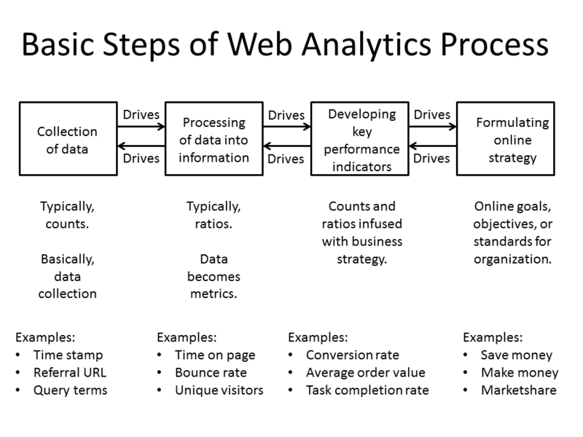

Slide 9
Basic Steps of Web Analytics Process
Most web analytics processes down to four essential stages or steps, which are:
Collection of data: This stage is the collection of the basic, elementary data. Usually, this data is counts of things. The objective of this stage is to gather the data.
Processing of data into information: This stage usually take counts and make them ratios, although there still may be some counts. The objective of this stage is to take the data and conform it into information, specifically metrics.

Slide 10
Developing KPI: This stage focuses on using the ratios (and counts) and infusing them with business strategies, referred to as Key Performance Indicators (KPI). Many times, KPIs deal with conversion aspects, but not always. It depends on the organization.
Formulating online strategy: This stage is concerned with the online goals, objectives, and standards for the organization or business. These strategies are usually related to making money, saving money, or increasing marketshare.

Slide 11
Web analytics technologies
There are at least two categories of web analytics; off-site and on-site web analytics.
Off-site web analytics refers to web measurement and analysis regardless of whether you own or maintain a website. It includes the measurement of a website's potential audience (opportunity), share of voice (visibility), and buzz (comments) that is happening on the Internet as a whole.

Slide 12
On-site web analytics, the most common, measure a visitor's behavior once on your website. This includes its drivers and conversions; for example, the degree to which different landing pages are associated with online purchases. On-site web analytics measures the performance of your website in a commercial context.
This data is typically compared against key performance indicators for performance, and used to improve a website or marketing campaign's audience response. Google Analytics and Adobe Analytics are the most widely used on-site web analytics service; although new tools are emerging that provide additional layers of information, including heat maps and session replay

Slide 13
Processing tools for analytics of big data
1. Hadoop
Hadoop is one of the top frameworks in use today. So prevalent is it, that it has almost become synonymous with Big Data. But you already know about Hadoop, and MapReduce, and its ecosystem of tools and technologies including Pig, and Hive, and Flume, and HDFS. And all the others. Hadoop was first out of the gate, and enjoyed (and still does enjoy) widespread adoption in industry.

Slide 14
Flink
Apache Flink is a streaming dataflow engine, aiming to provide facilities for distributed computation over streams of data. Treating batch processes as a special case of streaming data, Flink is effectively both a batch and real-time processing framework, but one which clearly puts streaming first.

Slide 15
Flink has an impressive set of additional features, including:
High Performance & Low Latency
Support for Event Time and Out-of-Order Events
Exactly-once Semantics for Stateful Computations
Continuous Streaming Model with Backpressure
Fault-tolerance via Lightweight Distributed Snapshots

Slide 16
Storm
Apache Storm is a distributed real-time computation system, whose applications are designed as directed acyclic graphs.
Storm is designed for easily processing unbounded streams, and can be used with any programming language. It has been benchmarked at processing over one million tuples per second per node, is highly scalable, and provides processing job guarantees.

Slide 17
Five characteristics which make Storm ideal for real-time processing workloads are :
Fast - benchmarked as processing one million 100 byte messages per second per node
Scalable - with parallel calculations that run across a cluster of machines
Fault-tolerant - when workers die, Storm will automatically restart them. If a node dies, the worker will be restarted on another node.
Reliable - Storm guarantees that each unit of data (tuple) will be processed at least once or exactly once. Messages are only replayed when there are failures.
Easy to operate - standard configurations are suitable for production on day one. Once deployed, Storm is easy to operate.

Slide 18
Samza
Finally, Apache Samza is another distributed stream processing framework. Samza is built on Apache Kafka for messaging and YARN for cluster resource management. Its website provides the following overview of Samza:
Simple API: Unlike most low-level messaging system APIs, Samza provides a very simple callback-based “process message” API comparable to MapReduce.
Managed state: Samza manages snapshotting and restoration of a stream processor’s state. When the processor is restarted, Samza restores its state to a consistent snapshot. Samza is built to handle large amounts of state (many gigabytes per partition).
Fault tolerance: Whenever a machine in the cluster fails, Samza works with YARN to transparently migrate your tasks to another machine.

Slide 19
Durability: Samza uses Kafka to guarantee that messages are processed in the order they were written to a partition, and that no messages are ever lost.
Scalability: Samza is partitioned and distributed at every level. Kafka provides ordered, partitioned, replayable, fault-tolerant streams. YARN provides a distributed environment for Samza containers to run in.
Pluggable: Though Samza works out of the box with Kafka and YARN, Samza provides a pluggable API that lets you run Samza with other messaging systems and execution environments.
Processor isolation: Samza works with Apache YARN, which supports Hadoop’s security model, and resource isolation through Linux CGroup

Slide 20
Fuzzy logic
Fuzzy logic is a form of many-valued logic in which the truth values of variables may be any real number between 0 and 1.
It is employed to handle the concept of partial truth, where the truth value may range between completely true and completely false.
By contrast, in Boolean logic, the truth values of variables may only be the integer values 0 or 1.

Slide 21
Humans and animals often operate using fuzzy evaluations in many everyday situations. In the case where someone is tossing an object into a container from a distance, the person does not compute exact values for the object weight, density, distance, direction, container height and width, and air resistance to determine the force and angle to toss the object. Instead the person instinctively applies quick "fuzzy" estimates, based upon previous experience, to determine what output values of force, direction and vertical angle to use to make the toss

Slide 22
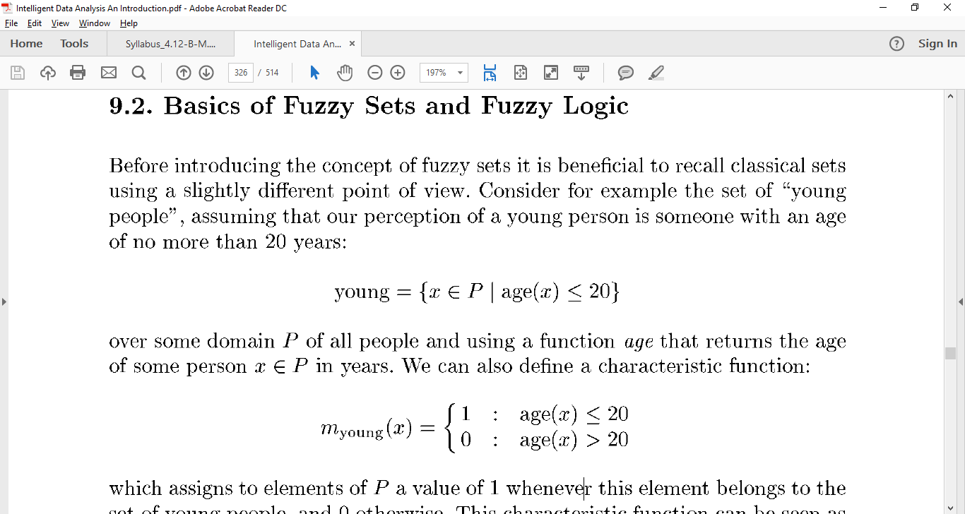

Slide 23
Fuzzy model for data set
In fuzzy set theory , the grade of membership of a value x to a set S is defined through a membership function ji(x) that can take a value in the range [0, 1].

Slide 24
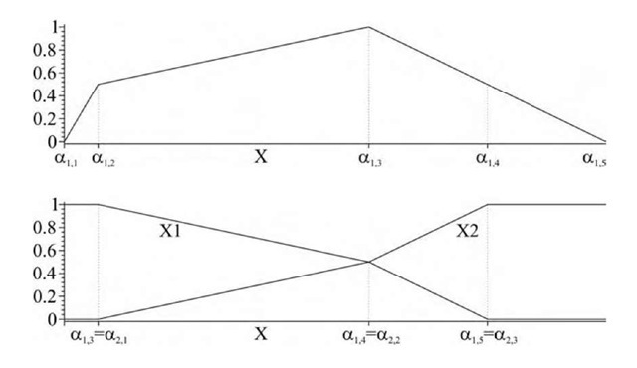

Slide 25
Pros and cons of FDT
Fuzzy Decision Trees Fuzzy decision trees (FDT) are particularly interesting for data mining and information retrieval because they enable the user to take into account imprecise descriptions of the cases, or heterogeneous values (symbolic, numerical, or fuzzy).
Moreover, they are appreciated for their interpretability, because they provide a linguistic description of the relations between descriptions of the cases and decision to make or class to assign.

Slide 26
Pros
Fuzzy decision trees (FDTs) benefit from the inductive learning approach that underpins their construction, to aid in the classification of objects based on their values over different attribute.
Their construction in a fuzzy environment allows for the potential critical effects of imprecision to be mitigated, as well as brings a beneficial level of interpretability to the results found, through the decision rules defined.

Slide 27
Cons
As with the more traditional ‘crisp’ decision tree approaches, there are issues such as the complexity of the results, in this case the tree defined.
Future trends will surely include how FDTs can work on re-grading the complexity of the tree constructed, commonly known as pruning. Further, the applicability of the rules constructed, should see the use of FDTs extending in the range of applications it can work with.

Slide 28
Regression Modelling
Regression is a data mining function that predicts a number. Age, weight, distance, temperature, income, or sales could all be predicted using regression techniques. For example, a regression model could be used to predict children's height, given their age, weight, and other factors.

Slide 29
A regression task begins with a data set in which the target values are known. For example, a regression model that predicts children's height could be developed based on observed data for many children over a period of time. The data might track age, height, weight, developmental milestones, family history, and so on. Height would be the target, the other attributes would be the predictors, and the data for each child would constitute a case.

Slide 30
Application
Regression modeling has many applications in trend analysis, business planning, marketing, financial forecasting, time series prediction, biomedical and drug response modeling, and environmental modeling.

Slide 31
Time series
A time series is a series of data points indexed (or listed or graphed) in time order. Most commonly, a time series is a sequence taken at successive equally spaced points in time.
Thus it is a sequence of discrete-time data.
Examples of time series are heights of ocean tides, counts of sunspots
Time series analysis comprises methods for analyzing time series data in order to extract meaningful statistics and other characteristics of the data.
Time series forecasting is the use of a model to predict future values based on previously observed values.

Slide 32
Neural network
A neural network consists of an interconnected group of artificial neurons, and it processes information using a connectionist approach to computation. In most cases a neural network is an adaptive system that changes its structure during a learning phase.
Neural networks are used to model complex relationships between inputs and outputs or to find patterns in data.
In an artificial neural network, simple artificial nodes, called “neurons“, “neurodes”, “processing elements” or “units”, are connected together to form a network which mimics a biological neural network.

Slide 33
In modern software implementations of artificial neural networks, the approach inspired by biology has been largely abandoned for a more practical approach based on statistics and signal processing. In some of these systems, neural networks or parts of neural networks (such as artificial neurons) are used as components in larger systems that combine both adaptive and non-adaptive elements.

Slide 34
Resampling
Resampling generates a unique sampling distribution on the basis of the actual data. The method of resampling uses experimental methods, rather than analytical methods, to generate the unique sampling distribution. The method of resampling yields unbiased estimates as it is based on the unbiased samples of all the possible results of the data studied by the researcher.

Slide 35
Principal component analysis (PCA)
Principal component analysis (PCA) is a statistical procedure that uses an orthogonal transformation to convert a set of observations of possibly correlated variables into a set of values of linearly uncorrelated variables called principal components (or sometimes, principal modes of variation).
The number of principal components is less than or equal to the smaller of the number of original variables or the number of observations.

Slide 36
In information processing such as pattern recognition, data compression and coding, image processing, high-resolution spectrum analysis, and adaptive beamforming, feature extraction or feature selection is necessary to deal with the large storage of raw data.
Feature extraction is a dimensionality-reduction technique, mapping high-dimensional patterns onto a lower-dimensional space by extracting the most prominent features using orthogonal transforms. The extracted features do not have any physical meaning.

Slide 37
Stochastic search model
Stochastic optimization (SO) methods are optimization methods that generate and use random variables.
For stochastic problems, the random variables appear in the formulation of the optimization problem itself, which involve random objective functions or random constraints.
Stochastic optimization methods also include methods with random iterates. Some stochastic optimization methods use random iterates to solve stochastic problems, combining both meanings of stochastic optimization.

Slide 38
Whether the goal is refining the design of a missile or aircraft, determining the effectiveness of a new drug, developing the most efficient timing strategies for traffic signals, or making investment decisions in order to increase profits, stochastic algorithms can help researchers and practitioners devise optimal solutions to countless real-world problems.

Slide 39
Big data platform
Big data platform is a type of IT solution that combines the features and capabilities of several big data application and utilities within a single solution.
It is an enterprise class IT platform that enables organization in developing, deploying, operating and managing a big data infrastructure environment.

Slide 40
Hadoop provides a cost effective storage solution for business.
It facilitates businesses to easily access new data sources and tap into different types of data to produce value from that data.
It is a highly scalable storage platform.
Unique storage method of Hadoop is based on a distributed file system that basically ‘maps’ data wherever it is located on a cluster. The tools for data processing are often on the same servers where the data is located, resulting in much faster data processing.

Slide 41
Hadoop is now widely used across industries, including finance, media and entertainment, government, healthcare, information services, retail, and other industries
Hadoop is fault tolerance. When data is sent to an individual node, that data is also replicated to other nodes in the cluster, which means that in the event of failure, there is another copy available for use.
Hadoop is more than just a faster, cheaper database and analytics tool. It is designed as a scale-out architecture that can affordably store all of a company’s data for later use.

Slide 42
Report generation
A report generator is a computer program whose purpose is to take data from a source such as a database, XML stream or a spreadsheet, and use it to produce a document in a format which satisfies a particular human readership.
Report generation functionality is almost always present in database systems, where the source of the data is the database itself.

Slide 43
Difference between reporting and analytics
Reporting is “the process of organizing data into informational summaries in order to monitor how different areas of a business are performing.”
Measuring core metrics and presenting them — whether in an email, a slidedeck, or online dashboard — falls under this category.
Analytics is “the process of exploring data and reports in order to extract meaningful insights, which can be used to better understand and improve business performance.”
Reporting provides you with information, analytics give you insights. Reporting raises questions, analytics attempts to answer them.

Slide 44
Working of Report Generator
The Report Generator utility is used to create reports for applications and processes running in the system.
The generated reports include dump files and event logs for the selected application or process. Usually, this information is required to analyse the application's behaviour and you may need to send it to the application developers so that they can investigate the problem and find a solution faster.

Slide 45
how to generate reports using the Report Generator and includes the following items
Introducing Report Generator
Describes the basic concepts of working with the Report Generator.
Working With the Report Generator
Contains a step-by-step instruction on how to create a report for the desired application or process using the Report Generator.
Report Generator Pages
This section describes the pages of the Report Generator wizard in detail.
Report Generator - System Requirements
Describes the Report Generator’s system requirements.
Report Generator Command Line
Describes how you can work with the Report Generator from the command line.

Slide 46
Prediction and statistical interference
Inference: Given a set of data you want to infer(conclude (something) from evidence and reasoning) how the output is generated as a function of the data.
Prediction: Given a new measurement, you want to use an existing data set to build a model that reliably chooses the correct identifier from a set of outcomes.
Indeed, one possible description of statistics is that it provides a means of transferring knowledge about a sample of a population to the whole population, and to other related populations, which is not necessarily the same as prediction over time.

Slide 47
In many applications, such as time series analysis, it is possible to estimate the models that generate the observations.
To use regression analysis for prediction, data are collected on the variable that is to be predicted, called the dependent variable or response variable, and on one or more variables whose values are hypothesized to influence it, called independent variables or explanatory variables.

Slide 48
Learning
Supervised learning is the task of inferring a function from labeled training data. The training data consist of a set of training examples. In supervised learning, each example is a pair consisting of an input object and a desired output value. A supervised learning algorithm analyzes the training data and produces an inferred function, which can be used for mapping new examples.

Slide 49
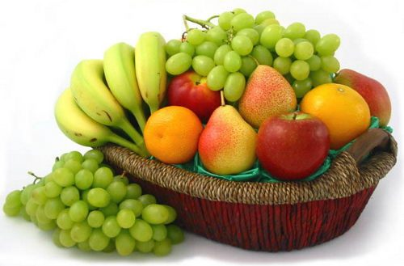

Slide 50
suppose you had a basket and it is fulled with some different kinds of fruits, your task is to arrange them as groups.
For understanding let me clear the names of the fruits in our basket.
We have four types of fruits. They are: apple, banana, grape and cherry.

Slide 51
SUPERVISED LEARNING :
You already learn from your previous work about the physical characters of fruits.
So arranging the same type of fruits at one place is easy now.
Your previous work is called as training data in data mining.
so you already learn the things from your train data, this is because of response variable.
Response variable mean just a decision variable.
You can observe response variable below (FRUIT NAME) .

Slide 52
NO. | SIZE | COLOR | SHAPE | FRUIT NAME
1 | Big | Red | Rounded shape with a depression at the top | Apple
2 | Small | Red | Heart-shaped to nearly globular | Cherry
3 | Big | Green | Long curving cylinder | Banana
4 | Small | Green | Round to oval, Bunch shape Cylindrical | Grape

Slide 53
Suppose you have taken an new fruit from the basket then you will see the size , color and shape of that particular fruit.
If size is Big , color is Red , shape is rounded shape with a depression at the top, you will conform the fruit name as apple and you will put in apple group.
Likewise for other fruits also.
Job of groping fruits was done and happy ending.
You can observe in the table that a column was labeled as “FRUIT NAME” this is called as response variable.
If you learn the thing before from training data and then applying that knowledge to the test data(for new fruit), This type of learning is called as Supervised Learning.
Classification come under Supervised learning.

Slide 54
UNSUPERVISED LEARNING
Suppose you had a basket and it is fulled with some different types fruits, your task is to arrange them as groups.
This time you don’t know any thing about that fruits, honestly saying this is the first time you have seen them.
so how will you arrange them.
What will you do first???
You will take a fruit and you will arrange them by considering physical character of that particular fruit. suppose you have considered color.
Then you will arrange them on considering base condition as color.

Slide 55
Then the groups will be some thing like this.
RED COLOR GROUP: apples & cherry fruits.
GREEN COLOR GROUP: bananas & grapes.
so now you will take another physical character such as size .
RED COLOR AND BIG SIZE: apple.
RED COLOR AND SMALL SIZE: cherry fruits.
GREEN COLOR AND BIG SIZE: bananas.
GREEN COLOR AND SMALL SIZE: grapes.
job done happy ending.
Here you didn’t know learn any thing before ,means no train data and no response variable.
This type of learning is know unsupervised learning.

Slide 56
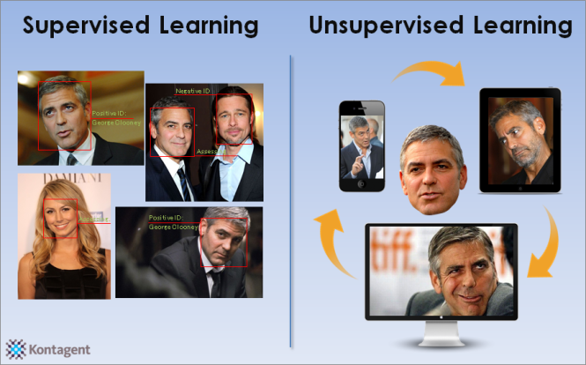

Slide 57
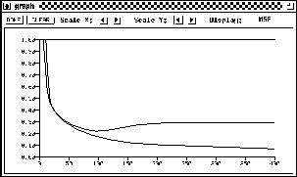
Generalization of Neural Networks

Slide 58
One of the major advantages of neural nets is their ability to generalize. This means that a trained net could classify data from the same class as the learning data that it has never seen before. In real world applications developers normally have only a small part of all possible patterns for the generation of a neural net. To reach the best generalization, the dataset should be split into three parts:
The training set is used to train a neural net. The error of this dataset is minimized during training.
The validation set is used to determine the performance of a neural network on patterns that are not trained during learning.
A test set for finally checking the over all performance of a neural net.

