Slide 1
Unit 1 – Chapter 1
Introduction

Slide 2
History
Java history is interesting to know. The history of java starts from Green Team. Java team members (also known as Green Team), initiated a revolutionary task to develop a language for digital devices such as set-top boxes, televisions etc.
For the green team members, it was an advance concept at that time. But, it was suited for internet programming. Later, Java technology as incorporated by Netscape.
Currently, Java is used in internet programming, mobile devices, games, e-business solutions etc.

Slide 3
There are given the major points that describe the history of java.
James Gosling, Mike Sheridan, and Patrick Naughton initiated the Java language project in June 1991. The small team of sun engineers called Green Team.
Originally designed for small, embedded systems in electronic appliances like set-top boxes.
Firstly, it was called "Greentalk" by James Gosling and file extension was .gt.
After that, it was called Oak and was developed as a part of the Green project.

Slide 4
Why "Oak" name
Oak is a symbol of strength and chosen as a national tree of many countries like U.S.A., France, Germany, Romania etc.
In 1995, Oak was renamed as "Java" because it was already a trademark by Oak Technologies.

Slide 5
Why "Java" name
The team gathered to choose a new name. The suggested words were "dynamic", "revolutionary", "Silk", "jolt", "DNA" etc. They wanted something that reflected the essence of the technology: revolutionary, dynamic, lively, cool, unique, and easy to spell and fun to say.
According to James Gosling "Java was one of the top choices along with Silk. Since java was so unique, most of the team members preferred java.
Java is an island of Indonesia where first coffee was produced (called java coffee).
Notice that Java is just a name not an acronym.
Originally developed by James Gosling at Sun Microsystems (which is now a subsidiary of Oracle Corporation) and released in 1995.
In 1995, Time magazine called Java one of the Ten Best Products of 1995.
JDK 1.0 released in(January 23, 1996).

Slide 6
Difference between Java and C++
Java is pure object oriented programming language. We can't design and develop our programs and applications without object. | C++ is semi object oriented language b'coz we can design and develop our programs and applications, with and without object.
Java is Dynamic, Java allocates memory at run-time. | C++ is static, C++ allocates memory at compile-time.
Java doesn't support pointers, goto statement, operator overloading, templates, etc. | C++ does support pointers, goto statement, operator overloading, templates.
Java doesn't support multiple inheritance. Java uses interface for multiple inheritance. | C++ does support multiple inheritance.

Slide 7
Java supports automatic garbage collection. Java does not support destructors as C++ does. | C++ does support destructors, which is automatically invoked when the object goes out of scope.
Java does not support default argument value. | C++ does support default argument value.
Java has built in support for threads. | C++ has no built in support for threads. Instead, c++ relies entirely upon the operating system to provide this threads.
Java compiler converts source code into byte code, which is platform independent. | C++ generates object code and the same code may not run on different platforms.

Slide 8
Java Version History
There are many java versions that has been released. Current stable release of Java is Java SE 8.
JDK Alpha and Beta (1995)
JDK 1.0 (23rd Jan, 1996)
JDK 1.1 (19th Feb, 1997)
J2SE 1.2 (8th Dec, 1998)
J2SE 1.3 (8th May, 2000)
J2SE 1.4 (6th Feb, 2002)
J2SE 5.0 (30th Sep, 2004)
Java SE 6 (11th Dec, 2006)
Java SE 7 (28th July, 2011)
Java SE 8 (18th March, 2014)

Slide 9
Features of Java
Simple
Object-Oriented
Portable
Platform independent
Secured
Robust
Architecture neutral
Dynamic
Interpreted
High Performance
Multithreaded
Distributed

Slide 10
JDK, JRE and JVM
JRE
JRE is an acronym for Java Runtime Environment.
It is used to provide runtime environment.
It contains set of libraries + other files

Slide 11
JDK
JDK is an acronym for Java Development Kit. It physically exists. It contains JRE + development tools.
Javac, java

Slide 12
JVM
A Java virtual machine (JVM) is a virtual machine that enables a computer to run Java programs as well as programs written in other languages that are also compiled to Java bytecode.
JVMs are available for many hardware and software platforms

Slide 13
The JVM performs following operation:
Loads code
Verifies code
Executes code
Provides runtime environment

Slide 14
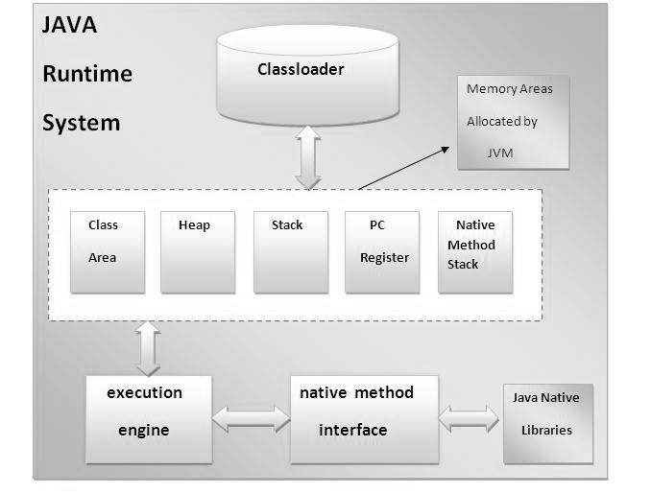
Internal Architecture of JVM

Slide 15
1) Classloader
Classloader : load class files.
2) Class(Method) Area
method data, the code for methods.
3) Heap
objects are allocated.
4) Stack
holds local variables.

Slide 16
5) Program Counter Register
It is a register. It contains the address of the Java virtual machine instruction currently being executed.
6) Native Method Stack
Java method written in another language like C.
7) Execution Engine
It contains:
A virtual processor
Interpreter
Just-In-Time (JIT) compiler: It is used to improve the performance. This is a component which helps the program execution to happen faster.
Once the byte code is recompiled by JIT compiler, the execution time needed will be much lesser.

Slide 17
What happens at compile time?
At compile time, java file is compiled by Java Compiler (It does not interact with OS) and converts the java code into bytecode.

Slide 18
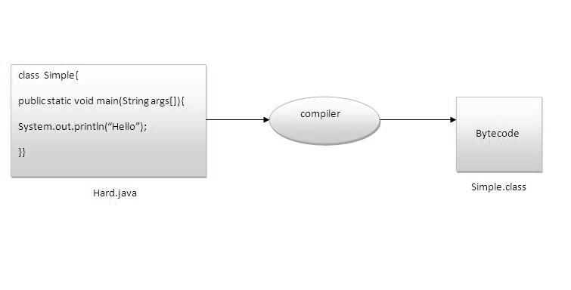
Can you save a java source file by other name than the class name?
To compile: | javac Hard.java
To execute: | java Simple

Slide 19
Path variable is set for use all the tools like java, javac, javap, javah, jar, appletviewer etc.
Example: "C:\Program Files\Java\jdk1.6.0\bin"
Classpath variable is used to set the path for all classes which is used in our program so we set classpath upto rj.jar. in rt.jar file all the .class files are present. When we decompressed rt.jar file we get all .class files.
Example
"C:\Program Files\Java\jre1.6.0\jre\lib\rt.jar"

Slide 20
Java Platform
Java Card: A technology that allows small Java-based applications (applets) to be run securely on smart cards and similar small-memory devices.
Java ME (Micro Edition): Specifies several different sets of libraries (known as profiles) for devices with limited storage, display, and power capacities. It is often used to develop applications for mobile devices, PDAs, TV set-top boxes, and printers.
Java SE (Standard Edition): For general-purpose use on desktop PCs, servers and similar devices.
Java EE (Enterprise Edition): Java SE plus various APIs which are useful for multi-tier client–server enterprise applications.

Slide 21
Basic Syntax
Case Sensitivity
Class Names − For all class names the first letter should be in Upper Case.
Method Names − All method names should start with a Lower Case letter.
Program File Name − Name of the program file should exactly match the class name.
public static void main(String args[]) − Java program processing starts from the main() method which is a mandatory part of every Java program.
variable name-- should start with lowercase letter e.g. firstName, orderNumber etc.
package name -- should be in lowercase letter e.g. java, lang, sql, util etc.
interface name-- should start with uppercase letter

Slide 22
Java Identifiers
All Java components require names. Names used for classes, variables, and methods are called identifiers. In Java, there are several points to remember about identifiers. They are as follows −
All identifiers should begin with a letter (A to Z or a to z), currency character ($) or an underscore (_).
A key word cannot be used as an identifier.
Examples of legal identifiers: age, $salary, _value, __1_value.
Examples of illegal identifiers: 123abc, -salary.

Slide 23
Java Applications
Desktop GUI Applications
Mobile Applications
Embedded Systems
Web Applications
Web Servers and Application Servers
Enterprise Applications
Scientific Applications

Slide 24
TYPES OF JAVA STATEMENTS
//declaration statement
int number;
//expression statement
number = 4;
//control flow statement
if (number < 10 )
{
System.out.println(number + " is less than ten");
}

Slide 25
Java Main Method

Slide 26
White Space in Java
Syntax: boolean isWhitespace(char ch)
Return Value
This method returns true, if the passed character is really a white space.

Slide 27
Example
public class Test
{
public static void main(String args[])
{
System.out.println(Character.isWhitespace('c'));
System.out.println(Character.isWhitespace(' '));
System.out.println(Character.isWhitespace('\n'));
System.out.println(Character.isWhitespace('\t'));
}
}
This will produce the following result −
Output
false
true
true
true

Slide 28
Keywords
abstract | Continue | for | new | switch
assert | default | goto | package | synchronized
boolean | Do | if | private | this
break | double | implements | protected | throw
byte | Else | import | public | throws
case | Enum | instanceof | return | transient
catch | extends | int | short | Try
char | Final | interface | static | void
class | finally | long | strictfp | volatile
const | Float | native | super | while

Slide 29
Java Comments
Types of Java Comments
There are 2 types of comments in java.
Single Line Comment
Multi Line Comment

Slide 30
Java Single Line Comment
The single line comment is used to comment only one line.
Syntax:
// : This is single line comment
Example:
public class CommentExample1
{
public static void main(String[] args)
{
int i=10; //Here, i is a variable
System.out.println(i);
}
}

Slide 31
Multi Line Comment
The multi line comment is used to comment multiple lines of code.
Syntax:
/* This is multi line comment
*/
Example:
public class CommentExample2
{
public static void main(String[] args)
{
/* Let's declare and
print variable in java. */
int i=10;
System.out.println(i);
}
}

Slide 32
Braces in Java
One: Opening Curly Braces on the Same Line:
Two: Opening Curly Braces on a Separate Line

Slide 33
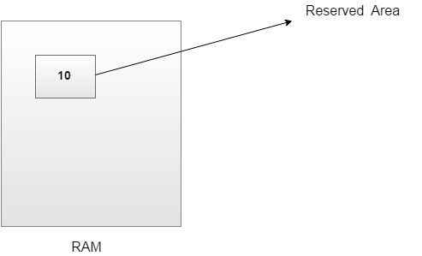
Variables in Java

Slide 34
Types of Variable
There are three types of variables in java:
local variable
instance variable
static variable

Slide 35
Local Variables:
A variable which is declared inside the method is called local variable.

Slide 36
2) Instance Variable
A variable which is declared inside the class but outside the method, is called instance variable . It is not declared as static.

Slide 37
3) Static variable
A variable that is declared as static is called static variable. It cannot be local.

Slide 38
Parameter Variable
Variable declared inside a method.

Slide 39
Example
class Abc
{
int a=5; // instance variable
static int f=8; // static variable
void display(int a) // parameter variable
{
int y=6; // local variable
.
.
.
.
}
}

Slide 40
Static and final both are the keywords used in Java. The static member can be accessed before the class object is created. ... Final keyword is used to declare, a constant variable, a method which can not be overridden and a class that can not be inherited.

Slide 41
Abstract class | Interface
1) Abstract class can have abstract and non-abstract methods. | Interface can have only abstract methods. Since Java 8, it can have default and static methods also.
2) Abstract class doesn't support multiple inheritance. | Interface supports multiple inheritance.
3) Abstract class can have final, non-final, static and non-static variables. | Interface has only static and final variables.
4) Abstract class can provide the implementation of interface. | Interface can't provide the implementation of abstract class.
5) The abstract keyword is used to declare abstract class. | The interface keyword is used to declare interface.
6) An abstract classcan extend another Java class and implement multiple Java interfaces. | An interface can extend another Java interface only.
7) An abstract classcan be extended using keyword "extends". | An interface classcan be implemented using keyword "implements".
8) A Java abstract class can have class members like private, protected, etc. | Members of a Java interface are public by default.
9)Example: public abstract class Shape{ public abstract void draw(); } | Example: public interface Drawable{ void draw(); }

Slide 42
Lambda Expressions
Lambda expression is a new and important feature of Java which was included in Java SE 8.
Lambda expression provides implementation of functional interface. An interface which has only one abstract method is called functional interface.
Less coding.

Slide 43
(argument-list) -> {body}
Java lambda expression is consisted of three components.
1) Argument-list: It can be empty or non-empty as well.
2) Arrow-token: It is used to link arguments-list and body of expression.
3) Body: It contains expressions and statements for lambda expression.

Slide 44
Java Example without Lambda Expression
interface Drawable {
public void draw();
}
public class LambdaExpressionExample
{
public static void main(String[] args) {
int width=10;
Drawable d=new Drawable()
{
public void draw()
{
System.out.println("Drawing "+width);
} };
d.draw();
} }
Output:
Drawing 10

Slide 45
Java Example with Lambda Expression
interface Drawable
{
public void draw();
}
public class LambdaExpressionExample
{
public static void main(String[] args)
{
int width=10;
//with lambda
Drawable d2=()->
{
System.out.println("Drawing "+width);
};
d2.draw();
} }
Output:
Drawing 10

Slide 46
Java Method References
Java provides a new feature called method reference in Java 8.
Each time when you are using lambda expression to just referring a method, you can replace your lambda expression with method reference.

Slide 47
Types of Method References
There are three types of method references:
Reference to a static method.
Reference to an instance method of a particular object.
Reference to a constructor.

Slide 48
1) Reference to a Static Method
Syntax : ClassName::staticMethodName

Slide 49
interface Sayable
{
void say();
}
public class MethodReference
{
public static void saySomething()
{
System.out.println("Hello, this is static method.");
}
public static void main(String[] args)
{
// Referring static method
Sayable abc = MethodReference::saySomething;
// Calling interface method
abc.say();
} }

Slide 50
2) Reference to an Instance Method
Syntax
ClassObject::classMethodName

Slide 51
interface Abc
{
void say();
}
public class Xyz
{
public void methodA ()
{
System.out.println("Hello, this is non-static method.");
}
public static void main(String[] args)
{
Xyz hello= new Xyz();
Abc obj1 = hello:: methodA;
obj1.say();
} }
Output:
Hello, this is non-static method.

Slide 52
3) Reference to a Constructor
Syntax: ClassName::new

Slide 53
interface Messageable
{
Message getMessage(String msg);
}
class Message
{
public Message(String msg)
{
System.out.print(msg);
} }
public class ConstructorReference
{
public static void main(String[] args)
{
Messageable hello = Message::new;
hello.getMessage("Hello");
} }
Output:
Hello

Slide 54
Java Compiler and Interpreter
No | Compiler | Interpreter
1 | Compiler Takes Entire program as input | Interpreter Takes Single instruction as input.
2 | Intermediate Object Code is Generated | No Intermediate Object Code is Generated
3 | Conditional Control Statements are Executes faster | Conditional Control Statements are Executes slower
4 | Memory Requirement : More(Since Object Code is Generated) | Memory Requirement is Less
5 | Program need not be compiled every time | Every time higher level program is converted into lower level program
6 | Errors are displayed after entire program is checked | Errors are displayed for every instruction interpreted (if any)
7 | Example : C Compiler | Example : BASIC

