Slide 1
Unit 1 – Chapter 2
Data Types

Slide 2
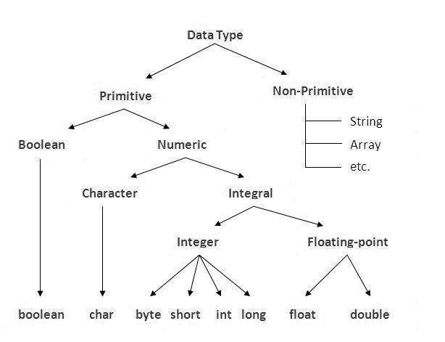
Data Types

Slide 3
Data Type | Default size
Boolean | 1 bit
Char | 2 byte
Byte | 1 byte
Short | 2 byte
Int | 4 byte
Long | 8 byte
Float | 4 byte
Double | 8 byte

Slide 4
Java Variable Example: Add Two Numbers
class Simple
{
public static void main(String[] args)
{
int a=10;
int b=10;
int c=a+b;
System.out.println(c);
}}
Output:
20

Slide 5
Java Literals
A value assigning to a variable which is going to be fixed and will not change is known as literal.
Example:
int a=5; // 5 is a literal value for a
int a; // not a literal because value will change

Slide 6
Object Reference Types
Consider This Example –
Rectangle r1 = new Rectangle();
Rectangle r2 = r1;
r1 is reference variable which contain the address of Actual Rectangle Object.
r2 is another reference variable
r2 is initialized with r1 means – “r1 and r2” both are referring same object , thus it does not create duplicate object , nor does it allocate extra memory.

Slide 7
Strings
String is a sequence of characters, for e.g. “Hello” is a string of 5 characters.
Creating a String
There are two ways to create a String in Java
String literal
Using new keyword

Slide 8
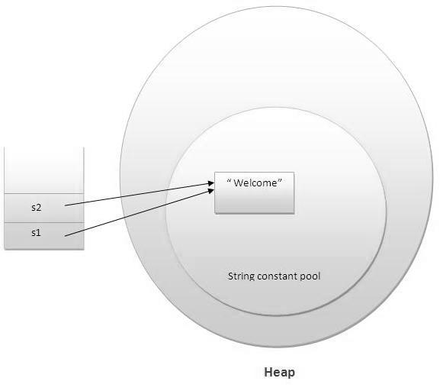
String literal
String str1 = "Welcome";
String str2 = "Welcome"; //will not create new instance

Slide 9
Using New Keyword
String str1 = new String("Welcome");
String str2 = new String("Welcome");

Slide 10
public class Example
{
public static void main(String args[])
{
String str = “world"; //creating a string by java string literal
char arrch[]={'h','e','l','l','o'};
String str2 = new String(arrch); //converting char array arrch[] to string str2
String str3 = new String("Java String Example");
System.out.println(str);
System.out.println(str2);
System.out.println(str3);
}}
Output:
world
hello
Java String Example

Slide 11
Java String Methods
Java String toUpperCase() and toLowerCase() method
String s="Sachin";
System.out.println(s.toUpperCase());//SACHIN
System.out.println(s.toLowerCase());//sachin
System.out.println(s); //Sachin(no change in original)

Slide 12
Java String trim() method
The string trim() method eliminates white spaces before and after string.
String s=" Sachin ";
System.out.println(s); // Sachin
System.out.println(s.trim()); //Sachin

Slide 13
Java String startsWith() and endsWith() method
String s="Sachin";
System.out.println(s.startsWith("Sa"));//true
System.out.println(s.endsWith("n"));//true

Slide 14
Java String charAt() method
String s="Sachin";
System.out.println(s.charAt(0));//S
System.out.println(s.charAt(3));//h

Slide 15
Java String length() method
String s="Sachin";
System.out.println(s.length());//6

Slide 16
Java String intern() method
String s=new String("Sachin");
String s2=s.intern();
System.out.println(s2);//Sachin

Slide 17
Java String valueOf() method
public class Test
{
public static void main(String args[])
{
Integer x =Integer.valueOf(9);
Double c = Double.valueOf(5);
Float a = Float.valueOf("80");
System.out.println(x);
System.out.println(c);
System.out.println(a);
} }
Output
9
5.0
80.0

Slide 18
Java String replace() method
String s1="Java is a programming language.";
String replaceString=s1.replace("Java","Kava"); //replaces all occurrences of "Java" to "Kava"
System.out.println(replaceString);

Slide 19
Type Casting
Widening Casting(Implicit)
Narrowing Casting(Explicitly done)

Slide 20
Widening or Automatic type conversion Example :
public class Test
{
public static void main(String[] args)
{
int i = 100;
long l = i;
float f = l;
System.out.println("Int value "+i);
System.out.println("Long value "+l);
System.out.println("Float value "+f);
} }
Output :
Int value 100
Long value 100
Float value 100.0

Slide 21
Narrowing or Explicit type conversion
public class Test
{
public static void main(String[] args)
{
double d = 100.04;
long l = (long)d; //explicit type casting required
int i = (int)l; //explicit type casting required
System.out.println("Double value "+d);
System.out.println("Long value "+l);
System.out.println("Int value "+i);
} }
Output :
Double value 100.04
Long value 100
Int value 100

Slide 22
Auto Boxing and Unboxing
many data structures in Java operate on objects. So you cannot use primitive data types with those data structures. To handle such type of situations, Java provides type Wrappers which provide classes that encapsulate a primitive type within an object.
The automatic conversion of primitive data types into its equivalent Wrapper type is known as boxing and opposite operation is known as unboxing. This is the new feature of Java5. So java programmer doesn't need to write the conversion code.

Slide 23
Benefits of Autoboxing / Unboxing
Autoboxing / Unboxing lets us use primitive types and Wrapper class objects interchangeably.
We don't have to perform Explicit typecasting.
It helps prevent errors, but may lead to unexpected results sometimes. Hence must be used with care.
Auto-unboxing also allows you to mix different types of numeric objects in an expression. When the values are unboxed, the standard type conversions can be applied.

Slide 24
Simple Example of Autoboxing in java:
class BoxingExample1
{
public static void main(String args[])
{
int a=50;
Integer a2=new Integer(a);//Boxing
Integer a3=5; //Boxing
System.out.println(a2+" "+a3);
}
}
Output:50 5

Slide 25
Simple Example of Unboxing in java:
class UnboxingExample1
{
public static void main(String args[])
{
Integer i=new Integer(50);
int a=i;
System.out.println(a);
}
}
Output: 50

Slide 26
Operators
Arithmetic operators
Relation operators
Logical operators
Bitwise operators
Assignment operators
Conditional operators
Misc operators

Slide 27
Arithmetic operators
Operator | Description
+ | adds two operands
- | subtract second operands from first
* | multiply two operand
/ | divide numerator by denominator
% | remainder of division
++ | Increment operator increases integer value by one
-- | Decrement operator decreases integer value by one

Slide 28
Java Arithmetic Operator Example
class OperatorExample
{
public static void main(String args[])
{
int a=10;
int b=5;
System.out.println(a+b); //15
System.out.println(a-b); //5
System.out.println(a*b); //50
System.out.println(a/b); //2
System.out.println(a%b); //0
}}
Output:
15
5
50
2
0

Slide 29
Relation operators
Operator | Description
== | Check if two operand are equal
!= | Check if two operand are not equal.
> | Check if operand on the left is greater than operand on the right
< | Check operand on the left is smaller than right operand
>= | check left operand is greater than or equal to right operand
<= | Check if operand on left is smaller than or equal to right operand

Slide 30
public class Test
{
public static void main(String args[])
{
int a = 10;
int b = 20;
System.out.println("a == b = " + (a == b) );
System.out.println("a != b = " + (a != b) );
System.out.println("a > b = " + (a > b) );
System.out.println("a < b = " + (a < b) );
System.out.println("b >= a = " + (b >= a) );
System.out.println("b <= a = " + (b <= a) );
}}
Output
a == b = false
a != b = true
a > b = false
a < b = true
b >= a = true
b <= a = false

Slide 31
Logical operators
Operator | Description | Example
&& | Logical AND | (a && b) is false
|| | Logical OR | (a || b) is true
! | Logical NOT | (!a) is false

Slide 32
Bitwise operators
Operator | Description
& | Bitwise AND
| | Bitwise OR
^ | Bitwise exclusive OR
>> | left shift
<< | right shift

Slide 33
A | B | a & b | a | b | a ^ b
0 | 0 | 0 | 0 | 0
0 | 1 | 0 | 1 | 1
1 | 0 | 0 | 1 | 1
1 | 1 | 1 | 1 | 0

Slide 34
Example
a = 0001000
b = 2
a << b = 0100000 right shift
a >> b = 0000010 left shift

Slide 35
Assignment Operators
Operator | Example
= | a = b
+= | a+=b is same as a=a+b
-= | a-=b is same as a=a-b
*= | a*=b is same as a=a*b
/= | a/=b is same as a=a/b
%= | a%=b is same as a=a%b

Slide 36
Misc operator
Conditional operator
epr1 ? expr2 : expr3
If epr1 Condition is true? Then value expr2 : Otherwise value expr3

Slide 37
Java Ternary Operator Example
class OperatorExample
{
public static void main(String args[])
{
int a=2;
int b=5;
int min=(a<b)?a:b;
System.out.println(min);
}}
Output:
2

Slide 38
Types of Increment and Decrement Operator
Pre Increment / Pre Decrement Operator
Post Increment / Post Decrement Operator
Syntax :
++ Increment operator : increments a value by 1
-- Decrement operator : decrements a value by 1

Slide 39
x++ is called post increment // firstly it will print then increase the value by 1. ++x is called pre increment // firstly it will increase the value by 1 then print.
Increment operators can be prefix X=42; Y=++x; Result X=43 Y=43 Increment operators can be postfix X=42; Y=x++; Result x=43 Y=42

Slide 40
class OperatorExample
{
public static void main(String args[])
{
int a=10;
int b=5;
int c=20;
System.out.println(a>b||a<c); //true || true = true
System.out.println(a>b|a<c); /true | true = true
System.out.println(a>b||a++<c); //true || true = true
System.out.println(a); //10
System.out.println(a>b|a++<c); //true | true = true
System.out.println(a); //11
}}

