Slide 1
Unit 2: Chapter 2
Cooling

Slide 2
Cooling Costs
Some estimates state that cooling can account for upward of 63 percent of your IT department’s power usage.
Electricity is paid for per kilowatt-hour (kWh). This is a measure of the hourly consumption of electrical power.
Let’s use a basic electrical device—the household incandescent light bulb—to determine how much electricity costs.
A 100-watt (W) bulb uses 100 watt-hours of electricity in 60 minutes. As such, ten 100 W light bulbs will use a total of 1 kWh of electricity per hour.

Slide 3
Causes of Cost
Increased power consumption as more servers and storage devices are deployed.
• Increased heat density in the racks because of increased computing power in a confined space.
Irregular heat load in the datacenter.
Increasing power costs
A tendency to overcool datacenters.

Slide 4
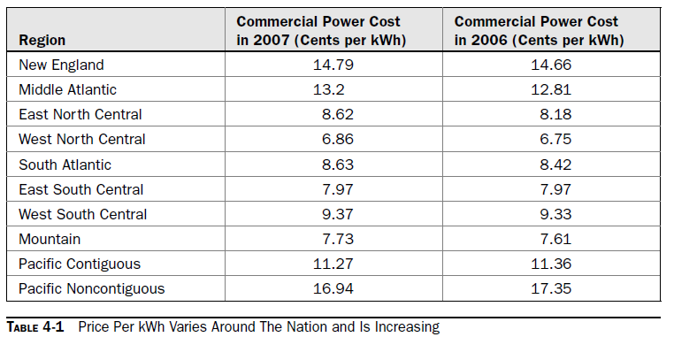

Slide 5
Room Size
All the equipment in your server room generates heat. So does the lighting. And so do the people working there. All these sources of heat contribute to the heat load of the server room. Typically this number is expressed in British Thermal Units (BTUs) or kW. One kilowatt is the same as 3412 BTUs.
In order for your air conditioner to cool a room, its output must be greater than the heat load

Slide 6
The room itself requires cooling. To calculate the cooling needs of the room, use this formula:
Room Area BTU = Length (meters(m)) × Width (m) × 337

Slide 7
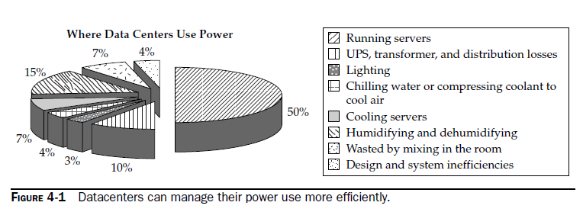

Slide 8
Reducing Cooling Costs
Economizers:
You can save a lot of money if you are able to put Mother Nature to work for you.
In a lot of the country, winter provides you with an opportunity to enhance your cooling system by using the cold outside air to cool things down.
But it isn’t as simple as opening a window to accomplish this. To do so, you need to employ what is called an economizer. There are two types: air-side economizers and waterside economizers.

Slide 9
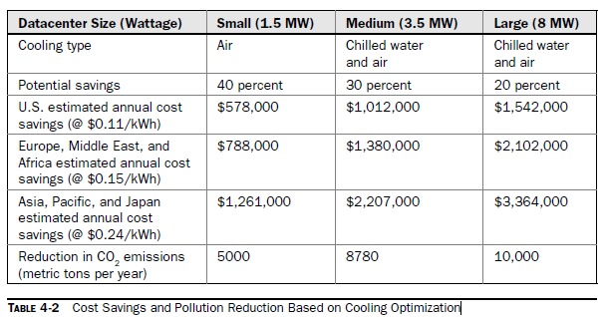
Air
An air-side economizer regulates the use of outside air for cooling a room or a building. It employs sensors, ducts, and dampers to regulate the amount of cool air brought in.

Slide 10
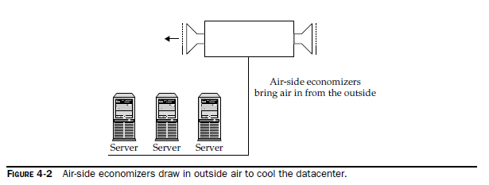
The sensors measure air temperature both inside and outside the building. If it notices that the outside air is suitably cold enough to cool the datacenter, it will adjust its dampers to draw in the outside air, making it the main source of cooling.

Slide 11
Fluid
A water-side economizer utilizes evaporative cooling (usually provided by cooling towers) to indirectly produce chilled water to cool a datacenter when outdoor conditions are cool (often at night).
Water-side economizers are especially beneficial, because not only do they save costs, but they don’t allow contaminants or altered humidity levels into the datacenter.

Slide 12
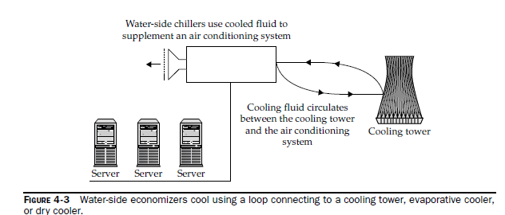

Slide 13
Optimizing Airflow
Air exchange is important. To deliver the precise cooling environment, air must be exchanged at a sufficient rate. Normal office environments must change air over twice an hour. In high-density datacenters, air has to be exchanged 50 times an hour. If enough air is not exchanged, cooling air will heat up before it reaches the equipment, and disaster could occur.

Slide 14
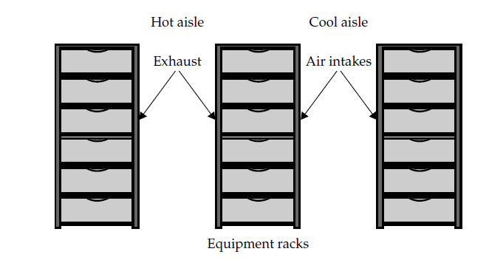
Hot Aisle/Cold Aisle

Slide 15
Raised Floors
Datacenters are conventionally built on a floor that is raised 18 to 36 inches. The higher the floor level, the more air that can be distributed under the floor and the more air that can be used by the cooling system.
Cable Management
Vapor Seal: If you have a poor vapor barrier, humidity will move into the datacenter during hot months and escape during the winter months.

Slide 16
Prevent Recirculation of Equipment Exhaust
1. Hot-aisle/cool aisle Employ the hot-aisle/cool-aisle design mentioned earlier in this chapter.
2. Rigid enclosures Build rigid enclosures to keep exhaust heat from being sucked back into the device’s cool air intakes.
3. Flexible strip curtains Use flexible strip curtains to block the open air above your racks that have been configured into a hot-aisle/cool-aisle layout.

Slide 17
4. Block unused rack locations with blanks Equipment typically draws in cool air from the front and exhausts it out the back. Blanking open areas under equipment prevents the exhaust from being drawn back into the device.
5. Design with cooling in mind Although most do, some equipment does not draw air in from the front and exhaust it out the back. Some have top-discharge or side to- side designs. Configure your racks to ensure your equipment doesn’t blow into the intake of other equipment.
6. Select racks with good airflow Buy racks that don’t have an internal structure that would block the smooth flow of air to your equipment.

Slide 18
Supply Air Directly to Heat Sources.
Fans
Humidity
Adding Cooling: Fluid Considerations
System Design: Closed systems are good for small solutions, assuming there is adequate ventilation if the system fails.
Datacenter Design
Centralized Control: This sort of system offers several benefits over the prevalent multiple-distributed unit system. Better efficiency., Less maintenance is required.

Slide 19
