Slide 1
Unit 2
MapReduce

Slide 2
Introduction
MapReduce is a framework using which we can write applications to process huge amounts of data, in parallel, on large clusters of commodity hardware in a reliable manner.

Slide 3
What is MapReduce?
MapReduce is a distributed computing based on java.
It contains Map and Reduce.
Map takes a set of data and converts it into another set of data, where individual elements are broken down into tuples (key/value pairs).
Secondly, reduce task, which takes the output from a map as an input and combines those data tuples into a smaller set of tuples.

Slide 4
Advantages
easy to scale
Decomposing a data processing application into mappers and reducers
simple scalability

Slide 5
The Algorithm
MapReduce program executes in three stages, namely map stage, shuffle stage, and reduce stage.

Slide 6
Map stage − The map or mapper’s job is to process the input data. Generally the input data is in the form of file or directory and is stored in the Hadoop file system (HDFS). The input file is passed to the mapper function line by line. The mapper processes the data and creates several small chunks of data.

Slide 7
Reduce stage − This stage is the combination of the Shuffle stage and the Reduce stage. The Reducer’s job is to process the data that comes from the mapper. After processing, it produces a new set of output, which will be stored in the HDFS.

Slide 8
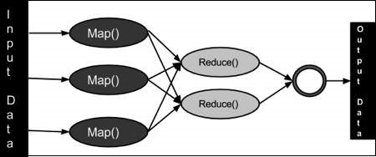

Slide 9
During a MapReduce job, Hadoop sends the Map and Reduce tasks to the appropriate servers in the cluster.
The framework manages all the details of data-passing such as issuing tasks, verifying task completion, and copying data around the cluster between the nodes.
Most of the computing takes place on nodes with data on local disks that reduces the network traffic.
After completion of the given tasks, the cluster collects and reduces the data to form an appropriate result, and sends it back to the Hadoop server.

Slide 10
Terminology
PayLoad − Applications implement the Map and the Reduce functions, and form the core of the job.
Mapper − Mapper maps the input key/value pairs to a set of intermediate key/value pair.
NamedNode − Node that manages the Hadoop Distributed File System (HDFS).
DataNode − Node where data is presented in advance before any processing takes place.
MasterNode − accepts job requests from clients.

Slide 11
SlaveNode − Node where Map and Reduce program runs.
JobTracker − Schedules jobs and tracks the assign jobs to Task tracker.
Task Tracker − Tracks the task and reports status to JobTracker.
Job − A program is an execution of a Mapper and Reducer across a dataset.
Task − An execution of a Mapper or a Reducer on a slice of data.
Task Attempt − A particular instance of an attempt to execute a task on a SlaveNode.

Slide 12
Grouping by Key
the key-value pairs are grouped by key, and the values
The grouping is performed by the system.
The master controller process knows how many Reduce tasks there will be, say r such tasks.
Then the master controller picks a hash function that applies to keys and produces a bucket number from 0 to r − 1.

Slide 13
That is, for each key k, the input to the Reduce task that handles key k is a pair of the form (k, [v1, v2, . . . ,vn]), where (k, v1), (k, v2), . . . , (k, vn) are all the key-value pairs with key k coming from all the Map tasks.

Slide 14
The Reduce Tasks
The Reduce function’s argument is a pair consisting of a key and its list of associated values.
The output of the Reduce function is a sequence of zero or more key-value pairs.

Slide 15
A Reduce task receives one or more keys and their associated value lists.
The outputs from all the Reduce tasks are merged into a single file.

Slide 16
Combiner
The Combiner class is used in between the Map class and the Reduce class to reduce the volume of data transfer between Map and Reduce. Usually, the output of the map task is large and the data transferred to the reduce task is high.

Slide 17
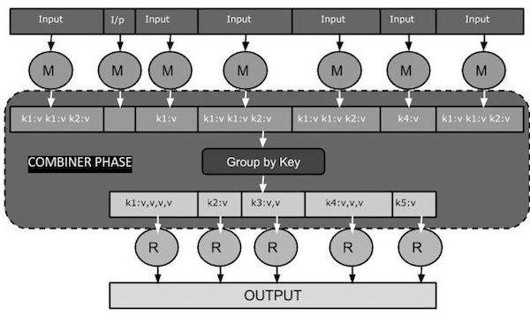

Slide 18
How Combiner Works?
A combiner does not have a predefined interface and it must implement the Reducer interface’s reduce() method.
A combiner operates on each map output key. It must have the same output key-value types as the Reducer class.
A combiner can produce summary information from a large dataset because it replaces the original Map output.

Slide 19
MapReduce Combiner Implementation
The following example provides a theoretical idea about combiners. Let us assume we have the following input text file named input.txt for MapReduce.
What do you mean by Object
What do you know about Java
What is Java Virtual Machine
How Java enabled High Performance

Slide 20
Record Reader
This is the first phase of MapReduce where the Record Reader reads every line from the input text file as text and yields output as key-value pairs.
Input − Line by line text from the input file.
Output − Forms the key-value pairs. The following is the set of expected key-value pairs.

Slide 21
<1, What do you mean by Object>
<2, What do you know about Java>
<3, What is Java Virtual Machine>
<4, How Java enabled High Performance>

Slide 22
Map Phase
The Map phase takes input from the Record Reader, processes it, and produces the output as another set of key-value pairs.
Input − The following key-value pair is the input taken from the Record Reader.
<1, What do you mean by Object>
<2, What do you know about Java>
<3, What is Java Virtual Machine>
<4, How Java enabled High Performance>

Slide 23
The Map phase reads each key-value pair, divides each word from the value using StringTokenizer, treats each word as key and the count of that word as value.
Output − The expected output is as follows −
<What,1> <do,1> <you,1> <mean,1> <by,1> <Object,1>
<What,1> <do,1> <you,1> <know,1> <about,1> <Java,1>
<What,1> <is,1> <Java,1> <Virtual,1> <Machine,1>
<How,1> <Java,1> <enabled,1> <High,1> <Performance,1>

Slide 24
Combiner Phase
The Combiner phase takes each key-value pair from the Map phase, processes it, and produces the output as key-value collection pairs.
Input − The following key-value pair is the input taken from the Map phase.

Slide 25
Output − The expected output is as follows −
<What,1,1,1> <do,1,1> <you,1,1> <mean,1> <by,1> <Object,1>
<know,1> <about,1> <Java,1,1,1>
<is,1> <Virtual,1> <Machine,1>
<How,1> <enabled,1> <High,1> <Performance,1>

Slide 26
Coping With Node Failures
The worst thing that can happen is that the compute node at which the Master is executing fails.
In this case, the entire MapReduce job must be restarted.
But only this one node can bring the entire process down.
All the Map tasks that were assigned to this Worker will have to be redone, even if they had completed.

Slide 27
The Master sets the status of each of these Map tasks to idle.
Dealing with a failure at the node of a Reduce worker is simpler.

Slide 28
Union and Intersection
Suppose relations R and S have the same schema
– Map tasks will be assigned chunks from either R or S
– Mappers don’t do much, just pass by to reducers
– Reducers do duplicate elimination
A MapReduce implementation of Union
Map: For each tuple t in R or S, emit a key/value pair (t, t)
Reduce: For each key t, emit a key/value pair (t, t) Note: each key will have either one or two values

Slide 29
Intersection
Very similar to computing Union
– Suppose relations R and S have the same schema
– The map function is the same (an identity mapper) as for union
– The reduce function must produce a tuple only if both relations have that tuple
A MapReduce implementation of Intersection
Map: For each tuple t in R or S, emit a key/value pair (t, t)
Reduce: If key t has value list [t, t], emit a key/value pair (t, t) Otherwise, emit a key/value pair (t, NULL)

Slide 30
Difference
Assume we have two relations R and S with the same schema
– The only way a tuple t can appear in the output is if it is in R but not in S
– The map function can pass tuples from R and S to the reducer
– NOTE: it must inform the reducer whether the tuple came from R or S
A = {1, 2, 3, 4, 5} and B = {3, 4, 5, 6, 7, 8}, the difference A - B = {1, 2 }.

Slide 31
Computing Natural Join by MapReduce
Natural join R S
– Given two relations, compare each pair of tuples, one from each relation
– If the tuples agree on all the attributes common to both schema " produce an output tuple that has components on each attribute
– Otherwise produce nothing
– Join condition can be on a subset of attributes

Slide 32
Below, we have part of a relation called Links describing the structure of the Web
– There are two attributes: From and To
– A row, or tuple, of the relation is a pair of URLs, indicating the existence of a link between them
– The number of tuples in a real dataset is in the order of billions (10^9)

Slide 33
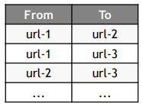
Question: find the paths of length two in the Web

Slide 34
Informally, to satisfy the query we must:
– find the triples of URLs in the form (u,v,w) such that there is a link from u to v and a link from v
Using the join operator
– Imagine we have two relations (with different schemas), and let’s try to apply the natural join operator
– There are two copies of Links: L1(U1, U2) and L2(U2, U3)
– Let’s compute L1 L2
For each tuple t1 of L1 and each tuple t2 of L2, see if their U2 component are the same
If yes, then produce a tuple in output, with the schema (U1,U2,U3) to w

Slide 35
Grouping and Aggregation by MapReduce
Grouping and Aggregation: γX (R)
– Given a relation R, partition its tuples according to their values in one set of attributes G
The set G is called the grouping attributes
– Then, for each group, aggregate the values in certain other attributes
Aggregation functions: SUM, COUNT, AVG, MIN, MAX, ...

Slide 36
Let’s work with an example
– Imagine that a social-networking site has a relation Friends(User, Friend)
– The tuples are pairs (a, b) such that b is a friend of a
– Question: compute the number of friends each member has

Slide 37
How to satisfy the query γUser, COUNT(Friend))(Friends)
– This operation groups all the tuples by the value in their first component " There is one group for each user
– Then, for each group, it counts the number of friends

Slide 38
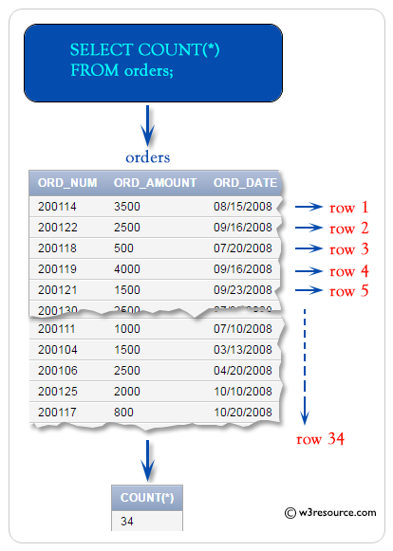

Slide 39
Matrix Multiplication with One MapReduce Step
There often is more than one way to use MapReduce to solve a problem. You may wish to use only a single MapReduce pass to perform matrix multiplication P = MN.
The keys will be pairs (i, k), where i is a row of M and k is a column of N. Here is a synopsis of the Map and Reduce functions.
The Map Function: For each element mij of M, produce all the key-value pairs (i, k), (M, j,mij )_ for k = 1, 2, . . ., up to the number of columns of N. Similarly, for each element njk of N, produce all the key-value pairs (i, k), (N, j, njk)_ for i = 1, 2, . . ., up to the number of rows of M.

Slide 41
The reduce( ) step in the MapReduce Algorithm for matrix multiplication

Slide 42
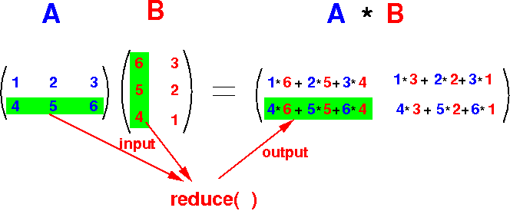

Slide 43
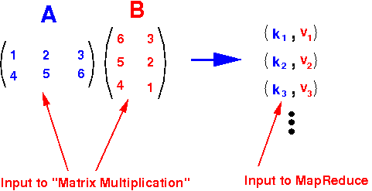

Slide 44
Recursive Extensions to MapReduce
That computation is simple. The computation of the fixed point of a matrix-vector multiplication.
The iteration typically continues for an unknown number of steps, each step being a MapReduce job, until the results of two consecutive iterations are sufficiently close that we believe convergence has occurred.

Slide 45
Workflow Systems
A master controller is responsible for dividing the work among the tasks that implement a function, usually by hashing the input elements to decide on the proper task to receive an element.
Thus, like Map tasks, each task implementing a function f has an output file of data destined for each of the tasks that implement the successor function(s) off.

