Slide 1
Unit 2 - Chapter 1
Control Flow Statements

Slide 2
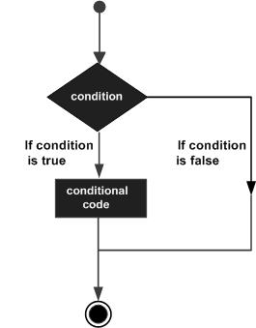

Slide 3
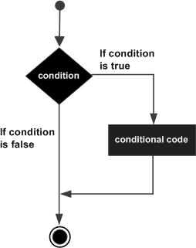
if statement

Slide 4
public class Test
{
public static void main(String args[])
{
int x = 10;
if( x < 20 )
{
System.out.print("This is if statement");
}
}
}

Slide 5
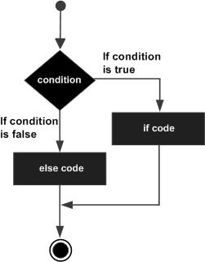
if-else statement

Slide 6
public class Test
{
public static void main(String args[])
{
int x = 30;
if( x < 20 )
{
System.out.print("This is if statement");
}
else
{
System.out.print("This is else statement");
}
}
}

Slide 7
The if...else if...else Statement
public class Test
{
public static void main(String args[])
{
int x = 30;
if( x == 10 )
{
System.out.print("Value of X is 10");
}
else if( x == 20 )
{
System.out.print("Value of X is 20");
}
else if( x == 30 )
{
System.out.print("Value of X is 30");
}
Else
{
System.out.print("This is else statement");
} } }

Slide 8
nested if statement
public class Test
{
public static void main(String args[])
{
int x = 30;
int y = 10;
if( x == 30 )
{
if( y == 10 )
{
System.out.print("X = 30 and Y = 10");
}
}
}
}

Slide 9
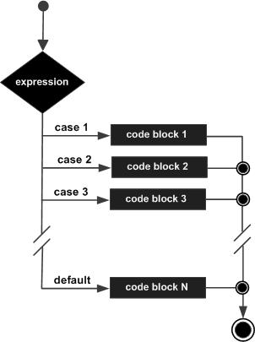
switch statement

Slide 10
public class Test {
public static void main(String args[]) {
char grade = 'C';
switch(grade) {
case 'A' :
System.out.println("Excellent!");
break;
case 'B' :
case 'C' :
System.out.println("Well done");
break;
case 'D' :
System.out.println("You passed");
case 'F' :
System.out.println("Better try again");
break;
default :
System.out.println("Invalid grade");
}
System.out.println("Your grade is " + grade);
}}

