Slide 1
Unit 2 – Chapter 2
ITERATIONS

Slide 2
Looping statements are the statements execute one or more statement repeatedly several number of times. In java programming language there are three types of loops; while, for and do-while.

Slide 3
Advantage with looping statement
Reduce length of Code
Take less memory space.
Burden on the developer is reducing.
Time consuming process to execute the program is reduced.

Slide 4
While loop
In while loop first check the condition if condition is true then control goes inside the loop body otherwise goes outside of the body. while loop will be repeats in clock wise direction.

Slide 5
Syntax
while(condition)
{
Statement(s)
Increment / decrements (++ or --);
}

Slide 6
Example while loop
class whileDemo
{
public static void main(String args[])
{
int i=0;
while(i<5)
{
System.out.println(i);
i++;
}
Output
0
1
2
3
4

Slide 7
for loop
for loop is a statement which allows code to be repeatedly executed. For loop contains 3 parts Initialization, Condition and Increment or Decrements

Slide 8
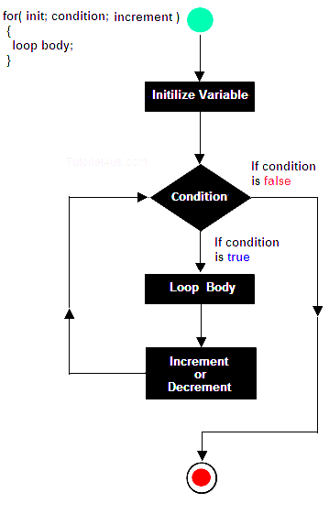

Slide 9
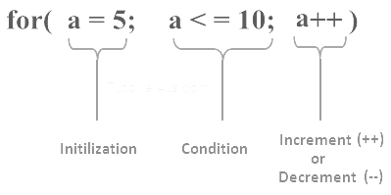
Syntax
for ( initialization; condition; increment )
{
statement(s);
}

Slide 10
class Hello
{
public static void main(String args[])
{
int i;
for (i=0: i<5; i++)
{
System.out.println("Hello Friends !");
}} }
Output
Hello Friends !
Hello Friends !
Hello Friends !
Hello Friends !
Hello Friends !

Slide 11
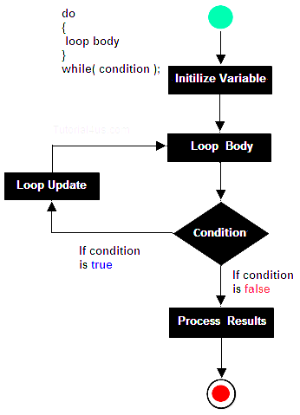
do-while
A do-while loop is similar to a while loop, except that a do-while loop is execute at least one time.

Slide 12
Syntax
do
{
Statement(s)
increment/decrement (++ or --)
}while();

Slide 13
class dowhileDemo
{
public static void main(String args[])
{
int i=20;
do
{
System.out.println("Hello world !");
i++;
}
while(i<10);
}}
Output
Hello world !

Slide 14
Break statement
The break statement in Java programming language has the following two usages −
When the break statement is encountered inside a loop, the loop is immediately terminated and the program control resumes at the next statement following the loop.

Slide 15
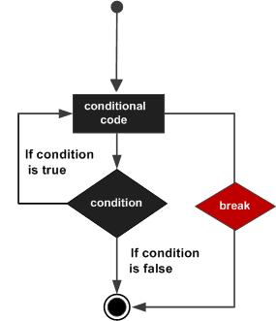
Syntax
The syntax of a break is a single statement inside any loop −
break;

Slide 16
public class Test
{
public static void main(String args[])
{
int [] numbers = {10, 20, 30, 40, 50};
for(int x : numbers )
{
if( x == 30 ) {
break;
}
System.out.print( x );
System.out.print("\n");
} } }
This will produce the following result −
Output
10
20

Slide 17
Continue statement
The continue keyword can be used in any of the loop control structures. It causes the loop to immediately jump to the next iteration of the loop.

Slide 18
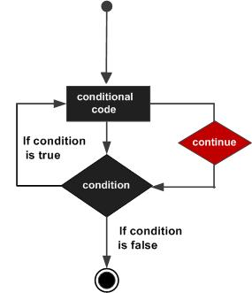
Syntax
The syntax of a continue is a single statement inside any loop −
continue;

Slide 19
public class Test
{
public static void main(String args[]) {
int [] numbers = {10, 20, 30, 40, 50};
for(int x : numbers ) {
if( x == 30 ) {
continue;
}
System.out.print( x );
System.out.print("\n");
}
}
}
This will produce the following result −
Output
10
20
40
50

Slide 20
For-each loop
The for-each loop introduced in Java5. It is mainly used to traverse array or collection elements. The advantage of for-each loop is that it eliminates the possibility of bugs and makes the code more readable.
Advantage of for-each loop:
It makes the code more readable.
It elimnates the possibility of programming errors.

Slide 21
Syntax of for-each loop:
for(data_type variable : array | collection){}

Slide 22
class ForEachExample1
{
public static void main(String args[])
{
int arr[]={12,13,14,44};
for(int i:arr)
{
System.out.println(i);
}
}
}
Output:
12
13
14
44

Slide 23
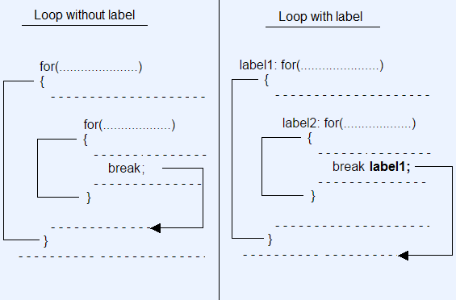
Labelled Loop

Slide 24
Example without labelled loop
class WithoutLabelledLoop
{
public static void main(String args[])
{
int i,j;
for(i=1;i<=10;i++)
{
System.out.println();
for(j=1;j<=10;j++)
{
System.out.print(j + " ");
if(j==5)
break; //Statement 1
} } } }

Slide 25
Output :
1 2 3 4 5
1 2 3 4 5
1 2 3 4 5
1 2 3 4 5
1 2 3 4 5
1 2 3 4 5
1 2 3 4 5
1 2 3 4 5
1 2 3 4 5
1 2 3 4 5

Slide 26
Example with labelled loop
class WithLabelledLoop
{
public static void main(String args[])
{
int i,j;
loop1: for(i=1;i<=10;i++)
{
System.out.println();
loop2: for(j=1;j<=10;j++)
{
System.out.print(j + " ");
if(j==5)
break loop1; //Statement 1
} } } }

Slide 27
Output :
1 2 3 4 5

