Slide 1
Unit 3
JAVASCRIPT

Slide 2
INTRODUCTION
JavaScript is a lightweight, interpreted programming language.
It is complimentary to and integrated with Java. JavaScript is very easy to implement because it is integrated with HTML. It is open and cross-platform.

Slide 3
Why to Learn Javascript
Javascript is the most popular programming language in the world and that makes it a programmer’s great choice. Once you learnt Javascript, it helps you developing great front-end as well as back-end softwares using different Javascript based frameworks like jQuery, Node.JS etc.

Slide 4
Javascript is everywhere, it comes installed on every modern web browser and so to learn Javascript you really do not need any special environment setup. For example Chrome, Mozilla Firefox , Safari and every browser you know as of today, supports Javascript.
Javascript helps you create really beautiful and crazy fast websites. You can develop your website with a console like look and feel and give your users the best Graphical User Experience.

Slide 5
JavaScript usage has now extended to mobile app development, desktop app development, and game development. This opens many opportunities for you as Javascript Programmer.
Due to high demand, there is tons of job growth and high pay for those who know JavaScript. You can navigate over to different job sites to see what having JavaScript skills looks like in the job market.

Slide 6
Great thing about Javascript is that you will find tons of frameworks and Libraries already developed which can be used directly in your software development to reduce your time to market.

Slide 7
There are many useful Javascript frameworks and libraries available:
Angular
React
jQuery
Vue.js
Ext.js
Ember.js
Meteor
Mithril
Node.js
Polymer
Aurelia
Backbone.js

Slide 8
Applications of Javascript Programming
Client side validation - This is really important to verify any user input before submitting it to the server and Javascript plays an important role in validating those inputs at front-end itself.
Manipulating HTML Pages - Javascript helps in manipulating HTML page on the fly. This helps in adding and deleting any HTML tag very easily using javascript and modify your HTML to change its look and feel based on different devices and requirements.
User Notifications - You can use Javascript to raise dynamic pop-ups on the webpages to give different types of notifications to your website visitors.

Slide 9
Back-end Data Loading - Javascript provides Ajax library which helps in loading back-end data while you are doing some other processing. This really gives an amazing experience to your website visitors.
Presentations - JavaScript also provides the facility of creating presentations which gives website look and feel. JavaScript provides RevealJS and BespokeJS libraries to build a web-based slide presentations.
Server Applications - Node JS is built on Chrome's Javascript runtime for building fast and scalable network applications. This is an event based library which helps in developing very sophisticated server applications including Web Servers.

Slide 10
Client-Side JavaScript
Client-side JavaScript is the most common form of the language. The script should be included in or referenced by an HTML document for the code to be interpreted by the browser.
It means that a web page need not be a static HTML, but can include programs that interact with the user, control the browser, and dynamically create HTML content.
The JavaScript client-side mechanism provides many advantages over traditional CGI server-side scripts. For example, you might use JavaScript to check if the user has entered a valid e-mail address in a form field.

Slide 11
Advantages of JavaScript
Less server interaction − You can validate user input before sending the page off to the server. This saves server traffic, which means less load on your server.
Immediate feedback to the visitors − They don't have to wait for a page reload to see if they have forgotten to enter something.
Increased interactivity − You can create interfaces that react when the user hovers over them with a mouse or activates them via the keyboard.
Richer interfaces − You can use JavaScript to include such items as drag-and-drop components and sliders to give a Rich Interface to your site visitors.

Slide 12
Limitations of JavaScript
Client-side JavaScript does not allow the reading or writing of files. This has been kept for security reason.
JavaScript cannot be used for networking applications because there is no such support available.
JavaScript doesn't have any multi-threading or multiprocessor capabilities.

Slide 13
JavaScript Development Tools
Microsoft FrontPage
Macromedia Dreamweaver MX
Macromedia HomeSite 5

Slide 14
Server-Side JavaScript
The extension of JavaScript to the server is made possible via embedded JavaScript engines.
The two most well established engines are SpiderMonkey and Rhino, both currently maintained by the Mozilla Foundation.
SpiderMonkey is the code name for the first ever JavaScript engine, an open source C implementation which can be found embedded in leading software products such as Mozilla Firefox, Adobe Acrobat.
Rhino is a Java implementation of JavaScript which is commonly embedded in Java applications to expose scripting capability.

Slide 15
JavaScript - Syntax
JavaScript can be implemented using JavaScript statements that are placed within the <script>... </script> HTML tags in a web page.
You can place the <script> tags, containing your JavaScript, anywhere within your web page, but it is normally recommended that you should keep it within the <head> tags.
<script ...>
JavaScript code
</script>

Slide 16
Hello World using Javascript
<html>
<body>
<script language = "javascript" type = "text/javascript">
<!--
document.write("Hello World!")
//-->
</script>
</body>
</html>

Slide 17
The script tag takes two important attributes −
Language − This attribute specifies what scripting language you are using. Typically, its value will be javascript.
Type − This attribute is what is now recommended to indicate the scripting language in use and its value should be set to "text/javascript".
<script language = "javascript" type = "text/javascript">
JavaScript code
</script>

Slide 18
Whitespace and Line Breaks
JavaScript ignores spaces, tabs, and newlines that appear in JavaScript programs.
Semicolons are Optional
Simple statements in JavaScript are generally followed by a semicolon character, just as they are in C, C++, and Java.

Slide 19
<script language = "javascript" type = "text/javascript">
<!--
var1 = 10
var2 = 20
//-->
</script>
But when formatted in a single line as follows, you must use semicolons −
<script language = "javascript" type = "text/javascript">
<!--
var1 = 10; var2 = 20;
//-->
</script>
Note − It is a good programming practice to use semicolons.

Slide 20
Case Sensitivity
JavaScript is a case-sensitive language.
So the identifiers Time and TIME will convey different meanings in JavaScript.

Slide 21
Comments in JavaScript
JavaScript supports both C-style and C++-style comments, Thus −
Any text between a // and the end of a line is treated as a comment and is ignored by JavaScript.
Any text between the characters /* and */ is treated as a comment. This may span multiple lines.
JavaScript also recognizes the HTML comment opening sequence <!--. JavaScript treats this as a single-line comment, just as it does the // comment.
The HTML comment closing sequence --> is not recognized by JavaScript so it should be written as //-->.

Slide 22
<script language = "javascript" type = "text/javascript">
<!--
// This is a comment. It is similar to comments in C++
/*
* This is a multi-line comment in JavaScript
* It is very similar to comments in C Programming
*/
//-->
</script>

Slide 23
JavaScript - Objects
JavaScript is an Object Oriented Programming (OOP) language. A programming language can be called object-oriented if it provides four basic capabilities to developers −
Encapsulation − the capability to store related information, whether data or methods, together in an object.
Aggregation − the capability to store one object inside another object.
Inheritance − the capability of a class to rely upon another class (or number of classes) for some of its properties and methods.
Polymorphism − the capability to write one function or method that works in a variety of different ways.

Slide 24
Object Properties
Object properties can be any of the three primitive data types, or any of the abstract data types, such as another object. Object properties are usually variables that are used internally in the object's methods, but can also be globally visible variables that are used throughout the page.
The syntax for adding a property to an object is −
objectName.objectProperty = propertyValue;
For example − The following code gets the document title using the "title" property of the document object.
var str = document.title;

Slide 25
User-Defined Objects
The new Operator
The new operator is used to create an instance of an object. To create an object, the new operator is followed by the constructor method.
In the following example, the constructor methods are Object(), Array(), and Date(). These constructors are built-in JavaScript functions.

Slide 26
var employee = new Object();
var books = new Array("C++", "Perl", "Java");
var day = new Date("August 15, 1947");

Slide 27
Javascript Operators
Syntax:
<Left operand> operator <right operand>
<Left operand> operator

Slide 28
Arithmetic Operators
Operator | Description
+ | Adds two numeric operands.
- | Subtract right operand from left operand
* | Multiply two numeric operands.
/ | Divide left operand by right operand.
% | Modulus operator. Returns remainder of two operands.
++ | Increment operator. Increase operand value by one.
-- | Decrement operator. Decrease value by one.

Slide 29
Arithmatic.txt

Slide 30
Comparison Operators
Operators | Description
== | Compares the equality of two operands without considering type.
=== | Compares equality of two operands with type.
!= | Compares inequality of two operands.
> | Checks whether left side value is greater than right side value. If yes then returns true otherwise false.
< | Checks whether left operand is less than right operand. If yes then returns true otherwise false.
>= | Checks whether left operand is greater than or equal to right operand. If yes then returns true otherwise false.
<= | Checks whether left operand is less than or equal to right operand. If yes then returns true otherwise false.

Slide 31
Comparison.txt

Slide 32
Logical Operators
Operator | Description
&& | && is known as AND operator. It checks whether two operands are non-zero (0, false, undefined, null or "" are considered as zero), if yes then returns 1 otherwise 0.
|| | || is known as OR operator. It checks whether any one of the two operands is non-zero (0, false, undefined, null or "" is considered as zero).
! | ! is known as NOT operator. It reverses the boolean result of the operand (or condition)

Slide 33
Logical.txt

Slide 34
Bitwise Operators
bitwise.txt

Slide 35
Assignment Operators
Assignment operators | Description
= | Assigns right operand value to left operand.
+= | Sums up left and right operand values and assign the result to the left operand.
-= | Subtract right operand value from left operand value and assign the result to the left operand.
*= | Multiply left and right operand values and assign the result to the left operand.
/= | Divide left operand value by right operand value and assign the result to the left operand.
%= | Get the modulus of left operand divide by right operand and assign resulted modulus to the left operand.

Slide 36
assignment.txt

Slide 37
Miscellaneous Operator
Conditional Operator (? :)
The conditional operator first evaluates an expression for a true or false value and then executes one of the two given statements depending upon the result of the evaluation.
ternary.txt

Slide 38
Comma Operator (,) in JavaScript?
The comma operator in JavaScript evaluates each of its operands. It returns the value of the last operand. Add multiple expressions using the comma operator.
The following is the syntax:
expression1,expression2, ……expression
Yes, you can use the comma operator to add multiple parameters in a for loop:
for (var a = 0, b =5; a <= 5; a++, b--)

Slide 39
Delete operator
const Employee = { firstname: 'John', lastname: 'Doe'}
console.log(Employee.firstname);
delete Employee.firstname;
console.log(Employee.firstname);
Output:
> "John"
> undefined

Slide 40
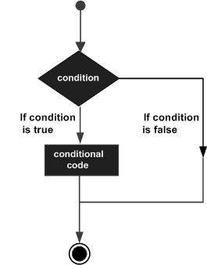
if-else

Slide 41
JavaScript supports the following forms of if..else statement −
if statement
if...else statement
if...else if... statement.

Slide 42
Example
<html> <body>
<script type = "text/javascript">
<!--
var age = 20;
if( age > 18 ) {
document.write("<b>Qualifies for driving</b>");
}
//-->
</script>
<p>Set the variable to different value and then try...</p>
</body></html>
Output
Qualifies for driving
Set the variable to different value and then try...

Slide 43
<html> <body>
<script type = "text/javascript">
<!--
var age = 15;
if( age > 18 ) {
document.write("<b>Qualifies for driving</b>");
} else {
document.write("<b>Does not qualify for driving</b>");
}
//-->
</script>
<p>Set the variable to different value and then try...</p>
</body></html>
Output
Does not qualify for driving
Set the variable to different value and then try...

Slide 44
Html> <body>
<script type = "text/javascript">
<!--
var book = "maths";
if( book == "history" ) {
document.write("<b>History Book</b>");
} else if( book == "maths" ) {
document.write("<b>Maths Book</b>");
} else if( book == "economics" ) {
document.write("<b>Economics Book</b>");
} else {
document.write("<b>Unknown Book</b>");
}
//-->
</script>
<p>Set the variable to different value and then try...</p>
</body> <html>
Output
Maths Book
Set the variable to different value and then try...

Slide 45
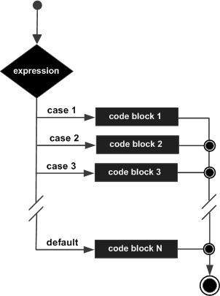
Switch Case

Slide 46
switch.txt

Slide 47
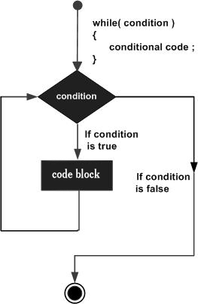
while Loop

Slide 48
<html> <body>
<script type = "text/javascript">
<!--
var count = 0;
document.write("Starting Loop ");
while (count < 10) {
document.write("Current Count : " + count + "<br />");
count++;
}
document.write("Loop stopped!");
//-->
</script>
<p>Set the variable to different value and then try...</p>
</body></html>

Slide 49
Output
Starting Loop
Current Count : 0
Current Count : 1
Current Count : 2
Current Count : 3
Current Count : 4
Current Count : 5
Current Count : 6
Current Count : 7
Current Count : 8
Current Count : 9
Loop stopped!
Set the variable to different value and then try...

Slide 50
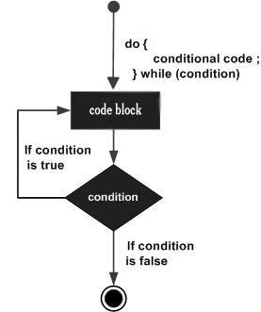
do...while Loop

Slide 51
<html> <body>
<script type = "text/javascript">
<!--
var count = 0;
document.write("Starting Loop" + "<br />");
do {
document.write("Current Count : " + count + "<br />");
count++;
}
while (count < 5);
document.write ("Loop stopped!");
//-->
</script>
<p>Set the variable to different value and then try...</p>
</body></html>

Slide 52
Output
Starting Loop
Current Count : 0
Current Count : 1
Current Count : 2
Current Count : 3
Current Count : 4
Loop Stopped!
Set the variable to different value and then try...

Slide 53
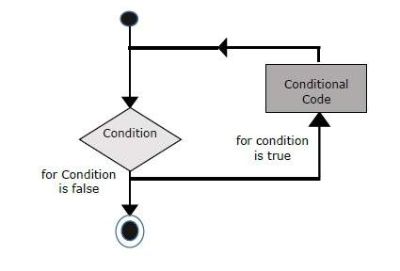
For Loop

Slide 54
<html> <body>
<script type = "text/javascript">
<!--
var count;
document.write("Starting Loop" + "<br />");
for(count = 0; count < 10; count++) {
document.write("Current Count : " + count );
document.write("<br />");
}
document.write("Loop stopped!");
//-->
</script>
<p>Set the variable to different value and then try...</p>
</body></html>

Slide 55
Output
Starting Loop
Current Count : 0
Current Count : 1
Current Count : 2
Current Count : 3
Current Count : 4
Current Count : 5
Current Count : 6
Current Count : 7
Current Count : 8
Current Count : 9
Loop stopped!
Set the variable to different value and then try...

Slide 56
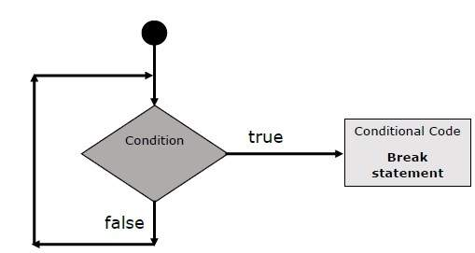
break Statement

Slide 57
<html> <body>
<script type = "text/javascript">
<!--
var x = 1;
document.write("Entering the loop<br /> ");
while (x < 20) {
if (x == 5) {
break; // breaks out of loop completely
}
x = x + 1;
document.write( x + "<br />");
}
document.write("Exiting the loop!<br /> ");
//-->
</script>
<p>Set the variable to different value and then try...</p>
</body> </html>

Slide 58
Live Demo
Output
Entering the loop
2
3
4
5
Exiting the loop!
Set the variable to different value and then try...

Slide 59
continue Statement
<html> <body>
<script type = "text/javascript">
<!--
var x = 1;
document.write("Entering the loop<br /> ");
while (x < 10) {
x = x + 1;
if (x == 5) {
continue; // skip rest of the loop body
}
document.write( x + "<br />");
}
document.write("Exiting the loop!<br /> ");
//-->
</script>
<p>Set the variable to different value and then try...</p>
</body> </html>

Slide 60
Output
Entering the loop
2
3
4
6
7
8
9
10
Exiting the loop!
Set the variable to different value and then try...

Slide 61
Functions
Before we use a function, we need to define it. The most common way to define a function in JavaScript is by using the function keyword, followed by a unique function name, a list of parameters (that might be empty), and a statement block surrounded by curly braces.
<script type = "text/javascript">
<!--
function functionname(parameter-list) {
statements
}
//-->
</script>

Slide 62
Example
<script type = "text/javascript">
<!--
function sayHello() {
alert("Hello there");
}
//-->
</script>

Slide 64
return Statement
A JavaScript function can have an optional return statement. This is required if you want to return a value from a function. This statement should be the last statement in a function.
If a value is included with the return statement, then the function returns that value.
If no value is included with the return statement, then the function returns a null (nothing).

Slide 65
function testMe (Val) {
if (Val < 5)
return (true);
else
return (false);
}

Slide 66
Var
The var statement is used is used to explicitly declare a variable. You may also define a value for the variable at the same time as you declare it, but this is not necessary. The var statement also sets the "scope" of a variable when the variable is defined inside a function. More about this in a bit.
The basic syntax is:
var VariableName;
or
var VariableName = value;
var VariableName = "value";
VariableName = "value";

Slide 67
With
The with statement is designed as a time and space saver. You use it to help cut down on extraneous keystrokes when writing a JavaScript program. The with statement is typically used with the built-in Math object, as it requires you to specify the name of the object when accessing any of its properties, such as:
alert (Math.PI);
alert (Math.round(1234.5678));
The syntax for with is:
with (object)
{ statements }

Slide 68
JavaScript Array
JavaScript array is an object that represents a collection of similar type of elements.
There are 3 ways to construct array in JavaScript
By array literal
By creating instance of Array directly (using new keyword)
By using an Array constructor (using new keyword)

Slide 69
1) JavaScript array literal
The syntax of creating array using array literal is given below:
var arrayname=[value1,value2.....valueN];
<script>
var emp=["Sonoo","Vimal","Ratan"];
for (i=0;i<emp.length;i++){
document.write(emp[i] + "<br/>");
}
</script>
Output of the above example
Sonoo Vimal Ratan

Slide 70
2) JavaScript Array directly (new keyword)
The syntax of creating array directly is given below:
var arrayname=new Array();
Here, new keyword is used to create instance of array.
3) JavaScript array constructor (new keyword)
Here, you need to create instance of array by passing arguments in constructor so that we don't have to provide value explicitly.

Slide 71
<script>
var i;
var emp = new Array();
emp[0] = "Arun";
emp[1] = "Varun";
emp[2] = "John";
for (i=0;i<emp.length;i++){
document.write(emp[i] + "<br>");
}
</script>
Output of the above example
Arun Varun John

Slide 72
JavaScript Array Methods
concat()It returns a new array object that contains two or more merged arrays.
indexOf()It searches the specified element in the given array and returns the index of the first match.
lastIndexOf()It searches the specified element in the given array and returns the index of the last match.
pop()It removes and returns the last element of an array.
push()It adds one or more elements to the end of an array.

Slide 73
JavaScript Booleans
Very often, in programming, you will need a data type that can only have one of two values, like
YES / NO
ON / OFF
TRUE / FALSE

Slide 74
The Boolean() Function
You can use the Boolean() function to find out if an expression (or a variable) is true:
Example
Boolean(10 > 9) // returns true

Slide 75
Date
Creating Date Objects
Date objects are created with the new Date() constructor.
There are 4 ways to create a new date object:
new Date()
new Date(year, month, day, hours, minutes, seconds, milliseconds)
new Date(milliseconds)
new Date(date string)

Slide 76
new Date()
new Date() creates a new date object with the current date and time:
Example
var d = new Date();
Output:
Tue Feb 04 2020 10:50:25 GMT+0530 (India Standard Time)

Slide 77
new Date(year, month, ...)
new Date(year, month, ...) creates a new date object with a specified date and time.
7 numbers specify year, month, day, hour, minute, second, and millisecond (in that order):
Example
var d = new Date(2018, 11, 24, 10, 33, 30, 0);
Output:
Mon Dec 24 2018 10:33:30 GMT+0530 (India Standard Time)

Slide 78
JavaScript Number() Function
The Number() function converts the object argument to a number that represents the object's value.
If the value cannot be converted to a legal number, NaN is returned.

Slide 79
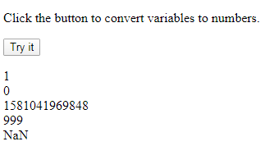
<script>
function myFunction() {
var x1 = true;
var x2 = false;
var x3 = new Date();
var x4 = "999";
var x5 = "999 888";
var n =
Number(x1) + "<br>" +
Number(x2) + "<br>" +
Number(x3) + "<br>" +
Number(x4) + "<br>" +
Number(x5);
}
</script>

Slide 80
MAX_VALUE
The Number.MAX_VALUE property belongs to the static Number object. It represents constants for the largest possible positive numbers that JavaScript can work with.
<script type="text/javascript">
<!--
function showValue()
{
var val = Number.MAX_VALUE;
document.write ("Value of Number.MAX_VALUE : " + val );
}
//-->
</script>
Output: Value of Number.MAX_VALUE : 1.7976931348623157 x 10308

Slide 81
MIN_VALUE
The Number.MIN_VALUE property belongs to the static Number object. It represents constants for the smallest possible positive numbers that JavaScript can work with.
The actual value of this constant is 5 x 10-324

Slide 82
NEGATIVE_INFINITY
This is a special numeric value representing a value less than Number.MIN_VALUE. This value is represented as "-Infinity".
var val = Number. NEGATIVE_INFINITY;
POSITIVE_INFINITY
var val = Number. POSITIVE_INFINITY;

Slide 83
JavaScript Objects
In JavaScript, almost "everything" is an object.
Booleans can be objects (if defined with the new keyword)
Numbers can be objects (if defined with the new keyword)
Strings can be objects (if defined with the new keyword)
Dates are always objects
Maths are always objects
Regular expressions are always objects
Arrays are always objects
Functions are always objects
Objects are always objects
All JavaScript values, except primitives, are objects.

Slide 84
JavaScript Primitives
A primitive value is a value that has no properties or methods.
A primitive data type is data that has a primitive value.
JavaScript defines 5 types of primitive data types:
string
number
boolean
null
undefined
Primitive values are immutable (they are hardcoded and therefore cannot be changed).
if x = 3.14, you can change the value of x. But you cannot change the value of 3.14.

Slide 85
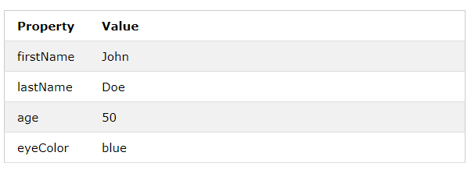
Object Properties
The named values, in JavaScript objects, are called properties.

Slide 86
Object Methods
Methods are actions that can be performed on objects.
Object properties can be both primitive values, other objects, and functions.
An object method is an object property containing a function definition.

Slide 87
JavaScript String
String Length
The length property returns the length of a string:
Example
var txt = "ABCDEFGHIJKLMNOPQRSTUVWXYZ"; var sln = txt.length;

Slide 88
Finding a String in a String
The indexOf() method returns the index of (the position of) the first occurrence of a specified text in a string:
Example
var str = "Please locate where 'locate' occurs!"; var pos = str.indexOf("locate");

Slide 89
The lastIndexOf() method returns the index of the last occurrence of a specified text in a string:
Example
var str = "Please locate where 'locate' occurs!"; var pos = str.lastIndexOf("locate");

Slide 90
Searching for a String in a String
The search() method searches a string for a specified value and returns the position of the match:
Example
var str = "Please locate where 'locate' occurs!"; var pos = str.search("locate");

Slide 91
concat()Combines the text of two strings and returns a new string.
split()Splits a String object into an array of strings by separating the string into substrings.
substr()Returns the characters in a string beginning at the specified location through the specified number of characters.
substring()Returns the characters in a string between two indexes into the string.
toLowerCase()Returns the calling string value converted to lower case.
toString()Returns a string representing the specified object.
toUpperCase()Returns the calling string value converted to uppercase.

Slide 92
JavaScript String toLowerCase() Method
<script>
var s1="JavaScript toLowerCase Example";
var s2=s1.toLowerCase();
document.write(s2);
</script>
Output:
javascript tolowercase example

Slide 93
JavaScript String toUpperCase() Method
<script>
var s1="JavaScript toUpperCase Example";
var s2=s1.toUpperCase();
document.write(s2);
</script>
Output:
JAVASCRIPT TOUPPERCASE EXAMPLE

Slide 94
JavaScript String slice(beginIndex, endIndex) Method
<script>
var s1="abcdefgh";
var s2=s1.slice(2,5);
document.write(s2);
</script>
Output:
cde

Slide 95
JavaScript String trim() Method
The JavaScript String trim() method removes leading and trailing whitespaces from the string.
<script>
var s1=" javascript trim ";
var s2=s1.trim();
document.write(s2);
</script>
Output:
javascript trim

Slide 96
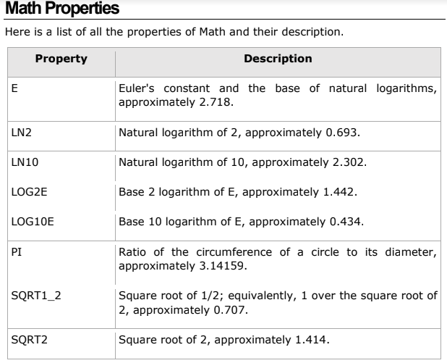
MATH

Slide 97
Math.E(Euler's constant)
<script type="text/javascript">
var property_value = Math.E
document.write("Property Value is :" + property_value);
</script>
Output
Property Value is :2.718281828459045

Slide 98
Math-LN2(natural logarithm of 2)
<script type="text/javascript">
var property_value = Math.LN2
document.write("Property Value is : " + property_value);
</script>

Slide 99
Math-LN10(natural logarithm of 10)
<script type="text/javascript">
var property_value = Math.LN10
document.write("Property Value is : " + property_value);
</script>
Output
Property Value is : 2.302585092994046

Slide 100
Math-LOG2E(base 2 logarithm of E)
<script type="text/javascript">
var property_value = Math.LOG2E
document.write("Property Value is : " + property_value);
</script>
Output
Property Value is : 1.4426950408889634

Slide 101
Math-SQRT2
<script type="text/javascript">
var property_value = Math.SQRT2
document.write("Property Value is : " + property_value);
</script>

Slide 102
abs ()
This method returns the absolute value of a number.
Syntax
Its syntax is as follows:
Math.abs( x ) ;
var value = Math.abs(-1);
var value = Math.abs(null);
var value = Math.abs(20);
var value = Math.abs("string");
Output
First Test Value : 1
Second Test Value : 0
Third Test Value : 20
Fourth Test Value : NaN

Slide 103
ceil ( )
This method returns the smallest integer greater than or equal to a number.
var value = Math.ceil(45.95);
var value = Math.ceil(45.20);
var value = Math.ceil(-45.95);
Output
First Test Value : 46
Second Test Value : 46
Third Test Value : -45

Slide 104
floor ( )
var value = Math.floor(10.3);
var value = Math.floor(30.9);
var value = Math.floor(-2.9);
Output
First Test Value : 10
Second Test Value : 30
Third Test Value : -3

Slide 105
max ( )
var value = Math.max(10, 20, -1, 100);
Output: First Test Value : 100
min ( )
var value = Math.min(10, 20, -1, 100);
Output: First Test Value : -1
pow ( ): base^exponent
var value = Math.pow(7, 2);
Output: First Test Value : 49
round ( )
var value = Math.round( 0.5 );
Output: First Test Value : 1
sqrt ( )
var value = Math.sqrt( 0.5 );
Output: First Test Value : 0.7071067811865476

Slide 106
JavaScript RegExp
A regular expression is an object that describes a pattern of characters.
Regular expressions are used to perform pattern-matching and "search-and-replace" functions on text.
Syntax
/pattern/modifiers;

Slide 107
Modifiers

Slide 108
Example
var patt = /hello/i
Example explained:
/hello/i is a regular expression.
hello is a pattern (to be used in a search).
i is a modifier (modifies the search to be case-insensitive).

Slide 109
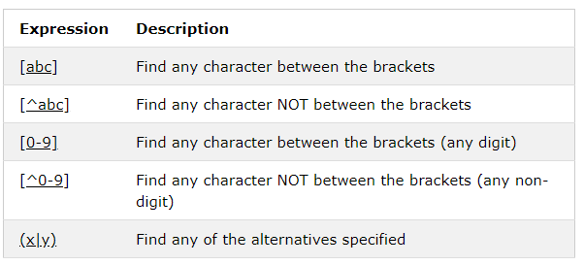
Brackets

Slide 110
JavaScript - Document
A Document object represents the HTML document that is displayed in that window. The Document object has various properties that refer to other objects which allow access to and modification of document content.
The way a document content is accessed and modified is called the Document Object Model, or DOM.

Slide 111
This hierarchical structure applies to the organization of objects in a Web document.
Window object − Top of the hierarchy. It is the outmost element of the object hierarchy.
Document object − Each HTML document that gets loaded into a window becomes a document object. The document contains the contents of the page.
Form object − Everything enclosed in the <form>...</form> tags sets the form object.
Form control elements − The form object contains all the elements defined for that object such as text fields, buttons, radio buttons, and checkboxes.

Slide 112
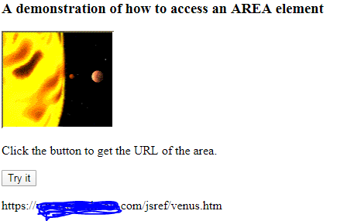
Area
Area Object
The Area object represents an HTML <area> element.
Access an Area Object
You can access an <area> element by using getElementById():
Example
<map name="planetmap">
<area id="myArea" shape="circle" coords="124,58,8" alt="Venus" href="venus.htm">
</map>
<p>Click the button to get the URL of the area.</p>
<button onclick="myFunction()">Try it</button>
<p id="demo"></p>
<script>
function myFunction() {
var x = document.getElementById("myArea").href;
document.getElementById("demo").innerHTML = x;
}
</script>

Slide 113
Link
Link Object
The Link object represents an HTML <link> element.
Access a Link Object
You can access a <link> element by using getElementById():
Example
<script>
function myFunction() {
var x = document.getElementById("myLink").href;
document.getElementById("demo").innerHTML = x;
}

Slide 114
Anchor
The anchor() method is not standard, and may not work as expected in all browsers.
The anchor() method is used to create an HTML anchor.
This method returns the string embedded in the <a> tag, like this:
<a name="anchorname">string</a>
Syntax
string.anchor("name")

Slide 115
<script>
function myFunction() {
var txt = "Chapter 10";
txt.anchor("chap10");
alert(txt.anchor("chap10"));
}
</script>

Slide 116
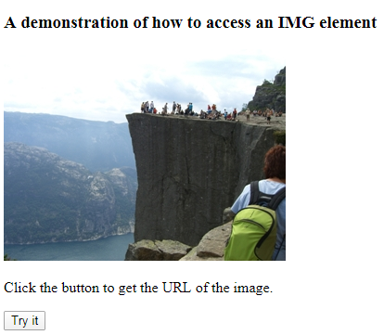
Image
The Image object represents an HTML <img> element.
Access an Image Object
You can access an <img> element by using getElementById():
<script>
function myFunction() {
var x = document.getElementById("myImg").src;
document.getElementById("demo").innerHTML = x;
}
</script>

Slide 117
Applet
The <applet> tag is not supported in HTML5. Use <embed> or <object> instead.
The <applet> tag defines an embedded applet.

Slide 118
JavaScript Events
HTML events are "things" that happen to HTML elements. When JavaScript is used in HTML pages, JavaScript can "react" on these events.
Event Handlers
Event handlers can be used to handle, and verify, user input, user actions, and browser actions:
Things that should be done every time a page loads
Things that should be done when the page is closed
Action that should be performed when a user clicks a button
Content that should be verified when a user inputs data
And more ...

Slide 119
HTML allows event handler attributes, with JavaScript code, to be added to HTML elements.
With single quotes:
<element event='some JavaScript'>
With double quotes:
<element event="some JavaScript">

Slide 120
onblur Event
The onblur event occurs when an object loses focus. The onblur event is most often used with form validation code (e.g. when the user leaves a form field).

Slide 121
Syntax
In HTML:
<element onblur="myScript">
<input type="text" onblur="myFunction()">
<script>
function myFunction() {
alert("Input field lost focus.");
}
</script>

Slide 122
onchange Event
The onchange event occurs when the value of an element has been changed.
For radiobuttons and checkboxes, the onchange event occurs when the checked state has been changed.

Slide 123
Syntax
In HTML:
<element onchange="myScript">
In JavaScript:
object.onchange = function(){myScript};

Slide 124
Enter your name: <input type="text" id="fname" onchange="myFunction()">
<script>
function myFunction() {
var x = document.getElementById("fname");
x.value = x.value.toUpperCase();
}
</script>

Slide 125
onclick Event
The onclick event occurs when the user clicks on an element.

Slide 126
Syntax
In HTML:
<element onclick="myScript">
In JavaScript:
object.onclick = function(){myScript};

Slide 127
ondblclick Event
The ondblclick event occurs when the user double-clicks on an element.
<p id="demo" ondblclick="myFunction()">Double-click me.</p>
<script>
function myFunction() {
document.getElementById("demo").innerHTML = "I was double-clicked!";
}
</script>

Slide 128
ondragend Event
The ondragend event occurs when the user has finished dragging an element or text selection.
In JavaScript, using the addEventListener() method:
object.addEventListener("dragend", myScript);

Slide 129
onerror Event
The onerror event is triggered if an error occurs while loading an external file (e.g. a document or an image).
<img id="myImg" src="image.gif">
<p id="demo"></p>
<script>
document.getElementById("myImg").onerror = function() {myFunction()};
function myFunction() {
document.getElementById("demo").innerHTML = "The image could not be loaded.";
}
</script>

Slide 130
onkeydown Event
The onkeydown event occurs when the user is pressing a key (on the keyboard).
The order of events related to the onkeydown event:
onkeydown
onkeypress
onkeyup

Slide 131
<script>
document.getElementById("demo").onkeydown = function() {myFunction()};
function myFunction() {
document.getElementById("demo").style.backgroundColor = "red";
}
</script>

Slide 132
onkeypress Event
<input type="text" onkeypress="myFunction()">
<script>
function myFunction() {
alert("You pressed a key inside the input field");
}
</script>

Slide 133
onkeyup Event
The onkeyup event occurs when the user releases a key (on the keyboard).
Enter your name: <input type="text" id="fname" onkeyup="myFunction()">
<script>
function myFunction() {
var x = document.getElementById("fname");
x.value = x.value.toUpperCase();
}
</script>

Slide 134
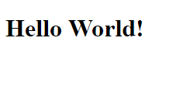
onload Event
The onload event occurs when an object has been loaded.
onload is most often used within the <body> element to execute a script once a web page has completely loaded all content (including images, script files, CSS files, etc.).
<body onload="myFunction()">
<h1>Hello World!</h1>
<script>
function myFunction() {
alert("Page is loaded");
}
</script>

Slide 135
onunload Event
The onunload event occurs once a page has unloaded (or the browser window has been closed).
onunload occurs when the user navigates away from the page (by clicking on a link, submitting a form, closing the browser window, etc.).

Slide 136
<p>Close this window or press F5 to reload the page.</p>
<p><strong>Note:</strong> Due to different browser settings, this event may not always work as expected.</p>
<script>
function myFunction() {
alert("Thank you for visiting");
}
</script>

Slide 137
onmousedown Event
The onmousedown event occurs when a user presses a mouse button over an element.

Slide 138
<p id="myP" onmousedown="mouseDown()" onmouseup="mouseUp()">
Click the text! The mouseDown() function is triggered when the mouse button is pressed down over this paragraph, and sets the color of the text to red. The mouseUp() function is triggered when the mouse button is released, and sets the color of the text to green.
</p>
<script>
function mouseDown() {
document.getElementById("myP").style.color = "red";
}
function mouseUp() {
document.getElementById("myP").style.color = "green";
}
</script>

Slide 139
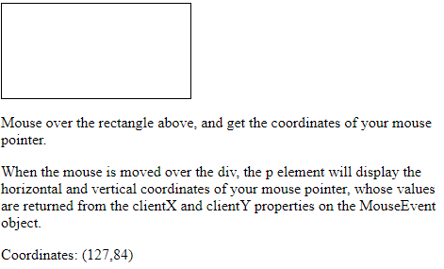
onmousemove Event
<div onmousemove="myFunction(event)" onmouseout="clearCoor()"></div>
<p id="demo"></p>
<script>
function myFunction(e) {
var x = e.clientX;
var y = e.clientY;
var coor = "Coordinates: (" + x + "," + y + ")";
document.getElementById("demo").innerHTML = coor;
}
function clearCoor() {
document.getElementById("demo").innerHTML = "";
}
</script>

Slide 140
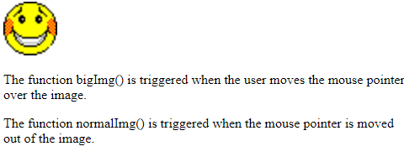
onmouseout Event
The onmouseout event occurs when the mouse pointer is moved out of an element, or out of one of its children.
<img onmouseover="bigImg(this)" onmouseout="normalImg(this)" border="0" src="smiley.gif" alt="Smiley" width="32" height="32">
<script>
function bigImg(x) {
x.style.height = "64px";
x.style.width = "64px";
}
function normalImg(x) {
x.style.height = "32px";
x.style.width = "32px";
}
</script>

Slide 141
onresize Event
The onresize event occurs when the browser window has been resized.
<script>
function myFunction() {
var w = window.outerWidth;
var h = window.outerHeight;
var txt = "Window size: width=" + w + ", height=" + h;
document.getElementById("demo").innerHTML = txt;
}
</script>

Slide 142
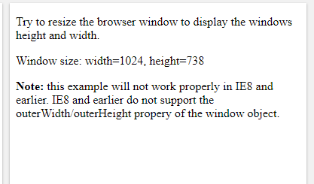
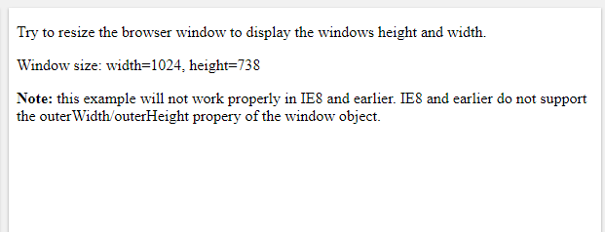

Slide 143
onselect Event
The onselect event occurs after some text has been selected in an element.
The onselect event is mostly used on <input type="text"> or <textarea> elements.
Select some of the text: <input type="text" value="Hello world!" onselect="myFunction()">
<script>
function myFunction() {
alert("You selected some text!");
}
</script>

Slide 144
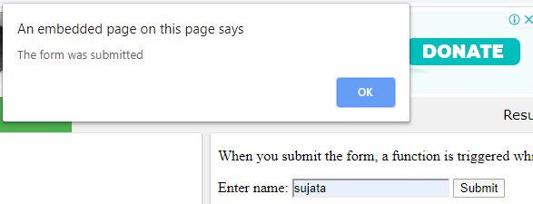
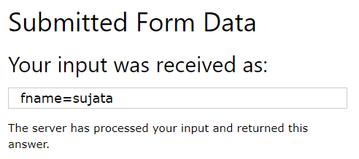
onsubmit Event
The onsubmit event occurs when a form is submitted.
<form action="/action_page.php" onsubmit="myFunction()">
Enter name: <input type="text" name="fname">
<input type="submit" value="Submit">
</form>
<script>
function myFunction() {
alert("The form was submitted");
}
</script>

