Slide 1
Unit 3 – Chapter 2
Packages

Slide 2
Package in java can be categorized in two form, built-in package and user-defined package.
There are many built-in packages such as java, lang, awt, javax, swing, net, io, util, sql etc.
Here, we will have the detailed learning of creating and using user-defined packages.

Slide 3
Advantage of Java Package
Java package is used to categorize the classes and interfaces so that they can be easily maintained.
Java package provides access protection.
Java package removes naming collision.

Slide 4
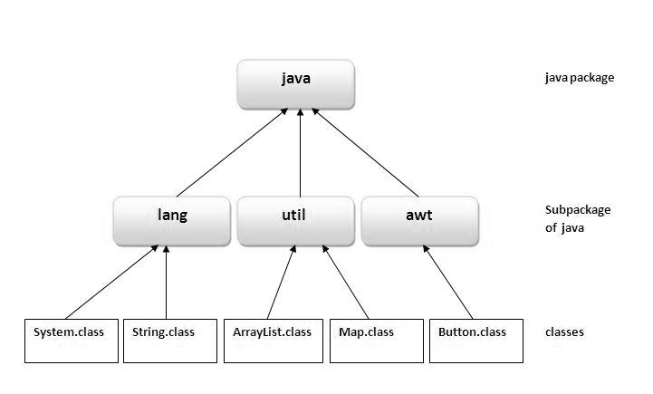

Slide 5
Creating a Package
Package packagename
Example: pakage abc;

Slide 6
example of java package
package mypack;
public class Simple
{
public static void main(String args[])
{
System.out.println("Welcome to package");
}
}

Slide 7
The import Keyword
There are three ways to access the package from outside the package.
import package.*;
import package.classname;
fully qualified name.

Slide 8
1) Using packagename.*
//save by A.java
package pack;
public class A
{
public void msg()
{
System.out.println("Hello");
}
}

Slide 9
//save by B.java
package mypack;
import pack.*;
class B
{
public static void main(String args[])
{
A obj = new A();
obj.msg();
}
}

Slide 10
2) Using packagename.classname
//save by A.java
package pack;
public class A
{
public void msg()
{
System.out.println("Hello");
} }

Slide 11
//save by B.java
package mypack;
import pack.A;
class B
{
public static void main(String args[])
{
A obj = new A();
obj.msg();
} }

Slide 12
3) Using fully qualified name
//save by A.java
package pack;
public class A
{
public void msg()
{
System.out.println("Hello");
}
}

Slide 13
//save by B.java
package mypack;
class B
{
public static void main(String args[])
{
pack.A obj = new pack.A(); //using fully qualified name
obj.msg();
}
}

Slide 14
Default Packages
Package Name
java.lang
java.io
java.util
java.applet
java.awt
java.net

Slide 15
Example:
import java.lang.Math; // import 'Math' class
public class ImportDemo
{
public static void main(String args[])
{
double val = 64.0;
double sqroot = Math.sqrt(val);
System.out.println("Sq. root of " + val + " is " + sqroot);
}
}

