Slide 1
Unit 4 - Chapter 2
JSP(Java Server Pages)

Slide 2
Introduction
JavaServer Pages (JSP) is a complimentary technology to Java Servlet which facilitates the mixing of dynamic and static web contents. JSP is Java's answer to the popular Microsoft's Active Server Pages(ASP). JSP, like ASP, provides a elegant way to mix static and dynamic contents. The main page is written in regular HTML, while special tags are provided to insert pieces of Java programming codes.

Slide 3
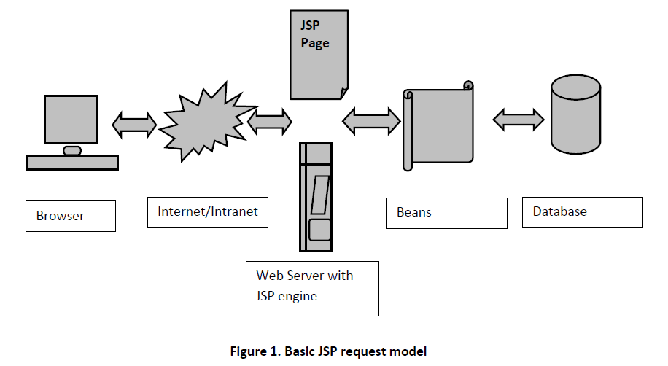
JSP Request Model

Slide 4
How Java Server Pages works?
When a user calls a JSP page, the Web server calls the JSP engine which creates a Java source code from the JSP script and compile the class to provide a compiled file (with the .class extension).
Note that: the JSP engine checks if the date of the .jsp file corresponds to the .class file. The JSP engine will convert and compile the class, only if the JSP script has been updated.

Slide 5
Why Use JSP?
Performance is significantly better because JSP allows embedding Dynamic Elements in HTML Pages itself instead of having a separate CGI files.
JSP are always compiled before it's processed by the server unlike CGI/Perl which requires the server to load an interpreter and the target script each time the page is requested.

Slide 6
Advantages of JSP
1. HTML friendly simple and easy language and tags.
2. Supports Java Code.
3. Supports standard Web site development tools.

Slide 7
Disadvantages of JSP
1. As JSP pages are translated to servlets and compiled, it is difficult to trace errors occurred in JSP pages.
2. JSP pages require double the disk space to hold the JSP page.
3. JSP pages require more time when accessed for the first time as they are to be compiled on the server.

Slide 8
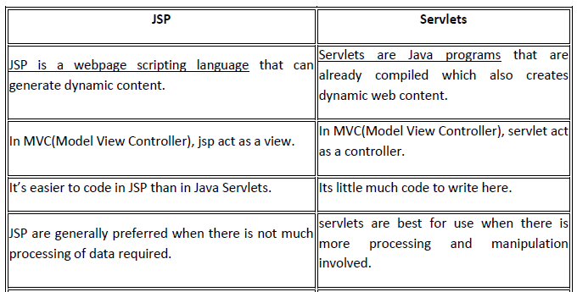
JSP v/s Servlets

Slide 9
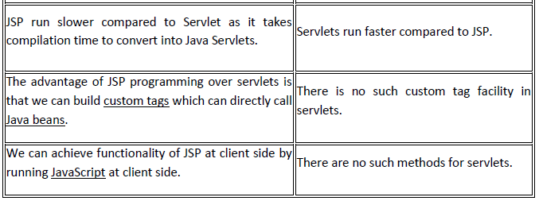

Slide 10
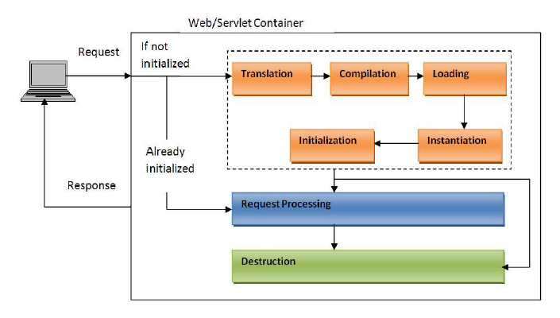
Lifecycle of JSP

Slide 11
Following diagram shows the different stages of life cycle of jsp. Broadly, these stages can be classified into three.
Instantiation
Request Processing
Destruction

Slide 12
1. Instantiation:
When a web container receives a jsp request (may be first or subsequent), it checks for the jsp’s servlet instance. If no servlet instance is available or if it is older than the jsp, then, the web container creates the servlet instance using following stages.
a) Translation
b) Compilation
c) Loading
d) Instantiation
e) Initialization

Slide 13
a) Translation:
Web container translates (converts) the jsp code into a servlet code. This means that jsp is actually a servlet.
After this stage, there is no jsp, everything is a servlet.

Slide 14
b)Compilation:
The generated servlet is compiled to validate the syntax. As it is a java class, the compilation is done using javac command. This will generate the byte code to be run on JVM.

Slide 15
c)Loading:
The compiled byte code is loaded by the class loader used by web container. This is a standard process of using any java class.

Slide 16
d)Instantiation:
In this step, instance of the servlet class is created so that it can serve the request.

Slide 17
e)Initialization:
Initialization is done by calling the jspInit() method. This is one time activity at the start of the initialization process.

Slide 18
2. Request Processing:
Entire initialization process is done to make the servlet available in order to process the incoming request. jspService() is the method that actually processes the request. It prints the response in html (any other) format, using ‘out’ object.

Slide 19
3. Destroy:
Whenever the server is shutting down or when the server needs memory, the server removes the instance of the servlet. The destroy method jspDestroy() can be called by the server after initialization and before or after request processing. Once destroyed the jsp needs to be initialized again.

Slide 20
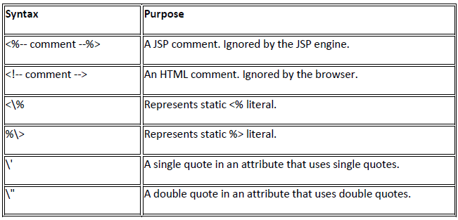
Comments

Slide 21
JSP documents
JSP Page - A JSP page written in an HTML format with JSP elements expressed as <% ... %> tags.
JSP Document - A JSP written in an XML format with JSP elements expressed as XML elements. A JSP document is JSP written in XML format and therefore must comply with the XML standard.

Slide 22
JSP Document Rules
JSP document must be well formed which means that each start tag must have a corresponding end tag and that the document must have only one root element.
A JSP Document should be saved with the .jspx extension.
A JSP Document must have a root element called "root" with a "version" attribute like: <jsp:root version="2.1“ xmlns:jsp="http://java.sun.com/JSP/Page">
By default content type of JSP document is text/xml so to display the document as html, you need to change the content type to text/html

Slide 23
Hello World Example
<jsp:root xmlns:jsp="http://java.sun.com/JSP/Page" version="2.1">
<html>
<head>
<title> Hello World JSP Document </title>
</head>
<body>
<h4>
Hello World JSP Document
</h4>
</body>
</html>
</jsp:root>

Slide 24
JSP elements(tags)
There are mainly three groups of jsp tags(elements) available in java server page:
1. JSP scripting elements
1.1 JSP scriptlet tag
1.2 JSP expression tag
1.3 JSP declaration tag
1.4 Comment tag
2. JSP directive elements
2.1 page directive
2.2 include directive
2.3 taglib directive
3. JSP standard action elements

Slide 25
1. JSP scripting elements
The scripting elements provides the ability to insert java code inside the jsp. JSP Scripting element are written inside <% %> tags. These code inside <% %> tags are processed by the JSP engine during translation of the JSP page. Any other text in the JSP page is considered as HTML code or plain text.
There are four types of scripting elements:
scriptlet tag
expression tag
declaration tag
Comment tag

Slide 26
scriptlet tag
A scriptlet is a valid code in java and is placed in the jspService() method of the JSP engine at the time of running. The scriplet syntax is –
<% java code %>

Slide 27
Example of JSP scriptlet tag that prints the user name
In this example, we have created two files index.html and welcome.jsp. The index.html file gets the username from the user and the welcome.jsp file prints the username with the welcome message.
index.html
<html>
<body>
<form action="welcome.jsp">
<input type="text" name="uname">
<input type="submit" value="go"><br/>
</form>
</body>
</html>

Slide 28
welcome.jsp
<html>
<body>
<%
String name=request.getParameter("uname");
out.print("welcome "+name);
%>
</form>
</body>
</html>

Slide 29
JSP expression tag
The code placed within expression tag is written to the output stream of the response. So you need not write out.print() to write data. It is mainly used to print the values of variable or method.
Note: Do not end your statement with semicolon in case of expression tag.

Slide 30
Example of JSP expression tag that prints the user name
index.html
<html>
<body>
<form action="welcome.jsp">
<input type="text" name="uname"><br/>
<input type="submit" value="go">
</form>
</html>

Slide 31
welcome.jsp
<html>
<body>
<%= "Welcome "+request.getParameter("uname") %>
</form>
</body>
</html>

Slide 32
JSP Declaration Tag
The JSP declaration tag is used to declare fields and methods. The code written inside the jsp declaration tag is placed outside the service() method of auto generated servlet. So it doesn't get memory at each request.
The syntax of the declaration tag is as follows:
<%! field or method declaration %>

Slide 33
Difference between the jsp scriptlet tag and jsp declaration tag ?

Slide 34
Example of JSP declaration tag that declares method
index.jsp
<html>
<body>
<%!
int cube(int n)
{
return n*n*n*;
}
%>
<%= "Cube of 3 is:"+cube(3) %>
</body>
</html>

Slide 35
JSP directive elements
The jsp directives are messages that tells the web container how to translate a JSP page into the corresponding servlet.
There are three types of directives:
page directive
include directive
taglib directive
Syntax of JSP Directive
<%@ directive attribute="value" %>

Slide 36
JSP page directive
The page directive defines attributes that apply to an entire JSP page.
Syntax of JSP page directive
<%@ page attribute="value" %>

Slide 37
Attributes of JSP page directive
import
contentType
extends
info
buffer
language
isELIgnored
isThreadSafe
autoFlush
session
pageEncoding
errorPage
isErrorPage

Slide 38
1)Import
The import attribute is used to import class,interface or all the members of a package. It is similar to import keyword in java class or interface.
2)contentType
The contentType attribute defines the MIME(Multipurpose Internet Mail Extension) type of the HTTP response.
3)extends
The extends attribute defines the parent class that will be inherited by the generated servlet.It is rarely used.
4)Info
This attribute simply sets the information of the JSP page which is retrieved later by using getServletInfo() method of Servlet interface.
5)buffer
The buffer attribute sets the buffer size in kilobytes to handle output generated by the JSP page.The default size of the buffer is 8Kb.
6)language
The language attribute specifies the scripting language used in the JSP page. The default value is "java".

Slide 39
7)isELIgnored
We can ignore the Expression Language (EL) in jsp by the isELIgnored attribute. By default its value is false i.e. Expression Language is enabled by default.
8)isThreadSafe
Servlet and JSP both are multithreaded.If you want to control this behaviour of JSP page, you can use isThreadSafe attribute of page directive.
9)errorPage
The errorPage attribute is used to define the error page, if exception occurs in the current page, it will be redirected to the error page.
10)isErrorPage
The isErrorPage attribute is used to declare that the current page is the error page.

Slide 40
JSP Include directive
The include directive is used to include the contents of any resource it may be jsp file, html file or text file. The include directive includes the original content of the included resource at page translation time (the jsp page is translated only once so it will be better to include static resource).
Syntax of include directive
<%@ include file="resourceName" %>

Slide 41
JSP Taglib directive
The JSP taglib directive is used to define a tag library that defines many tags. We use the TLD (Tag Library Descriptor) file to define the tags.
Syntax JSP Taglib directive
<%@ taglib uri="uri of the tag library" prefix="prefix of tag library" %>

Slide 42
Action elements
These actions use constructs in XML syntax to control the behavior of the servlet engine. You can dynamically insert a file, reuse JavaBeans components, forward the user to another page, or generate HTML for the Java plugin.
There is only one syntax for the Action element, as it conforms to the XML standard −
<jsp:action_name attribute = "value" />

Slide 43
Action elements are basically predefined functions. The following table lists out the available JSP actions −
S.No. | Syntax & Purpose
1 | jsp:include Includes a file at the time the page is requested.
2 | jsp:useBean Finds or instantiates a JavaBean.
3 | jsp:setProperty Sets the property of a JavaBean.
4 | jsp:getProperty Inserts the property of a JavaBean into the output.

Slide 44
5 | jsp:forward Forwards the requester to a new page.
6 | jsp:plugin Generates browser-specific code that makes an OBJECT or EMBED tag for the Java plugin.
7 | jsp:element Defines XML elements dynamically.
8 | jsp:attribute Defines dynamically-defined XML element's attribute.
9 | jsp:body Defines dynamically-defined XML element's body.
10 | jsp:text Used to write template text in JSP pages and documents.

Slide 45
Common Attributes
Id attribute
The id attribute uniquely identifies the Action element, and allows the action to be referenced inside the JSP page. If the Action creates an instance of an object, the id value can be used to reference it through the implicit object PageContext.
Scope attribute
This attribute identifies the lifecycle of the Action element. The id attribute and the scope attribute are directly related, as the scope attribute determines the lifespan of the object associated with the id. The scope attribute has four possible values: (a) page, (b)request, (c)session, and (d) application.

Slide 46
The <jsp:include> Action
This action lets you insert files into the page being generated. The syntax looks like this −
<jsp:include page = "relative URL" flush = "true" />

Slide 47
The <jsp:useBean> Action
The useBean action is quite versatile. It first searches for an existing object utilizing the id and scope variables. If an object is not found, it then tries to create the specified object.
The simplest way to load a bean is as follows −
<jsp:useBean id = "name" class = "package.class" />

Slide 48
The <jsp:setProperty> Action
The setProperty action sets the properties of a Bean. The Bean must have been previously defined before this action.
<jsp:useBean id = "myName" ... > ... <jsp:setProperty name = "myName" property = "someProperty" .../> </jsp:useBean>

Slide 49
The <jsp:getProperty> Action
The getProperty action is used to retrieve the value of a given property and converts it to a string, and finally inserts it into the output.
<jsp:useBean id = "myName" ... /> ... <jsp:getProperty name = "myName" property = "someProperty" .../>

Slide 50
The <jsp:forward> Action
The forward action terminates the action of the current page and forwards the request to another resource such as a static page, another JSP page, or a Java Servlet.
Following is the syntax of the forward action −
<jsp:forward page = "Relative URL" />

Slide 51
The <jsp:plugin> Action
The plugin action is used to insert Java components into a JSP page. It determines the type of browser and inserts the <object> or <embed> tags as needed.

Slide 52
The <jsp:text> Action
The <jsp:text> action can be used to write the template text in JSP pages and documents. Following is the simple syntax for this action −
<jsp:text>Template data</jsp:text>

Slide 53
Implicit objects
One of the advantages of JSP over Servlets is Implicit Objects. Implicit objects make JSP coding simple.
In Servlets, the Programmer should create these objects and then use, example, objects of HttpSession, ServletConfig, PrintWriter etc. But in case of JSP, just use them as they are implicitly created and supplied by JSP container. Programmer can use them straightaway in the code. As they are created by JSP container implicitly, they are known as implicit objects.
JSP Implicit objects are always either an instance of a class or interface belonging to a specific API.
There are total 9 JSP implicit objects . Following is the list of JSP Implicit objects.

Slide 54
OBJECT | CLASS OR INTERFACE | DESCRIPTION | SCOPE
PAGE | javax.servlet.jsp.HttpJspPage | Represents this object for the instance of the page | Page
CONFIG | javax.servlet.ServletConfig | Represents ServletConfig for the JSP page | Page
OUT | javax.servlet.jsp.JspWriter | Represents the JspWriter object to the output stream | Page
PAGECONTEXT | javax.servlet.jsp.PageContext | Represents the page context for the JSP | Page
APPLICATION | javax.servlet.ServletContext

Slide 55
SESSION | javax.servlet.http.HttpSession | Represents session object, if any, during the HTTP request | Session
EXCEPTION | java.lang.Throwable | Represents the uncaught error | Page
RESPONSE | javax.servlet.http.HttpServletResponse | Reprsents the response object that triggered the response | Response
REQUEST | javax.servlet.http.HttpServletRequest | Represents the request objects that triggered the request

Slide 56
1. request implicit object
This is an implicit object of javax.servlet.http.HttpServletRequest interface. This object is used by Programmer to extract (from JSP) the data send by client like user name and password and also header information, request query parameters, retrieving cookies from client etc.

Slide 57
2. response implicit object
This is an implicit object of javax.servlet.http.HttpServletResponse interface. This is used to send response to client (via out object). Used for setting content type, sending cookies to client, redirect operations etc.

Slide 58
3. out implicit object
It is an implicit object of javax.servlet.jsp.JspWriter, as subclass of java.io.Writer. Programmer uses out object to send response to client. This is mostly used Programmer.

Slide 59
4. session implicit object
It is an implicit object of javax.servlet.http.HttpSession interface. It represents the communication with the client. The session object is used to store a single client’s state.

Slide 60
5. application implicit object
It is an implicit object of javax.servlet.ServletContext interface. This represents the global object wherein all the JSPs of an application can store and retrieve values. Using this object, all JSPs can communicate in between.

Slide 61
6. exception implicit object
It is an instance of class java.lang.Throwable. Used to generate error pages.

Slide 62
7. config implicit object
This config represents an object of javax.servlet.ServletConfig interface. Used to retrieve configuration or initialization particulars of a jSP.

Slide 63
8. page implicit object
It is an instance of class java.lang.Object. This object represents the current JSP page. This objects takes lot of memory and thereby used rarely. It represents or used as a reference to the generated Servlet.

Slide 64
9. pageContext implicit object
It is an instance of javax.servlet.jsp.PageContext abstract class. It gets the all the page context information. Used to forward request to other sources with get and set methods. It can used as a reference to all other implicit objects.

Slide 65
Scope of JSP Objects
The availability of a JSP object for use from a particular place of the application is defined as the scope of that JSP object. Every object created in a JSP page will have a scope. Object scope in JSP is segregated into four parts and they are page, request, session and application.
page ‘page’ scope means, the JSP object can be accessed only from within the same page where it was created. The default scope for JSP objects created using <jsp:useBean> tag is page. JSP implicit objects out, exception, response, pageContext, config and page have ‘page’ scope.
request A JSP object created using the ‘request’ scope can be accessed from any pages that serves that request. More than one page can serve a single request. The JSP object will be bound to the request object. Implicit object request has the ‘request’ scope.

Slide 66
session ‘session’ scope means, the JSP object is accessible from pages that belong to the same session from where it was created. The JSP object that is created using the session scope is bound to the session object. Implicit object session has the ‘session’ scope.
application A JSP object created using the ‘application’ scope can be accessed from any pages across the application. The JSP object is bound to the application object. Implicit object application has the ‘application’ scope.

Slide 67
What Is the Expression Language(EL)?
The Expression Language (EL) provides a way to simplify expressions in JSP. It is a simple language used for accessing implicit objects and Java classes, and for manipulating collections in an elegant manner. EL provides the ability to use run-time expressions outside of JSP scripting elements.

Slide 68
Why a "Unified" Expression Language?
JavaServer Pages each has its own expression language. The expression language included in JSP provides greater flexibility to the web application developer. Deferred evaluation means that the technology using the unified EL takes over the responsibility of evaluating the expression from the JSP engine and evaluates the expression at the appropriate time during the page lifecycle. But the JSP EL is designed for immediate evaluation of expressions.
The Expression Language (EL) simplifies the accessibility of data stored in the Java Bean component, and other objects like request, session, application etc.
There are many implicit objects, operators and reserve words in EL.
It is the newly added feature in JSP technology version 2.0.

Slide 69
Syntax for Expression Language (EL)
${ expression }

Slide 70
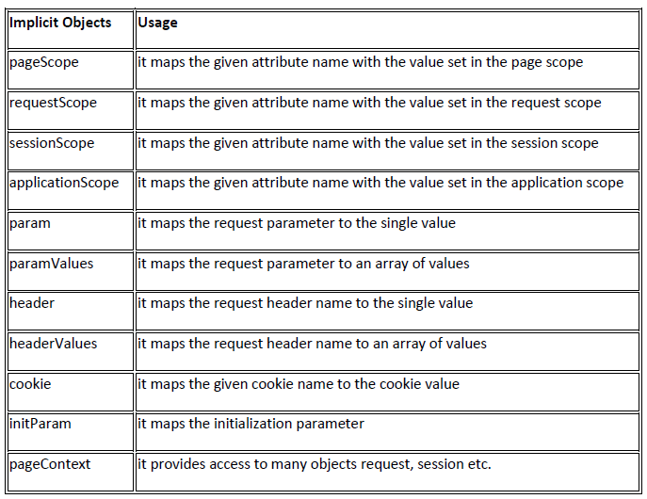
Implicit Objects in Expression Language (EL)

Slide 71
JSP Literals
The JSP expression language defines the following literals −
Boolean − true and false
Integer − as in Java
Floating point − as in Java
String − with single and double quotes; " is escaped as \", ' is escaped as \', and \ is escaped as \\.
Null − null

Slide 72
Basic Operators in EL
S.No. | Operator & Description
1 | . : -Access a bean property or Map entry
2 | [] :- Access an array or List element
3 | ( ) : -Group a subexpression to change the evaluation order
4 | + : Addition
5 | - : Subtraction or negation of a value
6 | * : Multiplication
7 | / or div :- Division
8 | % or mod Modulo (remainder)
9 | == or eq Test for equality

Slide 73
10 | != or ne Test for inequality
11 | < or lt Test for less than
12 | > or gt Test for greater than
13 | <= or le Test for less than or equal
14 | >= or ge Test for greater than or equal
15 | && or and Test for logical AND
16 | || or or Test for logical OR
17 | ! or not Unary Boolean complement
18 | empty Test for empty variable values

Slide 74
Reserve words in EL
lt | le | gt | ge
eq | ne | true | false
and | or | not | instanceof
div | mod | empty | null

