Slide 1
Unit 4 – Chapter 3
Java Exceptions

Slide 2
An exception is a problem that arises during the execution of a program. An exception can occur for many different reasons, including the following:
• A user has entered invalid data. • A file that needs to be opened cannot be found. • A network connection has been lost in the middle of communications or the JVM has run out of memory.

Slide 3
• Checked exceptions: A checked exception is an exception that is typically a user error or a problem that cannot be foreseen by the programmer. For example, if a file is to be opened, but the file cannot be found, an exception occurs. These exceptions cannot simply be ignored at the time of compilation.
• Runtime exceptions: A runtime exception is an exception that occurs that probably could have been avoided by the programmer. As opposed to checked exceptions, runtime exceptions are ignored at the time of compilation.
• Errors: These are not exceptions at all, but problems that arise beyond the control of the user or the programmer.

Slide 4
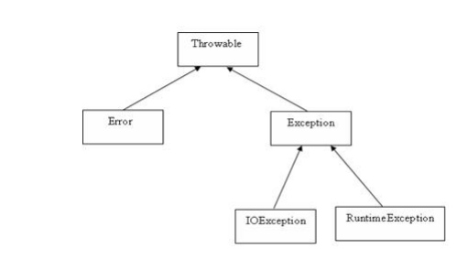
Exception Hierarchy:

Slide 5
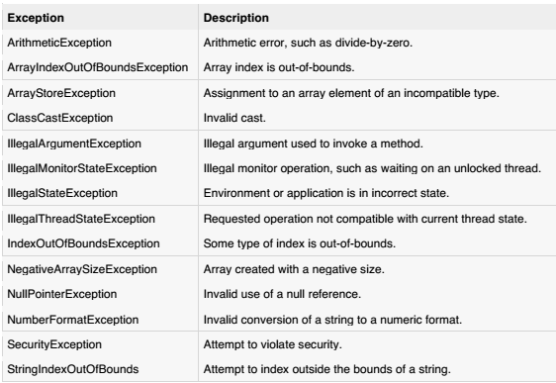
Java’s Built-in Exceptions

Slide 6
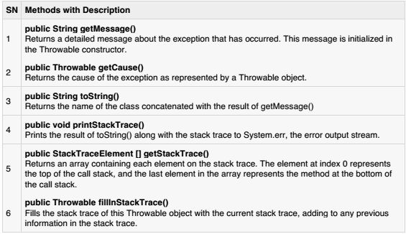
Exceptions Methods:

Slide 7
Catching Exceptions:
try { //Protected code } catch(ExceptionName e1) {
//Catch block }

Slide 8
import java. io.*; public class ExcepTest
{ public static void main(String args[])
{ try
{ int a[]=new int[ 2]; System. out. println("Access element three :" + a[ 3]); } catch(ArrayIndexOutOfBoundsException e)
{ System. out. println("Exception thrown :" + e); } System. out. println("Out of the block" ); }}
This would produce the following result:
Exception thrown : java. lang. ArrayIndexOutOfBoundsException:

Slide 9
Multiple catch Blocks:
try { //Protected code } catch(ExceptionType1 e1) { //Catch block } catch(ExceptionType2 e2) { //Catch block } catch(ExceptionType3 e3) { //Catch block }

Slide 10
The throws/throw Keywords:
import java. io.*; public class className { public void deposit(double amount) throws RemoteException { // Method implementation throw new RemoteException(); } //Remainder of class definition }

Slide 11
The finally Keyword
The finally keyword is used to create a block of code that follows a try block. A finally block of code always executes, whether or not an exception has occurred.
Using a finally block allows you to run any cleanup-type statements that you want to execute, no matter what happens in the protected code.

Slide 12
A finally block appears at the end of the catch blocks and has the following syntax:
try { //Protected code } catch(ExceptionType1 e1) { //Catch block } catch(ExceptionType2 e2) { //Catch block } catch(ExceptionType3 e3) { //Catch block } finally { //The finally block always executes. }

Slide 13
public class ExcepTest
{ public static void main(String args[])
{ int a[]=new int[ 2]; try{ System. out. println("Access element three :" + a[ 3]); } catch(ArrayIndexOutOfBoundsException e){ System. out. println("Exception thrown :" + e); } finally
{ a[ 0]=6; System. out. println("First element value: " +a[ 0]); System. out. println("The finally statement is executed" ); }}}

Slide 14
This would produce the following result:
Exception thrown : java. lang. ArrayIndexOutOfBoundsException First element value: 6 The finally statement is executed

Slide 15
Common Exceptions:
• JVM Exceptions: - These are exceptions/errors that are exclusively or logically thrown by the JVM.
Examples:
NullPointerException, ArrayIndexOutOfBoundsException, ClassCastException,
• Programmatic exceptions: - These exceptions are thrown explicitly by the application or the API programmers.
Examples:
IllegalArgumentException, IllegalStateException.

