Slide 1
Unit 5 – Chapter 2
Special Tests

Slide 2
What is GUI?
There are two types of interfaces for a computer application. Command Line Interface is where you type text and computer responds to that command. GUI stands for Graphical User Interface where you interact with the computer using images rather than text.

Slide 3
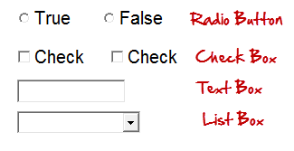
Following are the GUI elements which can be used for interaction between the user and application:

Slide 4
What is GUI Testing?
GUI testing is defined as the process of testing the system's Graphical User Interface of the Application Under Test. GUI testing involves checking the screens with the controls like menus, buttons, icons, and all types of bars - toolbar, menu bar, dialog boxes, and windows, etc.

Slide 5
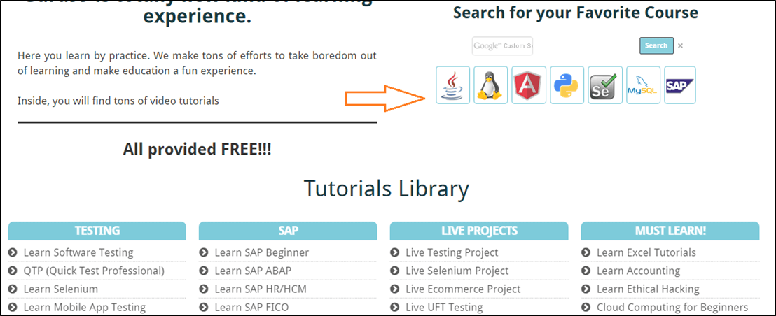
you will see say homepage it is the GUI (graphical user interface) of the site. A user does not see the source code. The interface is visible to the user. Especially the focus is on the design structure, images that they are working properly or not.

Slide 6
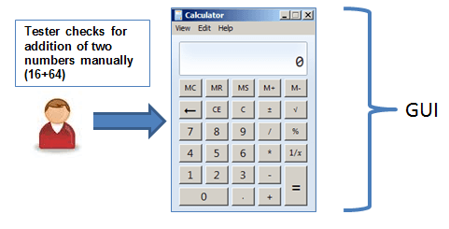
GUI Testing Techniques / Methods
Manual Based Testing: Under this approach, graphical screens are checked manually by testers in conformance with the requirements stated in the business requirements document.

Slide 7
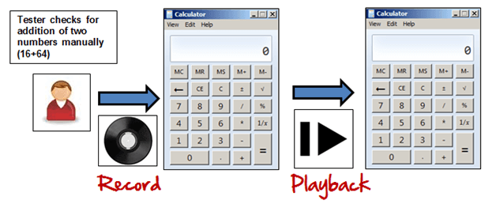
Record and Replay: GUI testing can be done using automation tools. This is done in 2 parts. During Record, test steps are captured by the automation tool. During playback, the recorded test steps are executed on the Application Under Test.

Slide 8
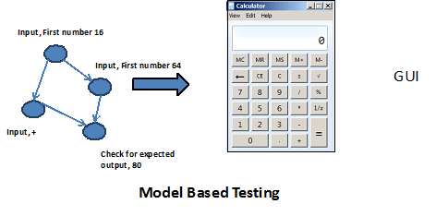
Model Based Testing: A model is a graphical description of a system's behavior. It helps us to understand and predict the system behavior. Models help in a generation of efficient test cases using the system requirements.

Slide 9
How to do GUI Test
GUI Testing.docx

Slide 10
What is Compatibility?
Compatibility is nothing but the capability of existing or living together. In normal life, Oil is not compatible with water, but milk can be easily combined with water.

Slide 11
What is Compatibility Testing?
Compatibility Testing is a type of Software testing to check whether your software is capable of running on different hardware, operating systems, applications, network environments or Mobile devices.

Slide 12
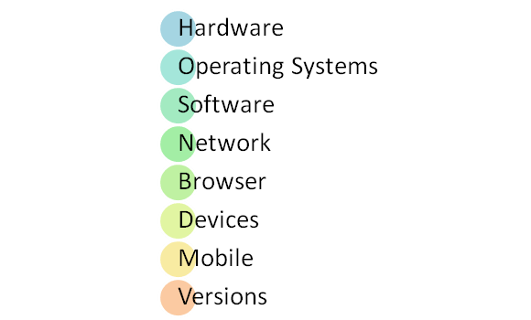
Compatibility Testing is a type of Non-functional testing

Slide 13
Types of Compatibility Testing
Friend Compatibility: when application behave on new plate form as it is working on its base platform.
Neutral Compatibility: It has its own utilities and services, and uses them as if nothing has been provided by any platform.
Enemy Platform: application is not compatible with the targeted platforms.

Slide 14
Multiplatform Testing: When system is expected to work with various platform
Major concerns: Need to define the platform for multiplatform testing as exhaustive testing is impossible
As platform configuration changes the performance of an application on it may get effected

Slide 15
Process of Multiplatform Testing
Define the platform
Prepare the list of platforms
List the interface platform effects
Execute Tests
Assess test laboratory configuration
Compare the results

Slide 16
Security Testing
Security Testing is defined as a type of Software Testing that ensures software systems and applications are free from any vulnerabilities, threats, risks, loopholes and weaknesses that may cause a big loss.

Slide 17
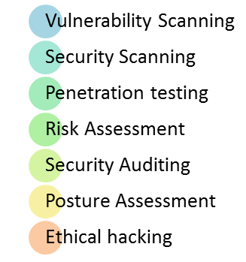
Types of Security Testing:

Slide 18
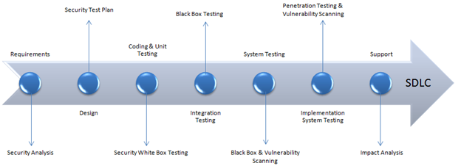
How to do Security Testing
Let's look into the corresponding Security processes to be adopted for every phase in SDLC

Slide 19
The test plan should include
Security-related test cases or scenarios
Test Data related to security testing
Test Tools required for security testing
Analysis of various tests outputs from different security tools

Slide 20
Example Test Scenarios for Security Testing:
Sample Test scenarios to give you a glimpse of security test cases -
A password should be in encrypted format
Application or System should not allow invalid users
Check cookies and session time for application
For financial sites, the Browser back button should not work.

Slide 21
Security Testing Roles
Hackers - Access computer system or network without authorization
Crackers - Break into the systems to steal or destroy data
Ethical Hacker - Performs most of the breaking activities but with permission from the owner
Script Kiddies or packet monkeys - Inexperienced Hackers with programming language skill

Slide 22
Performance Testing
Performance Testing is defined as a type of software testing to ensure software applications will perform well under their expected workload.
The focus of Performance Testing is checking a software program's
Speed - Determines whether the application responds quickly
Scalability - Determines maximum user load the software application can handle.
Stability - Determines if the application is stable under varying loads

Slide 23
Why do Performance Testing?
mission-critical applications like space launch programs or life-saving medical equipment should be performance tested to ensure that they run for a long period without deviations.
Only a 5-minute downtime of Google.com (19-Aug-13) is estimated to cost the search giant as much as $545,000.
It's estimated that companies lost sales worth $1100 per second due to a recent Amazon Web Service Outage.

Slide 24
Types of Performance Testing
Load testing
Stress testing
Volume testing
Scalability testing

Slide 25
Common Performance Problems
Long Load time
Poor response time
Poor scalability
Bottlenecking
CPU utilization
Memory utilization
Network utilization
Operating System limitations
Disk usage

Slide 26
Example Performance Test Cases
Verify response time is not more than 4 secs when 1000 users access the website simultaneously.
Verify response time of the Application Under Load is within an acceptable range when the network connectivity is slow
Check the maximum number of users that the application can handle before it crashes.
Check database execution time when 500 records are read/written simultaneously.
Check CPU and memory usage of the application and the database server under peak load conditions
Verify response time of the application under low, normal, moderate and heavy load conditions.

Slide 27
Volume Testing
Volume testing is defined as a type of Software Testing, where the software is subjected to a huge volume of data. It is also referred to as flood testing.
Volume testing is done to analyze the system performance by increasing the volume of data in the database.
With the help of Volume testing, the impact on response time and system behavior can be studied when exposed to a high volume of data.

Slide 28
Volume Testing Vs Load Testing
Volume Testing | Load Testing
Volume testing is testing of an application with large number of data in database is possible | While in load testing, application is subjected to certain level of load to analyze the behavior of the application
Volume testing verifies if the system responds as expected for a certain volume of data. It may include increasing size of the file | Load testing checks the performance of the system when the user load is increased. It may include increasing number of the file

Slide 29
What is Stress Testing?
Stress Testing is defined as a type of Software Testing that verified the stability & reliability of the system. This test mainly determines the system on its robustness and error handling under extremely heavy load conditions.

Slide 30
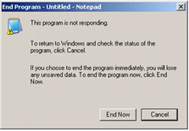
The application under testing will be stressed when 5GB data is copied from the website and pasted in notepad. Notepad is under stress and gives 'Not Responded' error message.

Slide 31
Need for Stress Testing
Consider the following scenarios -
During festival time, an online shopping site may witness a spike in traffic, or when it announces a sale.
When a blog is mentioned in a leading newspaper, it experiences a sudden surge in traffic.

Slide 32
Stress testing is also extremely valuable for the following reasons:
To check whether the system works under abnormal conditions.
Displaying appropriate error message when the system is under stress.
System failure under extreme conditions could result in enormous revenue loss
It is better to be prepared for extreme conditions by executing Stress Testing.

Slide 33
Recovery Testing
Recovery testing is also known as disaster recovery.
System Recovery: failure of components, terminals, routers and servers
There are three ways of disaster recovery of a system:
System returns to the point of integrity after meeting disaster
Storing data in temporary location
Completing the transaction

Slide 34
Machine Recovery: When there is a problem with application server and database server the data available may be lost or may not be available for some time and it can be huge loss.
Machine Recovery is of four types:
Cold Recovery: Data can stored after recovery to the external storage.
Warm Recovery: recovery happens when a backup is taken from one machine to another machine.
Hot Recovery: when two machines original as well as backup machine are present in the system.
Mirroring: every millisecond data is copied from one machine to another

Slide 35
Installation Testing
Installation testing is intended to find how the application can be installed by using the installation guide.
Installation Process: CD
Un-installation Testing
Upgradation Testing

Slide 36
Requirement Testing
Requirements-based testing is a testing approach in which test cases, conditions and data are derived from requirements. It includes functional tests and also non-functional attributes such as performance, reliability or usability.

Slide 37
Regression Testing
Regression Testing is defined as a type of software testing to confirm that a recent program or code change has not adversely affected existing features.
Regression Testing is nothing but a full or partial selection of already executed test cases which are re-executed to ensure existing functionalities work fine.

Slide 38
Intersystem Testing
Many a times, an application is hosted across locations; however, all data needs to be deployed over a central location. The process of testing the integration points for single application hosted at different locations and then ensuring correct data flow across each location is known as inter system testing.

Slide 39
Control Testing
A test of controls is an audit procedure to test the effectiveness of a control used by a client entity to prevent or detect material misstatements. Depending on the results of this test, auditors may choose to rely upon a client's system of controls as part of their auditing activities.

Slide 40
Smoke testing
SMOKE TESTING, also known as “Build Verification Testing”, is a type of software testing that comprises of a non-exhaustive set of tests that aim at ensuring that the most important functions work. The result of this testing is used to decide if a build is stable enough to proceed with further testing.

Slide 41
Manual Support testing
Testing technique that involves testing of all the functions performed by the people while preparing the data and using these data from automated system. it is conducted by testing teams.

Slide 42
AD Hoc Testing/Monkey Testing
Testing performed without planning and documentation - the tester tries to 'break' the system by randomly trying the system's functionality. It is performed by the testing team.

Slide 43
Parallel Testing
Testing technique which has the purpose to ensure that a new application which has replaced its older version has been installed and is running correctly. It is conducted by the testing team.

Slide 44
Execution Testing
Alpha Testing
Beta Testing

Slide 45
Operation Testing
Testing technique conducted to evaluate a system or component in its operational environment. Usually it is performed by testing teams.

Slide 46
Compliance Testing
Type of testing which checks whether the system was developed in accordance with standards, procedures and guidelines. It is usually performed by external companies

Slide 47
Usability Testing
Testing technique which verifies the ease with which a user can learn to operate, prepare inputs for, and interpret outputs of a system or component. It is usually performed by end users.

Slide 48
Decision Table Testing
Type of software testing where each condition/decision is executed by setting it on true/false. It is typically made by the automation testing teams.

Slide 49
Documentation Testing
Documentation Testing involves testing of the documented artifacts that are usually developed before or during the testing of Software. Documentation for Software testing helps in estimating the testing effort required, test coverage, requirement tracking/tracing, etc.

Slide 50
Training Testing
Training must be given to users who will be using the system in future.
Distance learning training

Slide 51
Rapid Testing
Exploratory testing which is used when there is too little time to obtain full test coverage.
It finds biggest bugs in shortest time.

Slide 52
Control flow graph
Dominators: when we start from the start of the program.
Post Dominators: From any point of the application.
Data Dependence Flow: depends on the data input.
Control dependence flow: defined the flow of instructions.

Slide 53
Steps for generating test cases
Analyse requirements
Identify category
Partition categories
Identification of categories
Identification of constraints
Creating test cases
Processing test cases
Evaluate the output
Generate test set

Slide 54
Risk Associated with new technologies
Unproven Technology
Technology itself is defective or not matured enough to use
Technology is inefficient as it is not matured
Technology is incompatible with other technologies already in use
New technology makes existing technology obsolete
Variation between technology delivered and documentation provided
Lack of developers / user’s competences to use new technology
Lack of knowledge and skill for optional usage of technology
Technology is not incorporated into organization’s process definition
Technology leads to obsolescence of existing development/testing tools
Inadequate support for technology from vendor

Slide 55
Process Maturity level of technology
Adhoc usage of new technology
Managed usage of new technology
Defined usage of new technology
Quantitatively managed usage of new technology
Optimized use of technology

Slide 56
Testing of Internal Controls
Testing of Transaction Processing Control
Transaction Organization
Transaction Entry in System
Transaction communication outside/ within the system
Transaction processing by the system
Storage and retrieval of data from the database
Transaction output

Slide 57
Testing Security Control
Points of Penetration
Vulnerable Points
Attributes of effective Security Control
Simplicity
Failure
Open design
Privileges
Acceptability
Defence in system
Compromised recording

Slide 58
COTS testing
“Commercially of the Shelf”
Available in market and used for development or testing as a tool
Benefits:
Cost effective
Less investment in time and resources
Not required domain knowledge
Cost of delivery is less

Slide 59
Challenges:
Evaluation of Software
Assessment of software
COTS Test process:
Assure completeness of specification
Define critical success factor of buying
Assure COTS can integrated with business
Demonstrate COTS
Demonstrate to vendor
Demonstrate to customer
Evaluate people fit

Slide 60
Client Server Testing
Component testing
Integration Testing
Performance Testing
Concurrency Testing
Disaster Testing
Testing for Extended periods
Compatibility Testing

Slide 61
Web Application Testing
Component
Integration
Performance
Concurrency
Disaster Recovery
Testing for extended periods
Compatibility Testing
Security Testing

Slide 62
Mobile Application Testing
Interface Design Testing

Slide 63
E-Business /E Commerce Testing
Distinct Parts of E-Business:
Information Access
Self Service
Shopping Services
Interpersonal Communication Service
Testing Approach
Challenges

Slide 64
Agile Development Testing
Includes extreme programming
Critical points for agile testing
Competencies/Maturity of Agile development and test team
Development and test process variability
Change management and communication
Test Process Flexibility
Focus on business objective
Stakeholder maturity and involovement

Slide 65
Data Warehousing Testing
They are:
Subject Oriented
Integrated Data
Time Variant
Non Volatile

Slide 66
Testing Process for DW
Requirements Testing
Unit Testing
Integration Testing
Verify Report data with Source
Field Level Data Verification
Creating Queries
Data Completeness
Data Transformation
Data Quality

