Slide 1
Unit 6-Chapter 2
Struts

Slide 2
Introduction
Struts is an application development framework that is designed for and used with the popular J2EE (Java 2, Enterprise Edition) platform.
Apache Software Foundation and comes with an Open Source license.
The struts framework is an open source framework for creating well-structured web based applications. The struts framework is based on the Model View Controller (MVC)
The struts framework is a complete web framework as it provides complete web form components, validators, error handling.
Struts framework provides its own Controller component. It integrates with other technologies for both Model and View components. Struts can integrate well with Java Server Pages (JSP), Java Server Faces (JSF) technologies for View
For Model, Struts works great with data access technologies like JDBC, Hibernate, EJB and many more.

Slide 3
How Does Struts Work?
Struts is based on the time-proven Model-View-Controller (MVC) design pattern. The MVC pattern is widely recognized as being among the most well-developed and mature design patterns in use. By using the MVC design pattern, processing is broken into three distinct sections aptly named the Model, the View, and the Controller. These are described in the following subsections:

Slide 4
Struts 2 Features
Configurable MVC components
POJO based actions
AJAX support
Integration support
Various Result Types
Various Tag support
Theme and Template support

Slide 5
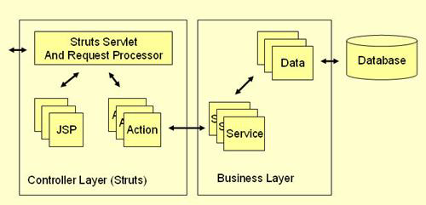
Architecture Overview

Slide 6
All incoming requests are intercepted by the Struts servlet controller. The Struts Configuration file struts-config.xml is used by the controller to determine the routing of the flow. This flows consists of an alternation between two transitions:
From View to Action : A user clicks on a link or submits a form on an HTML or JSP page. The controller receives the request, looks up the mapping for this request, and forwards it to an action. The action in turn calls a Model layer (Business layer) service or function.
From Action to View: After the call to an underlying function or service returns to the action class, the action forwards to a resource in the View layer and a page is displayed in a web browser.

Slide 7
Basic Components of Struts
The Struts framework is a rich collection of Java libraries and can be broken down into the following major pieces:
Base framework
JSP tag libraries
Tiles plugin
Validator plugin
A brief description of each follows.

Slide 8
A) Base Framework
The base framework provides the core MVC functionality and is comprised of the building blocks for your application. At the foundation of the base framework is the Controller servlet: ActionServlet

Slide 9
B) JSP Tag Libraries
JSP tag libraries enable JSP authors to use HTML-like tags to represent functionality that is defined by a Java class.

Slide 10
C) Tiles Plugin
With Tiles, JSP pages can be broken up into individual 'tiles' or pieces and then glued together to create one cohesive page.

Slide 11
D) Validator Plugin
Struts comes packaged, as of version 1.1, with the Validator subframework for performing data validation. Validator provides a rich framework for performing data validation on both the server side and client side (browser).

Slide 12
Struts framework core components
The Controller : The controller is implemented by a java servlet, this servlet is centralized point of control for the web application.
The ActionServlet extends the javax.servlet.http.httpServlet class.

Slide 13
The struts-config.xml File
This file contains all of the routing and configuration information for the Struts application. This XML file needs to be in the WEB-INF directory of the application.
Path
Type
Name
Scope
Validate
Input
Forward

Slide 14
Action Classes
It's the developer's responsibility to create these classes. They act as bridges between user-invoked URIs and business services. Actions process a request and return an ActionForward object that identifies the next component to invoke. They're part of the Controller layer, not the Model layer.
An action class handles the client request and prepares the response. It also decides where the response should be forwarded. Basically an action class receives data from the presentation layer and forwards the data to the corresponding business layer.

Slide 15
View Resources
View resources consist of Java Server Pages, HTML pages, JavaScript and Stylesheet files, Resource bundles, JavaBeans, and Struts JSP tags.

Slide 16
ActionForms
These greatly simplify user form validation by capturing user data from the HTTP request. They act as a "firewall" between forms (Web pages) and the application (actions). These components allow the validation of user input before proceeding to an Action. If the input is invalid, a page with an error can be displayed.

Slide 17
Model Components
The Struts Framework has no built-in support for the Model layer. Struts supports any model components:
• JavaBeans
• EJB
• CORBA
• JDO
• any other

Slide 18
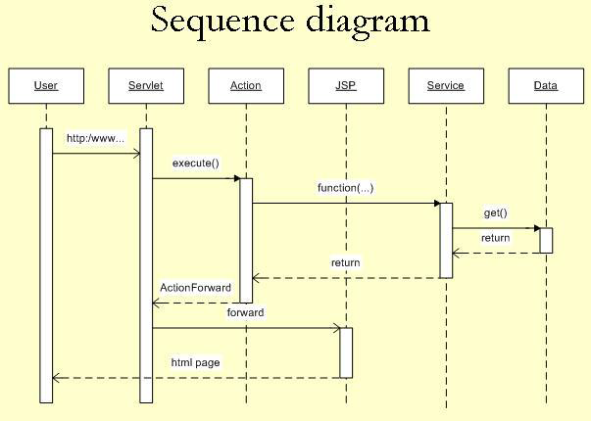

Slide 19
User clicks on a link in an HTML page.
Servlet controller receives the request, looks up mapping information in struts-config.xml, and routes to an action.
Action makes a call to a Model layer service.
Service makes a call to the Data layer (database) and the requested data is returned.
Service returns to the action.
Action forwards to a View resource (JSP page)
Servlet looks up the mapping for the requested resource and forwards to the appropriate JSP page.
JSP file is invoked and sent to the browser as HTML.
User is presented with a new HTML page in a web browser.

