Slide 1
Unit 6 – Chapter 1
Hibernate

Slide 2
Introduction
Hibernate framework simplifies the development of java application to interact with the database. Hibernate is an open source, lightweight, ORM (Object Relational Mapping) tool (is a programming technique for converting data between incompatible type systems using object-oriented programming languages. This creates, in effect, a "virtual object database" that can be used from within the programming language. There are both free and commercial packages available that perform object-relational mapping).
An ORM tool simplifies the data creation, data manipulation and data access. It is a programming technique that maps the object to the data stored in the database.
The ORM tool internally uses the JDBC API to interact with the database.

Slide 4
Advantages of Hibernate Framework
1) Open source and Lightweight
2) Fast performance
3) Database Independent query
4) Automatic table creation
5) Simplifies complex join
6) Provides query statistics and database status

Slide 5
Hibernate Architecture
The Hibernate architecture includes many objects persistent object, session factory, transaction factory, connection factory, session, transaction etc.
There are 4 layers in hibernate architecture java application layer, hibernate framework layer, backhand API layer and database layer. Let's see the diagram of hibernate architecture:

Slide 6
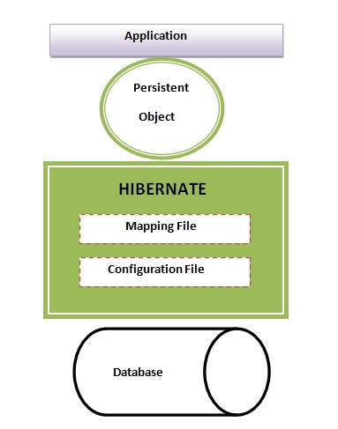

Slide 7
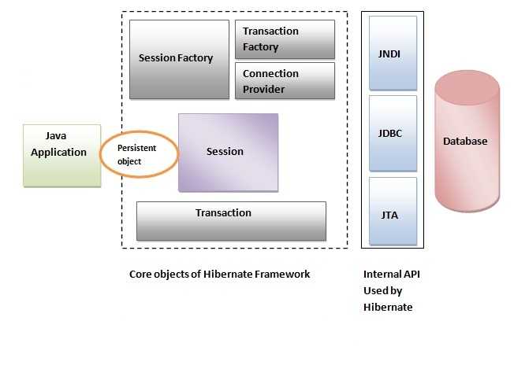
This is the high level architecture of Hibernate with mapping file and configuration file.

Slide 8
Hibernate framework uses many objects session factory, session, transaction etc. alongwith existing Java API such as JDBC (Java Database Connectivity), JTA (Java Transaction API) and JNDI (Java Naming Directory Interface).

Slide 9
Elements or Components of Hibernate Architecture
For creating the first hibernate application, we must know the elements of Hibernate architecture. They are as follows: SessionFactory The SessionFactory is a factory of session and client of ConnectionProvider. It holds second level cache (optional) of data. The org.hibernate.SessionFactory interface provides factory method to get the object of Session. Session The session object provides an interface between the application and data stored in the database. It is a short-lived object and wraps the JDBC connection. It is factory of Transaction, Query and Criteria. It holds a first-level cache (mandatory) of data. The org.hibernate.Session interface provides methods to insert, update and delete the object. It also provides factory methods for Transaction, Query and Criteria.

Slide 10
Transaction
The transaction object specifies the atomic unit of work. It is optional. The org.hibernate.Transaction interface provides methods for transaction management.
ConnectionProvider
It is a factory of JDBC connections. It abstracts the application from DriverManager or DataSource. It is optional.
TransactionFactory
It is a factory of Transaction. It is optional.

Slide 11
Persistent objects and collections (temporary session)
Short-lived, single threaded objects containing persistent state and business function.
As soon as the Session is closed, they will be detached and free to use in any application layer.
Transient and detached objects and collections
Instances of persistent classes that are not currently associated with a Session. They may have been instantiated by the application and not (yet) persisted or they may have been instantiated by a closed Session.

Slide 12
Hibernate Features
Inheritance, Polymorphism Support
Custom Data Types
Collections
Uni and Bi-directional entity Associations
Transactions and concurrency
Caching
Connection Pooling
HQL – Advanced Object Query Language

Slide 13
Mapping
Mapping Java classes to database table is accomplished through the configuration of an XML file or by using Java Annotation. When using an XML file, Hibernate can generate skeletal source code for the persistence classes. Hibernate can use the XML file or the annotation to maintain the database schema. Facilities to arrange one-to-many and many-to-many relationships between classes are provided. In addition to managing association between objects, Hibernate can also manage reflexive associations where an object has a one-to-many relationship with other instances of its own type.

Slide 14
Hibernate Query Language(HQL)
Hibernate provides a SQL inspired language called Hibernate Query Language (HQL) which allows SQL-like queries to be written against Hibernate's data objects.

Slide 15
hibernate.cfg.xml
Hibernate requires to know in advance where to find the mapping information that defines how your Java classes relate to the database tables. Hibernate also requires a set of configuration settings related to database and other related parameters. All such information is usually supplied as a standard Java properties file called hibernate.properties, or as an XML file named hibernate.cfg.xml.
Most of the properties take their default values and it is not required to specify them in the property file unless it is really required. This file is kept in the root directory of your application's classpath.

Slide 16
Hibernate Properties:
S.N. | Properties and Description
1 | hibernate.dialect This property makes Hibernate generate the appropriate SQL for the chosen database.
2 | hibernate.connection.driver_class The JDBC driver class.
3 | hibernate.connection.url The JDBC URL to the database instance.
4 | hibernate.connection.username The database username.
5 | hibernate.connection.password The database password.
6 | hibernate.connection.pool_size Limits the number of connections waiting in the Hibernate database connection pool.
7 | hibernate.connection.autocommit Allows autocommit mode to be used for the JDBC connection.

Slide 17
If you are using a database along with an application server and JNDI then you would have to configure the following properties
S.N. | Properties and Description
1 | hibernate.connection.datasource The JNDI name defined in the application server context you are using for the application.
2 | hibernate.jndi.class The InitialContext class for JNDI.
3 | hibernate.jndi.<JNDIpropertyname> Passes any JNDI property you like to the JNDI InitialContext.
4 | hibernate.jndi.url Provides the URL for JNDI.
5 | hibernate.connection.username The database username.
6 | hibernate.connection.password The database password.

Slide 18
Working of hibernate
1. Import the hibernate API, they are many more, but these 2 are more than enough…
import org.hibernate.*; import org.hibernate.cfg.*;

Slide 19
2. Mapping xml files
Load configuration xml, we need to create object of Configuration class, which is given in org.hibernate.cfg.*; and we need to call configure() method in that class, by passing xml configuration file name as parameter.
Eg:
Configuration cf = new Configuration(); cf.configure(“hibernate.cfg.xml”);

Slide 20
3. Reading data
cf will reads data from hibernate.cfg.xml
Stores the data in different variables
And finally all these variables are grouped and create one high level hibernate object we can call as SessionFactory object.
So Configuration class only can create this SessionFactory object
SessionFactory sf = cf.buildSessionFactory();

Slide 21
4. Creating an object of session
When ever session is opened then internally a database connection will be opened, in order to get a session or open a session we need to call openSession() method in SessionFactory, it means SessionFactory produces sessions.
Session session = sf.openSession();
sf is SessfionFactory object

Slide 22
5. Create a logical transaction
While working with insert, update, delete, operations from an hibernate application onto the database then hibernate needs a logical Transaction.
In order to begin a logical transaction in hibernate then we need to call a method beginTransaction() given by Session Interface.
Transaction tx = session.beginTransaction();
session is the object of Session Interface

Slide 23
6. Use the methods given by Session Interface
objects from application to database and from database to application
session .save(s) | Inserting object ‘s‘ into database
session.update(s) | Updating object ‘s‘ in the database
session.load(s) | Selecting object ‘s‘ object
session.delete(s) | Deleting object ‘s‘ from database

Slide 24
7. Commit and Close
So finally we need to call commit() in Transaction, like tx.commit();
And finally close the SessionFactory as sf.close()

Slide 25
POJO(Plain Old Java Object) in hibernate
The entire concept of Hibernate is to take the values from Java class attributes and persist them to a database table. A mapping document helps Hibernate in determining how to pull the values from the classes and map them with table and associated fields.
Java classes whose objects or instances will be stored in database tables are called persistent classes in Hibernate. Hibernate works best if these classes follow some simple rules, also known as the Plain Old Java Object (POJO) programming model.

Slide 26
There are following main rules of persistent classes, however, none of these rules are hard requirements.
All Java classes that will be persisted need a default constructor.
All classes should contain an ID in order to allow easy identification of your objects within Hibernate and the database. This property maps to the primary key column of a database table.
All attributes that will be persisted should be declared private and have getXXX and setXXX methods defined in the JavaBean style.
A central feature of Hibernate, proxies, depends upon the persistent class being either non-final, or the implementation of an interface that declares all public methods.
All classes that do not extend or implement some specialized classes and interfaces required by the EJB framework.

Slide 27
The Benefits of POJOs:
Decoupling: It decouples the application components from the infrastructure of the EJB framework that lets you construct an application from loosely coupled components.
Easier testing: You can test or run your business logic outside of the application server in a few seconds
Flexible: A Java POJO code can be implemented with any type of enterprise bean such as Message Driven Bean and Entity Bean.

Slide 28
A simple POJO example:
public class Employee {
private int id;
private String firstName;
private String lastName;
private int salary;
public Employee() {}
public Employee(String fname, String lname, int salary) {
this.firstName = fname;
this.lastName = lname;
this.salary = salary;
}
public int getId() {
return id;
}
public void setId( int id ) {
this.id = id;
}

Slide 29
public String getFirstName() {
return firstName;
}
public void setFirstName( String first_name ) {
this.firstName = first_name;
}
public String getLastName() {
return lastName;
}
public void setLastName( String last_name ) {
this.lastName = last_name;
}
public int getSalary() {
return salary;
}
public void setSalary( int salary ) {
this.salary = salary;
}
}

