Slide 1
Unit III

Slide 2
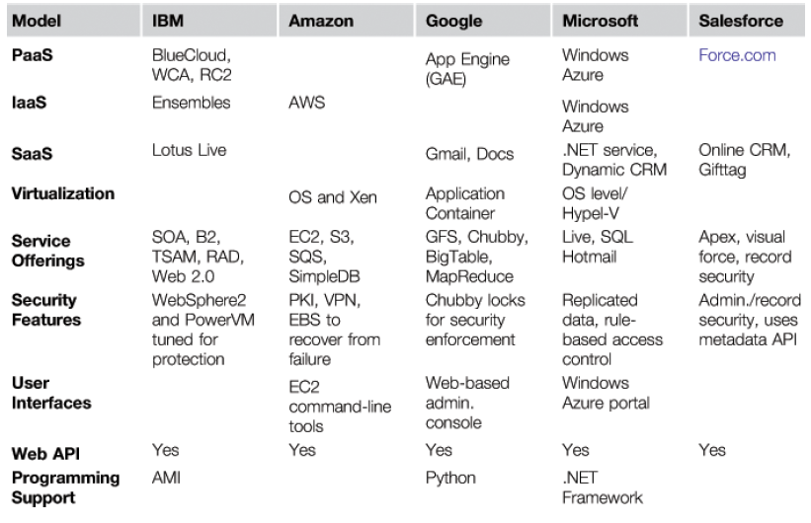
Five Major Cloud Platforms and Their Service Offerings

Slide 3
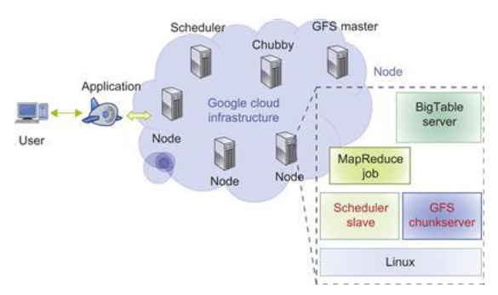
architecture of Google App Engine

Slide 4
The GAE platform comprises the following five major components:
a. The datastore offers object-oriented, distributed, structured data storage services based on BigTable techniques. The datastore secures data management operations.
b. The application runtime environment offers a platform for scalable web programming and execution. It supports two development languages: Python and Java.
c. The software development kit (SDK) is used for local application development. The SDK allows users to execute test runs of local applications and upload application code.
d. The administration console is used for easy management of user application development cycles, instead of for physical resource management.
e. The GAE web service infrastructure provides special interfaces to guarantee flexible use and management of storage and network resources by GAE.

Slide 5
applications of Google App Engine
Well-known GAE applications include the Google Search Engine, Google Docs, Google Earth, and Gmail. These applications can support large numbers of users simultaneously.

Slide 6
https://www.youtube.com/watch?v=avP5d16wEp0

Slide 7
architecture of Microsoft Windows Azure
The platform is divided into three major component platforms. Windows Azure offers a cloud platform built on Windows OS and based on Microsoft virtualization technology. Applications are installed on VMs deployed on the data-center servers. Azure manages all servers, storage, and network resources of the data center. On top of the infrastructure are the various services for building different cloud applications.

Slide 8
Cloud-level services provided by the Azure platform :
Live service Users can visit Microsoft Live applications and apply the data involved across multiple machines concurrently.
.NET service This package supports application development on local hosts and execution on cloud machines.
SQL Azure This function makes it easier for users to visit and use the relational database associated with the SQL server in the cloud.
SharePoint service This provides a scalable and manageable platform for users to develop their special business applications in upgraded web services.
Dynamic CRM service This provides software developers a business platform in managing CRM applications in financing, marketing, and sales and promotions.

Slide 9
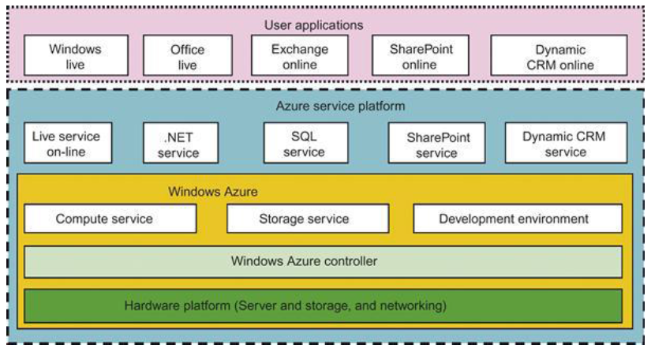

Slide 10
six layers of cloud services
six layers of cloud services, ranging from hardware, network, and collocation to infrastructure, platform, and software applications. We already introduced the top three service layers as SaaS, PaaS, and IaaS, respectively

Slide 11
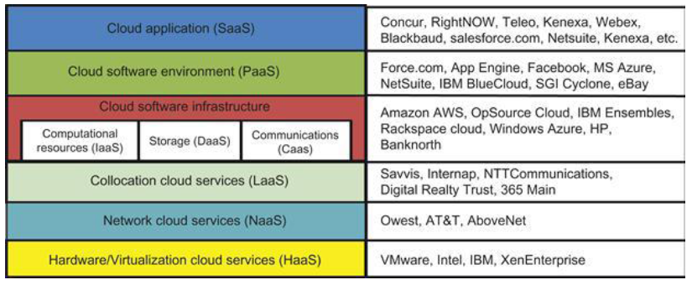

Slide 12
Provisioning of Storage Resources
The data storage layer is built on top of the physical or virtual servers. As the cloud computing applications often provide service to users, it is unavoidable that the data is stored in the clusters of the cloud provider. The service can be accessed anywhere in the world. One example is e-mail systems.

Slide 13
A typical large e-mail system might have millions of users and ach user can have thousands of e-mails and consume multiple gigabytes of disk space. Another example is a web searching application. In storage technologies, hard disk drives may be augmented with solid-state drives in the future.

Slide 14
Storage Services in Three Cloud Computing Systems
GFS: Google File System - Very large sustainable reading and writing bandwidth, mostly continuous accessing instead of random accessing. The programming interface is similar to that of the POSIX file system accessing interface.
HDFS: Hadoop Distributed File System - The open source clone of GFS Written in Java. The programming interfaces are similar to POSIX but not identical.
Amazon S3(Simple Storage Services) and EBS(Elastic Block Store) - S3 is used for retrieving and storing data from/to remote servers. EBS is built on top of S3 for using virtual disks in running EC2 instances.

Slide 15
cloud creation and management
Independent Service Management: By using independent service providers, the cloud applications can run different services at the same time. Some other services are used for providing data other than the compute or storage services.

Slide 16
Running Third-Party Applications : Cloud platforms have to provide support for building applications that are constructed by third-party application providers or programmers.

Slide 17
Virtual Machine Manager
The VM manager is the link between the gateway and resources. The gateway doesn’t share physical resources directly, but relies on virtualization technology for abstracting them. Hence, the actual resources it uses are VMs.

Slide 18
Virtual Machine Templates
A VM template is analogous to a computer’s configuration and contains a description for a VM with the following static information:
• The number of cores or processors to be assigned to the VM
• The amount of memory the VM requires
• The kernel used to boot the VM’s operating system
• The disk image containing the VM’s file system
• The price per hour of using a VM

Slide 19
Distributed VM Management
A distributed VM manager makes requests for VMs and queries their status. This manager requests VMs from the gateway on behalf of the user application. The manager obtains the list of requested VMs from the gateway.

Slide 20
security measures corresponding to different cloud service models
Three basic cloud security enforcements are expected. First, facility security in data centers demands on-site security year round. Biometric readers, CCTV (close-circuit TV), motion detection, and man traps are often deployed. Also, network security demands fault-tolerant external firewalls, intrusion detection systems (IDSes), and third-party vulnerability assessment. Finally, platform security demands SSL and data decryption, strict password policies, and system trust certification.

Slide 21
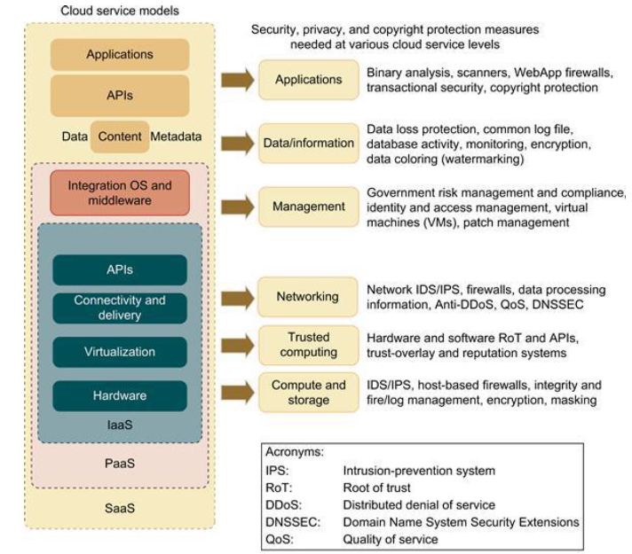

Slide 22
Here are some cloud components that demand special security protection:
• Protection of servers from malicious software attacks such as worms, viruses, and malware
• Protection of hypervisors or VM monitors from software-based attacks and vulnerabilities
• Protection of VMs and monitors from service disruption and DoS attacks
• Protection of data and information from theft, corruption, and natural disasters
• Providing authenticated and authorized access to critical data and services

Slide 23
Physical and Cyber Security Protection at Cloud/Data Centers
Secure data centers and computer buildings - Choose hazard-free location, enforce building safety. Avoid windows, keep buffer zone around the site, bomb detection, camera surveillance, earthquake-proof, etc.
Use redundant utilities at multiple sites - Multiple power and supplies, alternate network connections, multiple databases at separate sites, data consistency, data watermarking, user authentication, etc.

Slide 24
Trust delegation and negotiation - Cross certificates to delegate trust across PKI domains for various data centers, trust negotiation among certificate authorities (CAs) to resolve policy conflicts
Worm containment and DDoS defense - Internet worm containment and distributed defense against DDoS attacks to secure all data centers and cloud platforms

Slide 25
Reputation system for data centers - Reputation system could be built with P2P technology; one can build a hierarchy of reputation systems from data centers to distributed file systems
Fine-grained file access control - Fine-grained access control at the file or object level; this adds to security protection beyond firewalls and IDSes

Slide 26
Copyright protection and piracy prevention - Piracy prevention achieved with peer collusion prevention, filtering of poisoned content, nondestructive read, alteration detection, etc.
Privacy protection - Uses double authentication, biometric identification, intrusion detection and disaster recovery, privacy enforcement by data watermarking, data classification, etc.

Slide 27
Distributed Denial of service
A DDoS defense system must be designed to cover multiple network domains spanned by a given cloud platform. These network domains cover the edge networks where cloud resources are connected.
DDoS attacks come with widespread worms. The flooding traffic is large enough to crash the victim server by buffer overflow, disk exhaustion, or connection saturation.

Slide 28
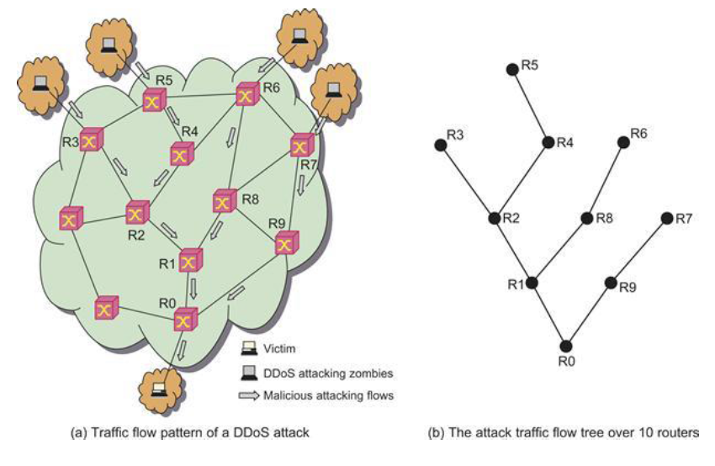

Slide 29
Figure shows a flooding attack pattern. Here, the hidden attacker launched the attack from many zombies toward a victim server at the bottom router R0.
The flooding traffic flows essentially with a tree pattern shown in Figure . Successive attack-transit routers along the tree reveal the abnormal surge in traffic. This DDoS defense system is based on change-point detection by all routers.

Slide 30
Data Integrity and Privacy Protection
Users desire a software environment that provides many useful tools to build cloud applications over large data sets.
In addition to application software for MapReduce, BigTable, EC2, 3S, Hadoop, AWS, GAE, and WebSphere2, users need some security and privacy protection software for using the cloud.

Slide 31
Such software should offer the following features:
• Special APIs for authenticating users and sending e-mail using commercial accounts
• Fine-grained access control to protect data integrity and deter intruders or hackers
• Shared data sets protected from malicious alteration, deletion, or copyright violation
• Ability to secure the ISP or cloud service provider from invading users’ privacy
• Personal firewalls at user ends to keep shared data sets from Java, JavaScript, and ActiveX applets
• A privacy policy consistent with the cloud service provider’s policy, to protect against identity theft, spyware, and web bugs
• VPN channels between resource sites to secure transmission of critical data objects

Slide 32
Data Coloring and Cloud Watermarking
With shared files and data sets, privacy, security, and copyright information could be compromised in a cloud computing environment. Users desire to work in a trusted software environment that provides useful tools to build cloud applications over protected data sets. In the past, watermarking was mainly used for digital copyright management.
As shown in Figure, the system generates special colors for each data object. Data coloring means labeling each data object by a unique color. Differently colored data objects are thus distinguishable. The user identification is also colored to be matched with the data colors.

Slide 33
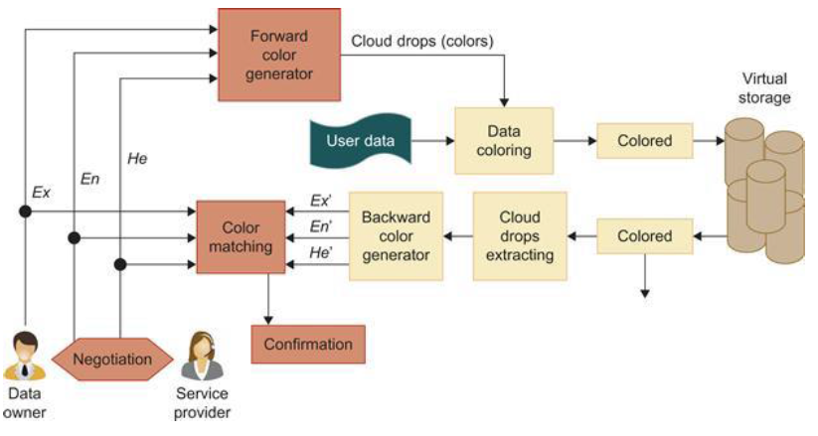

Slide 34
Data Lock-in Problem and Proactive Solutions
Cloud computing moves both the computation and the data to the server clusters maintained by cloud service providers. Once the data is moved into the cloud, users cannot easily extract their data and programs from cloud servers to run on another platform. This leads to a data lock-in problem.

Slide 35
capability needs of commercial clouds
Most of them were designed for P2P or social networks. These reputation systems can be converted for protecting cloud computing applications. In general, the reputation systems are classified as centralized or distributed depending on how they are implemented.
In a centralized system, a single central authority is responsible for managing the reputation system, while the distributed model involves multiple control centers working collectively. Reputation-based trust management and techniques for securing P2P and social networks could be merged to defend data centers and cloud platforms against attacks from the open network.

Slide 36
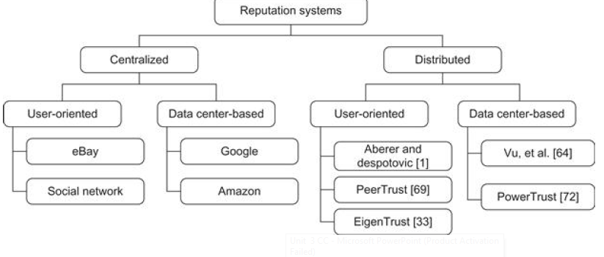

Slide 37
Infrastructure Cloud Features
Accounting: Includes economies; clearly an active area for commercial clouds
Appliances: Preconfigured virtual machine (VM) image supporting multifaceted tasks such as messagepassing interface (MPI) clusters
Authentication and authorization: Could need single sign-on to multiple systems
Data transport: Transports data between job components both between and within grids and clouds; exploits custom storage patterns as in BitTorrent
Operating systems: Apple, Android, Linux, Windows
Program library: Stores images and other program material
Virtualization: Basic feature of clouds supporting “elastic” feature highlighted by Berkeley as characteristic of what defines a (public) cloud; includes virtual networking.

Slide 38
Registry: Information resource for system (system version of metadata management)
Security: Security features other than basic authentication and authorization; includes higher level concepts such as trust
Scheduling: Basic staple of Condor, Platform, Oracle Grid Engine, etc.; clouds have this implicitly as is especially clear with Azure Worker Role
Gang scheduling: Assigns multiple (data-parallel) tasks in a scalable fashion; note that this is provided automatically by MapReduce
Software as a Service (SaaS): Shared between clouds and grids, and can be supported without special attention; Note use of services and corresponding service oriented architectures are very successful and are used in clouds very similarly to previous distributed systems.

Slide 39
Traditional Features in Cluster, Grid, and Parallel Computing Environments
Cluster management: ROCKS and packages offering a range of tools to make it easy to bring up clusters
Data management: Included metadata support such as RDF triple stores (Semantic web success and can be built on MapReduce as in SHARD); SQL and NOSQL included in
Grid programming environment: Varies from link-together services as in Open Grid Services Architecture (OGSA) to GridRPC (Ninf, GridSolve) and SAGA
OpenMP/threading: Can include parallel compilers such as Cilk; roughly shared memory technologies. Even transactional memory and fine-grained data flow come here
Portals: Can be called (science) gateways and see an interesting change in technology from portlets to HUBzero and now in the cloud: Azure Web Roles and GAE

Slide 40
Scalable parallel computing environments: MPI and associated higher level concepts including ill-fated HP FORTRAN, PGAS (not successful but not disgraced), HPCS languages (X-10, Fortress, Chapel), patterns (including Berkeley dwarves), and functional languages such as F# for distributed memory
Virtual organizations: From specialized grid solutions to popular Web 2.0 capabilities such as Facebook
Workflow: Supports workflows that link job components either within or between grids and clouds; relate to LIMS Laboratory Information Management Systems.

Slide 41
Platform Features Supported by Clouds and (Sometimes) Grids
Blob: Basic storage concept typified by Azure Blob and Amazon S3
DPFS: Support of file systems such as Google (MapReduce), HDFS (Hadoop), and Cosmos (Dryad) with compute-data affinity optimized for data processing
Fault tolerance: this was largely ignored in grids, but is a major feature of clouds
MapReduce: Support MapReduce programming model including Hadoop on Linux, Dryad on Windows HPCS, and Twister on Windows and Linux. Include new associated languages such as Sawzall, Pregel, Pig Latin, and LINQ
Monitoring: Many grid solutions such as Inca. Can be based on publish-subscribe

Slide 42
Notification: Basic function of publish-subscribe systems
Programming model: Cloud programming models are built with other platform features and are related to familiar web and grid models
Queues: Queuing system possibly based on publish-subscribe
Scalable synchronization: Apache Zookeeper or Google Chubby. Supports distributed locks and used by BigTable. Not clear if (effectively) used in Azure Table or Amazon SimpleDB
SQL: Relational database

Slide 43
Table: Support of table data structures modeled on Apache Hbase or Amazon SimpleDB/Azure Table. Part of NOSQL movement
Web role: Used in Azure to describe important link to user and can be supported otherwise with a portal framework. This is the main purpose of GAE
Worker role: Implicitly used in both Amazon and grids but was first introduced as a high-level construct by Azure

Slide 44
Security, Privacy, and Availability
The following techniques are related to security, privacy, and availability requirements for developing a healthy and dependable cloud programming environment.
We summarize these techniques here:
• Use virtual clustering to achieve dynamic resource provisioning with minimum overhead cost.
• Use stable and persistent data storage with fast queries for information retrieval.
• Use special APIs for authenticating users and sending e-mail using commercial accounts.
• Cloud resources are accessed with security protocols such as HTTPS and SSL.

Slide 45
Fine-grained access control is desired to protect data integrity and deter intruders or hackers.
• Shared data sets are protected from malicious alteration, deletion, or copyright violations.
• Features are included for availability enhancement and disaster recovery with life migration of VMs.
• Use a reputation system to protect data centers. This system only authorizes trusted clients and stops pirates.

Slide 46
system issues for running a typical parallel program
Computation partitioning This splits a given job or a program into smaller tasks. Partitioning greatly depends on correctly identifying portions of the job or program that can be performed concurrently. In other words, upon identifying parallelism in the structure of the program, it can be divided into parts to be run on different workers. Different parts may process different data or a copy of the same data.

Slide 47
Data partitioning This splits the input or intermediate data into smaller pieces. Similarly, upon identification of parallelism in the input data, it can also be divided into pieces to be processed on different workers. Data pieces may be processed by different parts of a program or a copy of the same program.

Slide 48
Mapping This assigns the either smaller parts of a program or the smaller pieces of data to underlying resources. This process aims to appropriately assign such parts or pieces to be run simultaneously on different workers and is usually handled by resource allocators in the system.

Slide 49
Mapping This assigns the either smaller parts of a program or the smaller pieces of data to underlying resources. This process aims to appropriately assign such parts or pieces to be run simultaneously on different workers and is usually handled by resource allocators in the system.

Slide 50
Communication Because data dependency is one of the main reasons for communication among workers, communication is always triggered when the intermediate data is sent to workers.

Slide 51
Scheduling For a job or program, when the number of computation parts (tasks) or data pieces is more than the number of available workers, a scheduler selects a sequence of tasks or data pieces to be assigned to the workers.

Slide 52
Formal Definition of MapReduce
The MapReduce software framework provides an abstraction layer with the data flow and flow of control to users, and hides the implementation of all data flow steps such as data partitioning, mapping, synchronization, communication, and scheduling. Here, although the data flow in such frameworks is predefined, the abstraction layer provides two well-defined interfaces in the form of two functions: Map and Reduce. These two main functions can be overridden by the user to achieve specific objectives. Therefore, the user overrides the Map and Reduce functions first and then invokes the provided MapReduce (Spec, & Results) function from the library to start the flow of data.

