Slide 1
Unit I – Chapter 1
Distributed System Models and Enabling Technologies

Slide 2
HPC
HPC systems emphasize the raw speed performance. The speed of HPC systems has increased from Gflops in the early 1990s to now Pflops in 2010. This improvement was driven mainly by the demands from scientific, engineering, and manufacturing communities.

Slide 3
HTC
HTC paradigm pays more attention to high-flux computing. The main application for high-flux computing is in Internet searches and web services by millions or more users simultaneously. The performance goal thus shifts to measure high throughput or the number of tasks completed per unit of time. HTC technology needs to not only improve in terms of batch processing speed, but also address the acute problems of cost, energy savings, security, and reliability at many data and enterprise computing centers.

Slide 4
Following are design objectives:
Efficiency measures the utilization rate of resources
Dependability measures the reliability and self-management. Provide high-throughput service with Quality of Service (QoS) assurance, even under failure conditions.
Adaptation in the programming model
measures the ability to support billions of job requests over massive data sets and virtualized cloud resources
Flexibility in application deployment measures the ability of distributed systems to run well in both HPC (science and engineering) and HTC (business) applications.

Slide 5
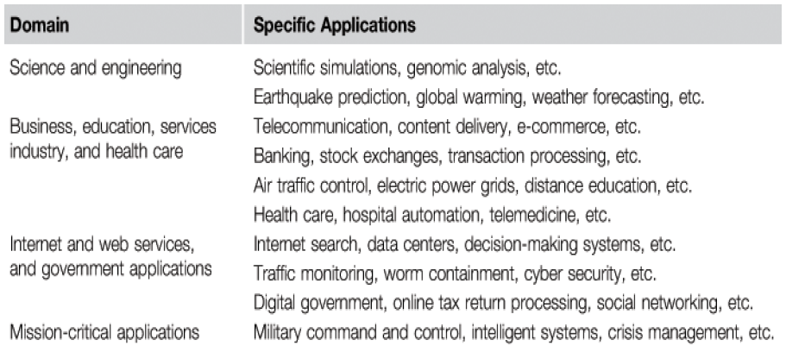
Applications of HPC and HTC Systems:

Slide 6
Centralized computing
This is a computing paradigm by which all computer resources are centralized in one physical system. All resources (processors, memory, and storage) are fully shared and tightly coupled within one integrated OS. Many data centers and supercomputers are centralized systems, but they are used in parallel, distributed, and cloud computing applications

Slide 7
Parallel computing
In parallel computing, all processors are either tightly coupled with centralized shared memory or loosely coupled with distributed memory. Interprocessor communication is accomplished through shared memory or via message passing.

Slide 8
Distributed computing
A distributed system consists of multiple autonomous computers, each having its own private memory, communicating through a computer network. Information exchange in a distributed system is accomplished through message passing.

Slide 9
Cloud computing
An Internet cloud of resources can be either a centralized or a distributed computing system. The cloud applies parallel or distributed computing, or both. Clouds can be built with physical or virtualized resources over large data centers that are centralized or distributed. Some authors consider cloud computing to be a form of utility computing or service computing.

Slide 10
Ubiquitous computing
It refers to computing with pervasive devices at any place and time using wired or wireless communication.

Slide 11
Internet computing
It is even broader and covers all computing paradigms over the Internet.

Slide 12
Different degrees of parallelism.
Fifty years ago, when hardware was bulky and expensive, most computers were designed in a bit-serial fashion. In this scenario, bit-level parallelism (BLP) converts bit-serial processing to word-level processing gradually.
Over the years, users graduated from 4-bit microprocessors to 8-, 16-, 32-, and 64-bit CPUs. This led us to the next wave of improvement, known as instruction-level parallelism (ILP), in which the processor executes multiple instructions simultaneously rather than only one instruction at a time.

Slide 13
VLIW (very long instruction word) architectures, and multithreading. ILP requires branch prediction, dynamic scheduling, speculation, and compiler support to work efficiently.
Data-level parallelism (DLP) was made popular through SIMD (single instruction, multiple data) and vector machines using vector or array types of instructions.

Slide 14
Ever since the introduction of multicore processors and chip multiprocessors (CMPs), we have been exploring task-level parallelism (TLP).
As we move from parallel processing to distributed processing, we will see an increase in computing granularity to job-level parallelism (JLP).

Slide 15
Internet of Things
https://www.youtube.com/watch?v=QSIPNhOiMoE

Slide 16
Cyber-Physical System
cyber-physical system (CPS) is the result of interaction between computational processes and the physical world. A CPS integrates “cyber” (heterogeneous, asynchronous) with “physical” (concurrent and information-dense) objects.

Slide 17
Example 1: Heart surgery often requires stopping the heart, performing the surgery, and then restarting the heart. Such surgery is extremely risky and carries many detrimental side effects. A number of research teams have been working on an alternative where a surgeon can operate on a beating heart rather than stopping the heart. There are two key ideas that make this possible. First, surgical tools can be robotically controlled so that they move with the motion of the heart. A surgeon can therefore use a tool to apply constant pressure to a point on the heart while the heart continues to beat. Second, a stereoscopic video system can present to the surgeon a video illusion of a still heart. To the surgeon, it looks as if the heart has been stopped, while in reality, the heart continues to beat. To realize such a surgical system requires extensive modelling of the heart, the tools, the computational hardware, and the software. It requires careful design of the software that ensures precise timing and safe fall-back behaviours to handle malfunctions. And it requires detailed analysis of the models and the designs to provide high conﬁdence.

Slide 18
Example 2: Consider a city where trafﬁc lights and cars cooperate to ensure efﬁcient ﬂow of trafﬁc. In particular, imagine never having to stop at a red light unless there is actual cross trafﬁc. Such a system could be realized with expensive infrastructure that detects cars on the road. But a better approach might be to have the cars themselves cooperate. They track their position and communicate to cooperatively use shared resources such as intersections. Making such a system reliable, of course, is essential to its viability. Failures could be disastrous.

Slide 19
Computer Cluster
A computing cluster consists of interconnected stand-alone computers which work cooperatively as a single integrated computing resource. In the past, clustered computer systems have demonstrated impressive results in handling heavy workloads with large data sets.

Slide 20
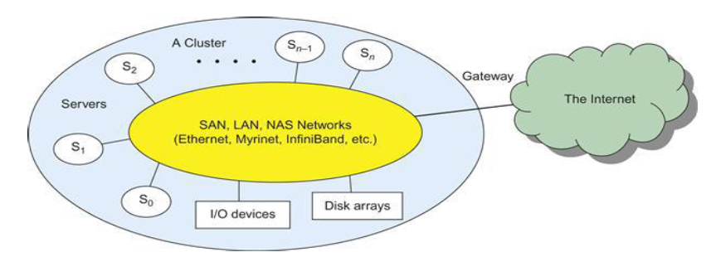
Architecture

Slide 21
Grid Computing
Grid computing is envisioned to allow close interaction among applications running on distant computers simultaneously.
Like an electric utility power grid, a computing grid offers an infrastructure that couples computers, software/middleware, special instruments, and people and sensors together. The grid is often constructed across LAN, WAN, or Internet backbone networks at a regional, national, or global scale.

Slide 22
https://www.youtube.com/watch?v=esVzoSqQ1Pc

Slide 23
Example: computational grid built over multiple resource sites owned by different organizations. The resource sites offer complementary computing resources, including workstations, large servers, a mesh of processors, and Linux clusters to satisfy a chain of computational needs. The grid is built across various IP broadband networks including LANs and WANs already used by enterprises or organizations over the Internet. The grid is presented to users as an integrated resource pool as shown in the upper half of the figure.

Slide 24
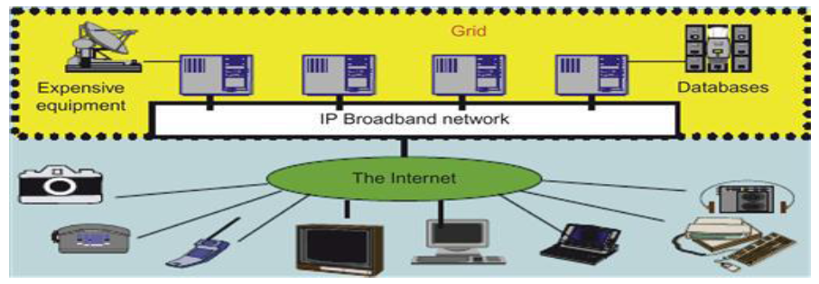

Slide 25
peer-to-peer systems
In a P2P system, every node acts as both a client and a server, providing part of the system resources. Peer machines are simply client computers connected to the Internet. All client machines act autonomously to join or leave the system freely.

Slide 26
Overlay Network
The virtual connection between two endpoints of a network used created using routing or switching software that can apply software tags, labels, and/or encryption to create a virtual tunnel that runs through the network. If encryption is used, the data can be secured between the endpoints so that the end-users must be authenticated in order to use the connection.

Slide 27
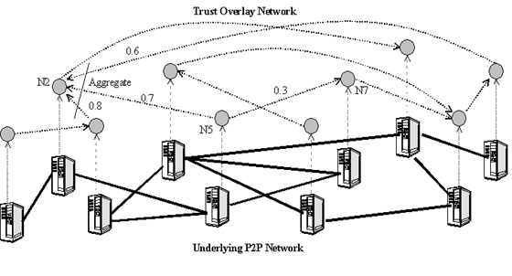

Slide 28
There are two types of overlay networks: unstructured and structured.
An unstructured overlay network is characterized by a random graph. There is no fixed route to send messages or files among the nodes. Often, flooding is applied to send a query to all nodes in an unstructured overlay, thus resulting in heavy network traffic and nondeterministic search results.
Structured overlay networks follow certain connectivity topology and rules for inserting and removing nodes (peer IDs) from the overlay graph. Routing mechanisms are developed to take advantage of the structured overlays.

Slide 29
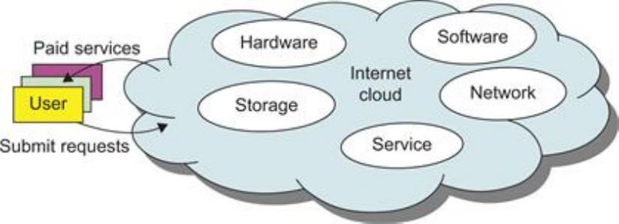
Internet Clouds
Cloud computing applies a virtualized platform with elastic resources on demand by provisioning hardware, software, and data sets dynamically.

Slide 30
three service models of cloud
Infrastructure as a Service (IaaS) This model puts together infrastructures demanded by users—namely servers, storage, networks, and the data center fabric. The user can deploy and run on multiple VMs running guest OSes on specific applications. The user does not manage or control the underlying cloud infrastructure, but can specify when to request and release the needed resources.

Slide 31
Platform as a Service (PaaS) This model enables the user to deploy user-built applications onto a virtualized cloud platform. PaaS includes middleware, databases, development tools, and some runtime support such as Web 2.0 and Java. The provider supplies the API and software tools (e.g., Java, Python, Web 2.0, .NET).

Slide 32
Software as a Service (SaaS) This refers to browser-initiated application software over thousands of paid cloud customers. The SaaS model applies to business processes, industry applications, consumer relationship management (CRM), enterprise resources planning (ERP), human resources (HR), and collaborative applications.

Slide 33
https://www.youtube.com/watch?v=whkyRvugqlM

Slide 34
service oriented architecture(SOA)
In grids/web services, Java, and CORBA, an entity is, respectively, a service, a Java object,
On top of this we have a base software environment, which would be .NET or Apache Axis for web services, the Java Virtual Machine for Java, and a broker network for CORBA.
On top of this base environment one would build a higher level environment reflecting the special features of the distributed computing environment.

Slide 35
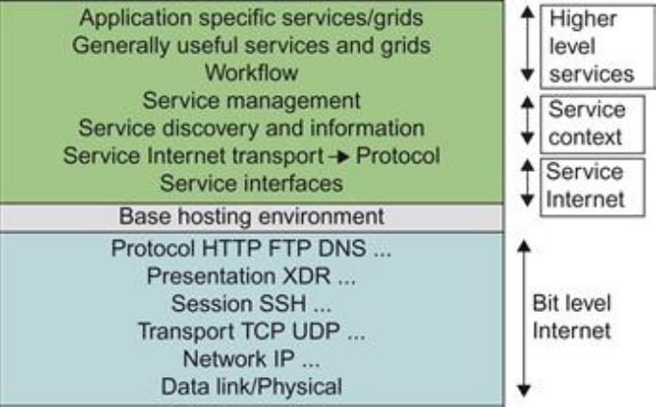

Slide 36
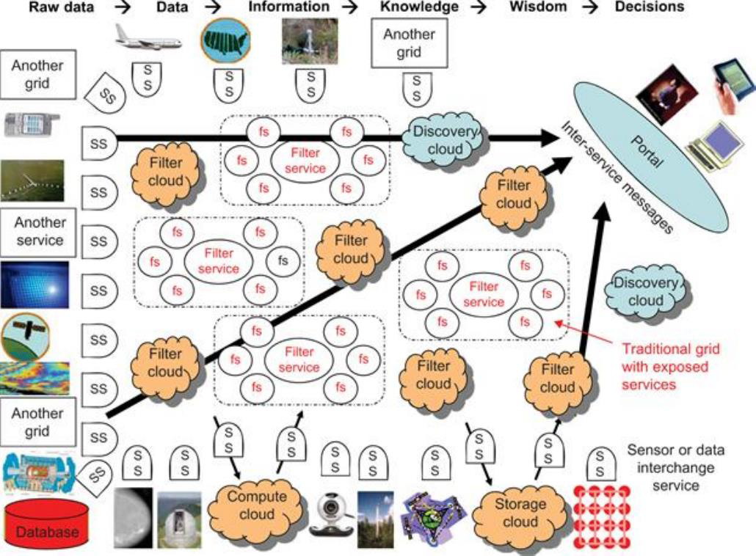
evolution of service oriented architecture

Slide 37
Compare grids and clouds
A grid system applies static resources, while a cloud emphasizes elastic resources.
For some researchers, the differences between grids and clouds are limited only in dynamic resource allocation based on virtualization and autonomic computing.
One can build a grid out of multiple clouds. This type of grid can do a better job than a pure cloud, because it can explicitly support negotiated resource allocation.
Thus one may end up building with a system of systems: such as a cloud of clouds, a grid of clouds, or a cloud of grids, or inter-clouds as a basic SOA architecture.

Slide 38
concept of transparent computing environments for computing platforms.
Data is owned by users, independent of the applications.
The OS provides clear interfaces, standard programming interfaces, or system calls to application programmers.
In future cloud infrastructure, the hardware will be separated by standard interfaces from the OS. Thus, users will be able to choose from different OSes on top of the hardware devices they prefer to use.
To separate user data from specific application programs, users can enable cloud applications as SaaS. Thus, users can switch among different services.

Slide 39
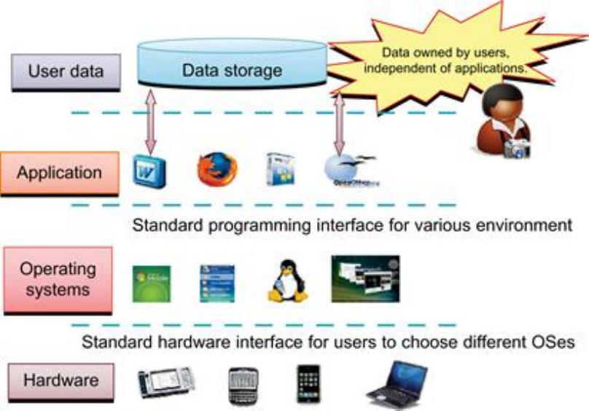

Slide 40
different programming models for parallel and distributed computing
Message-Passing Interface (MPI): This is the primary programming standard used to develop parallel and concurrent programs to run on a distributed system. MPI is essentially a library of subprograms that can be called from C or FORTRAN to write parallel programs running on a distributed system.

Slide 41
MapReduce: This is a web programming model for scalable data processing on large clusters over large data sets. The model is applied mainly in web-scale search and cloud computing applications.

Slide 42
Hadoop Library: Hadoop offers a software platform that was originally developed by a Yahoo! group. The package enables users to write and run applications over vast amounts of distributed data. Users can easily scale Hadoop to store and process petabytes of data in the web space.

Slide 43
different performance metrics in distributed systems
System throughput
job response time network latency
QoS for Internet and web services
system availability
dependability
security resilience for system defense against network attacks.

Slide 44
The following dimensions of scalability are characterized in parallel and distributed systems:
Size scalability This refers to achieving higher performance or more functionality by increasing the machine size. The word “size” refers to adding processors, cache, memory, storage, or I/O channels.
Software scalability This refers to upgrades in the OS or compilers, adding mathematical and engineering libraries, porting new application software, and installing more user-friendly programming environments.

Slide 45
Application scalability This refers to matching problem size scalability with machine size scalability.
Technology scalability This refers to a system that can adapt to changes in building technologies, such as the component and networking technologies. When scaling a system design with new technology one must consider three aspects: time, space, and heterogeneity.

Slide 46

State Amdahl’s Law
Amdahl's Law is a law governing the speedup of using parallel processors on a problem, versus using only one serial processor. Before we examine Amdahl's Law, we should gain a better understanding of what is meant by speedup.
Speedup:
The speed of a program is the time it takes the program to execute. This could be measured in any increment of time. Speedup is defined as the time it takes a program to execute in serial (with one processor) divided by the time it takes to execute in parallel (with many processors). The formula for speedup is:

Slide 47
Where T(j) is the time it takes to execute the program when using j processors. Efficiency is the speedup, divided by the number of processors used. This is an important factor to consider. Due to the cost of multiprocessor super computers, a company wants to get the most bang for their dollar.
To explore speedup more, we shall do a bit of analysis. If there are N workers working on a project, we may assume that they would be able to do a job in 1/N time of one worker working alone. Now, if we assume the strictly serial part of the program is performed in B*T(1) time, then the strictly parallel part is performed in ((1-B)*T(1)) / N time. With some substitution and number manipulation, we get the formula for speedup as:

Slide 48

This formula is known as Amdahl's Law.
https://www.youtube.com/watch?v=swiwgi5HA0E

Slide 49
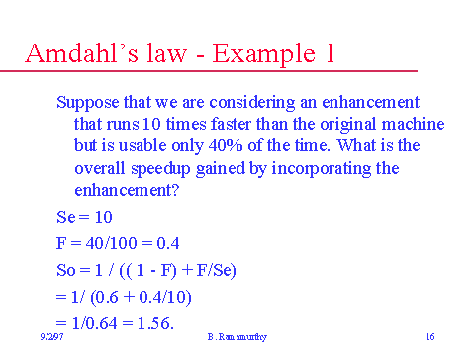

Slide 50
Problem with Fixed Workload
In Amdahl’s law, we have assumed the same amount of workload for both sequential and parallel execution of the program with a fixed problem size or data set. This was called fixed-workload speedup.
To execute a fixed work-load on n processors, parallel processing may lead to a system efficiency defined as follows:

Slide 51
Very often the system efficiency is rather low, especially when the cluster size is very large. To execute the aforementioned program on a cluster with n = 256 nodes, extremely low efficiency E = 1/[0.25 × 256 + 0.75] = 1.5% is observed. This is because only a few processors (say, 4) are kept busy, while the majority of the nodes are left idling.

Slide 52
To solve scaled problems, users should apply Gustafson’s law
To achieve higher efficiency when using a large cluster, we must consider scaling the problem size to match the cluster capability. This leads to the following speedup law proposed by John Gustafson, referred as scaled-workload speedup. Let W be the workload in a given program. When using an n-processor system, the user scales the workload to W′ = αW + (1− α)nW. This scaled workload W′ is essentially the sequential execution time on a single processor. The parallel execution time of a scaled workload W′ on n processors is defined by a scaled-workload speedup as follows:

Slide 53
This speedup is known as Gustafson’s law. By fixing the parallel execution time at level W, the following efficiency expression is obtained:

Slide 55
different threats to systems and networks in cyberspace
Information leaks lead to a loss of confidentiality.
Loss of data integrity may be caused by user alteration, Trojan horses, and service spoofing attacks.
A denial of service (DoS) results in a loss of system operation and Internet connections.
Lack of authentication or authorization leads to attackers’ illegitimate use of computing resources.
Malicious intrusions to these systems may destroy valuable hosts, as well as network and storage resources.
Internet anomalies found in routers, gateways, and distributed hosts may hinder the acceptance of these public-resource computing services.

Slide 57
Application Layer: Until now, most user applications in science, business, engineering, and financial areas tend to increase a system’s speed or quality.
Middleware Layer: The middleware layer acts as a bridge between the application layer and the resource layer. This layer provides resource broker, communication service, task analyzer, task scheduler, security access, reliability control, and information service capabilities.

Slide 58
Resource Layer: The resource layer consists of a wide range of resources including computing nodes and storage units. This layer generally interacts with hardware devices and the operating system; therefore, it is responsible for controlling all distributed resources in distributed computing systems.
Dynamic power management (DPM) and dynamic voltage-frequency scaling (DVFS) are two popular methods incorporated into recent computer hardware systems.
Network Layer: Routing and transferring packets and enabling network services to the resource layer are the main responsibility of the network layer in distributed computing systems.

