Slide 1
Unit II
Chapter 1: Minimizing Power Usage

Slide 2
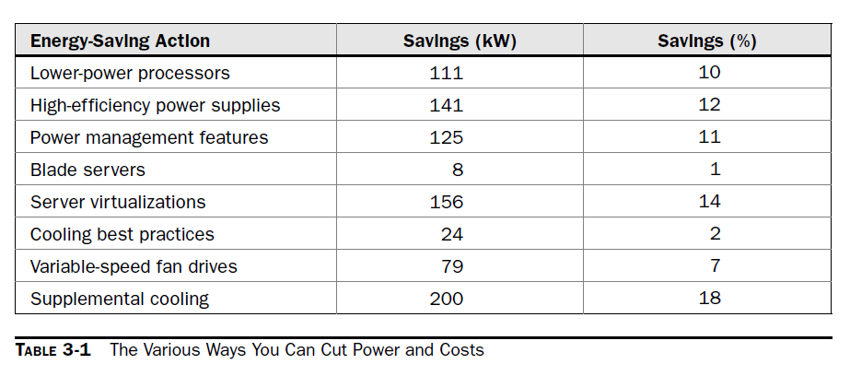
Power Problems

Slide 3
Monitoring Power Usage
Servers: To monitor power consumption yourself, you need to use power-monitoring software. Without knowledge of where you’re starting, it’s impossible to tell how much of a problem you have and to what degree your fixes are helping.
Several vendors offer tools that help monitor datacenter power. For instance, IBM’s PowerExecutive provides the tools needed to monitor and manage power consumption accurately. It can measure real-time power consumption and heat emission by individual server, server group, or location.
It allows for the optimization of energy use and the lowering of power consumption when low utilization can provide cost savings. These power monitoring and management capabilities are an important tool in achieving energy efficiency in the datacenter.

Slide 4
Low-Cost Options
Kill A Watt:
The Kill A Watt device is a US$25 product that you plug into the wall and then plug your computer or monitor into the device. The result is that it will show you how much power your device is using.
True, it’s not really practical in an environment with hundreds of workstations to run around and plug in this device. However, assuming all the devices’ settings are the same (or similar), you can measure a couple workstations and make some easy (and inexpensive) assumptions about power usage.

Slide 5
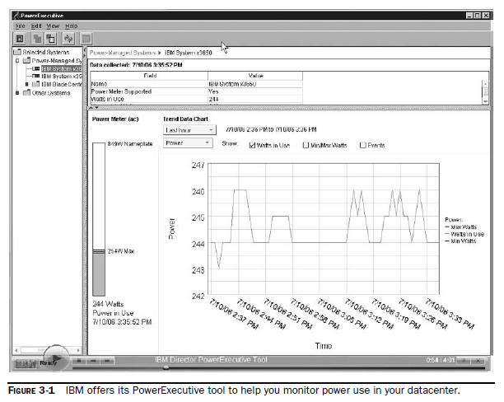

Slide 6
Calculator
Tech Republic offers a free worksheet to help you determine various costs for monitor power. It allows you to do the following:
• Determine how much you spend on electricity to power your existing monitors.
• Compare new LCD and CRT monitors to determine which option is less expensive.
• Compare different models of the same type of monitor to determine which one carries the lowest total cost, when power is considered.
• Compare the same monitor under two different operating scenarios. For example, see how much cost savings you could achieve by implementing a monitor’s sleep mode instead of leaving it running at full power when not in use.

Slide 7
Reducing Power Use
Data De-Duplication:
The mantra of computer use has been (and likely will continue to be) “Back up your data.” And that’s good advice. It’s like “Wear your seatbelt”. So-called “data de-duplication” is a tool for reducing storage and bandwidth consumed from disk-based backup. By eliminating the need to constantly back up the same file over and over again, backup storage consumption is reduced 10 to 50 times. Because less data is sent across your network, overall bandwidth consumption is reduced by almost 500 times.
The obvious benefit is freeing up storage space, but there are energy implications that affect your corporate ledger. Reducing the number of data copies reduces storage capacity needs and storage power consumption. Further, once data storage has been reduced, snapshots and other copies from high-performance disks can be shifted to lower-performance, energy-efficient disks.

Slide 8
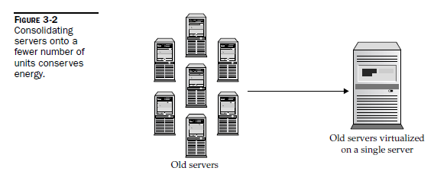
Virtualization

Slide 9
Storage
If your organization uses a lot of direct-attached storage, you will see a huge power savings if you switch over to a storage area network (SAN). By removing file servers, you see an instant reduction in power usage.
Management
In most organizations, computers are used for just 4 hours a day. The additional 20 hours, those idle machines are still using energy.
Some estimates say that 65 percent of the energy used by computers and monitors is wasted because workers don’t turn off computers when they leave for the day. Additionally, half of computer monitors do not have a power management scheme applied, so more money is wasted when they fail to automatically switch off.
A number of utilities are available that enable system administrators to easily manage power settings. These utilities usually enable sleep features built into prevalent operating systems and allow a computer to go into low-power-consuming sleep mode.

Slide 10
Bigger Drives
Another technological boon that can help you conserve power is to ditch all your older, smaller hard drives and install a new, bigger one.
Serial ATA (SATA) drives use about 50 percent less power per terabyte (TB) than Fibre Channel drives. They are also higher in storage density, which also helps reduce power consumption.

Slide 11
Involving Your Utility Company
Sellback Opportunities
If your organization is considering relying on the sun for its power, and possibly to sell back power to the utility company, you’ll need a few things:
• Photovoltaic panels These panels absorb solar radiation. They are made of silicon and coated with tempered glass. Panels are typically mounted on the roof or on a free-standing pole.

Slide 12
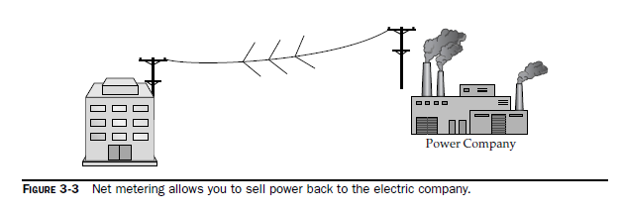

Slide 13
Low-Power Computers
PCs
Windows-based PCs are the backbone of industry. Sure, there are some Macs and Linux boxes out there, but most companies run on Windows. There aren’t too many low-power models out there, but 2008 saw a number of new models introduced.
Intel
HP
Linux
NorhTec: The Bangkok-based NorhTec offers a tiny PC (for less than US$100) capable of running Puppy and other lightweight Linux distributions.
Excito: Swedish company Excito offers a low-power, quiet Linux file and print server based on
Debian Linux.

Slide 14
Components
The big power draw is your server room, that’s no secret.
Servers
You can reduce the amount of energy your servers use by deploying blade servers and by virtualizing your servers.
Blades are entire computers contained on a card that can be inserted into a larger device.
As such, rather than one server taking an entire rack, 20 blades can be installed into one unit.

Slide 15
Ask.com has taken a unique tack in its efforts to maximize what its servers do and what it gets from them in return. The company asked its server vendor, Dell, to build servers that are customized for its very specific functions. That is, each server is built with specific memory, processors, disk space, and power supplies, all tuned to the application the server supports.

Slide 16
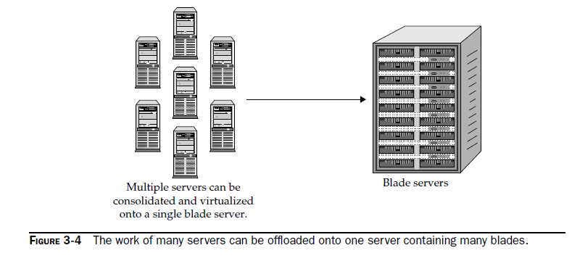

Slide 17
Computer Settings
Polling: If a computer is in an idle state, allow it to remain idle as much as possible. The more the computer wakes up (for polling or from someone moving the mouse), the more energy it will consume.
Turn Off Unused Devices
Use Large Buffers
Storage
Green Drives: Western Digital is a major producer of green hard drives and estimates that its green drives can shave off US$10 per drive, per year in electricity costs.

