Slide 1
Unit III- Introduction to PL/SQL

Slide 2
PL/SQL
PL/SQL is a combination of SQL along with the procedural features of programming languages. It was developed by Oracle Corporation in the early 90's to enhance the capabilities of SQL.
PL/SQL is one of three key programming languages embedded in the Oracle Database, along with SQL itself and Java.
The PL/SQL programming language was developed by Oracle Corporation in the late 1980s as procedural extension language for SQL and the Oracle relational database. Following are notable facts about PL/SQL:
PL/SQL is a completely portable, high-performance transaction-processing language.
PL/SQL provides a built-in interpreted and OS independent programming environment.
PL/SQL can also directly be called from the command-line SQL*Plus interface.
Direct call can also be made from external programming language calls to database.
PL/SQL's general syntax is based on that of ADA and Pascal programming language.
Apart from Oracle, PL/SQL is available in TimesTen in-memory database and IBM DB2.

Slide 3
Architecture of PL/SQL
The PL/SQL architecture mainly consists of following 3 components:
PL/SQL block
PL/SQL Engine
Database Server

Slide 4
PL/SQL block:
This is the component which has the actual PL/SQL code.
This consists of different sections to divide the code logically (declarative section for declaring purpose, execution section for processing statements, exception handling section for handling errors)
It also contains the SQL instruction that used to interact with the database server.
All the PL/SQL units are treated as PL/SQL blocks, and this is the starting stage of the architecture which serves as the primary input.
Following are the different type of PL/SQL units.
Anonymous Block
Function
Library
Procedure
Package Body
Package Specification
Trigger
Type
Type Body

Slide 5
PL/SQL Engine
PL/SQL engine is the component where the actual processing of the codes takes place.
PL/SQL engine separates PL/SQL units and SQL part in the input (as shown in the image below).
The separated PL/SQL units will be handled with the PL/SQL engine itself.
The SQL part will be sent to database server where the actual interaction with database takes place.
It can be installed in both database server and in the application server.

Slide 6
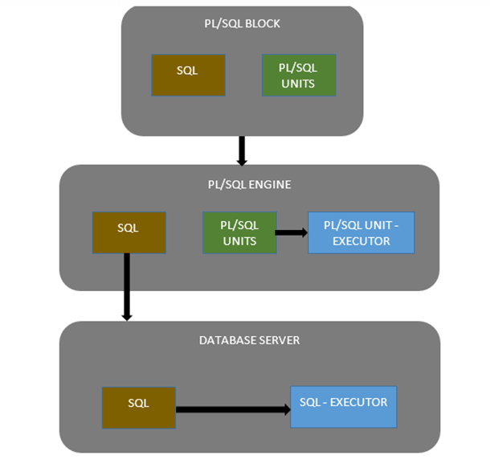
Database Server:
This is the most important component of Pl/SQL unit which stores the data.
The PL/SQL engine uses the SQL from PL/SQL units to interact with the database server.
It consists of SQL executor which actually parses the input SQL statements and execute the same.
Below is the pictorial representation of Architecture of PL/SQL.

Slide 7
Features of PL/SQL
PL/SQL has the following features:
PL/SQL is tightly integrated with SQL.
It offers extensive error checking.
It offers numerous data types.
It offers a variety of programming structures.
It supports structured programming through functions and procedures.
It supports object-oriented programming.
It supports developing web applications and server pages.

Slide 8
Advantages of PL/SQL
PL/SQL has the following advantages:
SQL is the standard database language and PL/SQL is strongly integrated with SQL. PL/SQL supports both static and dynamic SQL. Static SQL supports DML operations and transaction control from PL/SQL block. Dynamic SQL is SQL allows embedding DDL statements in PL/SQL blocks.
PL/SQL allows sending an entire block of statements to the database at one time. This reduces network traffic and provides high performance for the applications.
PL/SQL gives high productivity to programmers as it can query, transform, and update data in a database.
PL/SQL saves time on design and debugging by strong features, such as exception handling, encapsulation, data hiding, and object-oriented data types.
Applications written in PL/SQL are fully portable.
PL/SQL provides high security level.
PL/SQL provides access to predefined SQL packages.
PL/SQL provides support for Object-Oriented Programming.
PL/SQL provides support for Developing Web Applications and Server Pages.

Slide 9
Benefits of PL/SQL
Block Structures: PL SQL consists of blocks of code, which can be nested within each other. Each block forms a unit of a task or a logical module. PL/SQL Blocks can be stored in the database and reused.
Procedural Language Capability: PL SQL consists of procedural language constructs such as conditional statements (if else statements) and loops like (FOR loops).
Better Performance: PL SQL engine processes multiple SQL statements simultaneously as a single block, thereby reducing network traffic.
Error Handling: PL/SQL handles errors or exceptions effectively during the execution of a PL/SQL program. Once an exception is caught, specific actions can be taken depending upon the type of the exception or it can be displayed to the user with a message.

Slide 10
Benefits of PL/SQL
Procedural language support : PL/SQL is a development tools not only for data manipulation futures but also provide the conditional checking, looping or branching operations same as like other programming language.
Reduces network traffic : This one is great advantages of PL/SQL. Because PL/SQL nature is entire block of SQL statements execute into oracle engine all at once so it's main benefit is reducing the network traffic.
Error handling : PL/SQL is dealing with error handling, It's permits the smart way handling the errors and giving user friendly error messages, when the errors are encountered.
Declare variable : PL/SQL gives you control to declare variables and access them within the block. The declared variables can be used at the time of query processing.
Intermediate Calculation : Calculations in PL/SQL done quickly and efficiently without using Oracle engines. This improves the transaction performance.
Portable application : Applications are written in PL/SQL are portable in any Operating system. PL/SQL applications are independence program to run any computer.

Slide 11
PL/SQL - Basic Syntax
S.N. | Sections & Description
1 | Declarations This section starts with the keyword DECLARE. It is an optional section and defines all variables, cursors, subprograms, and other elements to be used in the program.
2 | Executable Commands This section is enclosed between the keywords BEGIN and END and it is a mandatory section. It consists of the executable PL/SQL statements of the program. It should have at least one executable line of code, which may be just a NULL command to indicate that nothing should be executed.
3 | Exception Handling This section starts with the keyword EXCEPTION. This section is again optional and contains exception(s) that handle errors in the program.
PL/SQL is a block-structured language, meaning that PL/SQL programs are divided and written in logical blocks of code. Each block consists of three sub-parts:

Slide 12
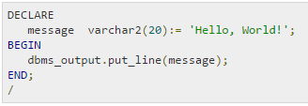
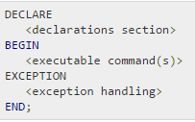
Every PL/SQL statement ends with a semicolon (;). PL/SQL blocks can be nested within other PL/SQL blocks using BEGIN and END. Here is the basic structure of a PL/SQL block:
The 'Hello World' Example:
The end; line signals the end of the PL/SQL block. To run the code from SQL command line, you may need to type / at the beginning of the first blank line after the last line of the code. When the above code is executed at SQL prompt, it produces the following result:

Slide 13
The PL/SQL Identifiers
PL/SQL identifiers are constants, variables, exceptions, procedures, cursors, and reserved words. The identifiers consist of a letter optionally followed by more letters, numerals, dollar signs, underscores, and number signs and should not exceed 30 characters.
By default, identifiers are not case-sensitive. So you can use integer or INTEGER to represent a numeric value. You cannot use a reserved keyword as an identifier.

Slide 14
The PL/SQL Delimiters
Delimiter | Description
+, -, *, / | Addition, subtraction/negation, multiplication, division
% | Attribute indicator
' | Character string delimiter
. | Component selector
(,) | Expression or list delimiter
: | Host variable indicator
, | Item separator
" | Quoted identifier delimiter
= | Relational operator
@ | Remote access indicator
A delimiter is a symbol with a special meaning. Following is the list of delimiters in PL/SQL:

Slide 15
; | Statement terminator
:= | Assignment operator
=> | Association operator
|| | Concatenation operator
** | Exponentiation operator
<<, >> | Label delimiter (begin and end)
/*, */ | Multi-line comment delimiter (begin and end)
-- | Single-line comment indicator
.. | Range operator
<, >, <=, >= | Relational operators
<>, '=, ~=, ^= | Different versions of NOT EQUAL

Slide 16
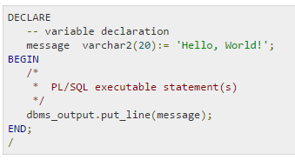
The PL/SQL Comments
Program comments are explanatory statements that you can include in the PL/SQL code that you write and helps anyone reading its source code. All programming languages allow for some form of comments.
The PL/SQL supports single-line and multi-line comments. All characters available inside any comment are ignored by PL/SQL compiler. The PL/SQL single-line comments start with the delimiter -- (double hyphen) and multi-line comments are enclosed by /* and */.
When the above code is executed at SQL prompt, it produces the following result:

Slide 17
PL/SQL Program Units
A PL/SQL unit is any one of the following:
PL/SQL block
Function
Package
Package body
Procedure
Trigger
Type
Type body

Slide 18
PL/SQL - Data Types
Category | Description
Scalar | Single values with no internal components, such as a NUMBER, DATE, or BOOLEAN.
Large Object (LOB) | Pointers to large objects that are stored separately from other data items, such as text, graphic images, video clips, and sound waveforms.
Composite | Data items that have internal components that can be accessed individually. For example, collections and records.
Reference | Pointers to other data items.
PL/SQL variables, constants and parameters must have a valid data type, which specifies a storage format, constraints, and valid range of values.

Slide 19
PL/SQL Scalar Data Types and Subtypes
PL/SQL Scalar Data Types and Subtypes come under the following categories:
Date Type | Description
Numeric | Numeric values on which arithmetic operations are performed.
Character | Alphanumeric values that represent single characters or strings of characters.
Boolean | Logical values on which logical operations are performed.
Datetime | Dates and times.
PL/SQL provides subtypes of data types. For example, the data type NUMBER has a subtype called INTEGER. You can use subtypes in your PL/SQL program to make the data types compatible with data types in other programs while embedding PL/SQL code in another program, such as a Java program.

Slide 20
PL/SQL Numeric Data Types and Subtypes
Data Type | Description
PLS_INTEGER | Signed integer in range -2,147,483,648 through 2,147,483,647, represented in 32 bits
BINARY_INTEGER | Signed integer in range -2,147,483,648 through 2,147,483,647, represented in 32 bits
BINARY_FLOAT | Single-precision IEEE 754-format floating-point number
BINARY_DOUBLE | Double-precision IEEE 754-format floating-point number
NUMBER(prec, scale) | Fixed-point or floating-point number with absolute value in range 1E-130 to (but not including) 1.0E126. A NUMBER variable can also represent 0.
DEC(prec, scale) | ANSI specific fixed-point type with maximum precision of 38 decimal digits.
DECIMAL(prec, scale) | IBM specific fixed-point type with maximum precision of 38 decimal digits.
Following is the detail of PL/SQL pre-defined numeric data types and their sub-types:

Slide 21
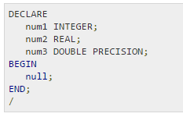
NUMERIC(pre, scale) | Floating type with maximum precision of 38 decimal digits.
DOUBLE PRECISION | ANSI specific floating-point type with maximum precision of 126 binary digits (approximately 38 decimal digits)
FLOAT | ANSI and IBM specific floating-point type with maximum precision of 126 binary digits (approximately 38 decimal digits)
INT | ANSI specific integer type with maximum precision of 38 decimal digits
INTEGER | ANSI and IBM specific integer type with maximum precision of 38 decimal digits
SMALLINT | ANSI and IBM specific integer type with maximum precision of 38 decimal digits
REAL | Floating-point type with maximum precision of 63 binary digits (approximately 18 decimal digits)
Following is a valid declaration:

Slide 22
PL/SQL Character Data Types and Subtypes
Data Type | Description
CHAR | Fixed-length character string with maximum size of 32,767 bytes
VARCHAR2 | Variable-length character string with maximum size of 32,767 bytes
RAW | Variable-length binary or byte string with maximum size of 32,767 bytes, not interpreted by PL/SQL
NCHAR | Fixed-length national character string with maximum size of 32,767 bytes
NVARCHAR2 | Variable-length national character string with maximum size of 32,767 bytes
LONG | Variable-length character string with maximum size of 32,760 bytes
LONG RAW | Variable-length binary or byte string with maximum size of 32,760 bytes, not interpreted by PL/SQL
ROWID | Physical row identifier, the address of a row in an ordinary table
UROWID | Universal row identifier (physical, logical, or foreign row identifier)
Following is the detail of PL/SQL pre-defined character data types and their sub-types:

Slide 23
PL/SQL Boolean Data Types
The BOOLEAN data type stores logical values that are used in logical operations. The logical values are the Boolean values TRUE and FALSE and the value NULL.
However, SQL has no data type equivalent to BOOLEAN. Therefore, Boolean values cannot be used in:
SQL statements
Built-in SQL functions (such as TO_CHAR)
PL/SQL functions invoked from SQL statements

Slide 24
PL/SQL Date time and Interval Types
The DATE datatype to store fixed-length date times, which include the time of day in seconds since midnight. Valid dates range from January 1, 4712 BC to December 31, 9999 AD.
The default date format is set by the Oracle initialization parameter NLS_DATE_FORMAT. For example, the default might be 'DD-MON-YY', which includes a two-digit number for the day of the month, an abbreviation of the month name, and the last two digits of the year, for example, 01-OCT-12.
Each DATE includes the century, year, month, day, hour, minute, and second. The following table shows the valid values for each field:

Slide 25
Field Name | Valid Date time Values | Valid Interval Values
YEAR | -4712 to 9999 (excluding year 0) | Any nonzero integer
MONTH | 01 to 12 | 0 to 11
DAY | 01 to 31 (limited by the values of MONTH and YEAR, according to the rules of the calendar for the locale) | Any nonzero integer
HOUR | 00 to 23 | 0 to 23
MINUTE | 00 to 59 | 0 to 59
SECOND | 00 to 59.9(n), where 9(n) is the precision of time fractional seconds | 0 to 59.9(n), where 9(n) is the precision of interval fractional seconds
TIMEZONE_HOUR | -12 to 14 (range accommodates daylight savings time changes) | Not applicable
TIMEZONE_MINUTE | 00 to 59 | Not applicable
TIMEZONE_REGION | Found in the dynamic performance view V$TIMEZONE_NAMES | Not applicable
TIMEZONE_ABBR | Found in the dynamic performance view V$TIMEZONE_NAMES | Not applicable

Slide 26
PL/SQL Large Object (LOB) Data Types
Data Type | Description | Size
BFILE | Used to store large binary objects in operating system files outside the database. | System-dependent. Cannot exceed 4 gigabytes (GB).
BLOB | Used to store large binary objects in the database. | 8 to 128 terabytes (TB)
CLOB | Used to store large blocks of character data in the database. | 8 to 128 TB
NCLOB | Used to store large blocks of NCHAR data in the database. | 8 to 128 TB
Large object (LOB) data types refer large to data items such as text, graphic images, video clips, and sound waveforms. LOB data types allow efficient, random, piecewise access to this data. Following are the predefined PL/SQL LOB data types:

Slide 27
PL/SQL - Variables
A variable is nothing but a name given to a storage area that our programs can manipulate. Each variable in PL/SQL has a specific data type, which determines the size and layout of the variable's memory; the range of values that can be stored within that memory and the set of operations that can be applied to the variable.
The name of a PL/SQL variable consists of a letter optionally followed by more letters, numerals, dollar signs, underscores, and number signs and should not exceed 30 characters. By default, variable names are not case-sensitive. You cannot use a reserved PL/SQL keyword as a variable name.
PL/SQL programming language allows to define various types of variables, which we will cover in subsequent chapters like date time data types, records, collections, etc. For this chapter, let us study only basic variable types.

Slide 28
Variable Declaration in PL/SQL
PL/SQL variables must be declared in the declaration section or in a package as a global variable. When you declare a variable, PL/SQL allocates memory for the variable's value and the storage location is identified by the variable name.
The syntax for declaring a variable is:
Where, variable_name is a valid identifier in PL/SQL, datatype must be a valid PL/SQL data type or any user defined data type which we already have discussed in last chapter.

Slide 29
Initializing Variables in PL/SQL
Whenever you declare a variable, PL/SQL assigns it a default value of NULL. If you want to initialize a variable with a value other than the NULL value, you can do so during the declaration, using either of the following:
The DEFAULT keyword
The assignment operator
You can also specify that a variable should not have a NULL value using the NOT NULL constraint. If you use the NOT NULL constraint, you must explicitly assign an initial value for that variable.
It is a good programming practice to initialize variables properly otherwise, sometimes program would produce unexpected result. Try the following example which makes use of various types of variables:

Slide 30
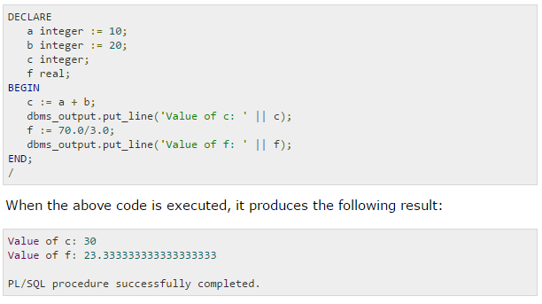

Slide 31
Variable Scope in PL/SQL
PL/SQL allows the nesting of Blocks, i.e., each program block may contain another inner block. If a variable is declared within an inner block, it is not accessible to the outer block. However, if a variable is declared and accessible to an outer Block, it is also accessible to all nested inner Blocks. There are two types of variable scope:
Local variables - variables declared in an inner block and not accessible to outer blocks.
Global variables - variables declared in the outermost block or a package.

Slide 32
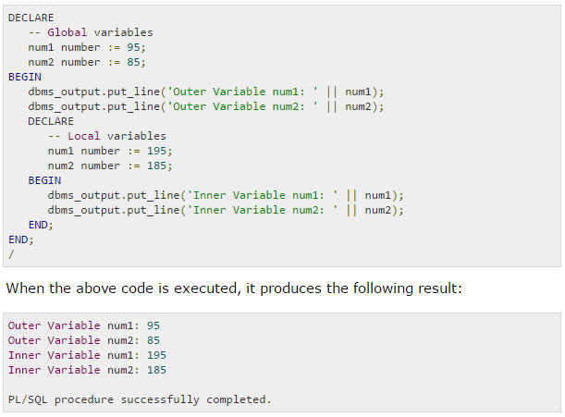
Following example shows the usage of Local and Global variables in its simple form:

Slide 33
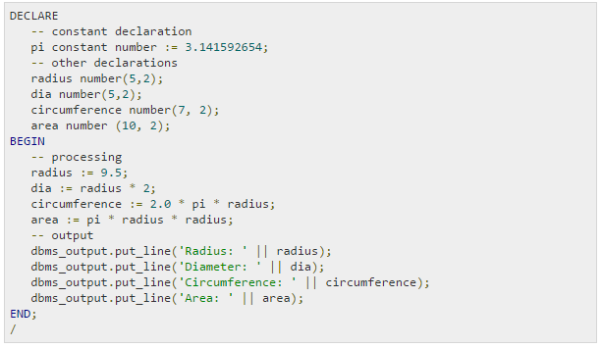
PL/SQL - Constants and Literals
A constant holds a value that once declared, does not change in the program. A constant declaration specifies its name, data type, and value, and allocates storage for it. The declaration can also impose the NOT NULL constraint.
Declaring a Constant
A constant is declared using the CONSTANT keyword. It requires an initial value and does not allow that value to be changed. For example:

Slide 34
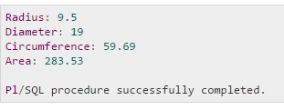
When the above code is executed at SQL prompt, it produces the following result:

Slide 35
PL/SQL - Operators
An operator is a symbol that tells the compiler to perform specific mathematical or logical manipulation. PL/SQL language is rich in built-in operators and provides the following types of operators:
Arithmetic operators
Relational operators
Comparison operators
Logical operators
String operators

Slide 36
Arithmetic Operators
Operator | Description | Example
+ | Adds two operands | A + B will give 15
- | Subtracts second operand from the first | A - B will give 5
* | Multiplies both operands | A * B will give 50
/ | Divides numerator by de-numerator | A / B will give 2
** | Exponentiation operator, raises one operand to the power of other | A ** B will give 100000
Following table shows all the arithmetic operators supported by PL/SQL. Assume variable A holds 10 and variable B holds 5 then:

Slide 37
Relational Operators
Operator | Description | Example
= | Checks if the values of two operands are equal or not, if yes then condition becomes true. | (A = B) is not true.
!= <> ~= | Checks if the values of two operands are equal or not, if values are not equal then condition becomes true. | (A != B) is true.
> | Checks if the value of left operand is greater than the value of right operand, if yes then condition becomes true. | (A > B) is not true.
< | Checks if the value of left operand is less than the value of right operand, if yes then condition becomes true. | (A < B) is true.
>= | Checks if the value of left operand is greater than or equal to the value of right operand, if yes then condition becomes true. | (A >= B) is not true.
<= | Checks if the value of left operand is less than or equal to the value of right operand, if yes then condition becomes true. | (A <= B) is true.
Relational operators compare two expressions or values and return a Boolean result. Following table shows all the relational operators supported by PL/SQL. Assume variable A holds 10 and variable B holds 20, then:

Slide 38
Comparison Operators
Operator | Description | Example
LIKE | The LIKE operator compares a character, string, or CLOB value to a pattern and returns TRUE if the value matches the pattern and FALSE if it does not. | If 'Zara Ali' like 'Z% A_i' returns a Boolean true, whereas, 'Nuha Ali' like 'Z% A_i' returns a Boolean false.
BETWEEN | The BETWEEN operator tests whether a value lies in a specified range. x BETWEEN a AND b means that x >= a and x <= b. | If x = 10 then, x between 5 and 20 returns true, x between 5 and 10 returns true, but x between 11 and 20 returns false.
IN | The IN operator tests set membership. x IN (set) means that x is equal to any member of set. | If x = 'm' then, x in ('a', 'b', 'c') returns boolean false but x in ('m', 'n', 'o') returns Boolean true.
IS NULL | The IS NULL operator returns the BOOLEAN value TRUE if its operand is NULL or FALSE if it is not NULL. Comparisons involving NULL values always yield NULL. | If x = 'm', then 'x is null' returns Boolean false.
Comparison operators are used for comparing one expression to another. The result is always either TRUE, FALSE OR NULL.

Slide 39
Logical Operators
Operator | Description | Example
and | Called logical AND operator. If both the operands are true then condition becomes true. | (A and B) is false.
or | Called logical OR Operator. If any of the two operands is true then condition becomes true. | (A or B) is true.
not | Called logical NOT Operator. Used to reverse the logical state of its operand. If a condition is true then Logical NOT operator will make it false. | not (A and B) is true.
Following table shows the Logical operators supported by PL/SQL. All these operators work on Boolean operands and produces Boolean results. Assume variable A holds true and variable B holds false, then:

Slide 40
PL/SQL Operator Precedence
Operator precedence determines the grouping of terms in an expression. This affects how an expression is evaluated. Certain operators have higher precedence than others; for example, the multiplication operator has higher precedence than the addition operator:
For example x = 7 + 3 * 2; here, x is assigned 13, not 20 because operator * has higher precedence than +, so it first gets multiplied with 3*2 and then adds into 7.
Here, operators with the highest precedence appear at the top of the table, those with the lowest appear at the bottom. Within an expression, higher precedence operators will be evaluated first.

Slide 41
Operator | Operation
** | exponentiation
+, - | identity, negation
*, / | multiplication, division
+, -, || | addition, subtraction, concatenation
comparison
NOT | logical negation
AND | conjunction
OR | inclusion

Slide 42
Sequences in PL/SQL
CREATE SEQUENCE test_seq
START WITH 1
INCREMENT BY 1;
-----Sequence created.
DECLARE
seq_value NUMBER;
BEGIN
seq_value:=test_seq.NEXTVALUE;
DBMS_OUTPUT.PUT_LINE(‘seq_val’ || seq_val);

Slide 43
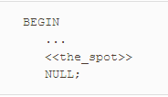
Labels
A PL/SQL label is a way to name a particular part of your program. Syntactically, a label has the format:
where identifier is a valid PL/SQL identifier (up to 30 characters in length and starting with a letter, as discussed earlier in the section Identifiers). There is no terminator; labels appear directly in front of the thing they’re labeling, which must be an executable statement—even if it is merely the NULL statement.

Slide 44
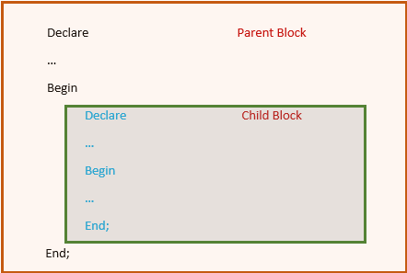
Nested Block Structure
A block can be nested into another block. This can be nested either in the execution part or in the exception handling part. These block can also be labelled. One outer block can contain many inner blocks. Each inner block is once again a PL/SQL block, hence all the properties and characteristics of the inner block will be the same as outer block. The below image gives the pictorial representation of nested block structure. Parent block is the main block and child block is the nested block.

Slide 45
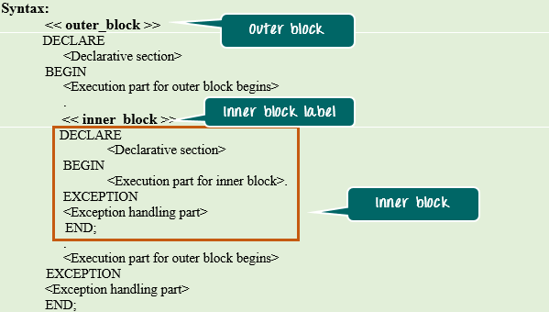
Below is the syntax for nested block.

Slide 46
Scopes in Nested Block
In nested block, one needs to understand the scope and visibility of each block clearly before using them. Particularly in the inner block the elements from both outer and the inner block will be visible, hence proper understanding of this is necessary.
Below points will summarize more regarding the scopes in nested blocks.
The elements declared in the outer block and value that is defined before the inner block definition is visible inside the inner block.
The elements declared in the inner block is not visible in the outer block. They are visible only within the inner block.
Outer block and Inner block can have a variable with the same name.
In case of variables with same name, inner block by default will refer to the variable declared in inner block only.
If inner block wants to refer the outer block variable that is having the same name as that of the inner block, then outer block should be LABELLED and the outer block variable can be referred as '<outer_block_label>.<variable_name>'

Slide 47
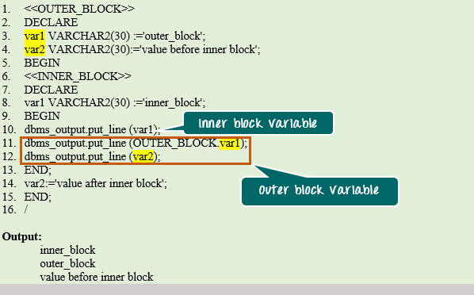
Example 1: In this example, we are going to see the scope of variables in the inner and outer block. Also, we are going to see how to refer the variables using block label.

Slide 48
PL/SQL - Transactions
A database transaction is an atomic unit of work that may consist of one or more related SQL statements. It is called atomic because the database modifications brought about by the SQL statements that constitute a transaction can collectively be either committed, i.e., made permanent to the database or rolled back (undone) from the database.
A successfully executed SQL statement and a committed transaction are not same. Even if an SQL statement is executed successfully, unless the transaction containing the statement is committed, it can be rolled back and all changes made by the statement(s) can be undone.

Slide 49
Starting an Ending a Transaction
A transaction has a beginning and an end. A transaction starts when one of the following events take place:
The first SQL statement is performed after connecting to the database.
At each new SQL statement issued after a transaction is completed.
A transaction ends when one of the following events take place:
A COMMIT or a ROLLBACK statement is issued.
A DDL statement, like CREATE TABLE statement, is issued; because in that case a COMMIT is automatically performed.
A DCL statement, such as a GRANT statement, is issued; because in that case a COMMIT is automatically performed.
User disconnects from the database.
User exits from SQL*PLUS by issuing the EXIT command, a COMMIT is automatically performed.
SQL*Plus terminates abnormally, a ROLLBACK is automatically performed.
A DML statement fails; in that case a ROLLBACK is automatically performed for undoing that DML statement.

Slide 50
To control transactions Oracle does not made permanent any DML statements unless you commit it. If you don’t commit the transaction and power goes off or system crashes then the transaction is roll backed.
TCL Statements available in Oracle are
COMMIT : Make changes done in transaction permanent. ROLLBACK : Rollbacks the state of database to the last commit point. SAVEPOINT : Use to specify a point in transaction to which later you can rollback.

Slide 51
Committing a Transaction
A transaction is made permanent by issuing the SQL command COMMIT. The general syntax for the COMMIT command is:
Example
insert into emp (empno,ename,sal) values (101,’Abid’,2300);
commit;

Slide 52
Rolling Back Transactions
Changes made to the database without COMMIT could be undone using the ROLLBACK command.
The general syntax for the ROLLBACK command is:
To rollback the changes done in a transaction give rollback statement. Rollback restore the state of the database to the last commit point.
Example :
delete from emp;
rollback; /* undo the changes */

Slide 53
Savepoints
Savepoints are sort of markers that help in splitting a long transaction into smaller units by setting some checkpoints. By setting savepoints within a long transaction, you can roll back to a checkpoint if required. This is done by issuing the SAVEPOINT command.
Specify a point in a transaction to which later you can roll back.
Example
insert into emp (empno,ename,sal) values (109,’Sami’,3000); savepoint a;
insert into dept values (10,’Sales’,’Hyd’); savepoint b;
Now if you give
rollback to a;
At this point you can commit the row inserted into emp table or rollback the transaction.

Slide 54
If you give
rollback to b;
At this point you can commit the row inserted into dept table and emp table or rollback to savepoint a or completely roll backed the transaction.
If you give
rollback;
Then the whole transactions is roll backed.
If you give
commit;
Then the whole transaction is committed and all savepoints are removed.

