Slide 1
Unit III-Chapter 1
Introduction to Servlets

Slide 2
Introduction
How do the pages you're reading in your favorite Web browser show up there? When you log into your favorite Web site, how does the Web site know that you're you? And how do Web retailers handle taking your order online? Those capabilities are possible because of code running on servers behind the scenes that interact with you in a Web session, access stored information throughout that process, and oftentimes present dynamic information in one or more Web pages.

Slide 3
Java servlets are server-side programs (running inside a web server) that handle clients' requests and return a customized or dynamic response for each request. The dynamic response could be based on user's input (e.g., search, online shopping, online transaction) with data retrieved from databases or other applications, or time-sensitive data (such as news and stock prices).
Java servlets typically run on the HTTP protocol.

Slide 4
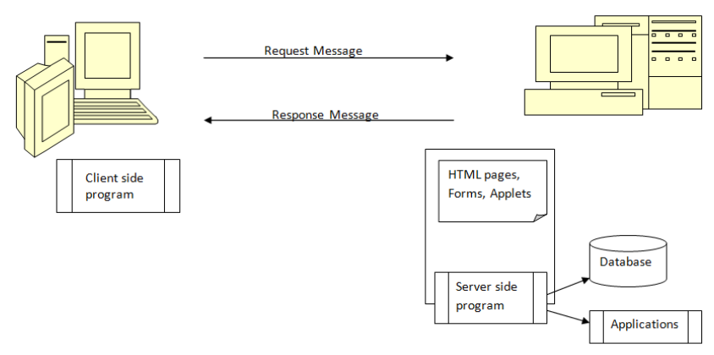

Slide 5
HTTP is a request-response protocol. The client sends a request message to the server. The server, in turn, returns a response message. The messages consists of two parts: header (information about the message) and body (contents). Header provides information about the messages.

Slide 6
Need for dynamic content
Applets, one of the earliest attempts toward this goal, focused on using the client platform to deliver dynamic user experiences.
Common Gateway Interface (CGI) server-side scripts were the main technology used to generate dynamic content. Although widely used, CGI scripting technology had many shortcomings, including platform dependence and lack of scalability. To address these limitations, Java Servlet technology was created as a portable way to provide dynamic, user-oriented content.
There are many (competing) server-side technologies available: Java-based (servlet, JSP, JSF, Struts, Spring, Hibernate), ASP, PHP, CGI Script, and many others.

Slide 7
CGI
Using CGI we could accept user input, process it and give relevant result back to user. All traditional web technologies provide support to CGI. PERL is one of the significant CGI supportive language.

Slide 8
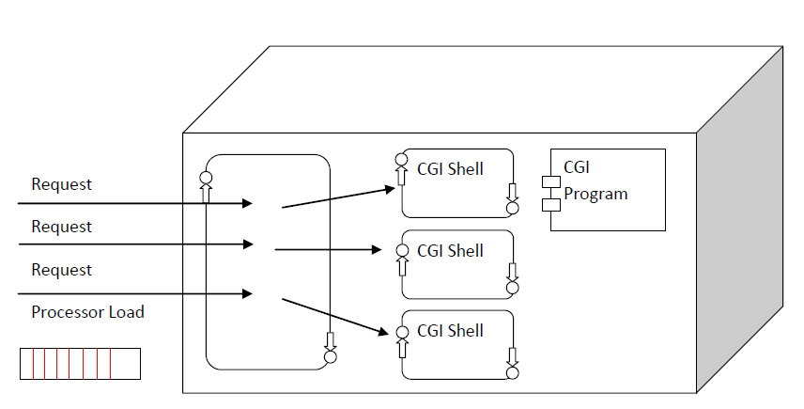

Slide 9
What are the Advantage of Servlets Over "Traditional" CGI?
Efficient
Convenient
Powerful
Portable
Inexpensive

Slide 10
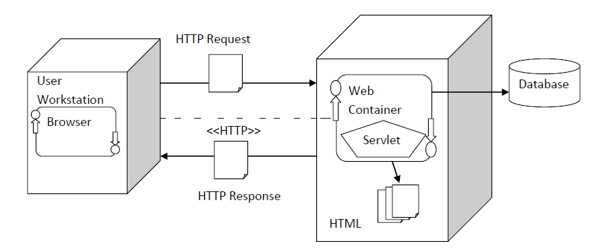
Java Servlet Technology

Slide 11
Most Java servlets that you'll encounter as a professional programmer are designed to respond to HTTP requests in the context of a Web application. As such, the HTTP-specific classes in the javax.servlet and javax.servlet.http packages are the ones you'll care about.
When you create a Java servlet, you typically subclass HttpServlet. This class has methods that give you access to the request and response wrappers you can use to handle requests and create responses.
When a user issues a request via a URL, the Java servlet classes convert it to an HttpServletRequest and send it to the target pointed to by the URL

Slide 12
HttpServletResponse then sends a HTTP response back to the client that made the request.
You usually make multiple requests and get multiple responses. All of them are within the context of a session, which Java language wraps in an HttpSession object.

Slide 13
Servlets and Web Servers.
When user request for dynamic contents from web server, even though web server has access to database it cannot produce web pages.
Here Servlets comes into middle and generate dynamic web pages upon user requests.

Slide 14
Servlet and Clients.
It’s not necessary that application from client side should written in java to get Servlets response.
Hence application written in any programming language can consumes Servlets outputs.

Slide 15
Servlet Container
Servlet container popularly known as Servlet Engine which provide execution environment for Servlets and manage Servlets lifecycle from creation to destroy phase.

