Slide 1
Unit III - Chapter 2
Going Paperless

Slide 2
Introduction
It costs a lot of money to print a bill and mail it (even more if it’s 300 pages long and shipped in a cardboard box). But many businesses still use that method, because they simply don’t want to change. Paperless billing doesn’t just save your organization lots of money—it’s environmentally conscious as well. If your organization can go paperless, the change will save trees and money. Being completely paperless might be a pipe dream. People just like to hold paper. That’s why newspapers and magazines—despite having a web presence—are still printed and sold.

Slide 3
Paper Problems
The Environment: Losing trees and forest land isn’t the only problem. The process of deforestation has released about 120 billion tons of carbon dioxide (CO2) into the atmosphere. Also, 3 million tons of chlorine are used each year to bleach paper. Chlorine is a major source of the carcinogen dioxin, which is regularly dumped into rivers and streams as waste water.

Slide 4
Your Costs: - Handling paper can account for 30 percent of your organization’s overhead. This number takes into account the average number of hours workers spend on tasks such as filing, distributing, creating, retrieving, and destroy
Given that thousands of pages of documents can be backed up onto a CD-ROM, can you imagine the savings in backing up a filing cabinet full of paper documenting documents.

Slide 5
Benefits…
• Lower paper costs
• Less pollution
• Less paper use
• Smaller waste disposal cost
• Lower storage costs
• Less energy use
• Less storage space needed
• Fewer trees cut
• Lower postage costs
• Less pulping
• Easier document handling
• Less waste to be recycled, burned, or sent to a landfill
• Less waste production by the organization
• Less landfill capacity needed

Slide 6
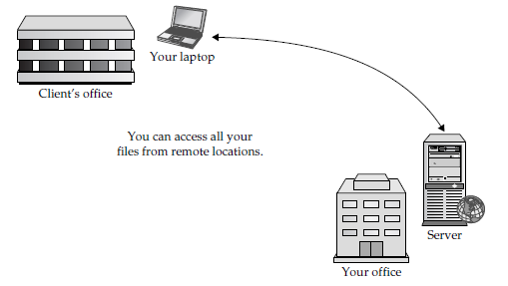
Paper and Your Office

Slide 7
Storage
Take a look around your office, and you realize where a lot of paper is hiding. It’s in the desk drawers, on the shelves, or tucked away in filing cabinets. It may very well be stashed in a long-term storage location offsite. If you use less paper, you will free up office space (filing cabinets can be removed) and you’ll save the expense of buying new filing cabinets.

Slide 8
Destruction
Most paper winds up in the trash, usually within a few years of its first being produced.
And for each piece of paper that goes into the trash, you pay with your pocketbook, and the environment pays in deleterious ways.

Slide 9
Going Paperless
It won’t happen overnight:- You simply cannot expect to make the transition immediately. You can start by scanning existing paperwork and then expand to incoming paperwork.
“Paperless” isn’t an absolute When we say “paperless” what we really mean is less paper. But not all of your work can be paperless. Some of your clients or business partners will still want their interactions done via paper. Plus, there will likely be some tax documentation that needs to be maintained as hard copies.
You have to sell it Not everyone likes change. The best thing you can do is educate them about the benefits of being paperless, and understand that it’ll take some time for everyone to come around.

Slide 10
Once you go paperless (or as paperless as possible), you’ll realize other benefits:
• Less time looking for lost paperwork
• The ability to access most documents in seconds
• The ability to access all your documents from home or satellite offices
• Freed-up real estate in your office as filing cabinets are moved out

Slide 11
Changing Over
All you need is to scan your paperwork and save it to your network. A good scanner and a system for storage are the keys to success.
Hardware:- The reality of today’s information documents is that most of them start out in an electronic format and then are printed. Other than documents that have signatures on them, most are created within spreadsheets, e-mail, word processing, or database applications. The best approach is to try to maintain the electronic format for as long as possible, if not 100 percent of the time.

Slide 12
Software:- A good scanner should come with drivers to make it work with whatever computer systems you have in your organization. The driver should allow for the management of the following:
• Resolution
• Color bit depth
• File type
• Default folders

Slide 13
PDFs:- Why should you standardize on PDF? First of all, there’s its sheer prevalence. If you download a document from a website, for instance, more often than not it is in the PDF format. But there are other reasons to consider PDF for your paperless documentation needs:
• Open format: Adobe has submitted the PDF format to the ISO to have it formally declared a standard.
• Multiplatform: PDF files are viewable on Windows, Mac, Unix/Linux, and many mobile platforms.
• Accuracy: Adobe PDF files look just like their paper counterparts. You can also add a layer of digitized text for easy searching.
• Security: PDFs can be digitally signed and password-protected to ensure only those with the proper security credentials can open the file.
• Searchable text: Text can be searched within a PDF file for easy information location.

Slide 14
Work Smart: -
Be realistic: Look at your documents and decide which ones you really need.
Naming Each document should be labeled as descriptively as possible as soon as you scan it.
Set up a filing system: Other people will need to use it, too.
Shredding and recycling Once you’ve scanned your documents, figure out what needs to be shredded, and what needs to be kept.
Know your limits Remember what we said earlier about going paperless not being an overnight thing?

Slide 15
Faxing
Of course, receiving incoming faxes is also a source of paper. Even worse, you never know who is going to be sending what, and you never know if it’s something you want to keep. There are a number of applications and services to which you can subscribe that will automatically take whatever is being faxed, convert it to an e-mail, and send it to you.

Slide 16
Paperless Billing

Slide 17
Handheld Computers vs. the Clipboard
As industry has been moving to a paperless environment, all those people we associate with clipboards are going high tech. They’re replacing those clipboards and piles of paper with personal digital assistants (PDAs) and tablet PCs. Some waitresses don’t even write your order down on a pad of paper anymore. They write your order on a PDA, which transmits it straight back to the kitchen.
PDAs: - PDAs are small, handheld computers with touch screens that allow you to enter information. They also have memory card slots for data storage, and a wireless connection (usually infrared, Bluetooth, WiFi, or a combination).

Slide 18
Tablet PCs:- Tablet PCs are a hybrid between a laptop and a PDA. Tablet PCs are similar to laptops in size (albeit a bit smaller), and users typically interact with them as they would a PDA—by entering data on a touch-sensitive screen.

Slide 19
Unified Communications
Cisco and IBM have introduced their own visions for a comprehensive communications system in an organization. This system has come under the blanket term Unified Communications. In this model, all types of communication—phone, messaging, e-mail, faxes, and so on—are maintained so that they can be sent around the office.
New Phones
Using the Internet
Intranets

Slide 20
What to Include in Intranet?
• Often-used documents, templates, and proposals that can help prepare a project
• Frequently asked questions about the organization
• Company bulletin board, where employees can share messages
• CEO blog, to serve as an informational line to the organization
• Staff directory, including personal skills (for example, Sally Johnson plays the banjo)
• Company calendar, with employee birthdays and upcoming events

Slide 21
You also need to think about the following:
Security
Usability
Publishing rights
Ownership
Backup plan

Slide 22
Building an Intranet
Parts:- You’ll need the following four components for your intranet,
Local area network (LAN)
Web server (Internet service provider (ISP))
Web browsers on client PCs
Web page development software

Slide 23
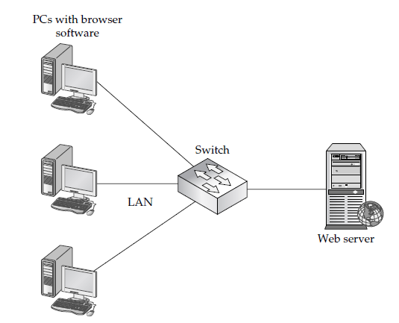

Slide 24
Content Management Systems: Drupal
CMS facilitates the following:
• Addition of new content
• Removal of old content
• Better organization of the data on the site
• Managing text, articles, documents, files, and other communications
• Managing images and other elements

Slide 25
Microsoft Office SharePoint Server 2007 --- CMS
Features
The ability to control access
Central management
Content management
Work across the organization
Better Business Operations : Search features, Security-minded sharing
Collaboration: The ability to integrate partner data, The ability to work remotely, Personalization

Slide 26
MySite
The MySite feature of MOSS allows users to create a site so they can store, present, view, and manage content. The sites can be used to present business information about the user, including skills, roles, colleagues, managers, work groups, and so forth.
MySite includes a public view and a private view. Privacy settings allow a user to establish whether their colleagues, manager, or everyone in the organization can see their information. The information that can be viewed includes the following:

Slide 27
Workspaces
MyLinks
Personalization sites
Colleague Tracker
Outlook e-mail
Distribution groups

Slide 28
Electronic Data Interchange (EDI)
It is also becoming more prevalent for organizations to manage their supply chains or deal with vendors and other companies using Electronic Data Interchange (EDI). EDI allows businesses, governmental entities, and other organizations a way to exchange entire documents.
EDI allows the electronic exchange of business documents, such as purchase orders, invoices, ship notices, and over 250 others in a standardized format. Here are some of the benefits to using EDI:
• Significant savings with lower EDI costs
• Increased staff efficiency
• A secure environment
• Increased efficiency through the ability to send and receive any type of file

Slide 30
EDI uses technologies such as Extensible Markup Language (XML) and the World Wide Web to function. The EDI format is used more for e-commerce transactions.
Value Added Networks:-
A VAN is sort of an electronic post office. It receives transactions, looks at the “To” and “From” information, and routes the messages to their intended recipients. VANs are still widely used, because they provide some additional services, such as retransmitting documents, providing third-party audit services, and providing support.

Slide 31
Benefits to using a VAN include:
• Alert system VANs can alerts organizations to transmission issues or delivery receipts.
• Archival storage VANs can store critical business data for extended periods of time.
• Audit trails Information including setup, configuration, and document transmission events can be audited.
• Real-time data delivery Data can be delivered in real time, rather than in batches, thus allowing speedier response to transmissions.
• Reliable and secure transmission VANs ensure that a company’s data is securely transmitted and is received by the recipient.

