Slide 1
Unit III
SHINGLING OF DOCUMENTS

Slide 2
One of the most common data-mining problem is to find similar items in the given dataset, this also applies for text data. Examples that comes directly into our mind includes detecting plagiarism, news recommendation (don’t show identical news articles to users) and the list goes on.

Slide 6
Jaccard Similarity
Now that we’ve transformed all the documents into shingle sets and used characteristic matrix to visualize the relationships between our documents. The next question is how do we measure the similarity between documents?
One well known measure for determining the degree of similarity is the Jaccard Similarity. Given two sets of shingles, set1 and set2. The math formula of this measurement will be :

Slide 8
This is equivalent to saying for any two given sets, its jaccard similarity is the size of their intersection divided by their union. For our “characteristic” matrix, if we restrict ourselves to only two columns (documents), then the rows can be divided into three types :
Type 1 : rows have 1s in both columns.
Type 2 : rows have 1 in one of the columns and 0 in the other.
Type 3 : rows have 0s in both columns.

Slide 9
Applying the jaccard similarity concept here, the similarities between two sets will then be

Slide 10
https://people.revoledu.com/kardi/tutorial/Similarity/Jaccard.html

Slide 11
What is the Jaccard Index?
The Jaccard similarity index (sometimes called the Jaccard similarity coefficient) compares members for two sets to see which members are shared and which are distinct.
It’s a measure of similarity for the two sets of data, with a range from 0% to 100%.
The higher the percentage, the more similar the two populations.
Although it’s easy to interpret, it is extremely sensitive to small samples sizes and may give erroneous results, especially with very small samples or data sets with missing observations.

Slide 12
How to Calculate the Jaccard Index
The formula to find the Index is:
Jaccard Index = (the number in both sets) / (the number in either set) * 100
The same formula in notation is: J(X,Y) = |X∩Y| / |X∪Y|

Slide 13
This percentage tells you how similar the two sets are.
Two sets that share all members would be 100% similar. the closer to 100%, the more similarity (e.g. 90% is more similar than 89%).
If they share no members, they are 0% similar.
The midway point — 50% — means that the two sets share half of the members.

Slide 14
Examples
A simple example using set notation: How similar are these two sets?
A = {0,1,2,5,6}
B = {0,2,3,4,5,7,9}
Solution: J(A,B) = |A∩B| / |A∪B| = |{0,2,5}| / |{0,1,2,3,4,5,6,7,9}| = 3/9 = 0.33.

Slide 15
Notes:
The cardinality of A, denoted |A| is a count of the number of elements in set A.
Although it’s customary to leave the answer in decimal form if you’re using set notation, you could multiply by 100 to get a similarity of 33.33%.

Slide 16
Example problem without set notations: Researchers are studying biodiversity in two rainforests. They catalog specimens from six different species, A,B,C,D,E,F. Two species are shared between the two rainforests. What is the Jaccard coefficient?
Solution:
Two species (3 and 5) are shared between both populations.
There are 6 unique species in the two populations.
2/6 = 1/3
1/3 * 100 = 33.33%.
Rainforests A and B are 33% similar.

Slide 17
Jaccard Distance
A similar statistic, the Jaccard distance, is a measure of how dissimilar two sets are. It is the complement of the Jaccard index and can be found by subtracting the Jaccard Index from 100%. For the above example, the Jaccard distance is 1 – 33.33% = 66.67%.
In set notation, subtract from 1 for the Jaccard Distance: D(X,Y) = 1 – J(X,Y)
Note though, that the decimals are usually converted to percentages as these are easier to interpret.

Slide 18
What to do with missing values
Sometimes data sets will have missing observations, which makes calculating similarity challenging. You have several options for filling in these missing data points:
Fill in the blank areas with zeros,
Replace the missing values with the median for the set
Use a k-nearest neighbor or EM algorithm(expectation–maximization is an iterative method to find maximum likelihood).

Slide 19
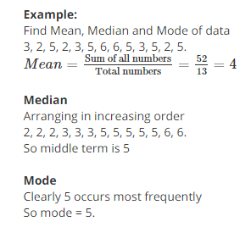

Slide 20
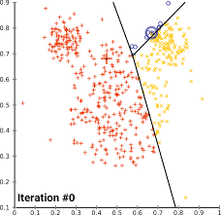

Slide 21
Similarity of Documents
An important class of problems that Jaccard similarity addresses well is that of finding textually similar documents in a large corpus such as the Web or a collection of news articles.
Textual similarity also has important uses. Many of these involve finding duplicates or near duplicates. First, let us observe that testing whether two documents are exact duplicates is easy; just compare the two documents character-by-character, and if they ever differ then they are not the same.

Slide 22
However, in many applications, the documents are not identical, yet they share large portions of their text. Here are some examples:
Plagiarism
Finding plagiarized documents tests our ability to find textual similarity. The plagiarizer may extract only some parts of a document for his own.
He may alter a few words and may alter the order in which sentences of the original appear.
Yet the resulting document may still contain 50% or more of the original. No simple process of comparing documents character by character will detect a sophisticated plagiarism.

Slide 23
Mirror Pages
It is common for important or popular Web sites to be duplicated at a number of hosts, in order to share the load.
The pages of these mirror sites will be quite similar, but are rarely identical.
Similar pages might change the name of the course, year, and make small changes from year to year.
It is important to be able to detect similar pages of these kinds, because search engines produce better results if they avoid showing two pages that are nearly identical within the first page of results.

Slide 24
Articles from the Same Source
It is common for one reporter to write a news article that gets distributed, say through the Associated Press, to many newspapers, which then publish the article on their Web sites.
Each newspaper changes the article somewhat.
They may cut out paragraphs, or even add material of their own. They most likely will surround the article by their own logo, ads, and links to other articles at their site.

Slide 25
However, the core of each newspaper’s page will be the original article.
News aggregators, such as Google News, try to find all versions of such an article, in order to show only one, and that task requires finding when two Web pages are textually similar, although not identical

Slide 26
Collaborative Filtering as a Similar-Sets Problem
Another class of applications where similarity of sets is very important is called collaborative filtering, a process whereby we recommend to users items that were liked by other users who have exhibited similar tastes.

Slide 27
On-Line Purchases
Amazon.com has millions of customers and sells millions of items. Its database records which items have been bought by which customers. We can say two customers are similar if their sets of purchased items have a high Jaccard similarity.
Likewise, two items that have sets of purchasers with high Jaccard similarity will be deemed similar. Note that, while we might expect mirror sites to have Jaccard similarity above 90%, it is unlikely that any two customers have Jaccard similarity that high (unless they have purchased only one item).

Slide 28
Even a Jaccard similarity like 20% might be unusual enough to identify customers with similar tastes.
The same observation holds for items; Jaccard similarities need not be very high to be significant.
Collaborative filtering requires several tools, in addition to finding similar customers or items. For example, two Amazon customers who like science-fiction might each buy many science-fiction books, but only a few of these will be in common. However, by combining similarity finding with clustering, we might be able to discover that science fiction books are mutually similar and put them in one group.

Slide 29
Movie Ratings
NetFlix records which movies each of its customers rented, and also the ratings assigned to those movies by the customers.
We can see movies as similar if they were rented or rated highly by many of the same customers, and see customers as similar if they rented or rated highly many of the same movies.
The same observations that we made for Amazon above apply in this situation: similarities need not be high to be significant, and clustering movies by genre will make things easier.

Slide 30
When comparing customers, imagine two set elements for each movie, “liked” and “hated.” If a customer rated a movie highly, put the “liked” for that movie in the customer’s set.
If they gave a low rating to a movie, put “hated” for that movie in their set. Then, we can look for high Jaccard similarity among these sets.
We can do a similar trick when comparing movies.
If ratings are 1-to-5-stars, put a movie in a customer’s set n times if they rated the movie n-stars. Then, use Jaccard similarity for bags when measuring the similarity of customers.

Slide 31
Shingling of Documents
The most effective way to represent documents as sets, for the purpose of identifying lexically similar documents is to construct from the document the set of short strings that appear within it.
If we do so, then documents that share pieces as short as sentences or even phrases will have many common elements in their sets, even if those sentences appear in different orders in the two documents.

Slide 32
k-Shingles
A document is a string of characters. Define a k-shingle for a document to be any substring of length k found within the document. Then, we may associate with each document the set of k-shingles that appear one or more times within that document.

Slide 33
A k -shingle (or k -gram) for a document is a sequence of k characters that appears in the document.
Example: k=2; doc = abcab.
Set of 2-shingles= {ab, bc, ca}.
Option: regard shingles as a bag, and count ab twice.
Represent a doc by its set of k-shingles.

Slide 34
Choosing the Shingle Size
We can pick k to be any constant we like. However, if we pick k too small, then we would expect most sequences of k characters to appear in most documents.
If so, then we could have documents whose shingle-sets had high Jaccard similarity, yet the documents had none of the same sentences or even phrases.
As an extreme example, if we use k = 1, most Web pages will have most of the common characters and few other characters, so almost all Web pages will have high similarity.

Slide 35
Hashing Shingles
The task of finding nearest neighbours is very common. You can think of applications like finding duplicate or similar documents, audio/video search.
Although using brute force to check for all possible combinations will give you the exact nearest neighbour but it’s not scalable at all.
Approximate algorithms to accomplish this task has been an area of active research. Although these algorithms don’t guarantee to give you the exact answer, more often than not they’ll be provide a good approximation.

Slide 36
Locality sensitive hashing (LSH) is one such algorithm. LSH has many applications, including:

Slide 37
LSH refers to a family of functions (known as LSH families) to hash data points into buckets so that data points near each other are located in the same buckets with high probability, while data points far from each other are likely to be in different buckets. This makes it easier to identify observations with various degrees of similarity.

Slide 38
The idea of hashing is to convert each document to a small signature using a hashing function H. Suppose a document in our corpus is denoted by d. Then:
H(d) is the signature and it’s small enough to fit in memory
If similarity(d1,d2) is high then Probability(H(d1)==H(d2)) is high
If similarity(d1,d2) is low then Probability(H(d1)==H(d2)) is low

Slide 39
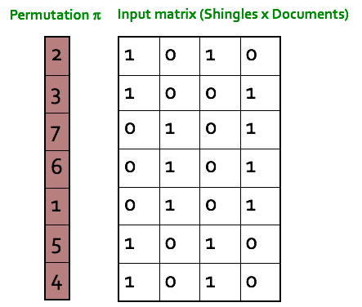
Min hashing
This is the critical and the most magical aspect of this algorithm:
Step 1: Random permutation (π) of row index of document shingle matrix.

Slide 40
Step 2: Hash function is the index of the first (in the permuted order) row in which column C has value 1. Do this several time (use different permutations) to create signature of a column.

Slide 41
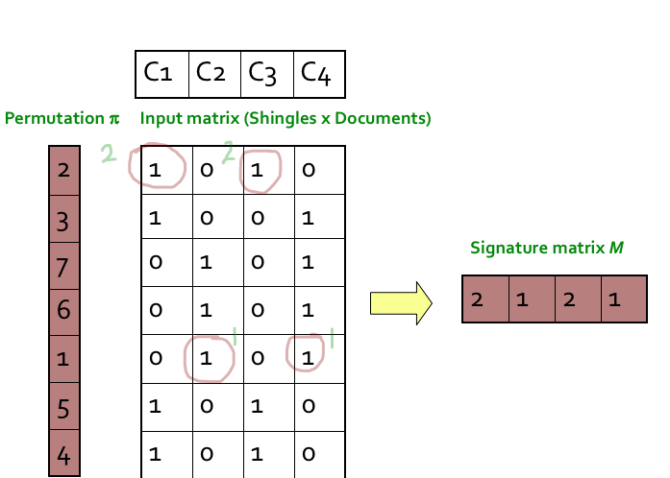

Slide 42
Minhash Signatures
To represent sets, we pick at random some number n of permutations of the rows of M. Perhaps 100 permutations or several hundred permutations will do. Call the minhash functions determined by these permutations h1, h2, . . . , hn.

Slide 43
Computing Minhash Signatures
It is not feasible to permute a large characteristic matrix explicitly. Even picking a random permutation of millions or billions of rows is time-consuming, and the necessary sorting of the rows would take even more time.

Slide 45
Locality-Sensitive Hashing for Documents
Suppose we have a million documents, and we use signatures of length 250. Then we use 1000 bytes per document for the signatures, and the entire data fits in a gigabyte – less than a typical main memory of a laptop.
However, there are 1,000,000₂ or half a trillion pairs of documents. If it takes a microsecond to compute the similarity of two signatures, then it takes almost six days to compute all the similarities on that laptop.

Slide 46
LSH for Minhash Signatures
One general approach to LSH is to “hash” items several times, in such a way that similar items are more likely to be hashed to the same bucket than dissimilar items are.
We then consider any pair that hashed to the same bucket for any of the hashings to be a candidate pair.
We check only the candidate pairs for similarity. The hope is that most of the dissimilar pairs will never hash to the same bucket, and therefore will never be checked.

Slide 47
Example 3.10 : Figure 3.6 shows part of a signature matrix of 12 rows divided
into four bands of three rows each. The second and fourth of the explicitly
shown columns each have the column vector [0, 2, 1] in the first band, so they
will definitely hash to the same bucket in the hashing for the first band. Thus,
regardless of what those columns look like in the other three bands, this pair
of columns will be a candidate pair. It is possible that other columns, such as
the first two shown explicitly, will also hash to the same bucket according to
the hashing of the first band. However, since their column vectors are different,
[1, 3, 0] and [0, 2, 1], and there are many buckets for each hashing, we expect the
chances of an accidental collision to be very small. We shall normally assume
that two vectors hash to the same bucket if and only if they are identical.
Two columns that do not agree in band 1 have three other chances to become
a candidate pair; they might be identical in any one of these other bands.

Slide 49
Definition of a Distance Measure
Suppose we have a set of points, called a space. A distance measure on this space is a function d(x, y) that takes two points in the space as arguments and produces a real number, and satisfies the following axioms:
d(x, y) ≥ 0 (no negative distances).
d(x, y) = 0 if and only if x = y (distances are positive, except for the distance from a point to itself).
d(x, y) = d(y, x) (distance is symmetric).
d(x, y) ≤ d(x, z) + d(z, y) (the triangle inequality).

Slide 51
Euclidean Distances
Euclidean distance is the distance between two points in Euclidean space. Euclidean space was originally devised by the Greek mathematician Euclid around 300 B.C.E. to study the relationships between angles and distances.

Slide 52
1D
Subtract one point on the number line from another; the order of the subtraction doesn't matter. For example, one number is 8 and the other is -3. Subtracting 8 from -3 equals -11.
Calculate the absolute value of the difference. To calculate the absolute value, square the number. For this example, -11 squared equals 121.
Calculate the square root of that number to finish calculating the absolute value. For this example, the square root of 121 is 11. The distance between the two points is 11.

Slide 53
2D
Subtract the x- and y-coordinates of the first point from the x- and y-coordinates of the second point. For example, the coordinates of the first point are (2, 4) and the coordinates of the second point are (-3, 8). Subtracting the first x-coordinate of 2 from the second x-coordinate of -3 results in -5. Subtracting the first y-coordinate of 4 from the second y-coordinate of 8 equals 4.

Slide 54
Square the difference of the x-coordinates and also square the difference of the y-coordinates. For this example, the difference of the x-coordinates is -5, and -5 squared is 25, and the difference of the y-coordinates is 4, and 4 squared is 16.
Add the squares together, and then take the square root of that sum to find the distance. For this example, 25 added to 16 is 41, and the square root of 41 is 6.403. (This is the Pythagorean Theorem at work; you are finding the value of the hypotenuse that runs from the total length expressed in x by the total width expressed in y.)

Slide 55
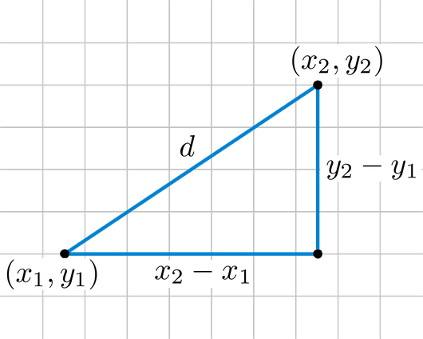

Slide 57
Cosine Similarity
Cosine similarity is a metric used to measure how similar the documents are irrespective of their size. The cosine similarity is advantageous because even if the two similar documents are far apart by the Euclidean distance (due to the size of the document), chances are they may still be oriented closer together. The smaller the angle, higher the cosine similarity.

Slide 58
What is Cosine Similarity and why is it advantageous?
Cosine similarity is a metric used to determine how similar the documents are irrespective of their size.
Mathematically, it measures the cosine of the angle between two vectors projected in a multi-dimensional space. In this context, the two vectors I am talking about are arrays containing the word counts of two documents.

Slide 59
Cosine Similarity Example
Let’s suppose you have 3 documents based on a couple of star cricket players – Sachin Tendulkar and Dhoni. Two of the documents (A) and (B) are from the wikipedia pages on the respective players and the third document (C) is a smaller snippet from Dhoni’s wikipedia page.

Slide 61
As you can see, all three documents are connected by a common theme – the game of Cricket.
Our objective is to quantitatively estimate the similarity between the documents.
For ease of understanding, let’s consider only the top 3 common words between the documents: ‘Dhoni’, ‘Sachin’ and ‘Cricket’.

Slide 62
However, if we go by the number of common words, the two larger documents will have the most common words and therefore will be judged as most similar, which is exactly what we want to avoid.
The results would be more congruent when we use the cosine similarity score to assess the similarity.

Slide 63
Edit Distance
This distance makes sense when points are strings. The distance between two strings x = x1x2 · · · xn and y = y1y2 · · · ym is the smallest number of insertions and deletions of single characters that will convert x to y.
Example 3.14 : The edit distance between the strings x = abcde and y = acfdeg is 3. To convert x to y:
Delete b.
Insert f after c.
Insert g after e.
No sequence of fewer than three insertions and/or deletions will convert x to y.
Thus, d(x, y) = 3.

Slide 64
Example 3.15 : The strings x = abcde and y = acfdeg have a unique LCS, which is acde. We can be sure it is the longest possible, because it contains every symbol appearing in both x and y. Fortunately, these common symbols appear in the same order in both strings, so we are able to use them all in an LCS. Note that the length of x is 5, the length of y is 6, and the length of their LCS is 4. The edit distance is thus 5 + 6 − 2 × 4 = 3

Slide 65
For another example, consider x = aba and y = bab. Their edit distance is 2. For example, we can convert x to y by deleting the first a and then inserting b at the end. There are two LCS’s: ab and ba. Each can be obtained by deleting one symbol from each string. As must be the case for multiple LCS’s of the same pair of strings, both LCS’s have the same length. Therefore, we may compute the edit distance as 3 + 3 − 2 × 2 = 2.

Slide 66
Hamming Distance
Hamming distance is a metric for comparing two binary data strings. While comparing two binary strings of equal length, Hamming distance is the number of bit positions in which the two bits are different.
The Hamming distance between two strings, a and b is denoted as d(a,b).
It is used for error detection or error correction when data is transmitted over computer networks. It is also using in coding theory for comparing equal length data words.

Slide 67
Calculation of Hamming Distance
In order to calculate the Hamming distance between two strings, and , we perform their XOR operation, (a⊕ b), and then count the total number of 1s in the resultant string.
Example 1:
Suppose there are two strings 1101 1001 and 1001 1101.
11011001 ⊕ 10011101 = 01000100. Since, this contains two 1s, the Hamming distance, d(11011001, 10011101) = 2.

Slide 68
Minimum Hamming Distance
In a set of strings of equal lengths, the minimum Hamming distance is the smallest Hamming distance between all possible pairs of strings in that set.
Example 2:
Suppose there are four strings 010, 011, 101 and 111.
010 ⊕ 011 = 001, d(010, 011) = 1.
010 ⊕ 101 = 111, d(010, 101) = 3.
010 ⊕ 111 = 101, d(010, 111) = 2.
011 ⊕ 101 = 110, d(011, 101) = 2.
011 ⊕ 111 = 100, d(011, 111) = 1.
101 ⊕ 111 = 010, d(011, 111) = 1.
Hence, the Minimum Hamming Distance, d_{min} = 1.

Slide 69
Example 3.16 : The Hamming distance between the vectors 10101 and 11110 is 3. That is, these vectors differ in the second, fourth, and fifth components, while they agree in the first and third components.

Slide 70
Applications of Locality-Sensitive Hashing
1. Entity Resolution: This term refers to matching data records that refer to the same real-world entity, e.g., the same person. The principal problem addressed here is that the similarity of records does not match exactly either the similar-sets or similar-vectors models of similarity on which the theory is built.
2. Matching Fingerprints: It is possible to represent fingerprints as sets. However, we shall explore a different family of locality-sensitive hash functions from the one we get by minhashing.
3. Matching Newspaper Articles: Here, we consider a different notion of shingling that focuses attention on the core article in an on-line newspaper’s Web page, ignoring all the extraneous material such as ads and newspaper-specific material.

Slide 71
Entity Resolution
It is common to have several data sets available, and to know that they refer to some of the same entities. For example, several different bibliographic sources provide information about many of the same books or papers. In the general case, we have records describing entities of some type, such as people or books.
The records may all have the same format, or they may have different formats, with different kinds of information.

Slide 72
There are many reasons why information about an entity may vary, even if the field in question is supposed to be the same. For example, names may be expressed differently in different records because of misspellings, absence of a middle initial, use of a nickname, and many other reasons. For example, “Bob S. Jomes” and “Robert Jones Jr.” may or may not be the same person.

Slide 73
Matching Fingerprints
When fingerprints are matched by computer, the usual representation is not an image, but a set of locations in which minutiae are located. A minutia, in the context of fingerprint descriptions, is a place where something unusual happens, such as two ridges merging or a ridge ending.
If we place a grid over a fingerprint, we can represent the fingerprint by the set of grid squares in which minutiae are located.

Slide 74
Similar News Articles
Each newspaper puts the story in its on-line edition, but surrounds it by information that is special to that newspaper, such as the name and address of the newspaper, links to related articles, and links to ads. In addition, it is common for the newspaper to modify the article, perhaps by leaving off the last few paragraphs or even deleting text from the middle.
As a result, the same news article can appear quite different at the Web sites of different newspapers.
As a result, the same news article can appear quite different at the Web sites of different newspapers.

Slide 75
Example 3.23 : A typical ad might say simply “Buy Sudzo.” On the other hand, a prose version of the same thought that might appear in an article is “I recommend that you buy Sudzo for your laundry.” In the latter sentence, it would be normal to treat “I,” “that,” “you,” “for,” and “your” as stop words.

Slide 76
They might have a Jaccard similarity of 75%. However, if the surrounding material is the same but the news content is different, then the number of common shingles would be small, perhaps 25%.

Slide 77
Methods for High Degrees of Similarity
Finding Identical Items
The extreme case is finding identical items, for example, Web pages that are identical, character-for-character. It is straightforward to compare two documents and tell whether they are identical, but we still must avoid having to compare every pair of documents.
Our first thought would be to hash documents based on their first few characters, and compare only those documents that fell into the same bucket.

Slide 78
Our second thought would be to use a hash function that examines the entire document. That would work, and if we use enough buckets, it would be very rare that two documents went into the same bucket, yet were not identical.
A better approach is to pick some fixed random positions for all documents, and make the hash function depend only on these.

Slide 79
Representing Sets as Strings The list is essentially a string of “characters,” where the characters are the elements of the universal set. These strings are unusual, however, in that:
1. No character appears more than once in a string, and
2. If two characters appear in two different strings, then they appear in the same order in both strings.
Example 3.24 : Suppose the universal set consists of the 26 lower-case letters, and we use the normal alphabetical order. Then the set {d, a, b} is represented by the string abd.

Slide 80
Length-Based Filtering
The simplest way to exploit the string is to sort the strings by length. Then, each string s is compared with those strings t that follow s in the list, but are not too long. Suppose the lower bound on Jaccard similarity between two strings is J.

Slide 81
Suppose that s is a string of length 9, and we are looking for strings with at least 0.9 Jaccard similarity. Then we have only to compare s with strings following it in the length-based sorted order that have length at most 9/0.9 = 10. That is, we compare s with those strings of length 9 that follow it in order, and all strings of length 10. We have no need to compare s with any other string.
Suppose the length of s were 8 instead. Then s would be compared with following strings of length up to 8/0.9 = 8.89. That is, a string of length 9 would be too long to have a Jaccard similarity of 0.9 with s, so we only have to compare s with the strings that have length 8 but follow it in the sorted order.

Slide 82
Prefix Indexing
In addition to length, there are several other features of strings that can be exploited to limit the number of comparisons that must be made to identify all pairs of similar strings.
The simplest of these options is to create an index for each symbol; recall a symbol of a string is any one of the elements of the universal set. For each string s, we select a prefix of s consisting of the first p symbols of s. How large p must be depends on Ls and J, the lower bound on Jaccard similarity.

Slide 83
The Jaccard similarity of s and t would then be
(Ls − p)/Ls.
To be sure that we do not have to compare s with t, we must be certain that J > (Ls − p)/Ls. That is, p must be at least ⌊(1 − J)Ls⌋ + 1. Of course we want p to be as small as possible, so we do not index string s in more buckets than we need to.
Thus, we shall hereafter take p = ⌊(1 − J)Ls⌋ + 1 to be the length of the prefix that gets indexed.
Example 3.26 : Suppose J = 0.9. If Ls = 9, then p = ⌊0.1 × 9⌋ + 1 = ⌊0.9⌋ + 1 = 1.

Slide 84
Using Position Information
Consider the strings s = acdefghijk and t = bcdefghijk, and assume J = 0.9. Since both strings are of length 10, they are indexed under their first two symbols. Thus, s is indexed under a and c, while t is indexed under b and c.

Slide 85
If that is the case, the size of their intersection is Ls − i + 1, since that is the number of symbols of s that could possibly be in t.
The size of their union is at least Ls + j − 1.
The ratio of the sizes of the intersection and union must be at least J, so we must have:
Ls − i + 1
Ls + j − 1 ≥ J

