Slide 1
Unit III - Chapter 2
Servlet API and Lifecycle

Slide 2
Introduction
Java provides a servlet Application Programming interface[API] which is class library.
Servlets can access the entire family of Java APIs. The java Servlet API is the class library using which request can be processed and responses can be constructed, dynamically.

Slide 3
Servlet API
The servlet API is included into two packages: javax.servlet and javax.servlet.http.
The first package is intended to be generic and the second specific to the HTTP and HTTPS protocols.
Servlet are java classes that extend javax.servlet.http.HttpServlet.

Slide 4
javax.servlet package
The javax.servlet package contains a number of classes and interfaces.
This package includes classes for:
Communicating with the host server and client:
ServletRequest
ServletResponse
Communicating with the client:
ServletInputStream
ServletOutputStream

Slide 5
Servlet Interface
This interface is for developing servlets. A servlet is a body of Java code that is loaded into and runs inside a servlet engine, such as a web server. It receives and responds to requests from clients. For example, a client may need information from a database; a servlet can be written that receives the request, gets and processes the data as needed by the client, and then returns it to the client.
Servlets receive and respond to requests from Web clients, usually across HTTP, the HyperText Transfer Protocol. To implement this interface, you can write a generic servlet that extends javax.servlet.GenericServlet or an HTTP servlet that extends javax.servlet.http.HttpServlet .

Slide 6
1. Servlet is created then initialized.
2. Zero or more service calls from clients are handled
3. Servlet is destroyed then garbage collected and finalized

Slide 7
The following are the methods available in this interface:
init() : Initializes the servlet
getServletConfig() : Returns a servlet config object, which contains any initialization parameters and startup configuration for this servlet.
Service() : Carries out a single request from the client. The method implements a request and response paradigm.
getServletInfo() : Returns a string containing information about the servlet, such as its author, version, and copyright.
destroy() : Cleans up whatever resources are being held (e.g., memory, file handles, threads) and makes sure that any persistent state is synchronized with the servlet's current in-memory state.

Slide 8
servletContext interface
An object of ServletContext is created by the web container at time of deploying the project. This object can be used to get configuration information from web.xml file. There is only one ServletContext object per web application.
web.xml
For a Java servlet to be accessible from a browser, you must tell the servlet container what servlets to deploy, and what URL's to map the servlets to. This is done in the web.xml file of your Java web application.

Slide 9
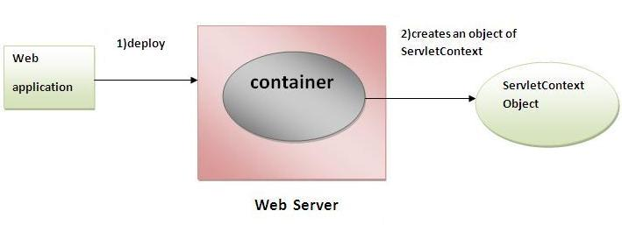

Slide 10
Advantage of ServletContext
Easy to maintain if any information is shared to all the servlet, it is better to make it available for all the servlet. We provide this information from the web.xml file, so if the information is changed, we don't need to modify the servlet. Thus it removes maintenance problem.

Slide 11
There can be a lot of usage of ServletContext object. Some of them are as follows:
The object of ServletContext provides an interface between the container and servlet.
The ServletContext object can be used to get configuration information from the web.xml file.
The ServletContext object can be used to set, get or remove attribute from the web.xml file.
The ServletContext object can be used to provide inter-application communication.

Slide 12
The following are the methods available in this interface:
getServerInfo()
getInitParameter ()
getInitParameterNames()
setInitParameter()
getAttribute()
getAttributeNames()
setAttribute()
removeAttribute
addServlet()
Etc…..

Slide 13
Example of getServletContext() method
ServletContext application=getServletContext();

Slide 14
servletConfig interface

