Slide 1
Unit III – Chapter 2
Equivalence Class Testing

Slide 2
Equivalence Partitioning Technique
Equivalence Partitioning Technique is also known as Equivalence Class Partitioning or ECP. The idea behind this technique is to divide/partition a set of test conditions into groups or sets that can be considered the same or equivalence .This is used to reduce the total number of test cases to a finite set of testable test cases, still covering maximum requirements.

Slide 3
Each and every condition of particular partition (group) works as same as other. If a condition in a partition is valid, other conditions are valid too. If a condition in a partition is invalid, other conditions are invalid too.
It helps to reduce the total number of test cases from infinite to finite. The selected test cases from these groups ensure coverage of all possible scenarios.

Slide 4
Example 1:
Assume, we have to test a field which accepts Age 18 – 56

Slide 5
Valid Input: 18 – 56
Invalid Input: less than or equal to 17 (<=17), greater than or equal to 57 (>=57)
Valid Class: 18 – 56 = Pick any one input test data from 18 – 56
Invalid Class 1: <=17 = Pick any one input test data less than or equal to 17
Invalid Class 2: >=57 = Pick any one input test data greater than or equal to 57
We have one valid and two invalid conditions here.

Slide 6
Example 2:
Assume, we have to test a filed which accepts a Mobile Number of ten digits.

Slide 7
Valid input: 10 digits
Invalid Input: 9 digits, 11 digits
Valid Class: Enter 10 digit mobile number = 9876543210
Invalid Class Enter mobile number which has less than 10 digits = 987654321
Invalid Class Enter mobile number which has more than 11 digits = 98765432109

Slide 8
Consider an example of an application that accepts a numeric number as input with value between 10 to 100 and finds its square. Now, we can create the following equivalence classes of the input-

Slide 9
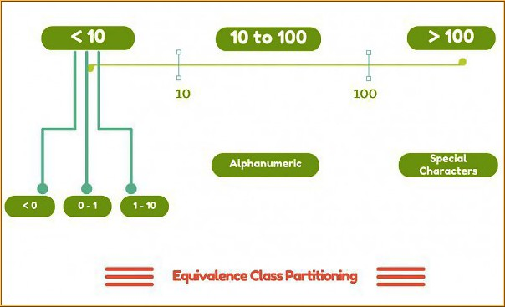

Slide 10
10 to 100 - A valid equivalence class with acceptable numeric numbers
Greater than 100 - An invalid equivalence class containing integer values greater than 100
Less than 0 - An invalid equivalence class with negative numbers
Between 0 to 1 - An invalid equivalence class with decimal numbers
Alphanumeric characters - An invalid equivalence class with alphanumeric characters for checking the robustness of application
Special characters - An invalid equivalence class with special characters

Slide 11
Advantages of equivalence class partitioning
Having equivalence classes greatly reduces the number of test cases without compromising the test coverage or quality of testing.
It helps in reducing the overall test execution time due to reduced set of test data.
It is higely used in cases where exhaustive testing is not possible but at the same time test good coverage needs to be maintained.

Slide 12
Disadvantages of equivalence class partitioning
The identification of equivalence classes relies heavily on the expertise of the tester. Having incorrectly identified equivalence classes leads to higher risk of defect leakage and less test coverage.
The equivalence classes needs to be partitioned just to the right amount and groups as having too large partitions leads to risk of missing defects. Whereas, partitioning into more groups of smaller sizes leads to redundant tests.

Slide 13
Suppose you have very important tool at office, accepts valid User Name and Password field to work on that tool, and accepts minimum 8 characters and maximum 12 characters. Valid range 8-12, Invalid range 7 or less than 7 and Invalid range 13 or more than 13.

Slide 14
Write Test Cases for Valid partition value, Invalid partition value and exact boundary value.
Test Cases 1: Consider password length less than 8.
Test Cases 2: Consider password of length exactly 8.
Test Cases 3: Consider password of length between 9 and 11.
Test Cases 4: Consider password of length exactly 12.
Test Cases 5: Consider password of length more than 12.

Slide 15
Test cases for the application whose input box accepts numbers between 1-1000. Valid range 1-1000, Invalid range 0 and Invalid range 1001 or more.

Slide 16
Write Test Cases for Valid partition value, Invalid partition value and exact boundary value.
Test Cases 1: Consider test data exactly as the input boundaries of input domain i.e. values 1 and 1000.
Test Cases 2: Consider test data with values just below the extreme edges of input domains i.e. values 0 and 999.
Test Cases 3: Consider test data with values just above the extreme edges of input domain i.e. values 2 and 1001.

