Slide 1
Unit III – Chapter 4
Decision Table Based Testing

Slide 2
What is Decision Table Testing?
Decision table testing is a software testing technique used to test system behavior for different input combinations. This is a systematic approach where the different input combinations and their corresponding system behavior (Output) are captured in a tabular form. That is why it is also called as a Cause-Effect table where Cause and effects are captured for better test coverage.

Slide 3
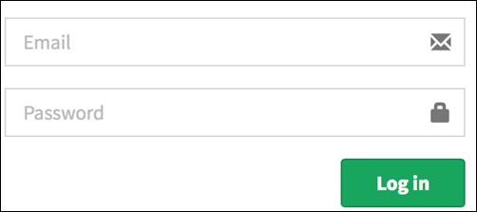
Example 1: How to make Decision Base Table for Login Screen

Slide 4
T – Correct username/password
F – Wrong username/password
E – Error message is displayed
H – Home screen is displayed

Slide 5
The condition is simple if the user provides correct username and password the user will be redirected to the homepage. If any of the input is wrong, an error message will be displayed.
Conditions | Rule 1 | Rule 2 | Rule 3 | Rule 4
Username (T/F) | F | T | F | T
Password (T/F) | F | F | T | T
Output (E/H) | E | E | E | H

Slide 6
Case 1 – Username and password both were wrong. The user is shown an error message.
Case 2 – Username was correct, but the password was wrong. The user is shown an error message.
Case 3 – Username was wrong, but the password was correct. The user is shown an error message.
Case 4 – Username and password both were correct, and the user navigated to homepage

Slide 7
Example 2: How to make Decision Table for Upload Screen
Now consider a dialogue box which will ask the user to upload photo with certain conditions like –
You can upload only '.jpg' format image
file size less than 32kb
resolution 137*177.
If any of the conditions fails the system will throw corresponding error message stating the issue and if all conditions are met photo will be updated successfully

Slide 8
Conditions | Case 1 | Case 2 | Case 3 | Case 4 | Case 5 | Case 6 | Case 7 | Case 8
Format | .jpg | .jpg | .jpg | .jpg | Not .jpg | Not .jpg | Not .jpg | Not .jpg
Size | Less than 32kb | Less than 32kb | >= 32kb | >= 32kb | Less than 32kb | Less than 32kb | >= 32kb | >= 32kb
resolution | 137*177 | Not 137*177 | 137*177 | Not 137*177 | 137*177 | Not 137*177 | 137*177 | Not 137*177
Output | Photo uploaded | Error message resolution mismatch | Error message size mismatch | Error message size and resolution mismatch | Error message for format mismatch | Error message format and resolution mismatch | Error message for format and size mismatch | Error message for format, size, and resolution mismatch

Slide 9
Advantages of Decision Table Testing
When the system behavior is different for different input and not same for a range of inputs, both equivalent partitioning, and boundary value analysis won't help, but decision table can be used.
The representation is simple so that it can be easily interpreted and is used for development and business as well.
This table will help to make effective combinations and can ensure a better coverage for testing
Any complex business conditions can be easily turned into decision tables
In a case we are going for 100% coverage typically when the input combinations are low, this technique can ensure the coverage.

Slide 10
Disadvantages of Decision Table Testing
The main disadvantage is that when the number of input increases the table will become more complex

Slide 11
What is Cause-Effect Graph?
Cause Effect Graph is a black box testing technique that graphically illustrates the relationship between a given outcome and all the factors that influence the outcome.

Slide 12
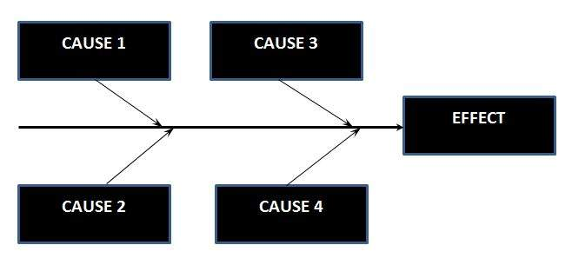
Cause Effect - Flow Diagram

Slide 13
Circumstances - under which Cause-Effect Diagram used
To Identify the possible root causes, the reasons for a specific effect, problem, or outcome.
To Relate the interactions of the system among the factors affecting a particular process or effect.
To Analyze the existing problems so that corrective action can be taken at the earliest.

Slide 14
Steps for generation of test cases
Identification of all causes and effects
Design the cause effects graph
Apply Constraints, if any
Design limited entry decision table from graph
Write test cases using every column of the decision table

Slide 15
Benefits :
It Helps us to determine the root causes of a problem or quality using a structured approach.
It Uses an orderly, easy-to-read format to diagram cause-and-effect relationships.
It Indicates possible causes of variation in a process.
It Encourages team participation and utilizes the team knowledge of the process.

