Slide 1
Unit III – Chapter 3
Path Testing

Slide 2
What is Path Testing?
Path testing is a structural testing method that involves using the source code of a program in order to find every possible executable path. It helps to determine all faults lying within a piece of code.
Any software program includes, multiple entry and exit points. Testing each of these points is a challenging as well as time-consuming. In order to reduce the redundant tests and to achieve maximum test coverage, basis path testing is used.

Slide 3
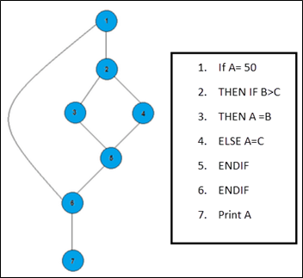

Slide 4
In the above example, we can see there are few conditional statements that is executed depending on what condition it suffice. Here there are 3 paths or condition that need to be tested to get the output,
Path 1: 1,2,3,5,6, 7
Path 2: 1,2,4,5,6, 7
Path 3: 1, 6, 7

Slide 5
Advantages of Basic Path Testing
It helps to reduce the redundant tests
It focuses attention on program logic
It helps facilitates analytical versus arbitrary case design
Test cases which exercise basis set will execute every statement in a program at least once

Slide 6
Notations
1) To indicate a Sequence:

Slide 7
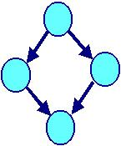
2) To indicate IF THEN ELSE:

Slide 8
3) To indicate a WHILE Loop:

Slide 9
4) To indicate a Repeat Until Loop:

Slide 10
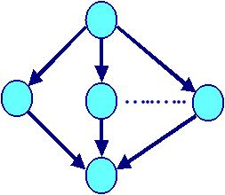
5) To indicate a SWITCH Statement:

Slide 11
6) To indicate a Post Test FOR Loop:

Slide 12
7) To indicate Pre Test FOR Loop:

Slide 13
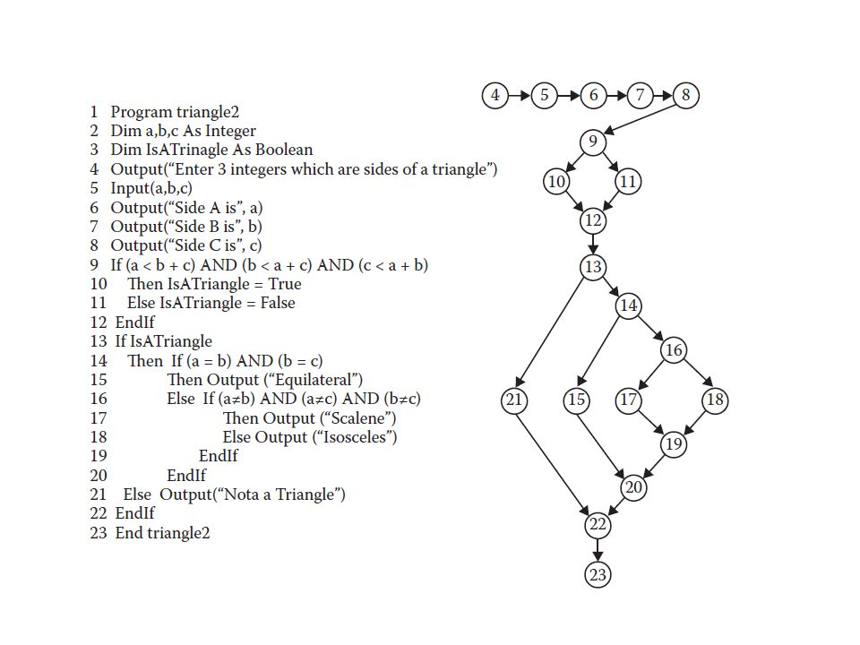

Slide 14
DD-Path
A decision-to-decision path (DD-Path) is a path chain in a program graph such that:
Initial and terminal nodes are distinct
Every interior node has indeg =1 and outdeg = 1
The initial node is 2-connected to every other node in the path.

Slide 16
A decision-to-decision path (DD-Path) is a chain in a program graph such that:
Case 1: consists of a single node with indeg=0
Case 2: consists of a single node with outdeg=0
Case 3: consists of a single node with indeg ≥ 2 or outdeg ≥ 2
Case 4: consists of a single node with indeg =1, and outdeg = 1
Case 5: it is a maximal chain of length ≥ 1

Slide 17
What is Code coverage?
Code coverage is a measure which describes the degree of which the source code of the program has been tested. It is one form of white box testing which finds the areas of the program not exercised by a set of test cases. It also creates some test cases to increase coverage and determining a quantitative measure of code coverage.

Slide 18
Why use Code Coverage?
Here, are some prime reasons for using code coverage:
It helps you to measure the efficiency of test implementation
It offers a quantitative measurement.
It defines the degree to which the source code has been tested.

Slide 19
Statement Coverage
Statement coverage is a white box test design technique which involves execution of all the executable statements in the source code at least once. It is used to calculate and measure the number of statements in the source code which can be executed given the requirements.

Slide 20
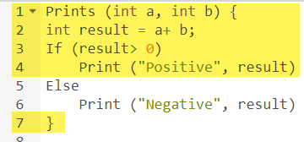
Example

Slide 21
The statements marked in yellow color are those which are executed as per the scenario
Number of executed statements = 5, Total number of statements = 7
Statement Coverage: 5/7 = 71%

Slide 22
What is covered by Statement Coverage?
Unused Statements
Dead Code
Unused Branches

Slide 23
Decision Coverage
Decision coverage reports the true or false outcomes of each Boolean expression. In this coverage, expressions can sometimes get complicated. Therefore, it is very hard to achieve 100% coverage.

Slide 24
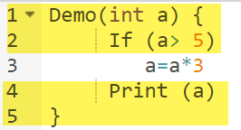
Example of decision coverage

Slide 25
Scenario 1: Value of a is 2
The code highlighted in yellow will be executed. Here the "No" outcome of the decision If (a>5) is checked.
Decision Coverage = 50%

Slide 26
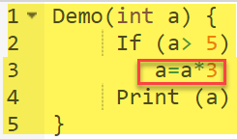
Scenario 2:
Value of a is 6

Slide 27
The code highlighted in yellow will be executed. Here the "Yes" outcome of the decision If (a>5) is checked.
Decision Coverage = 50%
Test Case | Value of A | Output | Decision Coverage
1 | 2 | 2 | 50%
2 | 6 | 18 | 50%

Slide 28
Branch Coverage
In the branch coverage, every outcome from a code module is tested. For example, if the outcomes are binary, you need to test both True and False outcomes.
It helps you to ensure that every possible branch from each decision condition is executed at least a single time.

Slide 29
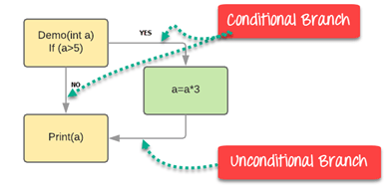
Example of Branch Coverage

Slide 30
Test Case | Value of A | Output | Decision Coverage | Branch Coverage
1 | 2 | 2 | 50% | 33%
2 | 6 | 18 | 50% | 67%

Slide 31
Condition Coverage
Conditional coverage or expression coverage will reveal how the variables or sub expressions in the conditional statement are evaluated. In this coverage expressions with logical operands are only considered.
For example, if an expression has Boolean operations like AND, OR, XOR, which indicated total possibilities.

Slide 32
Example:
For the below expression, we have 4 possible combinations
TT
FF
TF
FT

Slide 33
X=3 Y=4 | (x<y) | TRUE | Condition Coverage is ¼ = 25%
A=3 B=4 | (a>b) | FALSE

Slide 34
What is Cyclomatic Complexity?
Cyclomatic complexity is a software metric used to measure the complexity of a program. These metric, measures independent paths through program source code. Independent path is defined as a path that has at least one edge which has not been traversed before in any other paths. Cyclomatic complexity can be calculated with respect to functions, modules, methods or classes within a program.

Slide 35
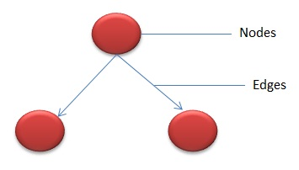

Slide 36
How to Calculate Cyclomatic Complexity
Mathematical representation:
V(G) = E - N + 2Where,
E - Number of edges
N - Number of Nodes
V (G) = P + 1 Where P = Number of predicate nodes (node that contains condition)

Slide 37
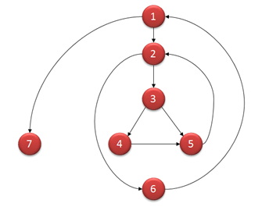

Slide 38
Computing mathematically,
V(G) = 9 - 7 + 2 = 4
V(G) = 3 + 1 = 4 (Condition nodes are 1,2 and 3 nodes)
Basis Set - A set of possible execution path of a program
1, 7
1, 2, 6, 1, 7
1, 2, 3, 4, 5, 2, 6, 1, 7
1, 2, 3, 5, 2, 6, 1, 7

