Slide 1
Unit IV- Chapter 1
JDBC(Java Database Connectivity

Slide 2
Introduction
JDBC is a Java standard that provides the interface for connecting from Java to relational databases. The JDBC standard is defined by Sun Microsystems and implemented through the standard java.sql interfaces. This allows individual providers to implement and extend the standard with their own JDBC drivers. JDBC stands for Java Database Connectivity, which is a standard Java API for database -independent connectivity between the Java programming language and a wide range of databases.

Slide 3
The JDBC library includes APIs for each of the tasks commonly associated with database usage:
Making a connection to a database
Creating SQL or MySQL statements
Executing that SQL or MySQL queries in the database
Viewing & Modifying the resulting records

Slide 4
JDBC API is a Java API that can access any kind of tabular data, especially data stored in a Relational Database. JDBC works with Java on a variety of platforms, such as Windows, Mac OS, and the various versions of UNIX.

Slide 5
Design of JDBC
JDBC is designed to provide a database-neutral API for accessing relational databases from different vendors. Just as a Java application does not need to be aware of the operating system platform on which it is running, so too JDBC has been designed so that the database
This is not to say that JDBC cannot be used with another type of database. In fact, there are JDBC drivers that allow the API to be used to connect to both high-end, mainframe databases, which are not relational, and to access flat files and spreadsheets as databases (which are definitely not relational). But the reality is that JDBC is most commonly used with relational databases.

Slide 6
The technical definition of a relational database is a database that stores dataas a collection of related entities. These entities are composed of attributes that describe the entity and attributes.
Uses SQL

Slide 7
JavaSoft's JDBC consists of two layers: the JDBC API and the JDBC Driver Manager API.
The JDBC API is the top layer and is the programming interface in Java to structured query language (SQL) which is the standard for accessing relational databases.
The JDBC API communicates with the JDBC Driver Manager API, sending it various SQL statements. The manager communicates (transparent to the programmer) with the various third party drivers (provided by Database vendors like Oracle) that actually connect to the database and return the information from the query.

Slide 8
JDBC Architecture:
The JDBC API supports both two-tier and three-tier processing models for database access but in general JDBC Architecture consists of two layers:
JDBC API: This provides the application-to-JDBC Manager connection.
JDBC Driver API: This supports the JDBC Manager-to-Driver Connection.
The JDBC API uses a driver manager and database-specific drivers to provide transparent connectivity to heterogeneous databases.
The JDBC driver manager ensures that the correct driver is used to access each data source. The driver manager is capable of supporting multiple concurrent drivers connected to multiple heterogeneous databases.

Slide 9
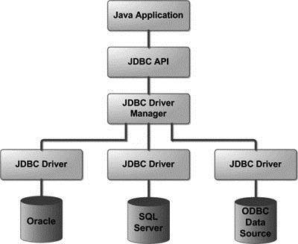

Slide 10
Common JDBC Components:
DriverManager: This class manages a list of database drivers.
Driver: This interface handles the communications with the database server.
Connection : This interface with all methods for contacting a database. The connection object represents communication context, i.e., all communication with database is through connection object only.
Statement : You use objects created from this interface to submit the SQL statements to the database.
ResultSet: These objects hold data retrieved from a database after you execute an SQL query using Statement objects. It
SQLException: This class handles any errors that occur in a database application.

Slide 11
ODBC
An ODBC driver uses the Open Database Connectivity (ODBC) interface by Microsoft that allows applications to access data in database management systems (DBMS) using SQL as a standard for accessing the data.
An ODBC driver uses the Open Database Connectivity (ODBC) interface by Microsoft that allows applications to access data in database management systems (DBMS) using SQL as a standard for accessing the data. ODBC permits maximum interoperability, which means a single application can access different DBMS. Application end users can then add ODBC database drivers to link the application to their choice of DBMS.

Slide 12
JDBC Drivers Types:
1) JDBC-ODBC bridge driver
The JDBC-ODBC bridge driver uses ODBC driver to connect to the database. The JDBC-ODBC bridge driver converts JDBC method calls into the ODBC function calls. This is now discouraged because of thin driver.

Slide 13
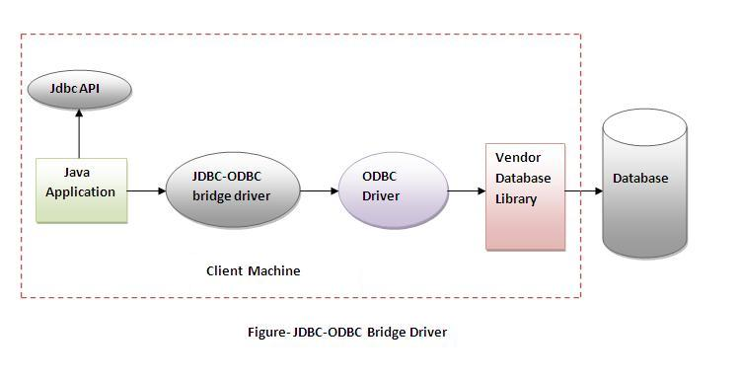

Slide 14
Advantages:
easy to use.
can be easily connected to any database.
Disadvantages:
Performance degraded because JDBC method call is converted into the ODBC function calls.
The ODBC driver needs to be installed on the client machine.

Slide 15
2) Native-API driver
The Native API driver uses the client-side libraries of the database. The driver converts JDBC method calls into native calls of the database API. It is not written entirely in java.
Native API driver uses native API to connect a java program directly to the database. Native API id s C, C++ library, which contains a set of function used to connect with database directly. Native API will be different from one database to another database. So this Native API driver is a database dependent driver.

Slide 16
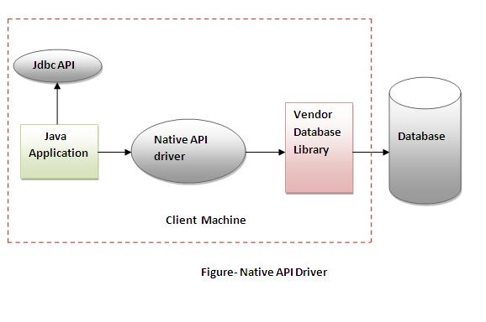

Slide 17
Advantage:
performance upgraded than JDBC-ODBC bridge driver.
Disadvantage:
The Native driver needs to be installed on the each client machine.
The Vendor client library needs to be installed on client machine.

Slide 18
3) Network Protocol driver
The Network Protocol driver uses middleware (application server) that converts JDBC calls directly or indirectly into the vendor-specific database protocol. It is fully written in java.

Slide 19
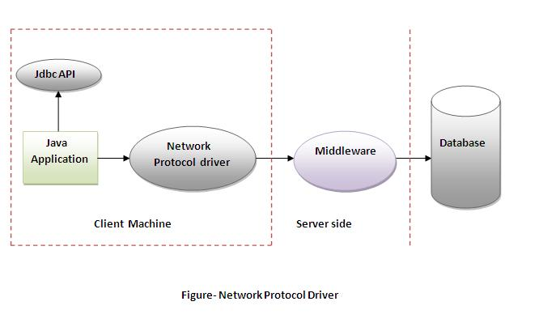

Slide 20
Advantage:
No client side library is required because of application server that can perform many tasks like auditing, load balancing, logging etc.
Disadvantages:
Network support is required on client machine.
Requires database-specific coding to be done in the middle tier.
Maintenance of Network Protocol driver becomes costly because it requires database-specific coding to be done in the middle tier.

Slide 21
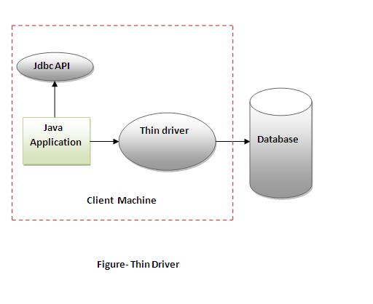
4) Thin driver
The thin driver converts JDBC calls directly into the vendor-specific database protocol. That is why it is known as thin driver. It is fully written in Java language.

Slide 22
Advantage:
Better performance than all other drivers.
No software is required at client side or server side.
Disadvantage:
Drivers depends on the Database.

Slide 23
Steps to connect a Java Application to Database
The following 5 steps are the basic steps involve in connecting a Java application with Database using JDBC.
Register the Driver
Create a Connection
Create SQL Statement
Execute SQL Statement
Closing the connection

Slide 24
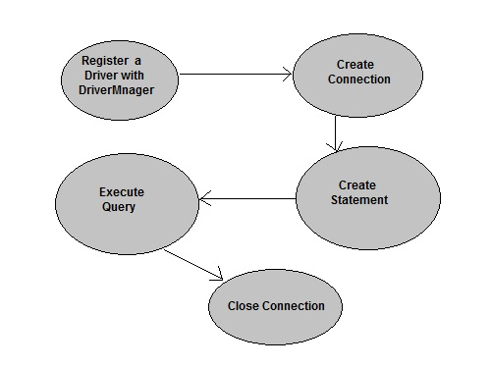

Slide 25
In this example we are using MySql as the database. So we need to know following informations for the mysql database:
Driver class: The driver class for the mysql database is com.mysql.jdbc.Driver.
Connection URL: The connection URL for the mysql database is jdbc:mysql://localhost:3306/sujata where jdbc is the API, mysql is the database, localhost is the server name on which mysql is running, we may also use IP address, 3306 is the port number and sujata is the database name. We may use any database, in such case, you need to replace the sujata with your database name.
Username: The default username for the mysql database is root.
Password: Password is given by the user at the time of installing the mysql database. In this example, we are going to use root as the password.

Slide 26
Step 1: Import JDBC Packages
import java.sql.*;
import oracle.jdbc.driver.*;
import oracle.sql.*;

Slide 27
Step 2:Load and Register the JDBC Driver
Class.forName("sun.jdbc.odbc.JdbcOdbcDriver");
Class.forName("oracle.jdbc.driver.OracleDriver");

Slide 28
Step 3: Connecting to a Database
The getConnection() method is an overloaded method that takes
Three parameters, one each for the URL, username, and password.
Only one parameter for the database URL. In this case, the URL contains the username and password.
Connection conn = DriverManager.getConnection(URL, username, passwd);
Connection conn = DriverManager.getConnection(URL);

Slide 29
Step 4: Querying the Database
Statement sql_stmt = conn.createStatement();

Slide 30
Step 5: Executing the Query and Returning a ResultSet
ResultSet rset = sql_stmt.executeQuery ("SELECT empno, ename, sal, deptno FROM emp ORDER BY ename");
Alternatively, the SQL statement can be placed in a string and then this string passed to the executeQuery() function. This is shown below.
String sql = "SELECT empno, ename, sal, deptno FROM emp ORDER BY ename";
ResultSet rset = sql_stmt.executeQuery(sql);

Slide 31
Step 6: Closing the ResultSet and Statement
rset.close(); (ResultSet object)
sql_stmt.close(); (Statement Object)
conn.close(); (Connection object)

Slide 32
Example
import java.sql.*;
class MysqlCon{
public static void main(String args[]){
try{
Class.forName("com.mysql.jdbc.Driver");
Connection con=DriverManager.getConnection(
"jdbc:mysql://localhost:3306/sonoo","root","root");
//here sonoo is database name, root is username and password
Statement stmt=con.createStatement();
ResultSet rs=stmt.executeQuery("select * from emp");
while(rs.next())
System.out.println(rs.getInt(1)+" "+rs.getString(2)+" "+rs.getString(3));
con.close();
}catch(Exception e){ System.out.println(e);}
}
}

Slide 33
JDBC Statements
Once a connection is obtained we can interact with the database. The JDBC Statement, CallableStatement, and PreparedStatement interfaces define the methods and properties that enable you to send SQL or PL/SQL commands and receive data from your database.

Slide 34
Interfaces | Recommended Use
Statement | Use the for general-purpose access to your database. Useful when you are using static SQL statements at runtime. The Statement interface cannot accept parameters.
PreparedStatement | Use the when you plan to use the SQL statements many times. The PreparedStatement interface accepts input parameters at runtime.
CallableStatement | Use the when you want to access the database stored procedures. The CallableStatement interface can also accept runtime input parameters.

Slide 35
1. The Statement Objects
Creating Statement Object
Statement stmt = null;
try
{
stmt = conn.createStatement( ); . . .
}
catch (SQLException e)
{ . . . }

Slide 36
Closing Statement Object
Statement stmt = null;
try
{
stmt = conn.createStatement( ); . . .
}
catch (SQLException e)
{ . . . }
finally
{
stmt.close();
}

Slide 37
The PreparedStatement Objects
The PreparedStatement interface extends the Statement interface, which gives you added functionality with a couple of advantages over a generic Statement object.
This statement gives you the flexibility of supplying arguments dynamically.

Slide 38
Creating PreparedStatement Object
PreparedStatement pstmt = null;
try
{
String SQL = "Update Employees SET age = ? WHERE id = ?";
pstmt = conn.prepareStatement(SQL); . . .
}
catch (SQLException e)

Slide 39
Closing PreparedStatement Object
PreparedStatement pstmt = null;
try
{
String SQL = "Update Employees SET age = ? WHERE id = ?";
pstmt = conn.prepareStatement(SQL); . . .
}
catch (SQLException e)
{ . . . }
finally
{
pstmt.close(); }

Slide 40
The CallableStatement Objects
Just as a Connection object creates the Statement and PreparedStatement objects, it also creates the CallableStatement object, which would be used to execute a call to a database stored procedure.

Slide 41
Creating CallableStatement Object
CallableStatement cstmt = null;
try
{
String SQL = "{call getEmpName (?, ?)}";
cstmt = conn.prepareCall (SQL); . . .
}
catch (SQLException e)
{ . . . }

Slide 42
Closing CallableStatement Object
CallableStatement cstmt = null;
try
{
String SQL = "{call getEmpName (?, ?)}";
cstmt = conn.prepareCall (SQL); . . .
}
catch (SQLException e)
{ . . . }
finally
{
cstmt.close(); }

Slide 43
JDBC RowSet
The instance of RowSet is the java bean component because it has properties and java bean notification mechanism. It is introduced since JDK 5.
It is the wrapper of ResultSet. It holds tabular data like ResultSet but it is easy and flexible to use.
The implementation classes of RowSet interface are as follows:
JdbcRowSet
CachedRowSet
WebRowSet
JoinRowSet
FilteredRowSet

Slide 44
Advantage of RowSet
The advantages of using RowSet are given below:
It is easy and flexible to use
It is Scrollable and Updatable by default

Slide 45
Scrollable Resultset in JDBC
In Jdbc ResultSet Interface are classified into two type;.
Non-Scrollable ResultSet in JDBC
Scrollable ResultSet
By default a ResultSet Interface is Non-Scrollable, In non-scrollable ResultSet we can move only in forward direction (that means from first record to last record), but not in Backward Direction, If you want to move in backward direction use Scrollable Interface.

Slide 46
Difference between Scrollable ResultSet and Non-Scrollable ResultSet
Non-Scrollable ResultSet | Scrollable ResultSet
Cursor move only in forward direction | Cursor can move both forward and backward direction
Slow performance, If we want to move nth record then we need to n+1 iteration | Fast performance, directly move on any record.
Non-Scrollable ResultSet cursor can not move randomly | Scrollable ResultSet cursor can move randomly

Slide 47
Create Scrollable ResultSet
To create a Scrollable ResultSet, create Statement object with two parameters.
Syntax
Statement stmt=con.CreateStatement(param1, param2);

Slide 48
These type and mode are predefined in ResultSet Interface of Jdbc like below which is static final.
Type:
public static final int TYPE_FORWARD_ONLY=1003
public static final int TYPE_SCROLL_INSENSITIVE=1004
public static final int TYPE_SCROLL_SENSITIVE=1005
Mode:
public static final int CONCUR_READ_ONLY=1007
public static final int CONCUR_UPDATABLE=1008

Slide 49
Example
Statement stmt=con.CreateStatement(1004, 1007); or
Statement stmt=con.CreateStatement(ResutlSet.TYPE_SCROLL_INSENSITIVE,ResultSet.CONCUR_READ_ONLY);

Slide 50
Methods of Scrollable ResultSet
Below all methods are used for move the cursor in Scrollable ResultSet.
afterLast Used to move the cursor after last row.
BeforeFirst: Used to move the cursor before first row.
previous: Used to move the cursor backward.
first: Used to move the cursor first at row.
last: Used to move the cursor at last row.

Slide 51
Batch Processing in JDBC
Instead of executing a single query, we can execute a batch (group) of queries. It makes the performance fast.
The java.sql.Statement and java.sql.PreparedStatement interfaces provide methods for batch processing.
Advantage of Batch Processing
Fast Performance

Slide 52
Methods of Statement interface
The required methods for batch processing are given below:
Method | Description
void addBatch(String query) | It adds query into batch.
int[] executeBatch() | It executes the batch of queries.

Slide 53
import java.sql.*;
class FetchRecords
{
public static void main(String args[])throws Exception
{
Class.forName("oracle.jdbc.driver.OracleDriver");
Connection con=DriverManager.getConnection("jdbc:oracle:thin:@localhost:1521:xe","system","oracle");
Statement stmt=con.createStatement();
stmt.addBatch("insert into user420 values(190,'abhi',40000)");
stmt.addBatch("insert into user420 values(191,'umesh',50000)");
stmt.executeBatch();//executing the batch
con.commit();
con.close();
}}

Slide 54
Transaction Management in JDBC
Transaction represents a single unit of work. The ACID properties describes the transaction management well. ACID stands for Atomicity, Consistency, isolation and durability.
Atomicity means either all successful or none.
Consistency ensures bringing the database from one consistent state to another consistent state.
Isolation ensures that transaction is isolated from other transaction.
Durability means once a transaction has been committed, it will remain so, even in the event of errors, power loss etc.
Advantage of Transaction Mangaement
fast performance It makes the performance fast because database is hit at the time of commit.

Slide 55
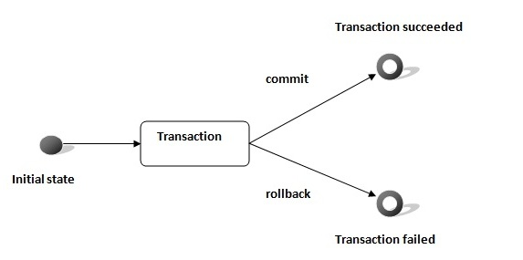

Slide 56
Method | Description
void setAutoCommit(boolean status) | It is true bydefault means each transaction is committed bydefault.
void commit() | commits the transaction.
void rollback() | cancels the transaction.

Slide 57
import java.sql.*;
class FetchRecords
{
public static void main(String args[])throws Exception
{
Class.forName("oracle.jdbc.driver.OracleDriver");
Connection con=DriverManager.getConnection("jdbc:oracle:thin:@localhost:1521:xe","system","oracle");
con.setAutoCommit(false);
Statement stmt=con.createStatement();
stmt.executeUpdate("insert into user420 values(190,'abhi',40000)");
stmt.executeUpdate("insert into user420 values(191,'umesh',50000)");
con.commit();
con.close();
}}

Slide 58
If your JDBC Connection is in auto-commit mode, which it is by default, then every SQL statement is committed to the database upon its completion.
That may be fine for simple applications, but there are three reasons why you may want to turn off the auto-commit and manage your own transactions −
To increase performance.
To maintain the integrity of business processes.
To use distributed transactions.

Slide 59
Commit & Rollback
Once you are done with your changes and you want to commit the changes then call commit() method on connection object as follows −
conn.commit( );
Otherwise, to roll back updates to the database made using the Connection named conn, use the following code −
conn.rollback( );

Slide 60
Using Savepoints
The new JDBC 3.0 Savepoint interface gives you the additional transactional control. Most modern DBMS, support savepoints within their environments such as Oracle's PL/SQL.
When you set a savepoint you define a logical rollback point within a transaction. If an error occurs past a savepoint, you can use the rollback method to undo either all the changes or only the changes made after the savepoint.
The Connection object has two new methods that help you manage savepoints −

Slide 61
setSavepoint(String savepointName): Defines a new savepoint. It also returns a Savepoint object.
releaseSavepoint(Savepoint savepointName):Deletes a savepoint.

Slide 62
