Slide 1
Unit IV- Chapter 2
Hardware Considerations

Slide 2
Certification Programs
EPEAT: Electronic Product Environmental Assessment Tool (EPEAT)
There aren’t a lot of machines out there that have been EPEAT certified; however, because this is a mandate for U.S. government procurement—and because the government buys a lot of computers each year—look for manufacturers to kick up their production of EPEAT-certified machines.
EPEAT evaluates electronic products according to three tiers of environmental performance: bronze, silver, and gold.

Slide 3
RoHS :
European businesses are already required to be environmentally responsible because of Restriction of Hazardous Substances (RoHS) laws.

Slide 4
Energy Star
Biggest and most well-known program for certifying energy-efficient electronics in the United States is the Environmental Protection Agency’s (EPA’s) Energy Star program. Like EPEAT, hardware must meet specific standards in order to be Energy Star certified. In this case, however, those standards are based on power consumption.

Slide 5
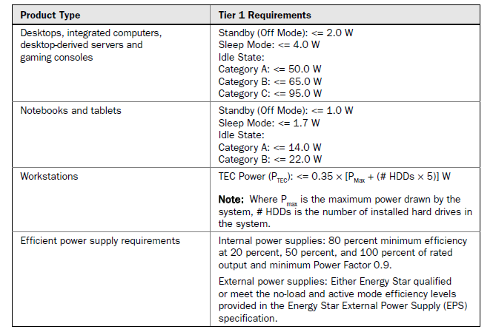
Computers

Slide 6
Monitors
In order to achieve an Energy Star certification, monitors must meet the following criteria:
• In On mode, the maximum allowed power varies based on the computer monitor’s resolution.
• In Sleep mode, computer monitor models must consume 2 watts or less.
• In Off mode, computer monitor models must consume 1 watt or less.

Slide 7
Benefits
Your business will save money by using Energy Star–certified monitors. Consider the following issues:
Electricity usage cut in half
Cooling loads reduced
Reduction in peak load demand charges
Faster boot times

Slide 8
Printers, Scanners, All-in-Ones
For a laser printer to earn the Energy Star certification, it must:
• Use at least 25 percent less energy than regular printers.
• Be able to print on both sides of a page, thus saving paper.
• Run cooler and last longer, thus reducing the cost of air conditioning and maintenance.

Slide 9
Thin Clients
Thin clients usually run web browsers or remote desktop software.
Advantages to using thin clients include the following:
Lower administration costs
Security
Lower hardware costs
Efficiency
Lower energy consumption
Easy hardware failure management
Hostile environments
Ease of upgrade
Less noise
Less disposed equipment

Slide 10
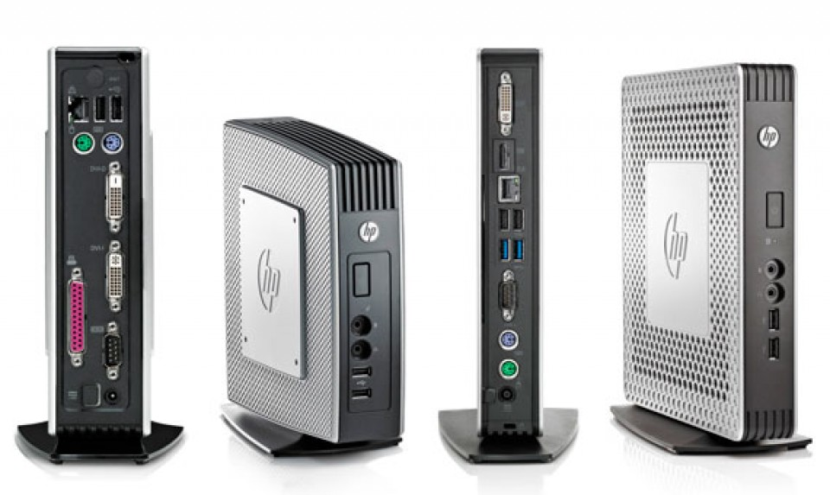

Slide 11
Servers
Blade Servers:
Less space needed
Reduced power consumption
Lower management cost
Simplified cabling

Slide 12
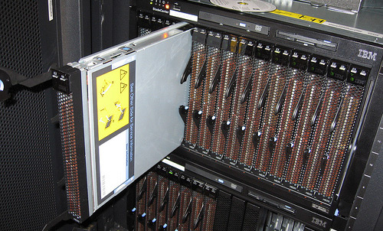

Slide 13
Products : Many companies offer blades. IBM, Hewlett-Packard, and Dell all have their own offerings with their own features and capabilities.

Slide 14
Hardware Considerations
Planned Obsolescence: Realizing up front that at some day in the future, your shiny new equipment won’t serve you anymore.
When looking at new hardware, also think about how you will dispose of it and consider buying hardware that can be kept around longer than normal. The following are some considerations:
Lease and buy-back programs
Use hardware and operating systems that are readily upgradeable.
Make sure the memory is easily expandable.

Slide 15
Packaging
Although packaging and shipping aren’t a concern for the overall operation and functionality of your system, they are a consideration when trying to lessen one’s environmental impact. The following are some tips you can employ when having new computers shipped to you:
• Ask for multiple computers to be packaged together for shipping, rather than being boxed individually.
• Require recycled-content materials and recyclable packaging.
• Require material types to be identified. Recyclers need to know material types, so require labeling to show what type of plastic is used.
• Require manufacturers or shippers to take back packaging for reuse or recycling.
• Ask for online manuals and preinstalled programs.

Slide 16
Toxins
• Look for manufacturers who use lead-free solder.
• Look for manufacturers who use low-mercury and long-life lamps in flat-panel displays.
• Batteries should be removable, rechargeable, and recyclable.

Slide 17
Remote Desktop
You can also make life easier for workers who are on the road or occasionally have to work from home or a remote site. They can access their office computers, if they’re using Windows, via Remote Desktop.
• To power thin clients
• To extend the life of existing machines

Slide 18
There are two components to a Remote Desktop connection:
Server
Client
Remote Desktop Connection

