Slide 1
Unit IV –Chapter 1
Verification and Validation

Slide 2
Verification
Verification is the process of evaluating work-products of a development phase to determine whether they meet the specified requirements.
Verification ensures that the product is built according to the requirements and design specifications. It also answers to the question, Are we building the product right?

Slide 3
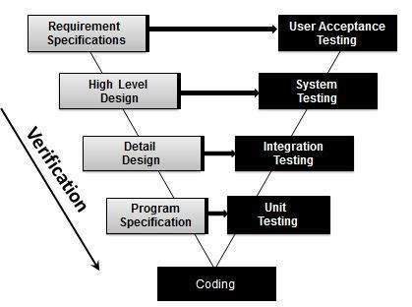
Verification Testing - Workflow

Slide 4
Advantages of Software Verification :
Verification helps in lowering down the count of the defect in the later stages of development.
Verifying the product at the starting phase of the development will help in understanding the product in a better way.
It reduces the chances of failures in the software application or product.
It helps in building the product as per the customer specifications and needs.

Slide 5
Disadvantages
Not suitable for bigger and complex projects
Not a good option If Requirement changes frequently.
The client sees the only final project, not intermediate modules.
Don’t scope for risk management and risk mitigation.

Slide 6
Prerequisites for Verification
Tools
Checklists
Guidelines
Process definitions
Standards
Training for people for conducting verification

Slide 7
Verification Workbench
Inputs
Outputs
Verification Process
Check Process
Standards, Tools, Guidelines

Slide 8
Methods of Verification
Self Review – self learning and retrospection
Advantages:
Highly flexible with time and defect finding
Excellent way of self learning
Findings need not be shared with anybody
Disadvantages:
May not conduct review in reality

Slide 9
Peer Review
Informal type of review where an author and peer are involved
There are two types of review:
Online Review: Author and Reviewer meet together and review the work product jointly
Offline review: Author informs the reviewer that the work product is ready for review

