Slide 1
Unit V – Chapter 1
Levels of Testing

Slide 2
Proposal Testing
Proposal is made to the customer on the basis of Request for proposal(RFP), Request for information(RFI) and Request for Quotation(RFQ).
Agencies Involved: Customer, Business Analyst, System Analyst, Project Manager

Slide 3
There are two types of review:
Technical Review: involves technical feasibility
Commercial Review: financial feasibility

Slide 4
Requirement Testing
Gathering and Arranging customer requirements It can be technical, economical, legal, operational and system requirements.
Requirement Specifications should meet the following criteria:
Clarity
Complete
Measurable
Testable
Not Conflicting
Identifiable

Slide 5
Design Testing
Start building low-level design and made high level architecture.
Design should following criteria:
Clarity
Complete
Traceable
Implementable
Testable

Slide 6
Code Review
Reviewing Code, database schema, object definitions, procedures, methods
Must have following characteristics:
Clarity
Complete
Traceable
Maintainable

Slide 7
Types of Testing
Unit Testing
Module Testing
Integration Testing
Bottom Up
Top Down
Stubs and Drivers
Big Bang Testing
Sandwich testing
Critical path Testing
Sub System testing
System Testing
Functional Testing
User Interface Testing

Slide 8
Big Bang Approach
Here all component are integrated together at once and then tested.
Advantages:
Convenient for small systems.
Disadvantages:
Fault Localization is difficult.
Since the Integration testing can commence only after "all" the modules are designed, the testing team will have less time for execution in the testing phase.

Slide 9
What is Stub and Driver?
Incremental Approach is carried out by using dummy programs called Stubs and Drivers. Stubs and Drivers do not implement the entire programming logic of the software module but just simulate data communication with the calling module.
Stub: Is called by the Module under Test.
Driver: Calls the Module to be tested.

Slide 10
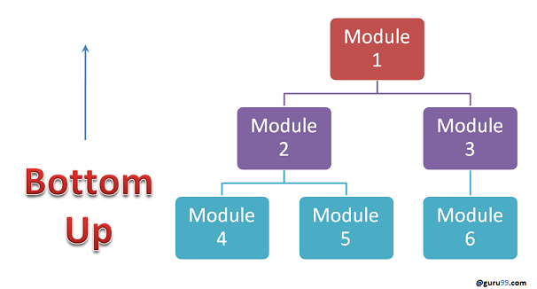
Bottom-up Integration
In the bottom-up strategy, each module at lower levels is tested with higher modules until all modules are tested. It takes help of Drivers for testing

Slide 11
Advantages:
Fault localization is easier.
No time is wasted waiting for all modules to be developed unlike Big-bang approach
Disadvantages:
Critical modules (at the top level of software architecture) which control the flow of application are tested last and may be prone to defects.
An early prototype is not possible

Slide 12
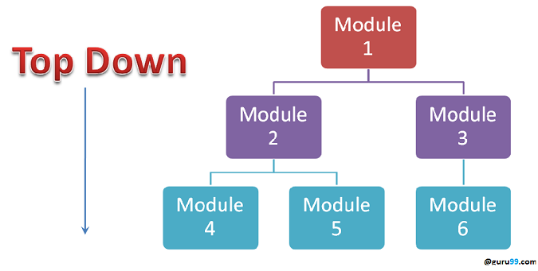
Top-down Integration
In Top to down approach, testing takes place from top to down following the control flow of the software system.

Slide 13
Advantages:
Fault Localization is easier.
Possibility to obtain an early prototype.
Critical Modules are tested on priority; major design flaws could be found and fixed first.
Disadvantages:
Needs many Stubs.
Modules at a lower level are tested inadequately.

Slide 14
Hybrid/ Sandwich Integration
In the sandwich/hybrid strategy is a combination of Top Down and Bottom up approaches. Here, top modules are tested with lower modules at the same time lower modules are integrated with top modules and tested. This strategy makes use of stubs as well as drivers.

Slide 15
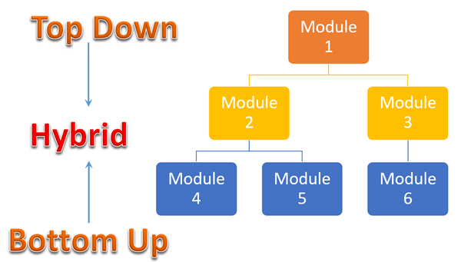

Slide 16
Critical Path First
One must define critical path in which development team concentrates on design, implementation and testing of critical path of a system first.
Critical path first is used where complete system testing is impossible and systems are so large.

Slide 17
Sub System Testing
In involves collection of units, sub modules, modules which have been integrated to form subsystems.
The subsystem can be independently designed and implemented and can be a separate executable.

Slide 18
System Testing
Represents the final testing done on a system before it is delivered to the customer.
System testing goes through the following stages:
Functional Testing
User Interface Testing: involves testing of colors, spelling, navigations and fonts

Slide 19
Testing Stages
Unit Testing
Module Testing
Subsystem Testing
System Testing
Acceptance Testing

