Slide 1
Unit V – Chapter 2
Staying Green

Slide 2
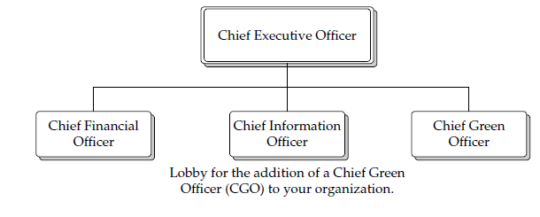
Organizational Checkups
This will involve putting people in new roles and keeping important people—such as the CEO—sold on the merits of a green plan.

Slide 3
The CGO, ultimately, is going to be responsible for three things:
• Reducing the organization’s environmental footprint
• Engaging diverse stakeholders
• Discovering new revenue opportunities

Slide 4
Transitioning
Many companies started their eco-friendly behavior because, at first, it was the law—they were simply trying to achieve a certain level of environmental responsibility because of compliance issues.

Slide 5
Compliance : law, organizations
Personal commitment : It’s important for the entire organization to sign on to the notion of being green.
Public trust : Although the public wants you to be responsible.
Sustainable growth : develop greener products, increase energy efficiency, and reduce waste further.

Slide 6
Structure

Slide 7
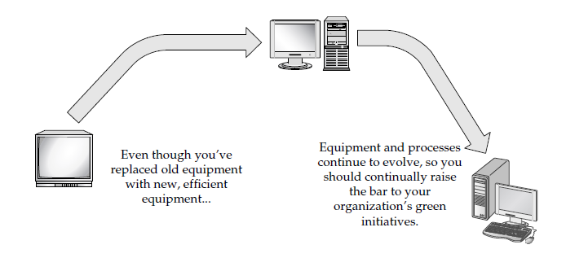
Evolution

Slide 8
Sell the CEO
Unless your management—especially your CEO—buys into the notion that going green is a good idea, nothing will change.
CEOs also know that their company needs to make money. So the best way to explain the benefits of going green is by explaining the monetary benefits.

Slide 9
Here are some other strategies that can help win over upper management:
Keep contacts updated: If upper management is engaged, it’s easier to sell your projects.
Talk to the investor relations staff: Meet regularly with your investor relations staff and explain the value of energy management.
Gain recognition for your “wins”:

Slide 10
SMART Goals
Specific A goal should be precise and put in terms people can relate to. E.g. “We are going to reduce our greenhouse gas emissions by 30 percent by the end of next year.
Measurable: measuring progress, you stay on track, achieve milestones.
Attainable When you identify your goals, you think of ways to achieve them.
Realistic: “We’re going to have zero impact on the environment by the end of the quarter,” it’s just not realistic.
Timely You need to have a timeline in mind.

Slide 11
Equipment Checkups
When you’re collecting data, keep these issues in mind:
Determine the level of detail The scope of data collection
Detail all energy sources Take readings of all the energy you use.
Document energy use For the energy you pay for, gather energy bills, meter readings.
Gather facility data To normalize your data, you may have to collect non-energy related data for your facilities, such as the building size and hours of operation.

Slide 12
Tracking Your Data
It can be as simple as an Excel spreadsheet, or you can get something as in-depth as SQL Server.
Scope: how much data and what types of data are being measured.
Ease of use Although SQL Server databases are very powerful, they aren’t for the squeamish. And although an Excel spreadsheet is easy enough to use.
Reporting Not only is your tracking system good for monitoring your data.

Slide 13
Baseline Data
Establish a base year: Use as complete data as you can.
Choose your metrics Select what you are going to measure based on your organization’s performance desires.
Share your results Make sure you share the baseline results with managers, departments, and other stakeholders.

Slide 14
Benchmarking
Benchmarking can be performed in a number of ways:
• Past performance Compare your current status to historical performance.
• Industry average Compare your organization’s results to an average of other organizations in your industry.
• Best in class Compare your organization to the best in the industry, not just the average.
• Best practices Compare your organization’s results to established practices that have been deemed to be the best in the industry.

Slide 15
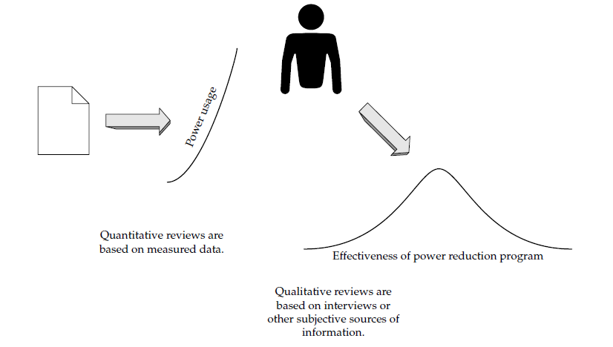
Analyze Data

Slide 16
Quantitative Reviews
Usage profiles
Performance comparisons
High costs
What’s missing

Slide 17
Qualitative Reviews
Interviews
Review policies

Slide 18
Conduct Audits
In order to conduct an energy audit, you need to follow these steps:
Assemble your team
Plan and develop a strategy
Generate a report

Slide 19
Get Back on Track
Reviewing your action plan involves these key strategies:
Get feedback
Gauge awareness
Identify critical details
Know your side benefits

Slide 20
Certifications
Energy Star
EPEAT
RoHS

